Slide 1
Common historical paths
The ancestors of Italians, the Romans, lived in Italy and conquered many areas around the Mediterranean Sea.
ΡΩΜΑΙΟΙ

Slide 2
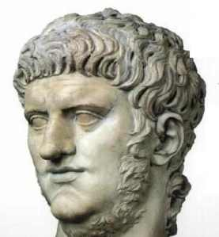
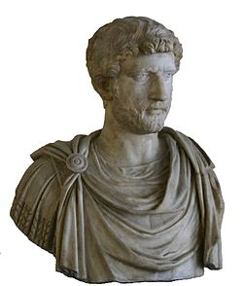
Nero, the Roman emperor, was born in Anzio
In Athens emperor Handrian made a lot of constructions, a street is named after him and there are a lot of monuments.
ΝΕΡΩΝΑΣ
ΑΔΡΙΑΝΟΣ

Slide 3
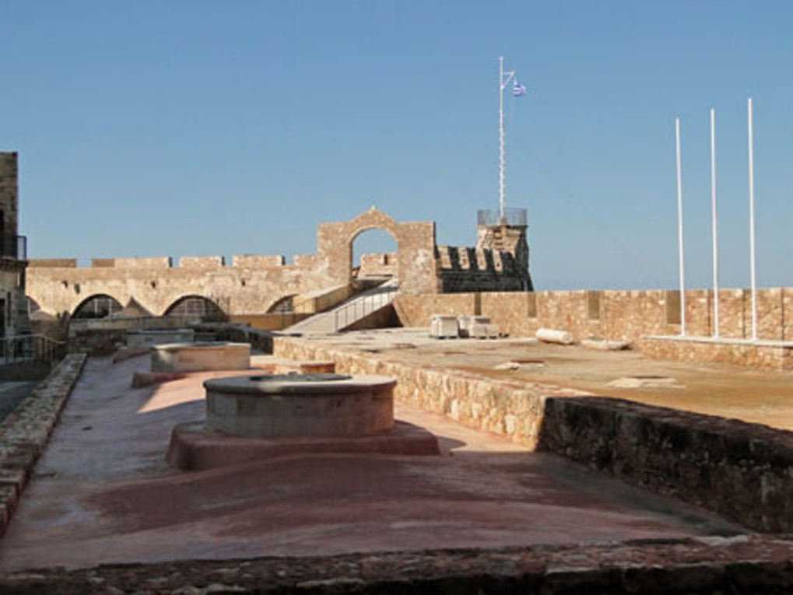
Later Venetians and other Italians moved east and constructed castles, ports and churches.
Firka Castle in Chania

Slide 4
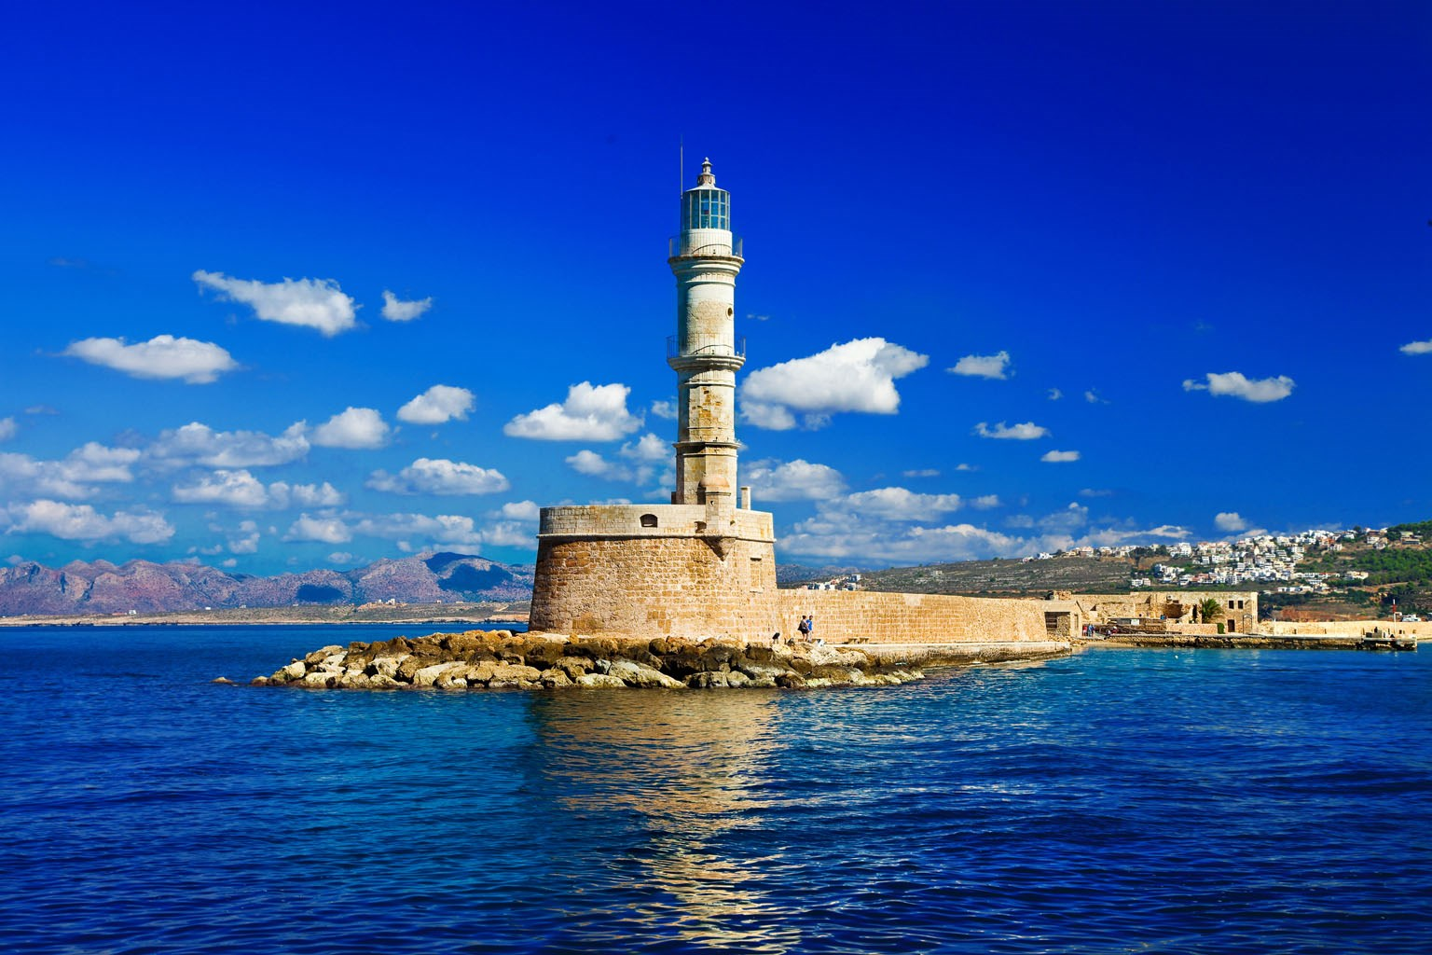
The Egyptian Lighthouse at the Venetian port of Chania is its most photographed monument. Even though it is called “Egyptian”, it was built by Venetians in the 16th century.

Slide 5
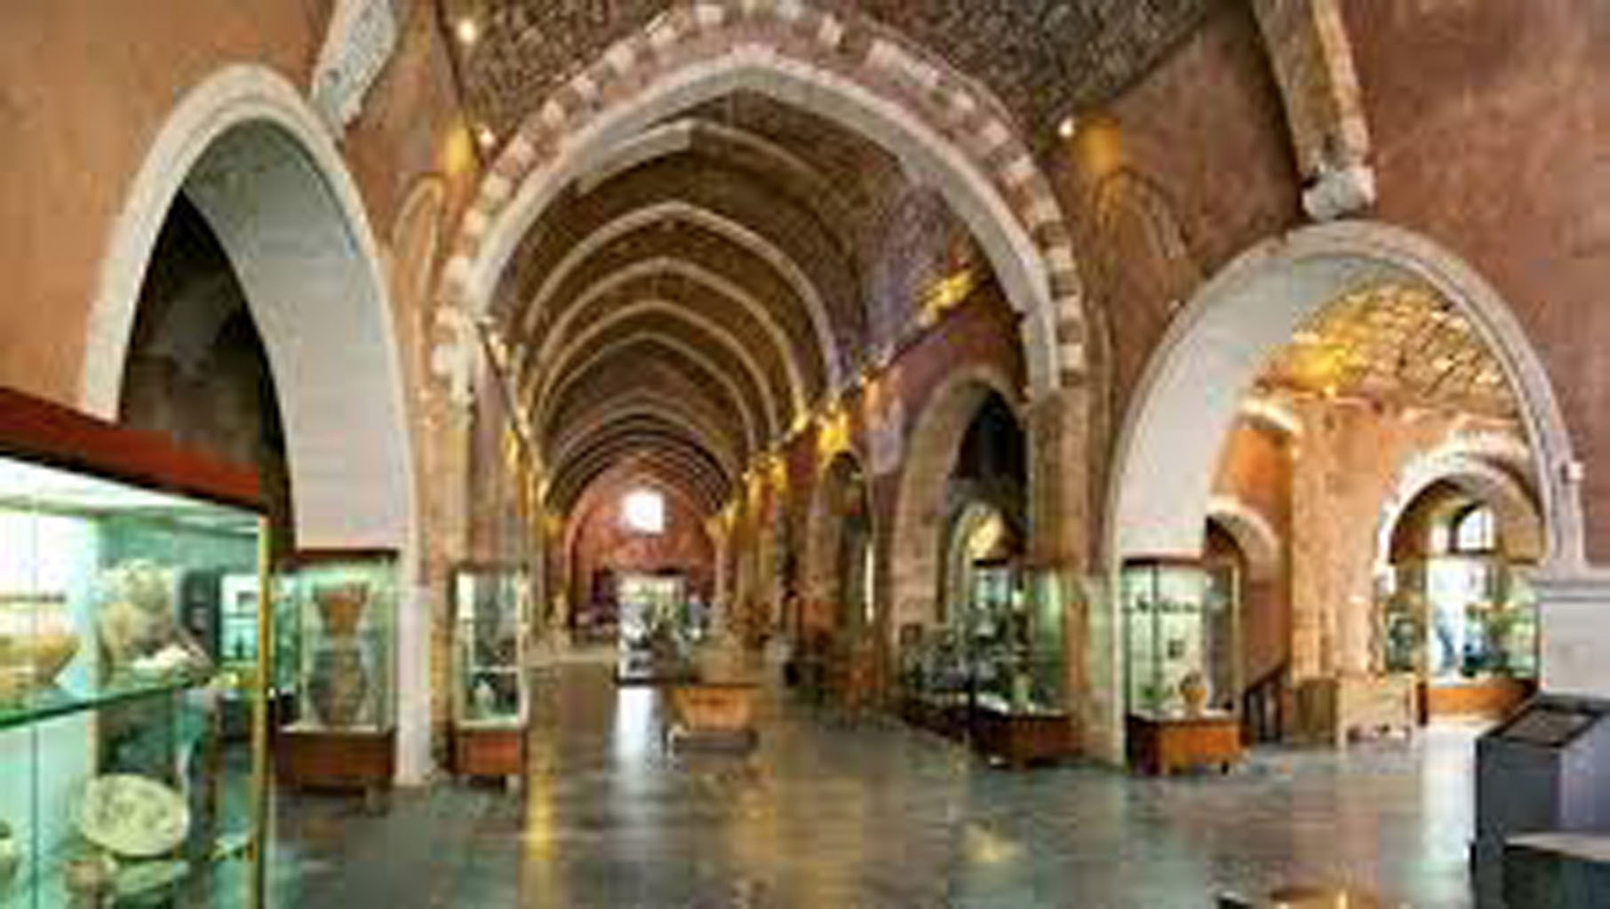
Franciscan Monastery of Agios Fragkiskos

Slide 6
The ancestors of today’s Turks were the Ottomans, who came from the depths of Asia and conquered many areas around the Mediterranean sea.
ΟΘΩΜΑΝΟΙ

Slide 7
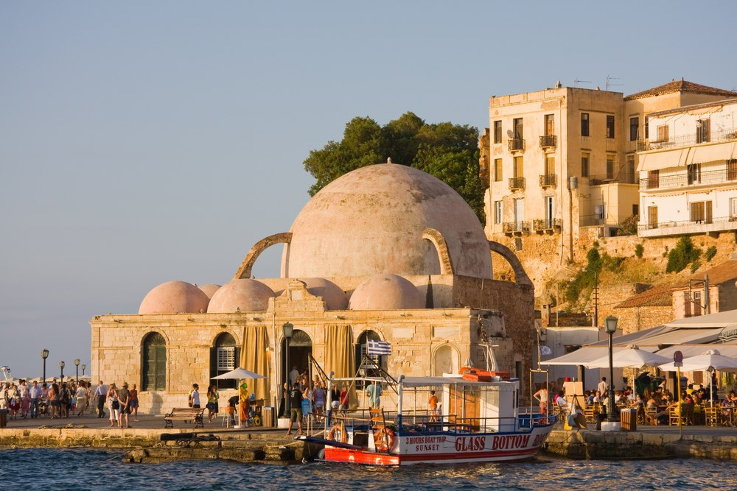
There are buildings from this era in Chania, Yiali Tzami which functioned as a muslim mosque and later on as Archaeological Museum, storage place, museum of folk art and today it hosts events and exhibitions.

Slide 8
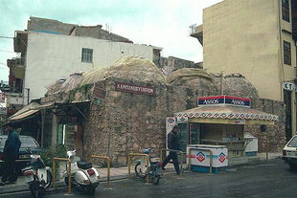
Also the Turkish Hammam in Halidon street is one of the many public and private baths ( hammams ) that were built in Chania during the Turkish occupation.

Slide 9
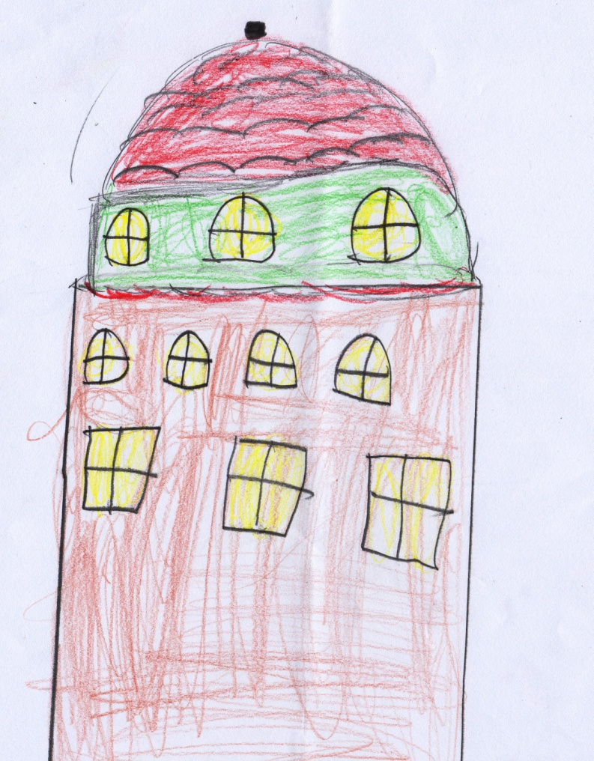
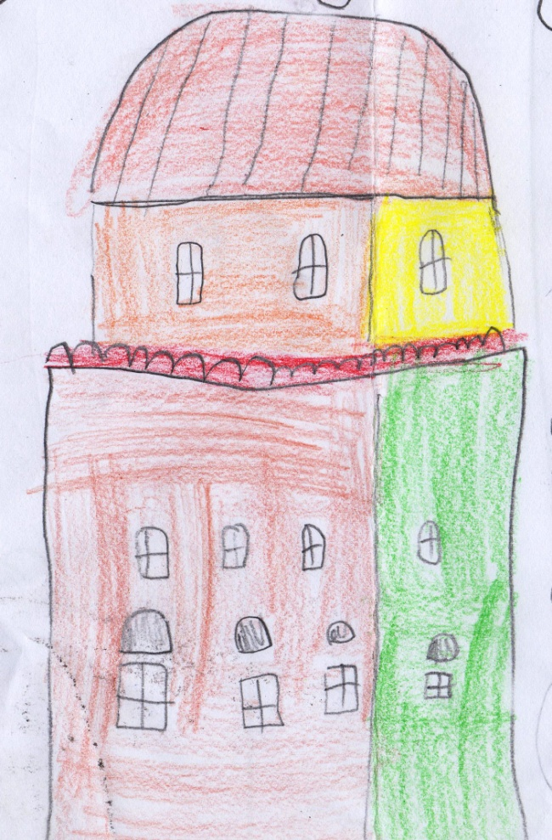
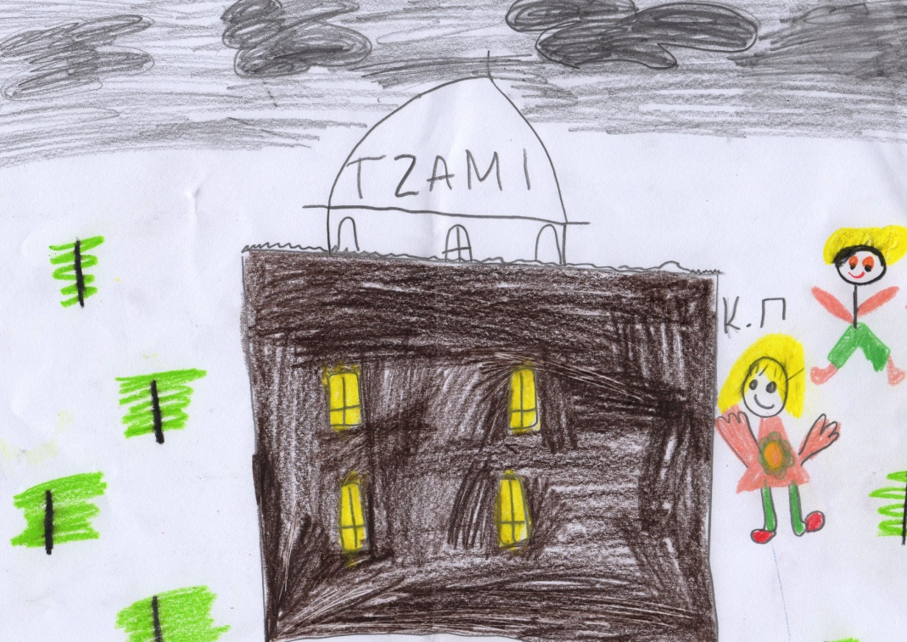
In Athens Tzistaraki Mosque at Monastiraki square and Fethiye Mosque were built by Ottomans.

Slide 10
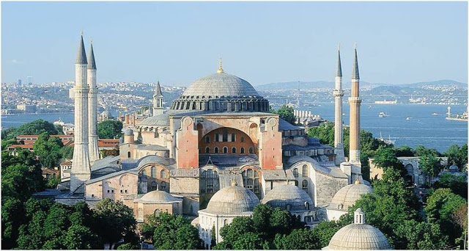
In Istanbul the church of St. Sophia, which was built by Emperor Justinian in Byzantine times, was an orthodox church, later it became α catholic church by the crusaders, an islamic mosque by the Ottomans and today it is a museum.

