Slide 1
CROSS-CURRICULAR TEACHING IN THE MFL CLASSROOM
by Magdalena Bobek, mag.

Slide 2
CROSS-CURRICULAR TEACHING IN THE MFL CLASSROOM
Cross-curricular teaching and learning has been interpreted by teachers who use it in their lessons, in many different ways. One of the basic objectives in cross-curricular teaching is to cover as many subject areas within the lessons of a particular subject as possible to enable students to do activities that will access as much knowledge from as many subject areas within the curriculum. It also enables teachers to not stick so rigidly to their coursebooks, but rather expand the given objectives being taught to other subject areas while keeping in mind the main objectives within a certain unit.

Slide 3
Today's MFL coursebooks are often written by authors who are not natives of the country where a particular coursebook is being used, and sometimes the reading content presented in the books is not close to home for students who come from a different cultural background from that of the author. This can have a negative effect on them because they cannot identify themselves with that particular content. With little or no prior knowledge of the content's background, learning grammar from this perspective can be very difficult.

Slide 4
However, if teachers can bring content, which has already been taught in another subject area into the MFL classroom, even though foreign at first, it will serve as a basis from which to build vocabulary as well as grammar, and make it easier for students to understand.
MFL can be incorporated into any subject area in the curriculum. In MFL the cross- curricular approach can be used when introducing a new topic or grammar point, when reviewing grammar and expanding it to another subject area, expanding vocabulary as well as reading and writing skills.

Slide 5
The cross-curricular sample of a lesson presented here shows how a geography lesson on Japan can be used in the L2 language classroom when revising the use of the degrees of the adjective and expanding vocabulary.
https://www.youtube.com/watch?v=i-ZZwY5Q8ZA
https://www.youtube.com/watch?v=2SYtynp-zg4

Slide 6
THE LESSON PLAN 1 JAPAN - (CROSS-CURRICULAR LINK – GEOGRAPHY)

Slide 7
THE LESSON PLAN 1 JAPAN - (CROSS-CURRICULAR LINK – GEOGRAPHY)
SUBJECT: English
AGE GROUP: 12 / 13 (7th class)
COURSE BOOK: MESSAGES 2 by Diana Goodey and Noel Goodey
MODULE 1 / UNIT 2: Differences (The degrees of the adjective)
THEME: JAPAN (CROSS-CURRICULAR LINK – GEOGRAPHY)
TEACHING APPROACH: frontal, individual, pair work, group work, project work
TEACHING METHODS: discussion, explanations, reading, listening, revising, working with ICT
LEARNING TOOLS AND ACCESSORIES: the computer, the white board, powerpoint, dictionaries, task in envelope, notebooks, geography notes, the Internet

Slide 8
LESSON OBJECTIVES:
a. Educational objectives:
Reviewing and learning interesting facts about an unknown country – Japan
completing a given text using English geographical names and other new expressions
searching for required information using Internet sources, books, notes from the geography lesson
writing new particularities using the new information obtained
b. Language content:
English vocabulary linked to Japan
Using the degrees of the adjective, primarily the comparative and superlative degrees

Slide 9
WORKING OBJECTIVES:
a. Listening and listening comprehension:
listening and understanding the task instructions
getting to know the vocabulary within the framework of the theme (Japan) and its meaning and use in context
b. Speech and speech communication:
Answering questions
Using appropriate linguistic resources and vocabulary

Slide 10
c. Reading and reading comprehension:
Developing reading skills and reading comprehension
Learning the vocabulary within the framework of the given theme (Japan) and its use in context
Reading out loud
Individual reading literature from the internet linked to the theme of the lesson (Japan)
d. Writing skills:
Independent gap filling
Independent writing of short texts

Slide 11
e. Mediation:
Spoken and written mediation of answers
f. Developing digital competences:
Responsible and safe use of ICT for acquiring, assessing and storing information

Slide 12
LESSON PROCEDURE
English will be referred to as L2
Slovenian (mother tongue) will be referred to as L1
Step 1:
Introduction for motivation purposes based on prior knowledge of Japan from the geography lesson:
- Using a power point presentation of the rising sun and the Japanese anthem, the students are asked if they know why Japan is known as
*'the land of the rising sun'.
- Looking at the Japanese flag with the red sun on a white background, students discuss its symbolism*

Slide 13
Step 2:
New vocabulary linked to Japan:
The teacher projects some English (L2) words (these are translations of newly-acquired L1 words and expressions from their previous geography lesson on Japan
With the help of their geography notes, students are asked to read the words projected silently to themselves and discuss their meanings with their neighbours as well as help those students who have difficulty finding a link between the L2 and L1 equivalents.
Students are invited to explain the L2 word in L1 or give its L1 equivalent

Slide 14
Step 3:
Gap Fill:
the students are then directed to individual L2 sentences containing known information about Japan, but filled with gaps
the students are asked to fill in the gaps using the newly-acquired L2 vocabulary already discussed in the first exercise
the sentences are shown on the powerpoint one by one, so that everyone concentrates on and/or discusses the same sentence.
(Once an answer is given by a student, the correct answers appear under the given sentence in yellow)

Slide 15
Step 4:
A revision of the degrees of the adjective:
the new vocabulary is shown once again on the powerpoint
students are asked to find adjectives among the projected words
(= the biggest, the strongest, restless, overpopulated)
with a raise of hands individual students give all three degrees of the adjectives found and the L1 equivalent
students are invited to check their geography notes and produce more L2 adjectives with which they could describe Japan and its people, which the teacher randomly writes on the board.

Slide 16
A revision of the expressions used with the degrees of the adjectives:
the teacher projects and reviews L2 expressions used with adjectives
as ______ as
too ______
______ enough
_______ than
_______ in the world
students add the appropriate degree:
as __1°___ as
too ___ 1°___
___1°__ enough
___2°__ than
___3°__ in the world
this is followed by a short exercise again containing information of Japan, which the students must complete with the correct degree of the given adjective and with the help of the underlined words

Slide 17
Step 5:
PROJECT WORK:
students are told that they are going to learn more about Japan
each student is given an envelope containing material for project work:
= one adjective, one thing/person/place that is linked to Japan, the
name of another place with which to make a comparison; the internet site
where to look for information
Instructions: (the instructions are explained and projected on the powerpoint as well)

Slide 18
TASK:
Write three sentences:
= in the first sentence use the superlative degree of the given adjective to describe the thing/person/place in Japan
= in the second sentence find a fact, a piece of information to describe the thing/person/place
= in the third sentence compare the thing/person/place with a similar thing/person/place from a different country or place
= add a picture of the thing/person/place presented in your project = prepare the material on A4 paper and print out
= exhibit in the L2 classroom

Slide 19
EXAMPLE:
Envelope material:
Beautiful / park in Tokyo
Write a fact about the park.
Compare it to: Hibiya Park
http://en.wikipedia.org/wiki/List_of_records_of_Japan

Slide 20
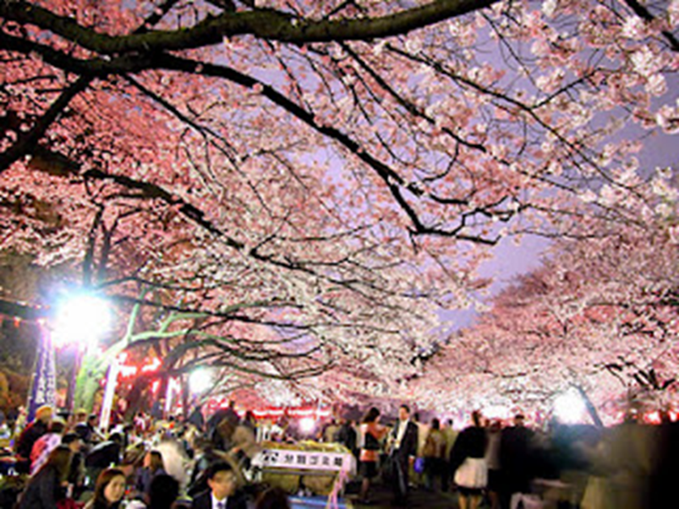
The most beautiful park in Tokyo is UENO PARK.
It has got Sakura blossoms, a famous Japanese flower.
UENO PARK is more beautiful than Hibiya Park.

Slide 21
THE LESSON PLAN 2 AUSTRALIA (CROSS-CURRICULAR LINK - HISTORY / GEOGRAPHY)

Slide 22
THE LESSON PLAN 2 AUSTRALIA (CROSS-CURRICULAR LINK - HISTORY / GEOGRAPHY)
SUBJECT: English
AGE GROUP: 13/14 (8th class)
COURSE BOOK: MESSAGES 3 by Diana Goodey, Noel Goodey and Miles Craven
MODULE 2 / UNIT 4 / Extra Reading: Australia
THEME: (CROSS-CURRICULAR LINK – HISTORY / GEOGRAPHY)
TEACHING APPROACH: frontal, individual
TEACHING METHODS: discussion, explanations, reading, listening, revising, working with ICT
LEARNING TOOLS AND ACCESSORIES: the course book, the computer, the white board, glossaries, dictionaries, task in envelope, notebooks, the Internet

Slide 23
LESSON OBJECTIVES:
Educational objectives:
getting to know interesting facts about a less-known country – Australia
reading about the given country
analysing new words and expressions from the text and explaining them in L2
searching for required information using Internet sources
writing up particularities about other less-known countries using the new information obtained
b. Language content:
English vocabulary linked to Australia
Learning to fill in a form

Slide 24
WORKING OBJECTIVES:
Listening and listening comprehension:
listening and understanding the task instructions
reciprocal listening during pair work
b. Speech and speech communication:
Answering questions
Using appropriate linguistic resources and vocabulary

Slide 25
c. Reading and reading comprehension:
Developing reading skills and reading comprehension
Learning the vocabulary within the framework of the given theme (Australia) and its use in context
Reading silently and out loud
Individual reading literature from the internet linked to the theme of the lesson (Australia)

Slide 26
d. Writing and writing skills:
Independent gap filling
e. Mediation:
Spoken and written mediation of answers
Developing digital competences:
- learning to independently search the Internet for information
- practing the responsible and safe use of ICT for acquiring, assessing and storing
information

Slide 27
LESSON PROCEDURE
English will be referred to as L2 Slovenian (mother tonue) will be referred to as L1
Step 1:
Introduction for motivation purposes based on any prior knowledge of Australia
Using the students' prior knowledge (from geography/history, relatives), students are asked if they know anything about Australia
Using the course book picture and/or internet links as reference they discuss and comment on what they see

Slide 28
Step 2:
Preparing for pair work / listening to instructions
Students work in pairs using the text of Australia, the coursebook dictionary and their glossaries
The teacher projects words and expressions from the text and gives instructions for their task
= students are to recopy the words and expressions into their glossaries
= they search for the words and expressions in the text and try to guess at
their meaning through the context of the text in which they are found
= students write their meanings into their glossaries in L1 but also try to add
an L2 explanation or find their synonyms

Slide 29
= they are given a time limit, after which their work is discussed and
corrected by the students themselves
Step 3:
Pair work continued – Complete the Fact File about Australia
Still working in pairs students recopy the fact file form for Australia into their
exercise notebooks and fill in the required information from the text
Their work in discussed and corrected

Slide 30
Step 4:
Learning about other unknown countries in the world
Students work individually one per computer
Each student is given an envelope in which there is the name of an unknown country, an empty fact file and the internet site where to look for the required information about the given country
Each student searches the internet and having found the information, fills in the fact file

Slide 31
Step 5:
A Poster of new countries
Having filled in their fact file with facts of the unknown coutry, each student sticks their fact file onto a poster entitled 'DID YOU KNOW...?'
Step 6:
A Collage of newly aquired countries
After all the students have added their fact files to the poster, each student presents their new country to the class.

Slide 32
END RESULT: A COLLAGE OF NEWLY ACQUIRED COUNTRIES

Slide 33
Expanding on the FACT FILE end product:
= find your country on the map of the world and signpost it (geography)
= search the Internet to find how you can get from your school to that country (means of transport; the cost of travel; time difference; weather conditions...) (geo.)
= research the history of your country (who were the first settlers, wars fought, trade, currency) (history)
= using the fact file, make a simple travel brochure for a tourist agency about what you can do and see there

Slide 34
= pretend to be a tourist who has just arrived in that country and describe your first impressions and/or expectations of the people, the land, animals, food
= Create a dialogue or interview with one of the locals, where you ask them questions about the country/region using the information provided from your research and then write a report.
= Investigate the ´School of the Air‘ – what it entails, advantages/disadvantages

Slide 35
STATEMENT
This project has been funded with support from the European Commission. This publication [communication] reflects the views only of the author, and the Commission cannot be held responsible for any use which may be made of the information contained therein.

Slide 36
Sources:
Map of Japan:
http://www.freeworldmaps.net/asia/japan/
Map of Australia:
http://www.turkey-visit.com/map/australia/toowoomba-map.asp
Picture of puzzle taken from:
https://jhall128-integrate.weebly.com/key-elements.html
https://www.tes.com/lessons/B8x4jJw40alP2Q/aborigines
https://mobilab.lu/event/instr-2018/

