Slide 1
CROSS-CURRICULAR APPROACH
And Integrated Language Learning

Slide 2
Independence
Reflection
team work
Projects

Slide 3
PRESENTATION
SEARCHING
PLANNING
exhibition
students
Common topic
Planning form

Slide 5
the foreign language provides elements to be used in other subject classes
teaching the disciplines in the target language
creating a thematic unit
integrating languages with other subjects helps students improve their English

Slide 6
Selecting a theme
Defining the learning outcomes
Deciding a final product
Evaluating

Slide 7
EVALUATION GRID students’ team work
PARTICIPATION | The student takes active part into the project and gives appropriate solutions | 1 | 2 | 3 | 4 | The student is passive in the project and accepts solutions given by others
INITIATIVE | The student gives his personal contribution to improve the working methods. | 1 | 2 | 3 | 4 | The student never makes specific proposals
AUTHONOMY | The student plans and organizes his work without any help. | 1 | 2 | 3 | 4 | The student asks for help continuously.
DECISION MAKING ABILITY | The student makes his own decisions correctly | 1 | 2 | 3 | 4 | The student does not have any ability in making decisions.
MOTIVATION | The student is highly motivated. | 1 | 2 | 3 | 4 | The student does not show any interest in the activities.
SENSE OF RESPONSIBILITY | The student understands his responsibilities and is able to evaluate the consequences of his own work. | 1 | 2 | 3 | 4 | The student is not interested in the results of his own work

Slide 8
Students working individually
LEARNING ABILITY | The student learns easily in each operative state | 1 | 2 | 3 | 4 | The student is not interested in the learning process
UNDERSTANDING OF THE ASSIGNED TASK | The student is able to solve problems on his own | 1 | 2 | 3 | 4 | The student needs to be helped
PUNCTUALITY IN THE PERFORMANCE OF THE ASSIGNED TASKS | The student carries on the tasks on time | 1 | 2 | 3 | 4 | The student is never punctual
ORGANISATIONAL SKILLS | The student prepares his work and checks the results | 1 | 2 | 3 | 4 | The student is not able to organize himself
QUALITY OF WORK | The work is correct both in the content and in the form | 1 | 2 | 3 | 4 | The student makes important mistakes

Slide 9
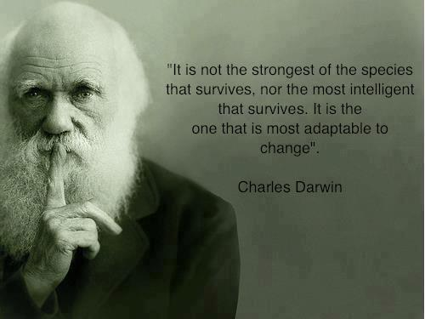
THANK YOU FOR YOUR ATTENTION!!

