Slide 1
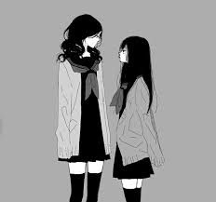
Presentation
Presentation
My Name is
I’m years old.
I’m French and Algerian.
I want be doctor
I have 1 sister.

Slide 2
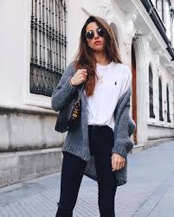
pp
My physical and moral description
I am Tall and thin.
I have long wavy hair.
I am smart , generous , open mind , calm , honest

Slide 3
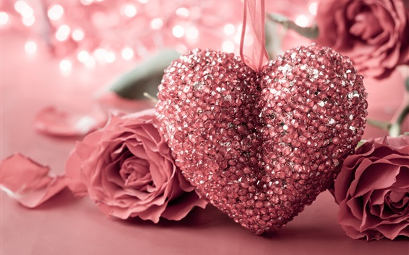
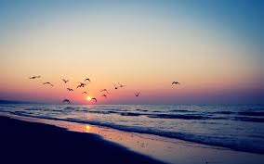
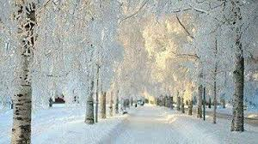
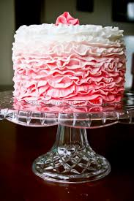
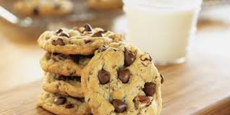
I Like
I like cakes, cookies
I love Summer and Winter
Running
I like flowers
I LOVE Algeria

Slide 4
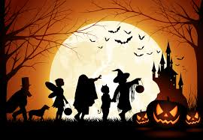
I don’t like
Orange colour
Reggae
Halloween
Rugby

Slide 5
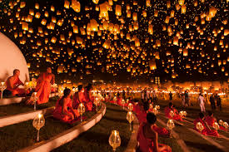
Why I participate has Erasmus + ?
Why I participate has Erasmus + ?
1- Discover new cultures
2- to meet new people to create links because I am sociable
3- Speak with them in English
1- Discover new cultures
2- to meet new people to create links because I am sociable.
3- Speak with them in English

