Slide 1
French Celebrations
Erasmus +

Slide 2
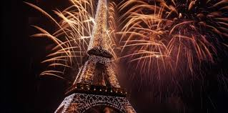
New Year’s Eve – 1st of January

Slide 3

May Day (fête du travail) 1st of May
The day when we don’t go to work or schol. Celebration originally coming from USA

Slide 4

Victory in Europe Day- 8th of may
The day symbolises the vicotry and the end of the WWII in 1945

Slide 5

Bastille day - 14th of July
The anniversary of Storming of the Bastille on 14 July 1789, a turning point of the French Revolution

Slide 6

Remembrance day – 11th of November
Remembrance day is a national holiday in France and Belgium. It commemorates the armistice signed between the Allies and Germany at Compiègne, France, for the cessation of hostilities on the Western Front

