Slide 1
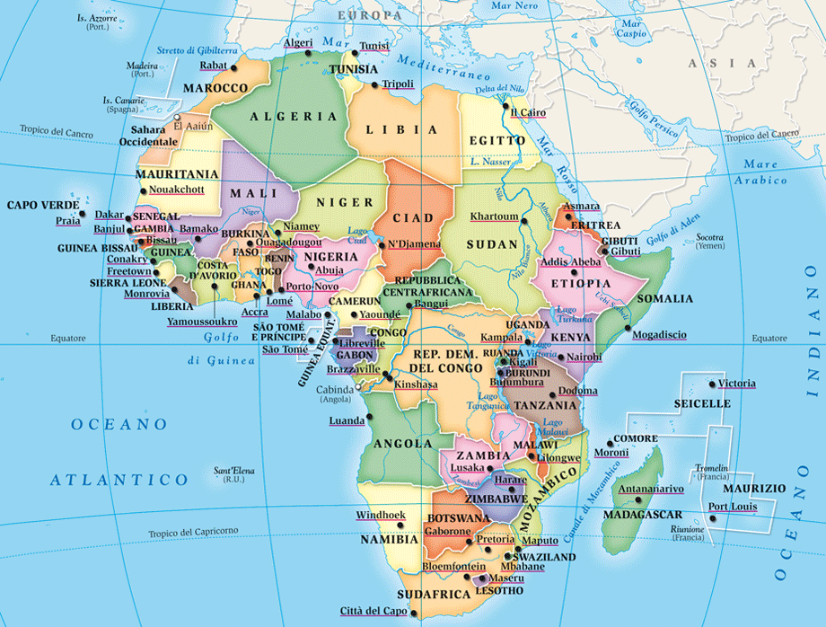
An African legend.
Princesse Abla Pokou: from Ghana to Cote d'Ivoire
Notes:
1

Slide 2
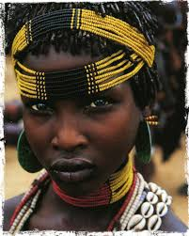
ONCE UPON THE TIME....BUT NOT SO LONG AGO,
ABLA POKOU WAS A GHANA PRINCESS.
SHE WAS THE NIECE OF THE WISE EMPEROR OSSEI TUTU.
Notes:
2

Slide 3
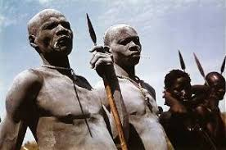
WHEN THE EMPEROR WAS DEAD, A WAR STARTED IN GHANA. ABLA POKOU, WHO WAS THE DIRECT HEIRESS OF THE EMPEROR, HAD TO RUN AWAY TO NORTH WITH HER PEOPLE TO SAVE LIFE......
Notes:
3

Slide 4
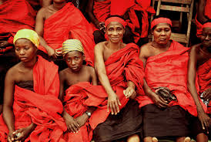
AFTER DAYS AND NIGHS OF WALKING, ASHANTI PEOPLE (THAT'S THE NAME OF THIS TRIBE), ARRIVED AT A WIDE RIVER. THEY HAD NO IDEA HOW TO CROSS IT.
Notes:
4

Slide 5
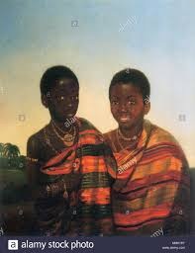
THEY STARTED TO PRAY ALL THEIR GODS.
AT ONCE, THEY HAD THE RESPONSE:
A HUMAN SACRIFICE WAS NEEDED,
BUT NOBODY
WANTED TO DIE.
Notes:
5

Slide 6
ABLA POKOU COULD NOT GO, OTHERWISE ALL HER PEOPLE WOULD BE LOST. IT WAS ANOTHER VERY DIFFICULT MOMENT.
Notes:
6

Slide 7
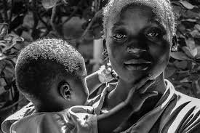
SHE HAD TO TAKE A DECISION TO SAVE HER PEOPLE, THE NAME OF THE TRIBE: SOMEBODY HAVE TO DIE!
WHO ELSE, IF NOT HER OWN LITTLE CHILD??????
Notes:
7

Slide 8
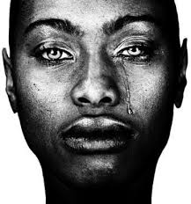
SO SHE SCREAMED LOUD:
“BAULE' – THE CHILD IS DEAD!”
AND TROW THE CHILD INTO WATER.
Notes:
8

Slide 9
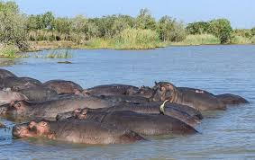
SUDDENLY, HIPPOPOTAMUS STARTED TO COME OUT OF WATER. THEY STOOD ONE BY THE OTHER, CREATING A BRIDGE.
ABLA POKOUS PEOPLE COULD CROSS TO THE OTHER SIDE
Notes:
9

Slide 10
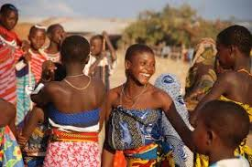
THEY ARRIVED TO NORTH COTE D'IVOIRE, AND THEY STILL LIVE THERE.
THEIR ETHNIC GROUP IS CALLED
BAULE'
Notes:
10

Slide 11
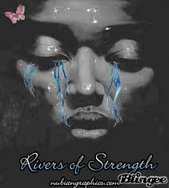
BAULE' PEOPLE WILL NEVER FORGET THEIR BRAVE PRINCESSE.
BAULE' – THE CHILD IS DEAD.
Notes:
11

