Slide 1
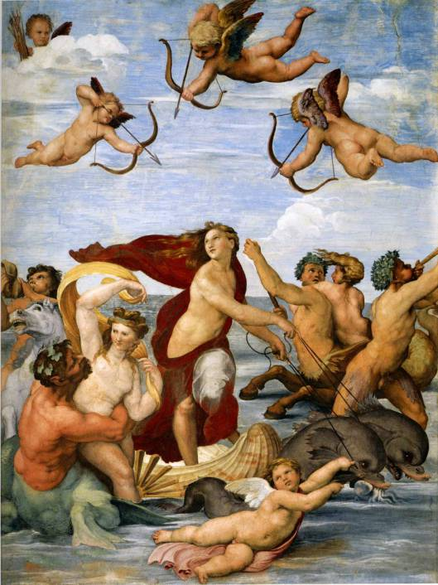
ACIS AND GALATAEA
GALATAEA WAS A FEMALE SPIRIT OF SEA WATER (NYNPH).
GALATAEA LOVED TO SWIM AND HAVE FUN BY THE SEA IN FRONT OF OUR COAST.
Notes:
1

Slide 2
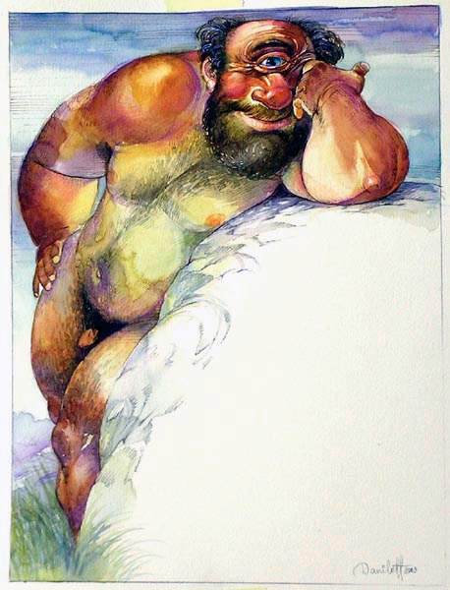
POLIFEMUS!!!
ONE HORRIBLE DAY POLIFEMUS, THE MONSTROUSE SON OF THE KING OF THE SEA, FELT IN LOVE WITH HER.
Notes:
2

Slide 3
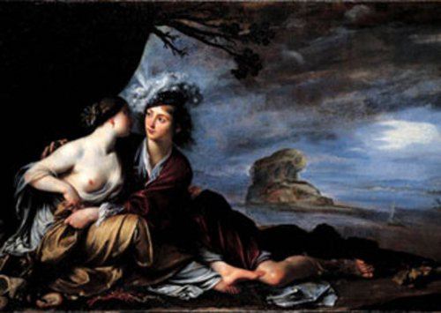
BUT GALATAEA LOVED ACIS...
Notes:
3

Slide 4
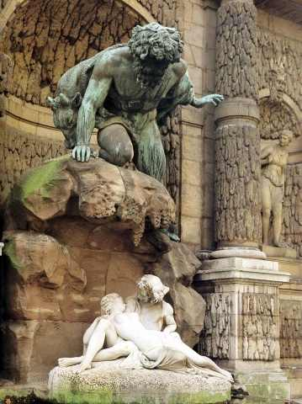
POLIFEMUS WAS VERY JELOUSE!
Notes:
4

Slide 5
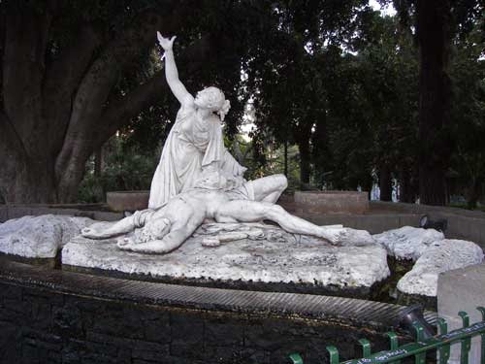
AND KILLED ACIS, BUT....
Notes:
5

