Slide 1
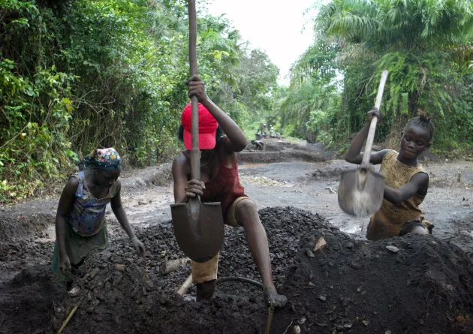
slavery
Slavery is the social and economic system based on slavery.
Slavery means being torn from one's own context and therefore from all those social relations that constitute a human being.
In these ten countries - China, the Democratic Republic of the Congo, India, Indonesia, Iran, Nigeria, North Korea, Pakistan, the Philippines and Russia - together live about 60% of all enslaved people and more than half of the population world.
We also have phenomena of child slavery.
Almost half of the total (72 million) is in Africa, with Mali, Nigeria, Guinea Bissau and Chad having the highest percentages of children between 5 and 17 years involved in child labor
Noemi D’Andrea 2AL
Don Tonino Bello High School

