Slide 1
Nemrut Mountaın

Slide 2
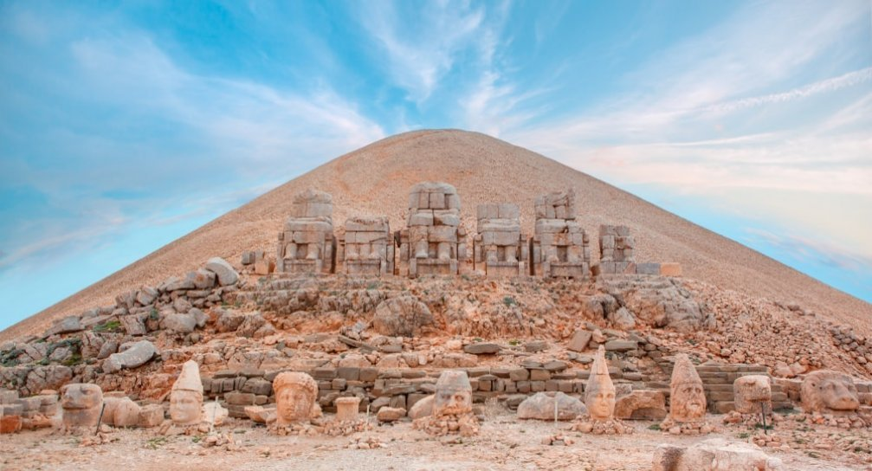
It is located in the Kahta district of Adıyaman

Slide 3
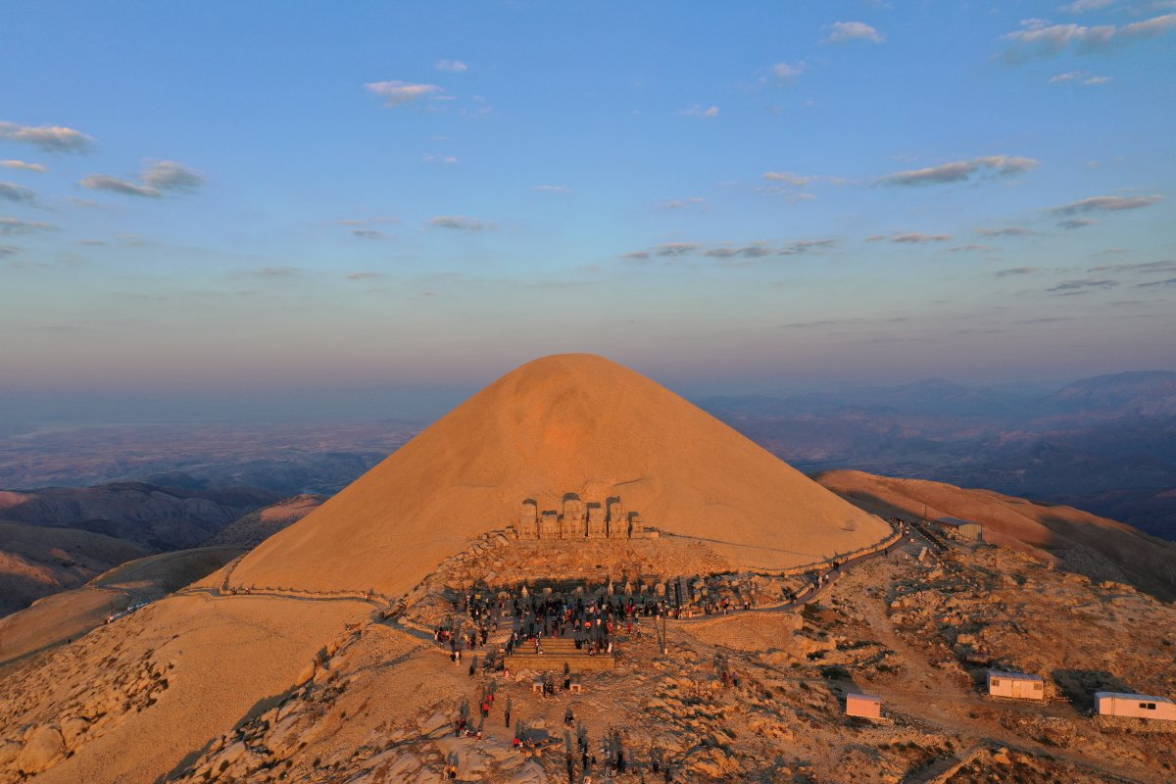
It became a World heritage site by UNESCO in one thousand nineteen eighty-seven

Slide 4
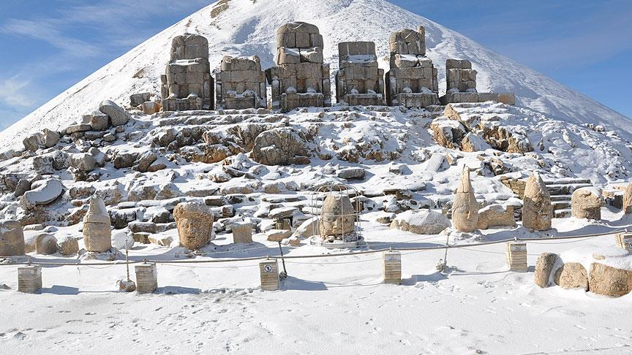
It is the eighth Wonder of the World

Slide 5
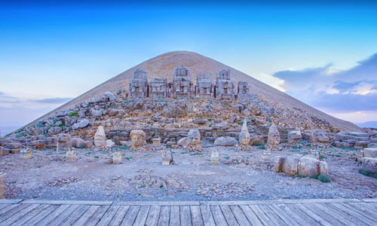
It is two thousand years old

Slide 6
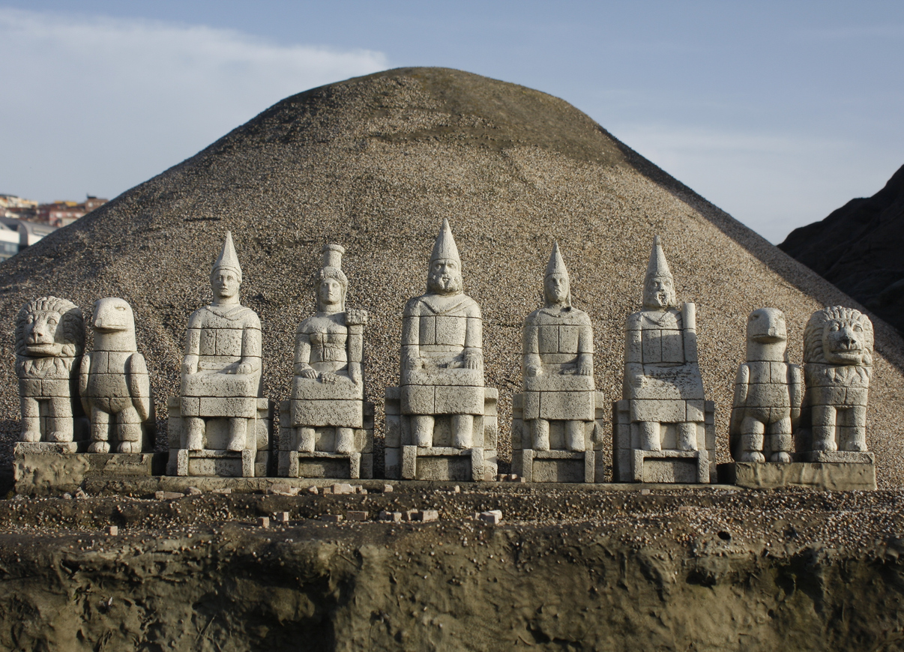
Statues can be ten meters long on Mount Nemrut

Slide 7
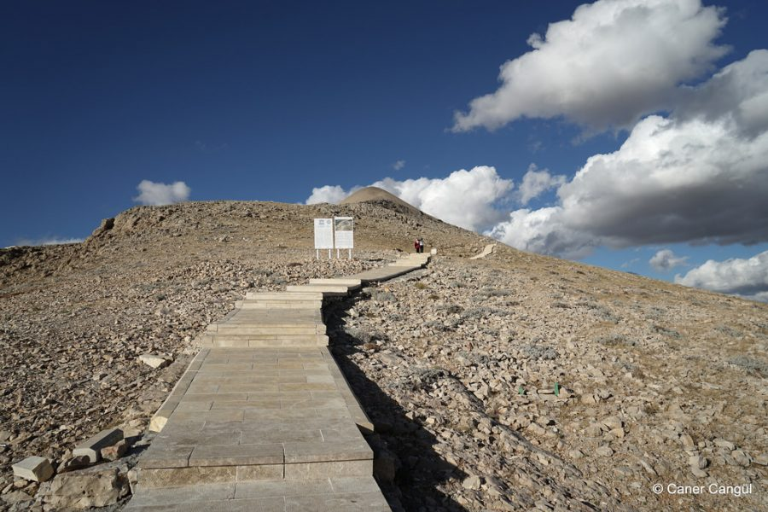
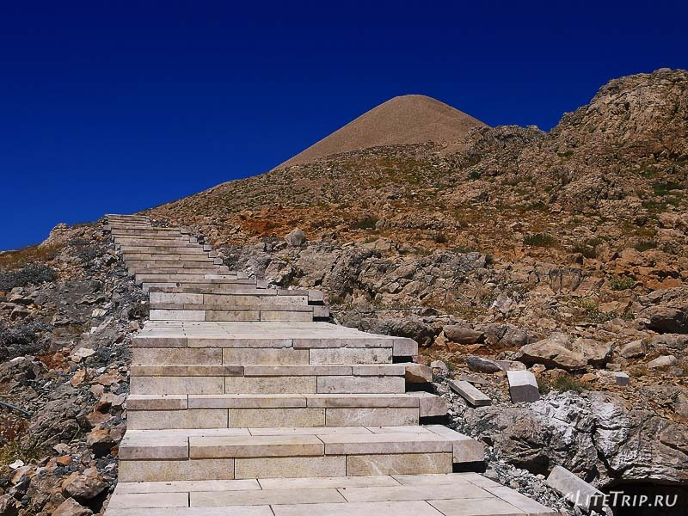
We have to climb stairs to reach Nemrut Mountain

Slide 8
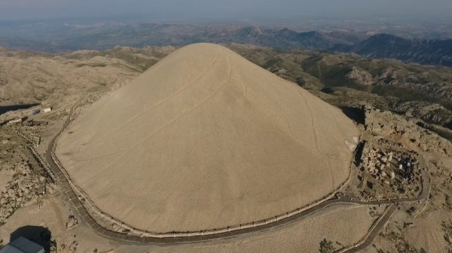
Nemrut Mount is a volcanic mountain

Slide 9
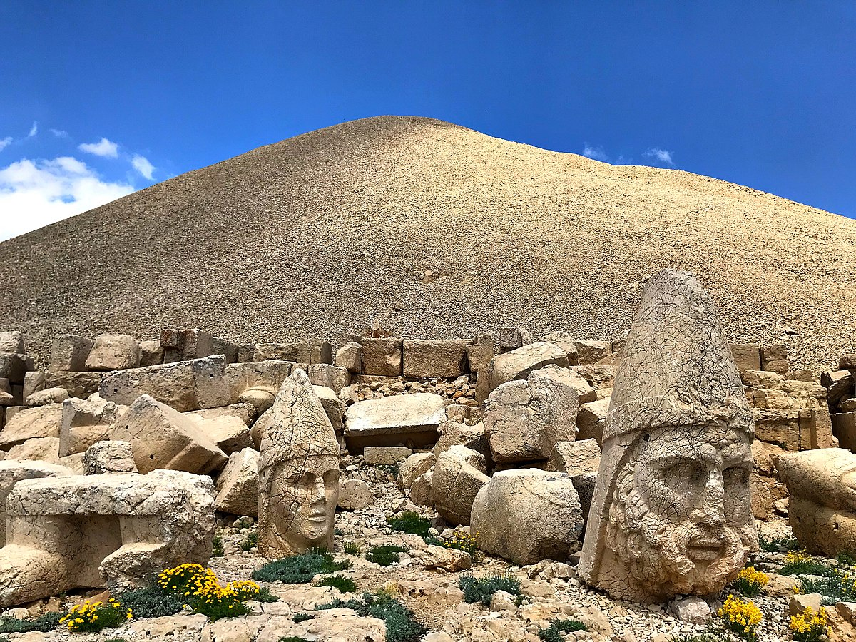
Two thousand one hundred and fifty meters high

Slide 10
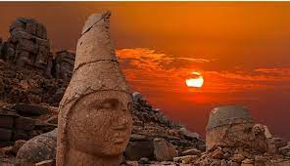
Some statues are on the side where the sun rises

Slide 11
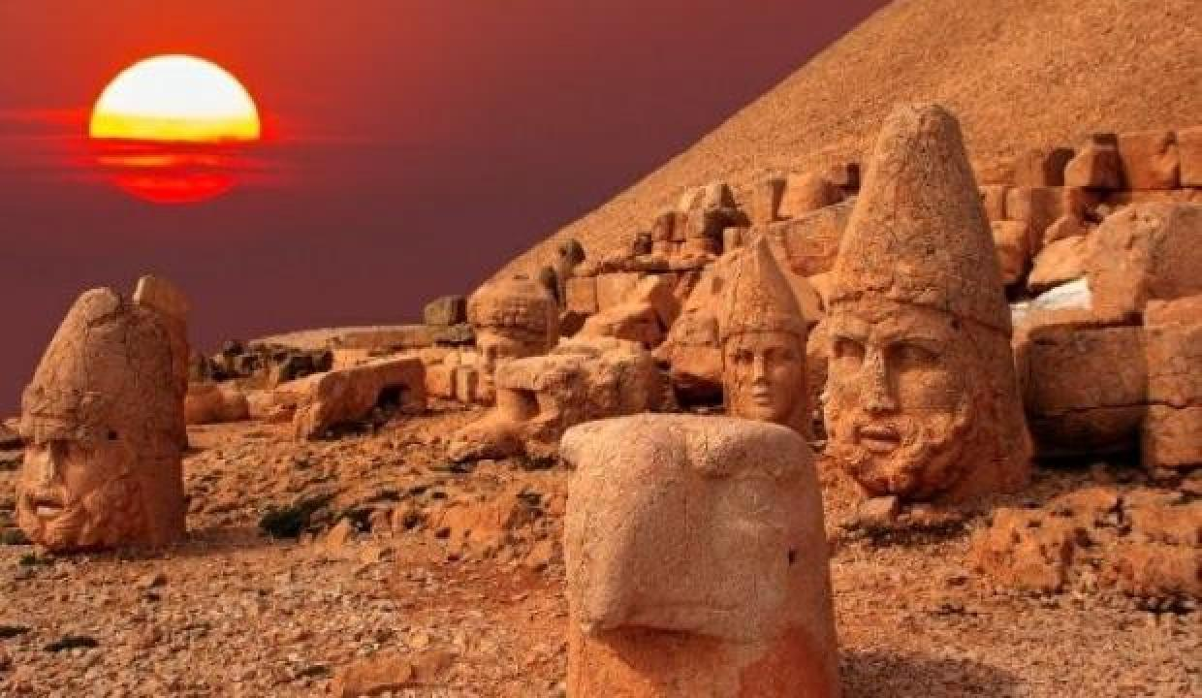
Some statues are on the side where the sun sets

Slide 12
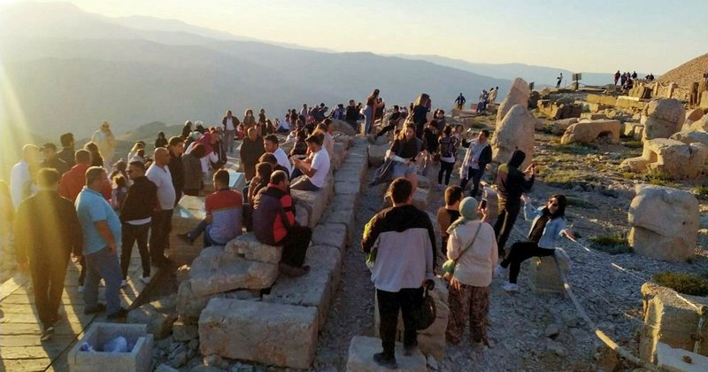
It attracts about one hundred six thousand tourists per year

Slide 13
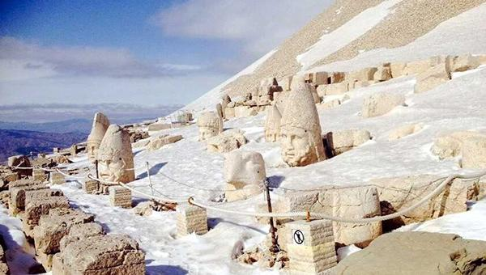
It is cold we have to dress thick clothes

Slide 14
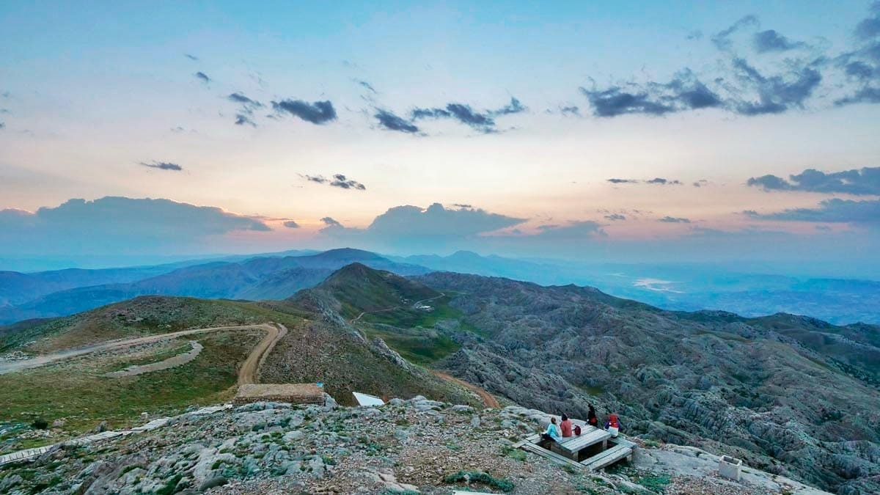
It has a very beautiful view

Slide 15
It is made by
GFL eTwinning team

