Slide 1
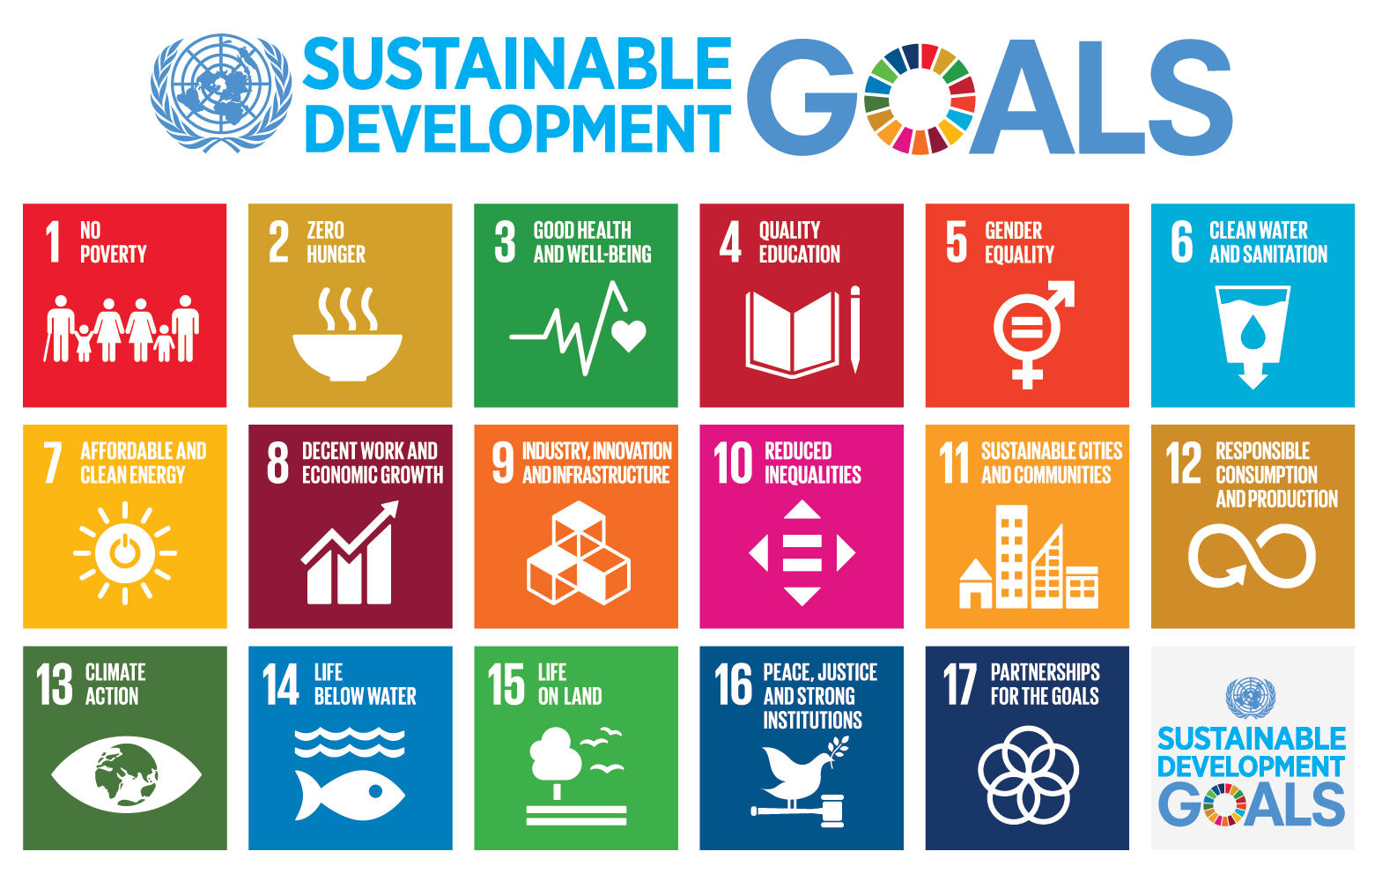
WHAT’S THE CURRENT STATUS
WHAT’S THE CURRENT STATUS OF THE 2030 GOALS?
Liceo Scientifico Scienze applicate
“G. Ferro”
a.s. 2021-2022
Work made by:
Giovanna A.
Chiara A.
Carla B.
Laura D.
Stefania S.

Slide 2
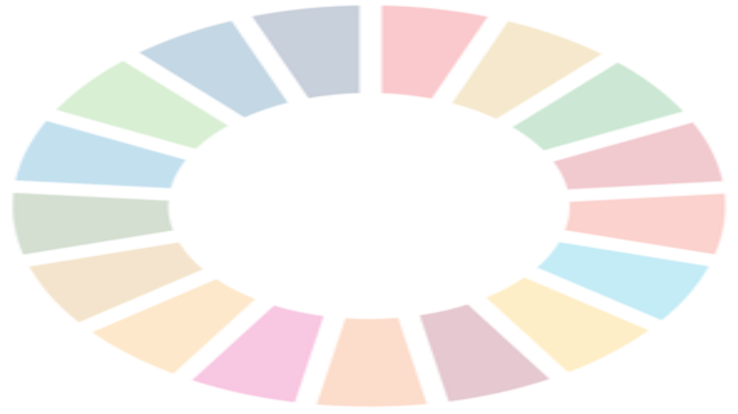
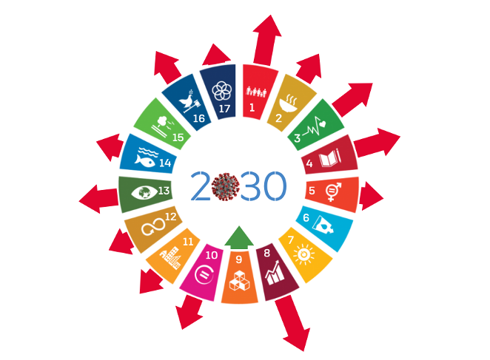
BEFORE THE PANDEMIC
AFTER THE PANDEMIC
It was clear that covid-19 and lockdown would have had negative effects on the majority of the 2030 goals which weren’t at a good point before the pandemic.
The goals that were most negatively affected were:
Goal 1, poverty 0;
Goal 4, quality education;
Goal 8, decent work and economic growth;
But 13 goals of 17 have been damaged.
The situation before covid-19 pandemic regarding the 2030 goals was generally delayed compared to the achievements of the goals that have been set for 2020.
Following these pessimistic statistic the necessity to rethink and rebuild the way to reach the 17 global goals must be reinforced.

Slide 3
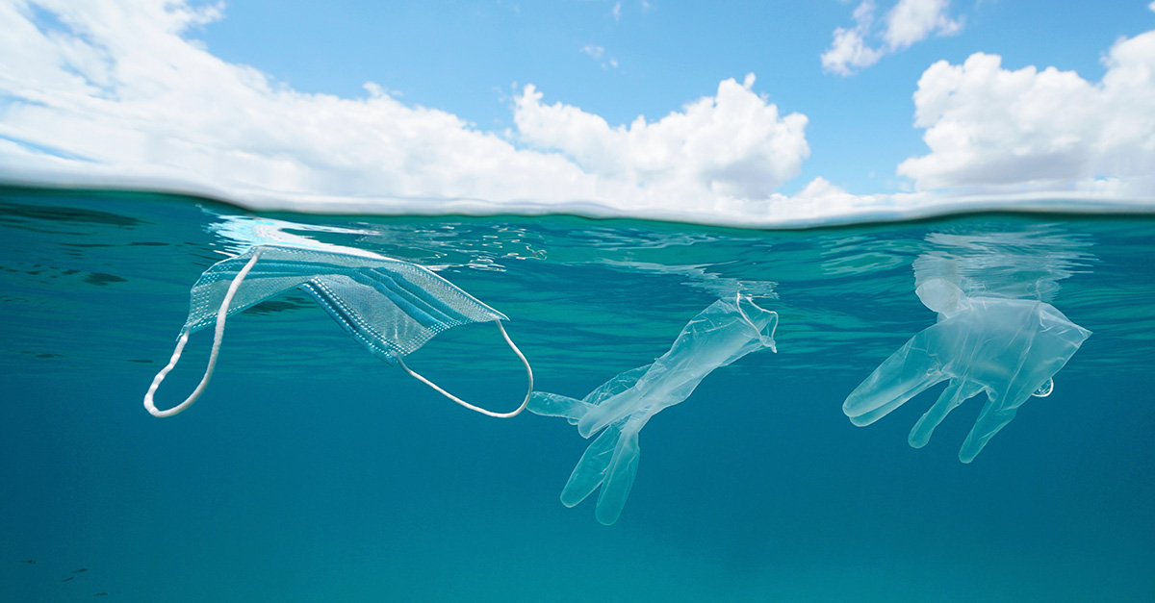
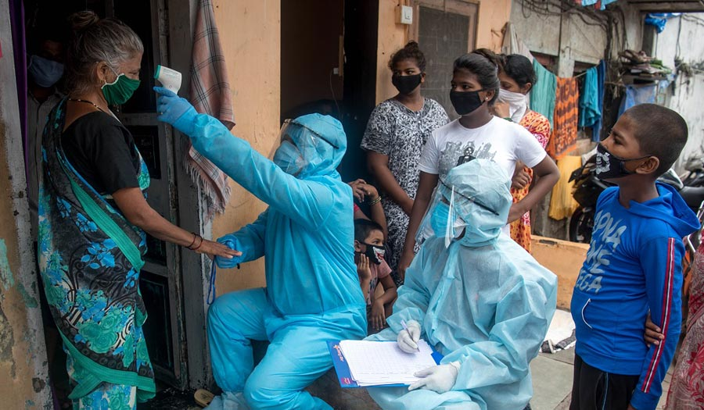
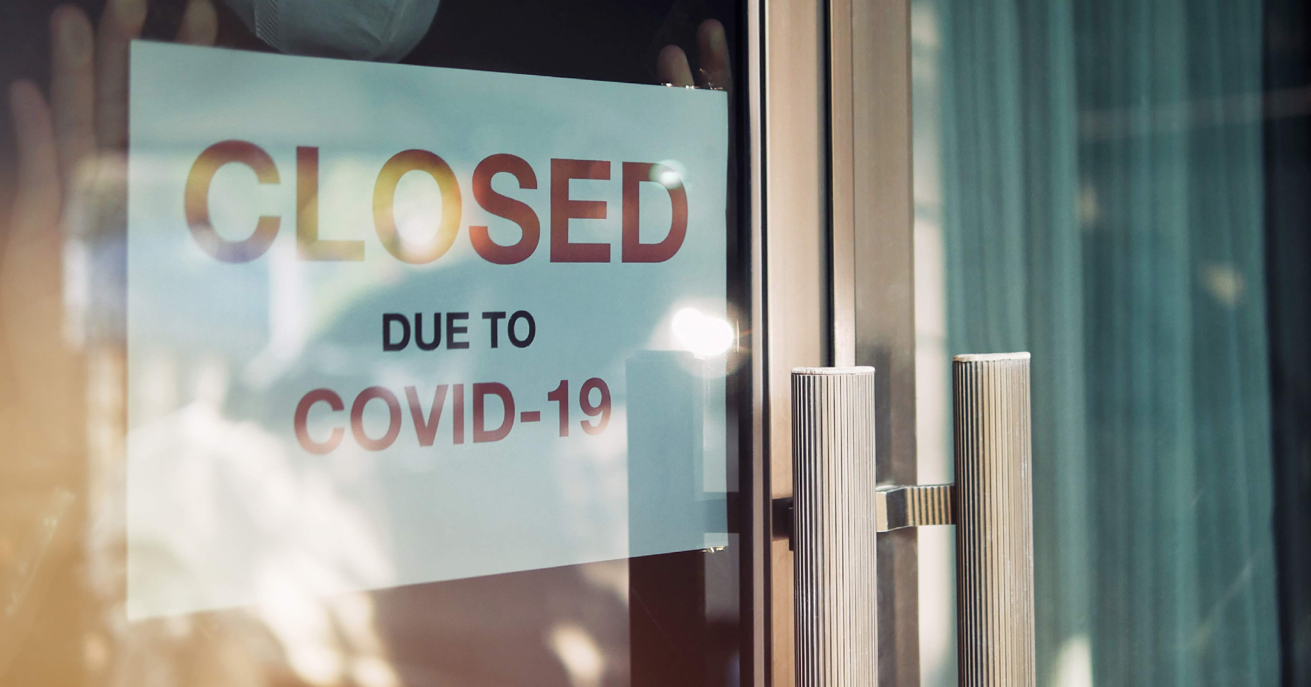
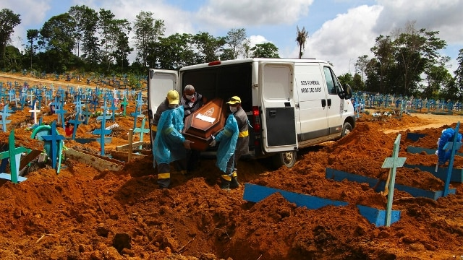
SOME EXAMPLES OF COVID-19 CONSEQUENCES
pollution due to covid-19 protective devices;
block of the economy activities and consequent poverty;
In the poorest nation insufficient medical care;
deforestation of fertile areas to make cemeteries and to get wood used to cremate dead bodies of covid-19.

Slide 4
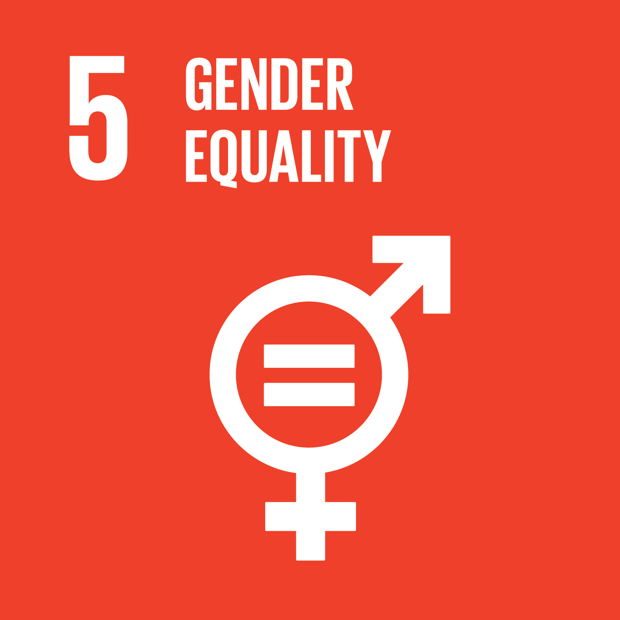
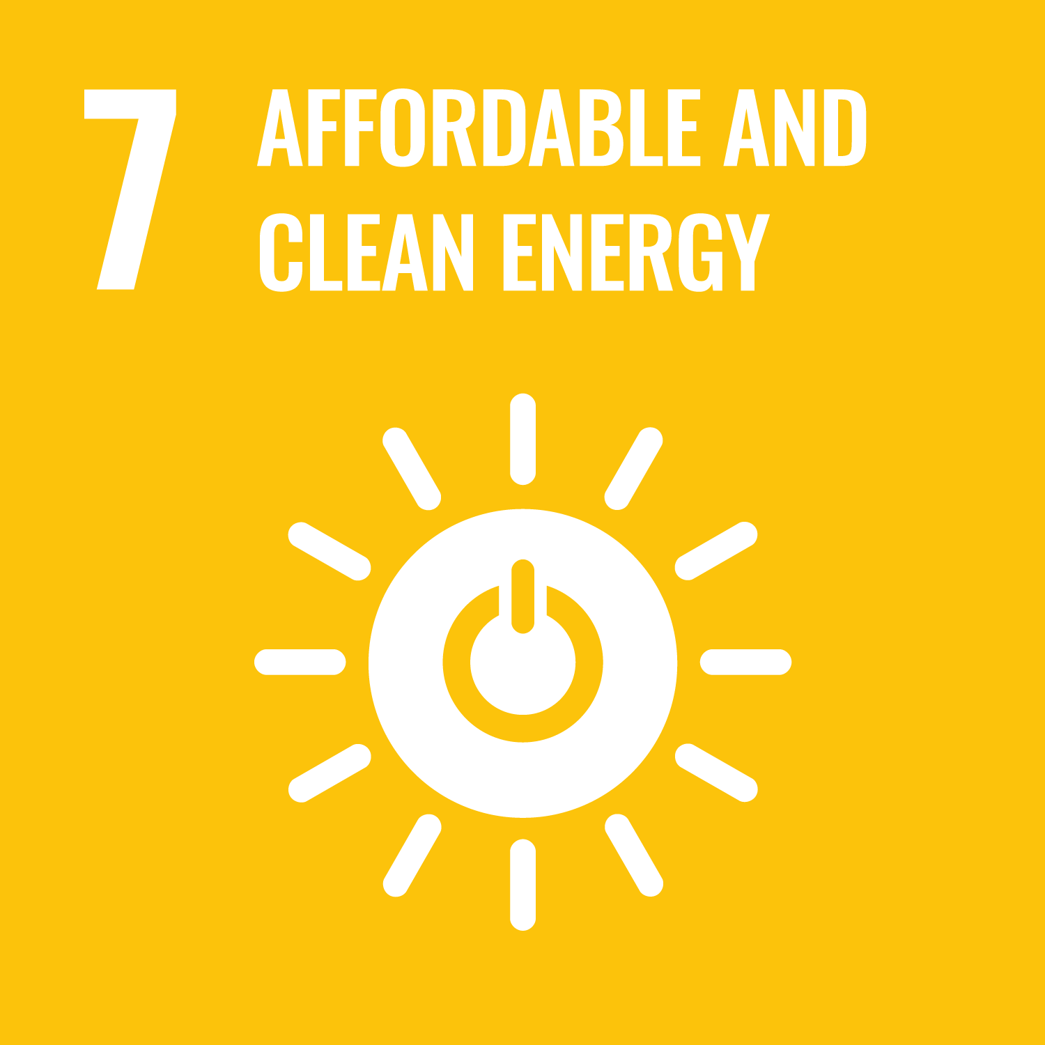
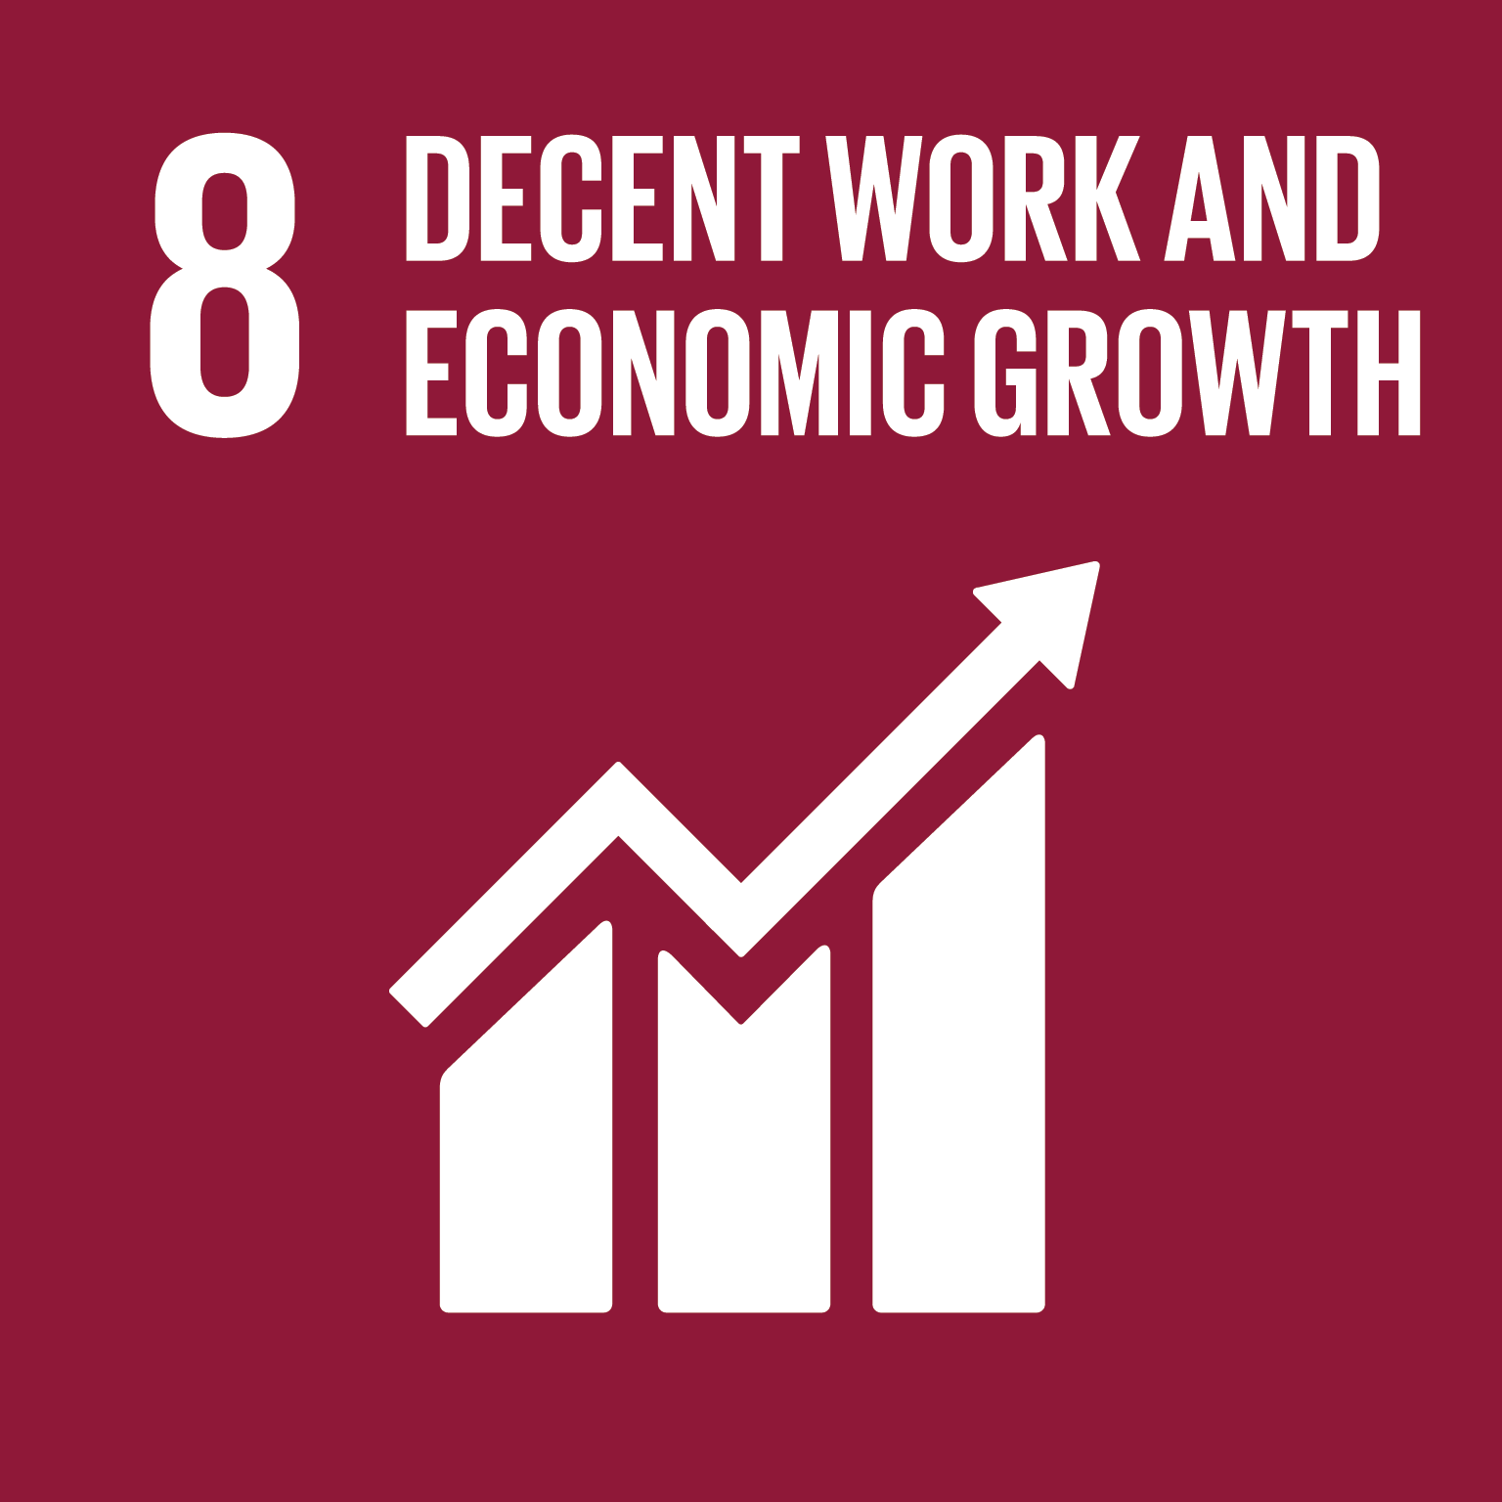
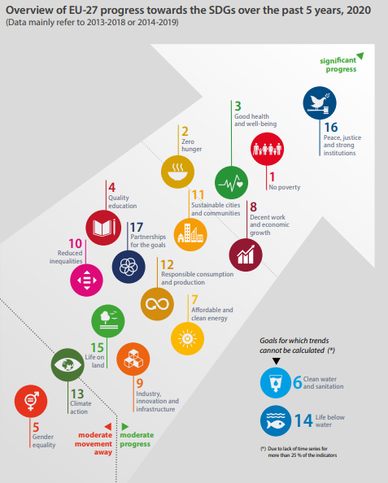
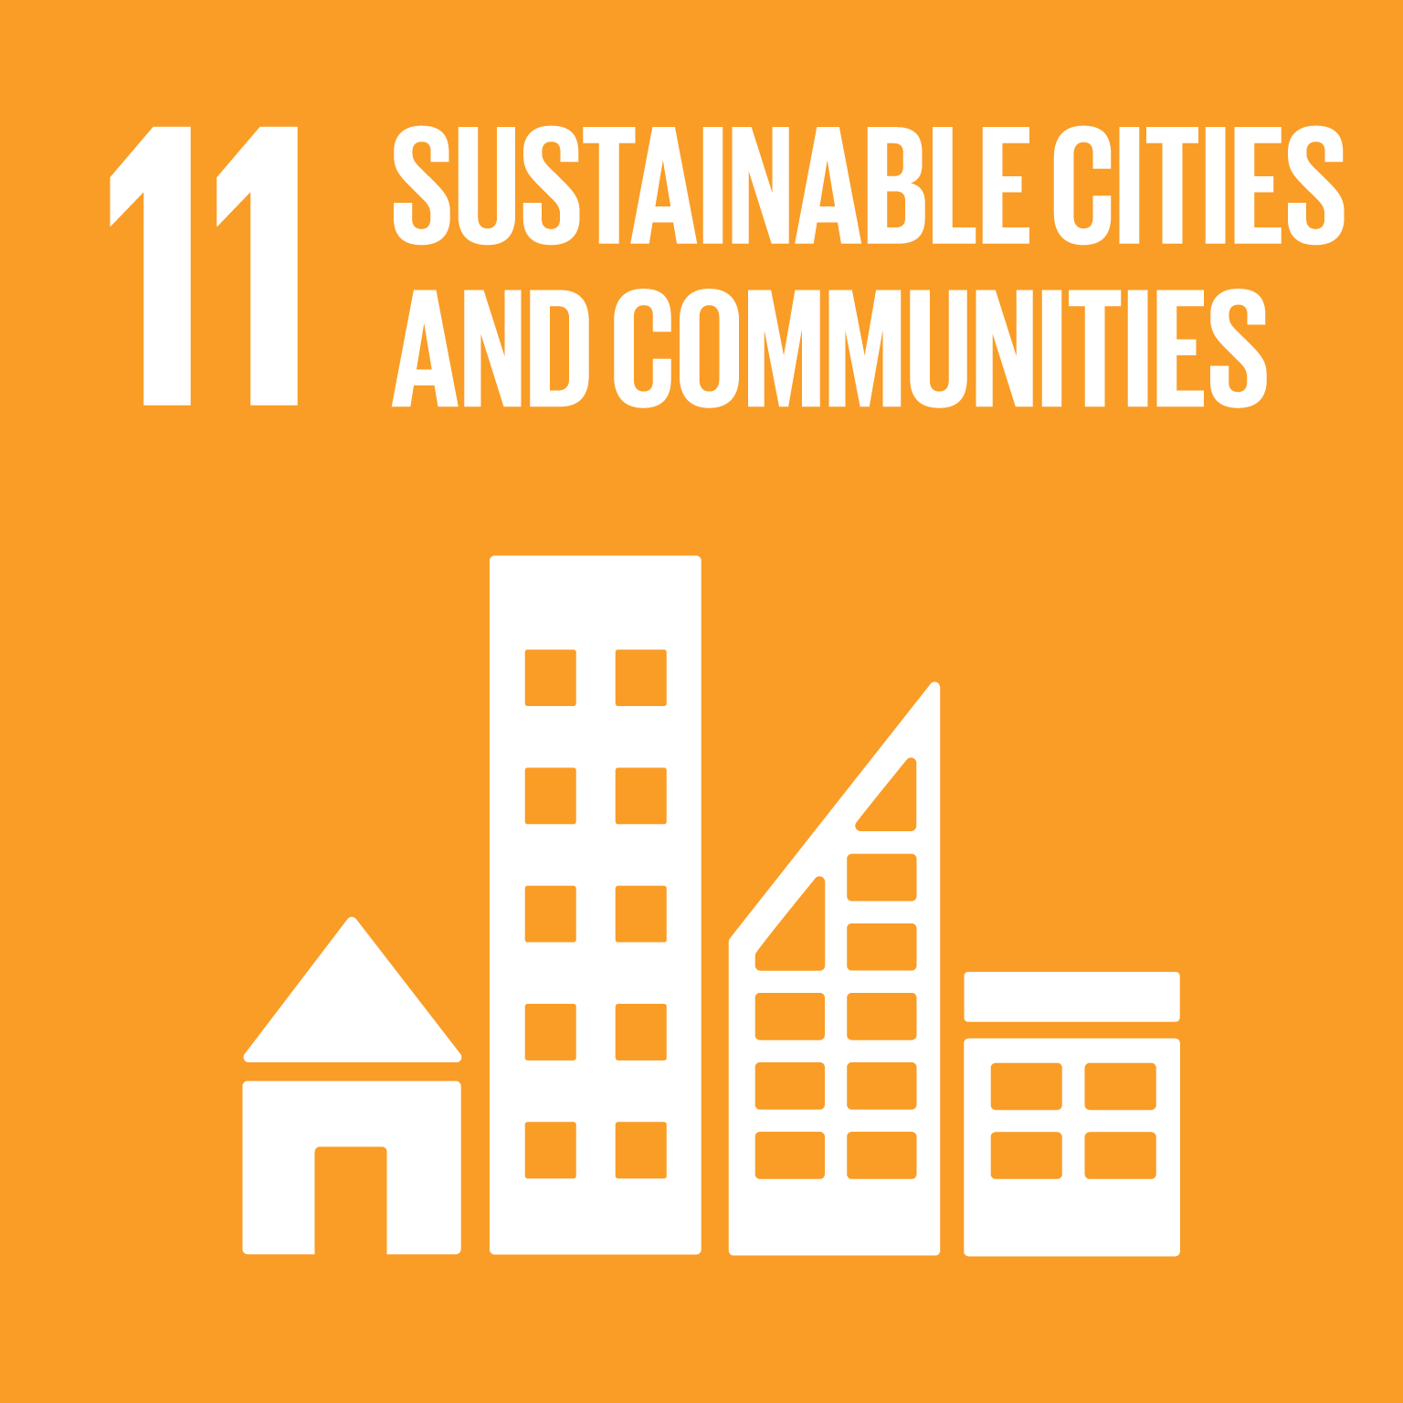
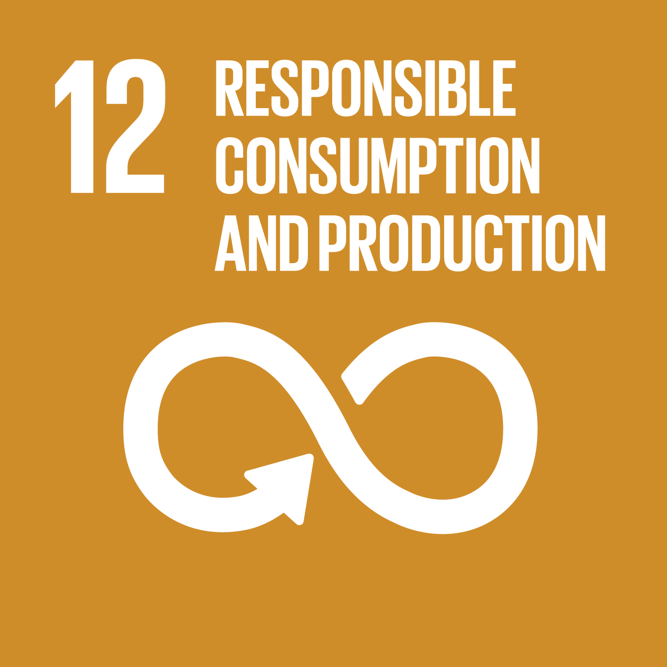
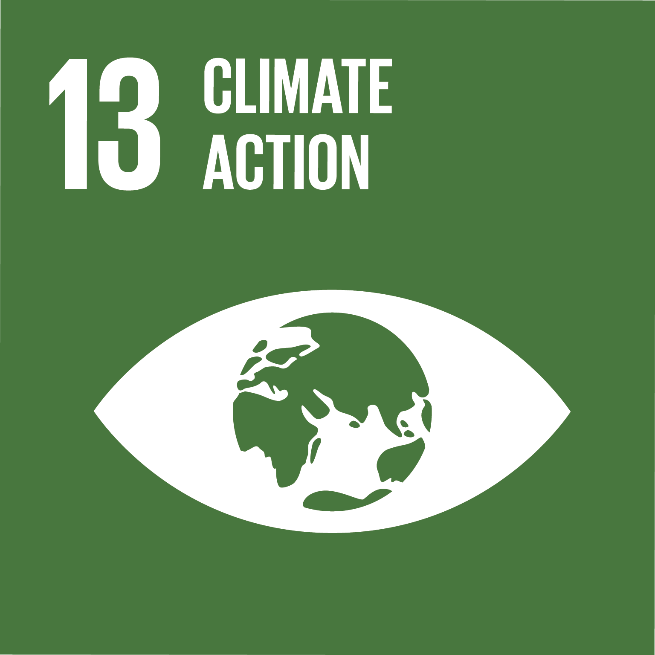
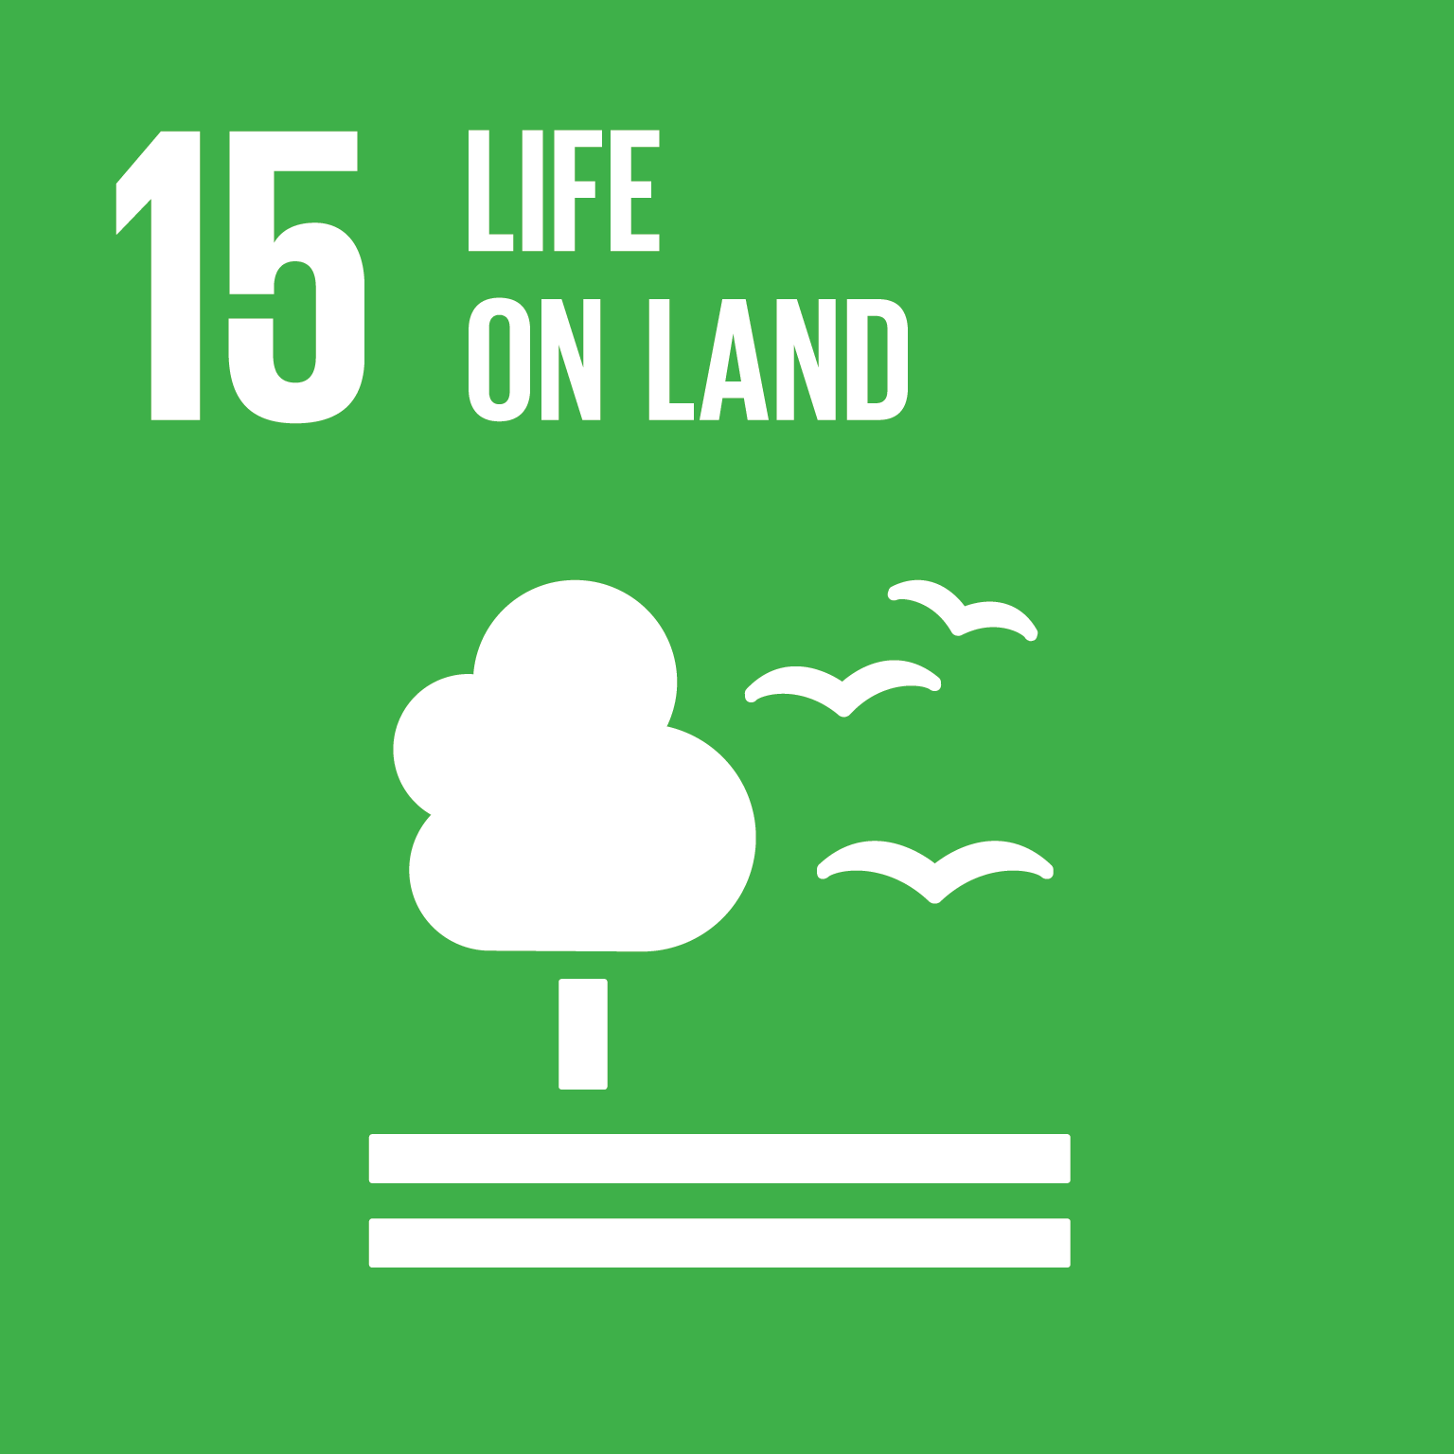
IN EUROPE
The European Union is moving on too slowly compared to the objectives of 2030.
Between 2010 and 2018, the situation in Europe improved in the following objectives:
It got worse in these objectives:
And for the other objective the situation was stable.
In the following years, due to the pandemic, the situation has got worse but today it seems to improving.

Slide 5
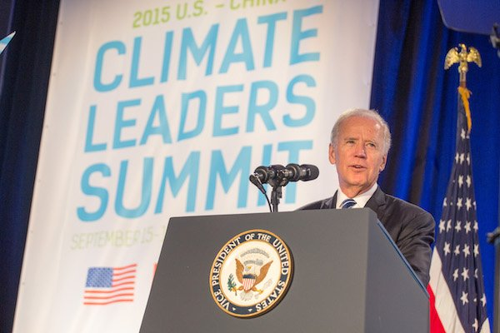
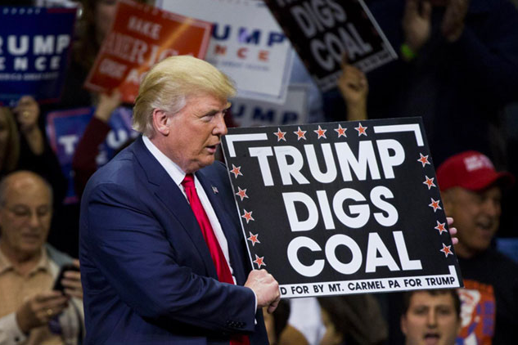
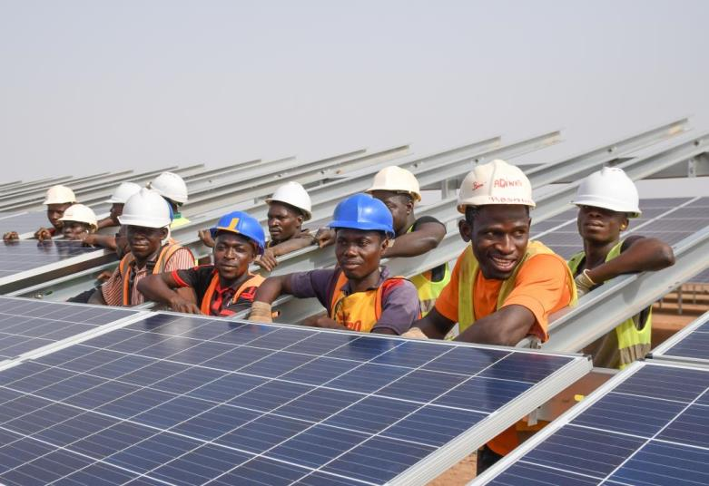
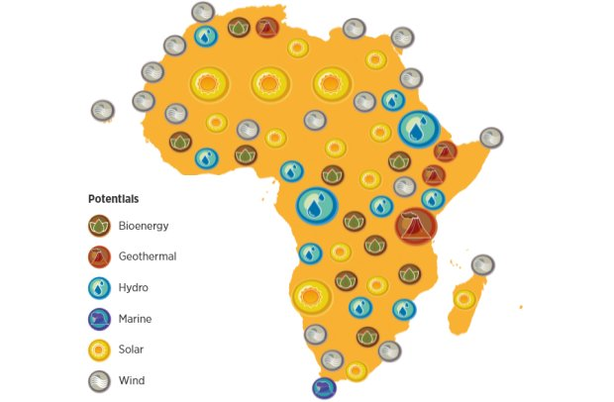
BEYOND EUROPE
USA has been influenced by the Trump’s presidential government that has slowed down the development of this project. Now with the collaboration of the new president Biden, the situation seems to be able to improve. In general, we can say that the situation in USA is medium-negative
Regarding outside Europe we know that in the poorest areas already in difficult, the achievement of this objective is more difficult (Asia, Africa, South America). Also the fact that most of these areas are always involved in internal wars, it doesn’t allow sustainable development and the governments prefer not to take responsibilities; but the fact that in these areas people live on farming and the energy is renewable, it influences positively the goals about the climate.

Slide 6
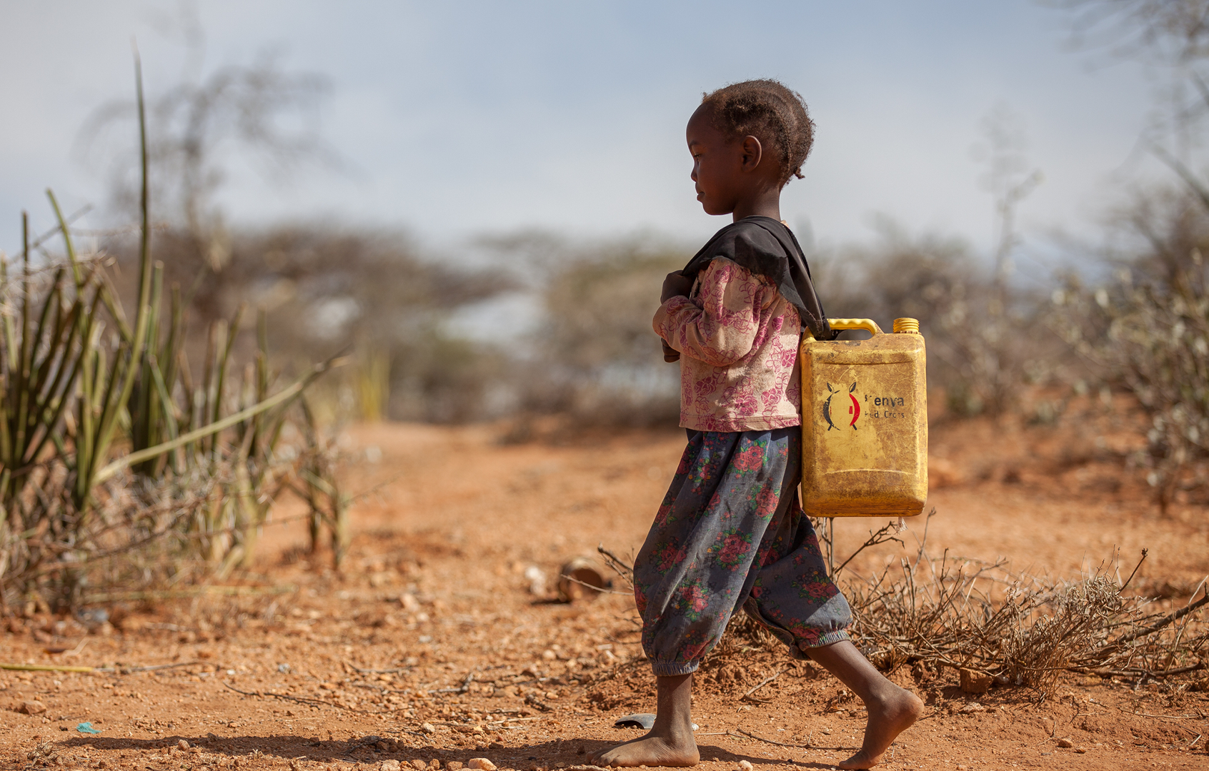
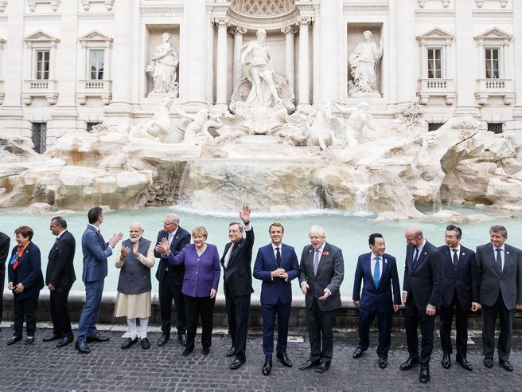
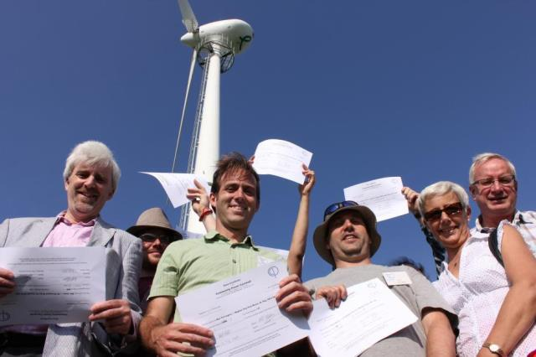
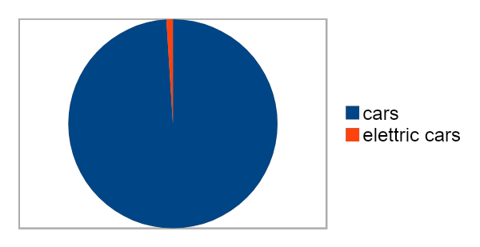
SOME EXAMPLES OF THE PRESENT SITUATION IN THE WHOLE WORLD
In Africa, climate change hasn’t allowed rainy seasons for two years, so agriculture is negatively affected;
Most of the countries of Asia affirm that in the past years, the west has polluted more, so they feel allowed not to set sustainable goals (China, India);
A lot of plastic free islands have been created (for example Procida) and in Denmark 100% of the population use renewable energy;
The spread of electric cars is difficult due to excessive cost.
In the G20 meeting of Rome the 20 presidents talked about these goals and they admitted the fact that the world is late, so they promised that they’ll try to reach these objectives with collaboration;
(only 1% of elettric cars)

Slide 7
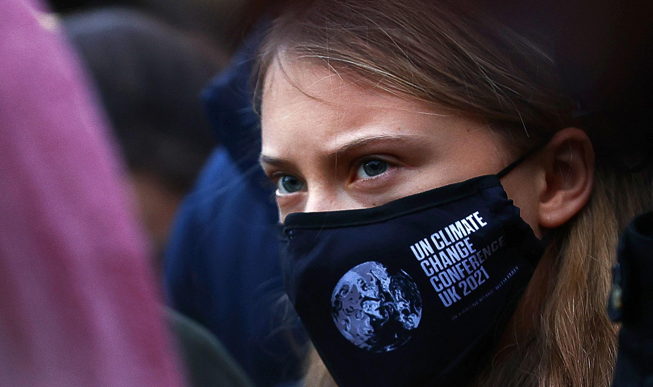
G20 AND COP26 RESULTS
In the summits of G20 (30 - 31 Oct. 2021, Rome) and Cop26 (31 Oct - 12 Nov 2021, Glasgow) the presidents of plenty of countries and also a lot of militants, talked about all the problems that are involving our planet.
These are the most important results of their meetings.
hold the increasing in the global average temperature below 2° above pre-industrial levels and limit this temperature increase to 1.5° (so they confirmed the Paris Agreement);
aim of zero emissions by 2050;
phase down coal power plants;
sustain the ecological transition of developing countries and countries in trouble;
target of 40% global population vaccinated by 2021 and 70% by 2022;
plant more and more trees and plants;
achievement of a deal between USA and China which expects to limit and stop the CO2 emissions as soon as possible;
stop preventing foreign economy with few taxes or none.

Slide 8
WHAT CAN WE DO TO IMPROVE THE CURRENT SITUATION?
Donate extra food;
Do voluntary work;
Have healthy habits (sport, no smoking...);
Show to children educational and instructional films and programs and teach them important and global values (they are the future of our planet!);
Don't waste electricity and water;
Fight stereotypes and discriminations;
Use public transports and bicycles to limit CO2 emissions;
Use biodegradable products and avoid disposable products;
Limit the use of plastic and recycle it correctly.

Slide 9
CONCLUSIONS
Despite the current situation is critical and worrying, let’s keep going and let’s hope that with the collaboration of all the people of the world, we can reach these important goals which are essential for our future.
Liceo Scientifico
Scienze applicate
“G. Ferro”
a.s. 2021-2022
Work made by:
Giovanna A.
Chiara A.
Carla B.
Laura D.
Stefania S.

