Slide 1
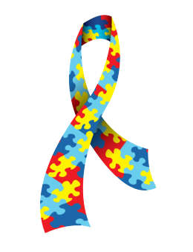
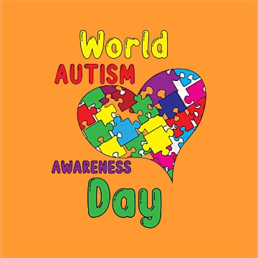
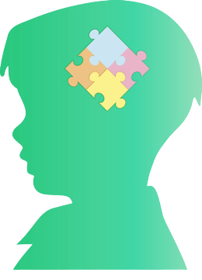
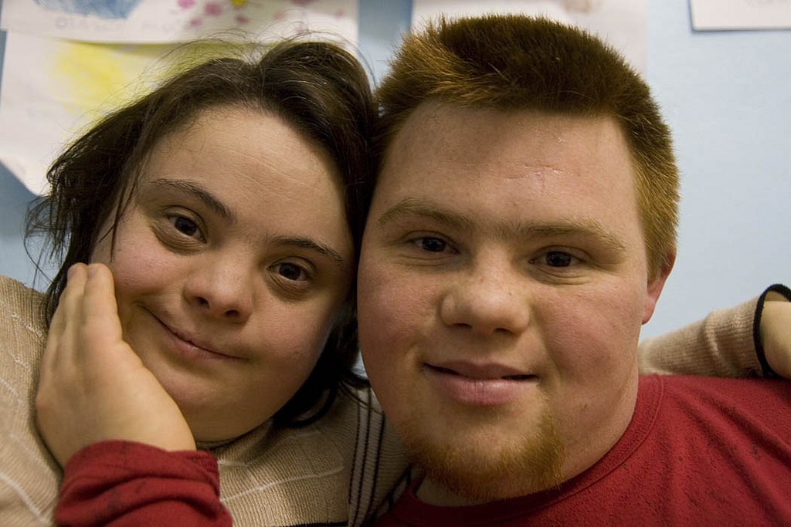
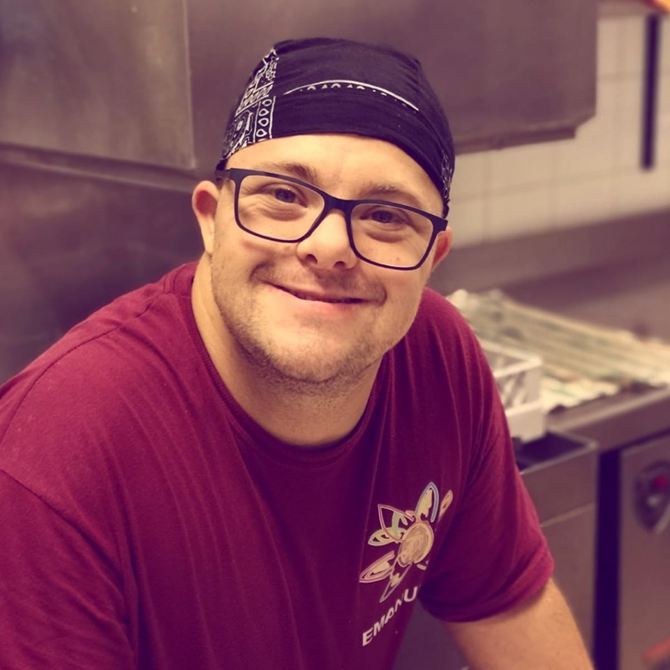
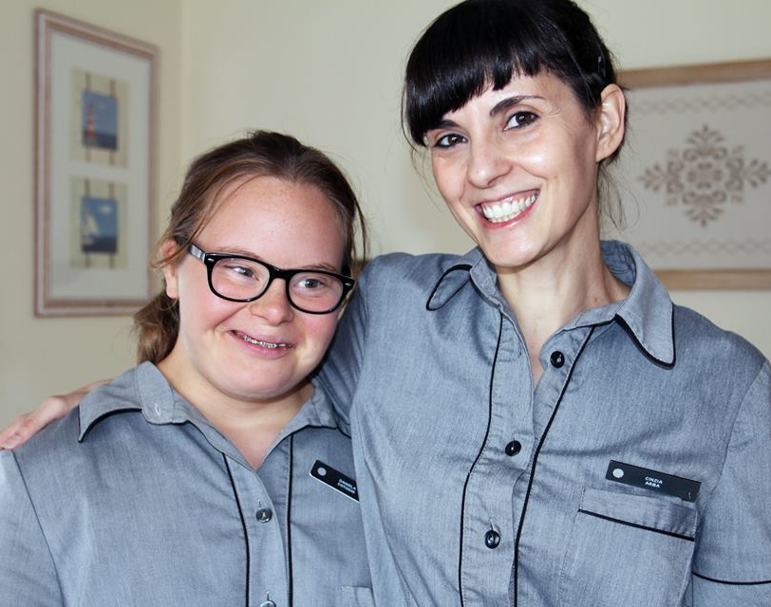
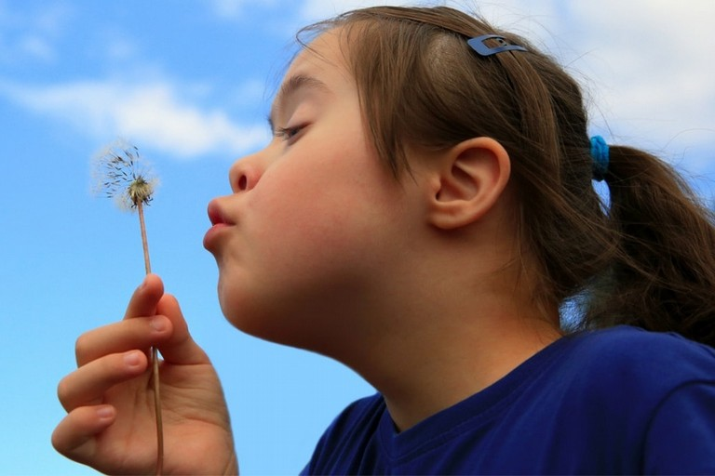
AUTISM AWARENESS DAY
People with autism don’t need awareness.
What they need is:
Acceptance
Understanding
Tolerance
Inclusion
Satisfaction and
Meaning
as part of their everyday life.
«Just DIFFERENT not LESS»
Tarantino Martina

