Slide 1
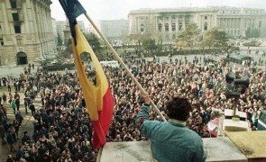
The Romanian Revolution of 1989

Slide 2
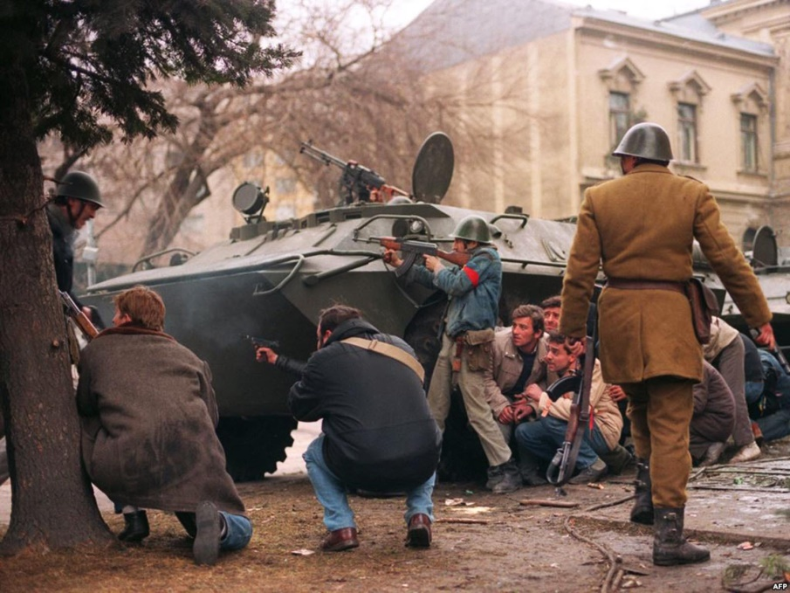
Nicolae Ceausescu-Causes
Nicolae Ceausescu ruled Romania for 21 years, earning a reputation as a brutal dictator. During his reign he developed the largest network of spies in Eastern Europe, silenced his opposition with a secret police force known as the Securitate, and eventually threw the nation into tremendous debt and economic turmoil.
Ceausescu maintained an independence from the Soviet Union that was unparalleled in the Eastern Bloc. In the late 1980s, as the Soviet Union and Eastern Bloc countries began to liberalize, Ceausescu maintained his hardline policies. In 1981, Ceausescu began an austerity program designed to enable Romania to liquidate its entire national debt ($10 billion). To achieve this, many basic goods, including gas, heat and food were rationed, which drastically reduced the standard of living in Romania. The secret police, Securitate, had become so ubiquitous as to make Romania essentially a police state. Free speech was limited and opinions that did not favor the Communist Party were forbidden. Even by Soviet bloc standards, the Securitate was exceptionally brutal.
A group of anti-Communist civilian fighters along with a Romanian soldier supporting anti-Ceausescu’s activists, protect themselves behind an armoured personnel carrier from snipers fire shot by the supposedly Securitate secret police agents loyal to the communist power .

Slide 3
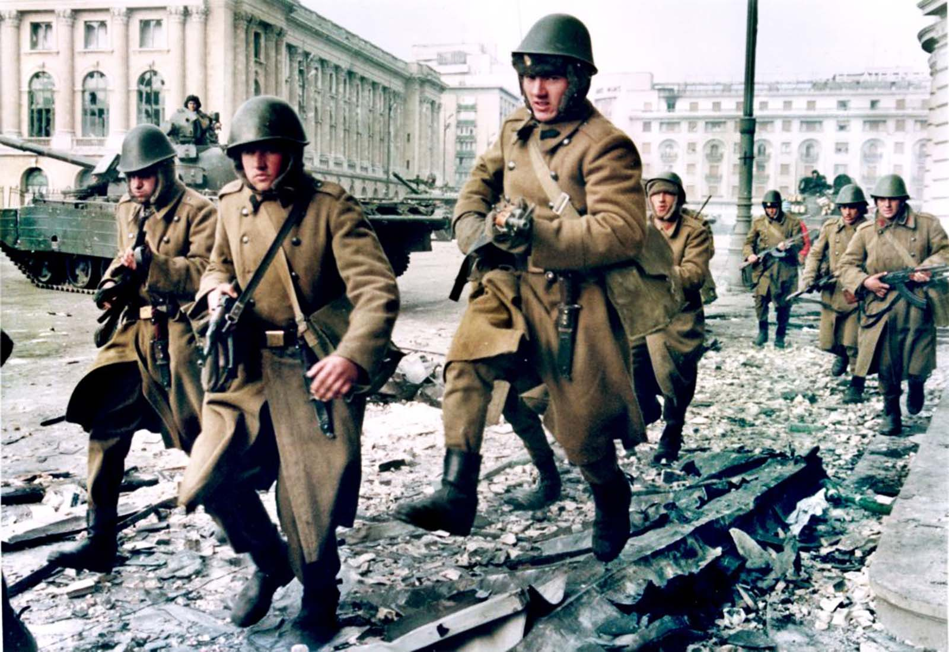
Soldiers run for cover during crossfire between pro-Ceaucescu troops and anti-regime supporters near the Republican square in Bucharest.

Slide 4
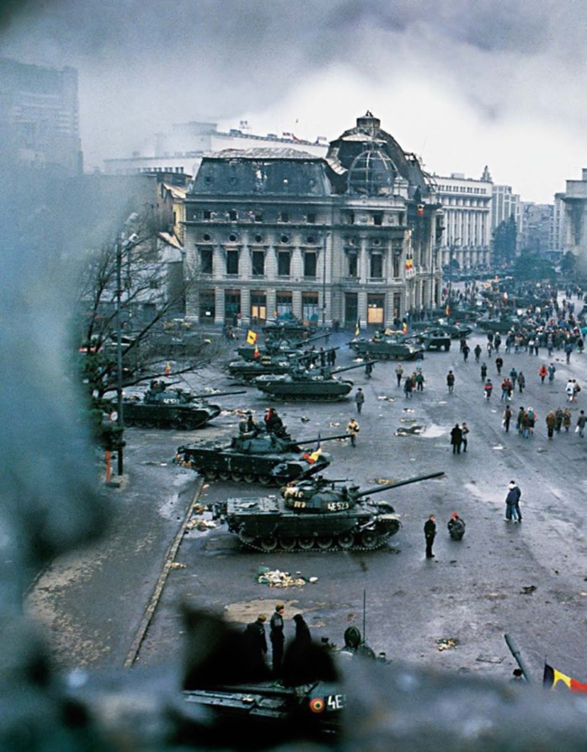
How everything it started ?
The Romanian Revolution was swifter and more violent than the other Eastern Bloc revolutions of 1989. It began on December 15 in Timisoara, when demonstrations support of dissident Hungarian priest Laszlo Tokes rapidly fomented widespread protest. Since Romania did not have riot police (Ceausescu, who genuinely believed that the Romanian people loved him, never saw the need for them), the military were sent in to control the riots because the situation was too large for the Securitate and conventional police to handle. However, the chief of minister of defense, sent soldiers in without live ammunition. The army failed to establish order.
The next day, trains loaded with workers originating from factories in the South arrived. The regime was attempting to use them to repress the mass protests, but after a brief encounter they ended up joining the protests. One worker explained: “Yesterday, our factory boss and a Party official rounded us up in the yard, handed us wooden clubs and told us that Hungarians and hooligans were devastating Timișoara and that it is our duty to go there and help crush the riots. But I realized that wasn’t the truth”.
View of tanks and damaged buildings in Bucharest’s central square during the Romanian Revolution.

Slide 5
On the morning of 21 December Ceausescu addressed an assembly of approximately 100,000 people, to condemn the uprising in Timișoara. Party officials took great pains to make it appear that Ceausescu was still immensely popular. Thousands of workers were bussed into the square under threat of being fired. They were given red flags, banners and large pictures of Ceausescu and his wife. The crowd were given orders on where to stand, when to applaud and what to sing. The front rows of the assembly were made up of low-level Communist Party officials and members who acted as cheer-leaders.
Ceausescu’s Speech
Ceausescu blamed the Timișoara uprising on “fascist agitators”. However, Ceausescu was out of touch with his people and completely misread the crowd’s mood. The people remained unresponsive, and only the front rows supported Ceausescu with cheers and applause. Eight minutes into the speech, some in the crowd actually began to jeer, boo, whistle and utter insults at him. In response, Ceausescu raised his right hand in hopes of silencing the crowd; his stunned expression remains one of the defining moments of the end of Communism in Eastern Europe.
The entire speech was being broadcast live around Romania, and it is estimated that perhaps 76% of the nation was watching. Censors attempted to cut the live video feed, and replace it with Communist propaganda songs and video praising the Ceausescu regime, but parts of the riots had already been broadcast and most of the Romanian people realized that something unusual was in progress. His security guard appeared, disappeared and, finally, hustled Ceausescu off the balcony. At that very moment, many everyday Romanians saw the weakness of Ceausescu’s regime for the first time.
“It is as if, in that moment, everyday Romanian’s saw the possibility, saw the reality of the weakness of Ceausescu’s regime”, according to the Center for History & New Media. “Those moments of Ceausescu’s weakness and the power of popular pressure explain why, a mere 48 hours later, Ceausescu was attempting to flee Romania, all power lost”.

Slide 6
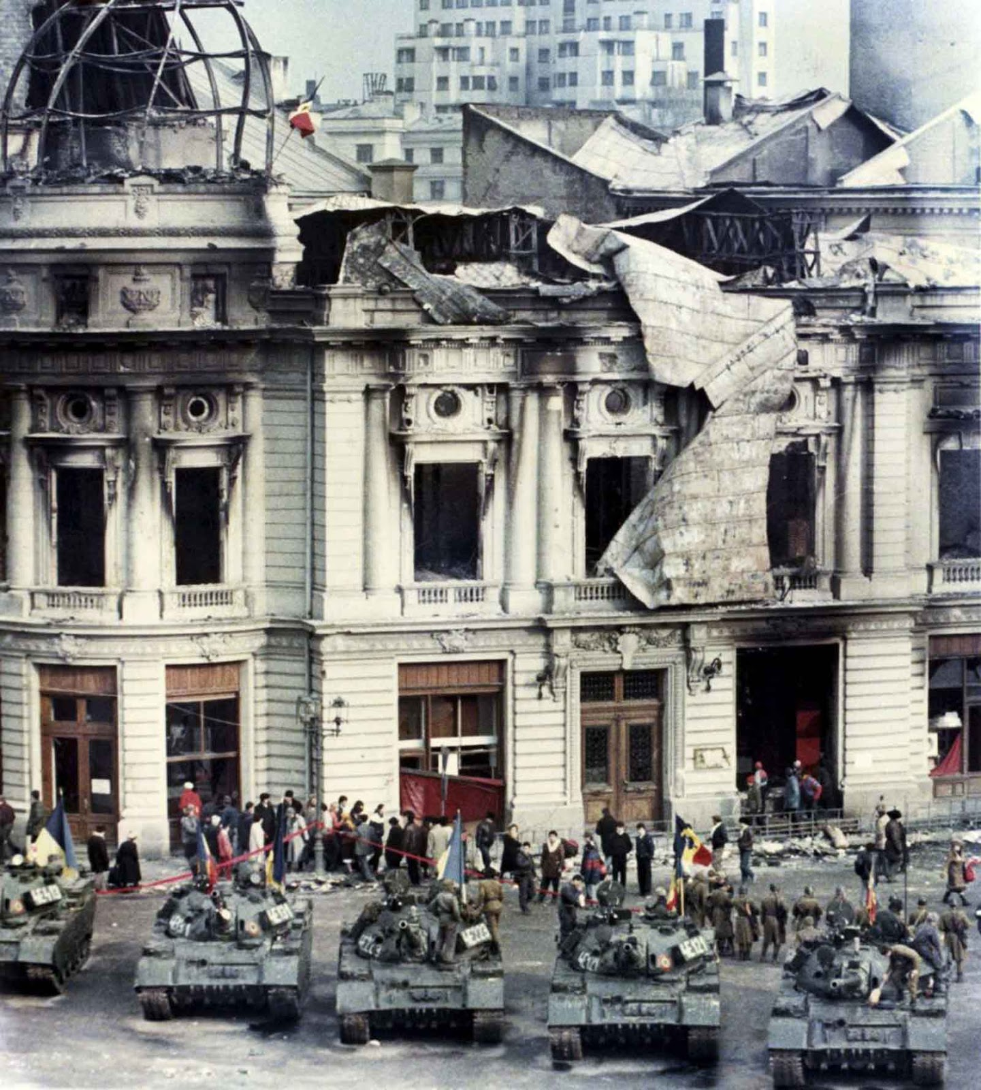
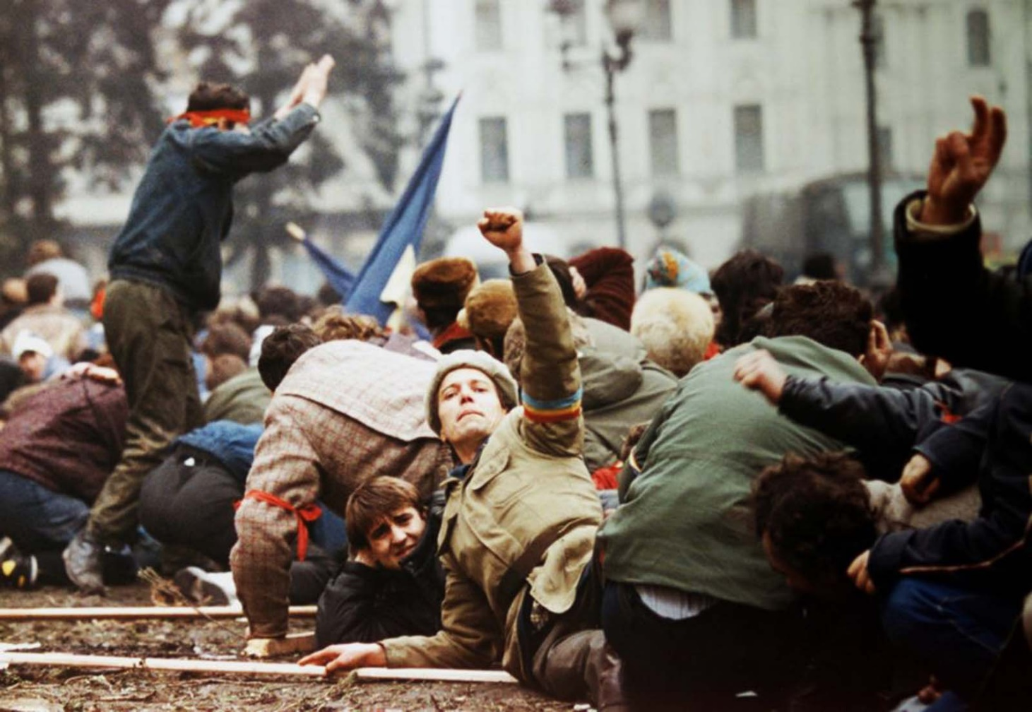
Civilians standing behind tanks after a battle between the army backed up by armed civilians and pro-Ceausescu supporters in Bucharest.
An anti-Ceaucescu revolutionary makes a V-sign as demonstrators lie on the ground to escape from the crossfire between the pro-Ceausescu troops and anti-regime supporters.

Slide 7
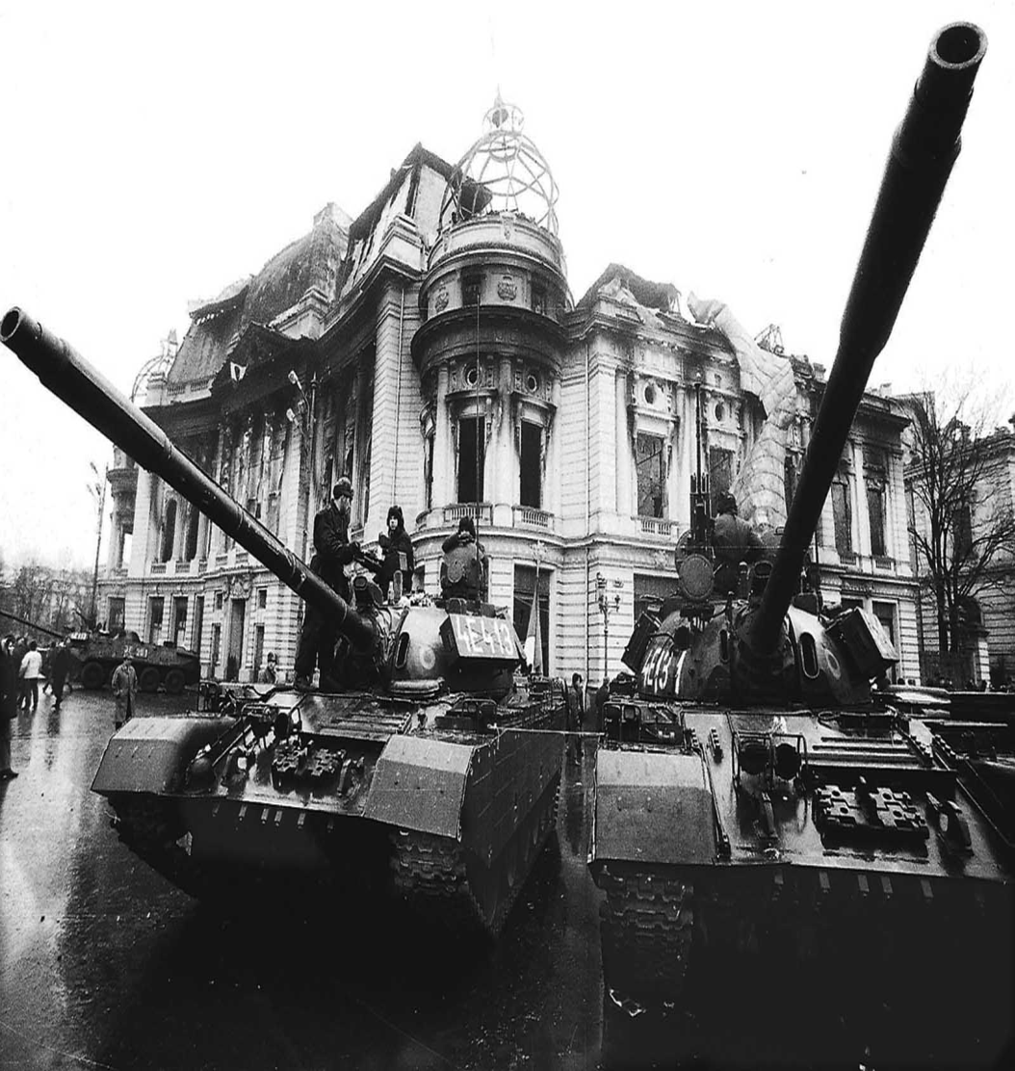
The following day, violence erupted on the streets of Bucharest. Senior generals gave up their support for Ceausescu, and the remaining loyal sections of the army and Securitate were overrun. At approximately 09:30 on the morning of December 22, Vasile Milea, Ceausescu’s minister of defense, died under suspicious circumstances. A communique by Ceausescu stated that Milea had been sacked for treason, and that he had committed suicide after his treason was revealed. The most widespread opinion at the time was that Milea hesitated to follow Ceausescu’s orders to fire on the demonstrators, even though tanks had been dispatched to downtown Bucharest that morning. Milea was already in severe disfavor with Ceausescu for initially sending soldiers to Timișoara without live ammunition. The rank-and-file soldiers believed that Milea had actually been murdered, and went over virtually en masse to the revolution. The senior commanders wrote off Ceausescu as a lost cause and made no effort to keep their men loyal to the regime. This effectively ended any chance of Ceausescu staying in power.
Tanks in front of a burned government building.

Slide 8
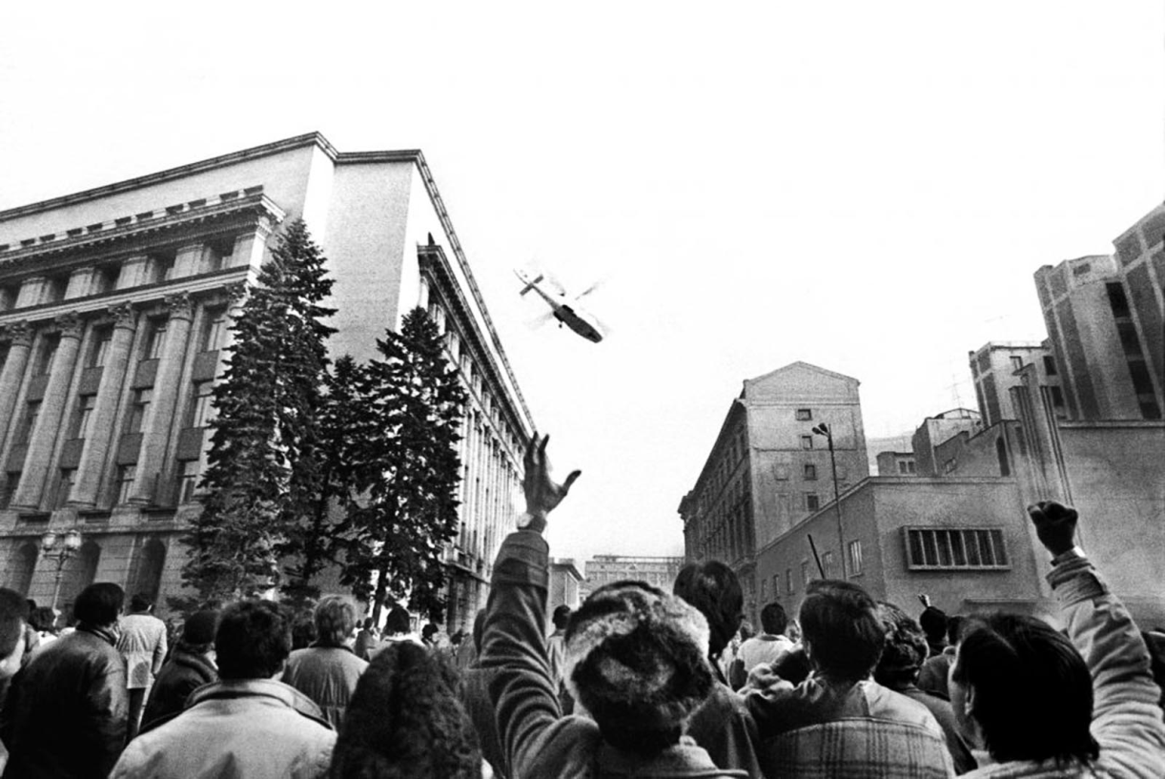
As crowds stormed Communist Party headquarters, senior officials directed the Ceausescus to escape by helicopter; the shaken couple was said to be carried aboard by bodyguards shortly after noon. The helicopter was forced to land before it could reach its intended destination because of reports that the army would shoot it down.
The Ceausescus were taken to a military base in Tergoviste and held for three days. In the chaos of Ceausescu’s ouster, the newly formed National Salvation Front (NSF), a loosely aligned organization of anti-Ceausescu forces, took control of the government with former Communist Party member Ion Iliescu as its leader.
People gesturing towards a helicopter in which the country’s communist dictator Nicolae Ceausescu fled the Romanian Communist Party Central Committee headquarters.

Slide 9
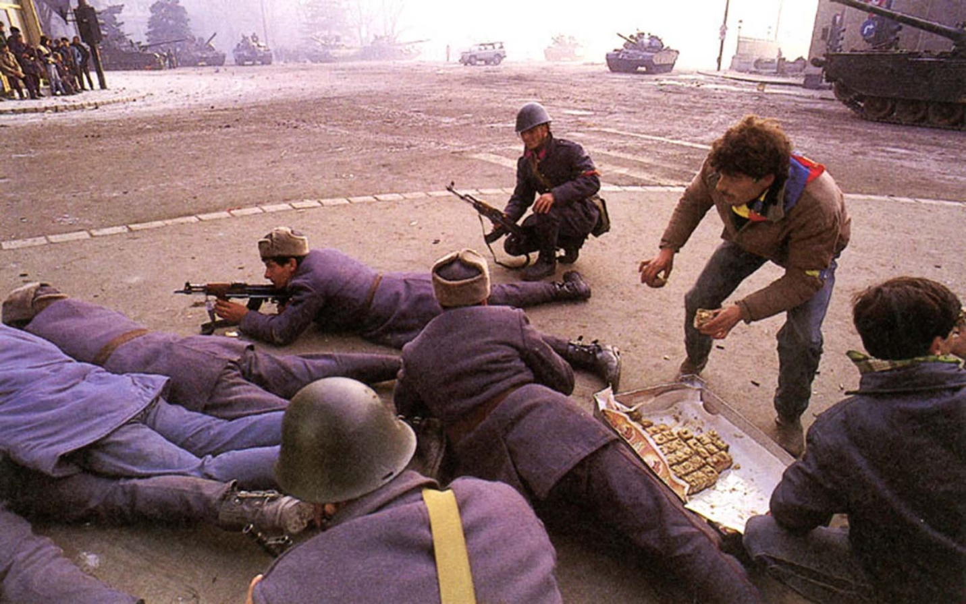
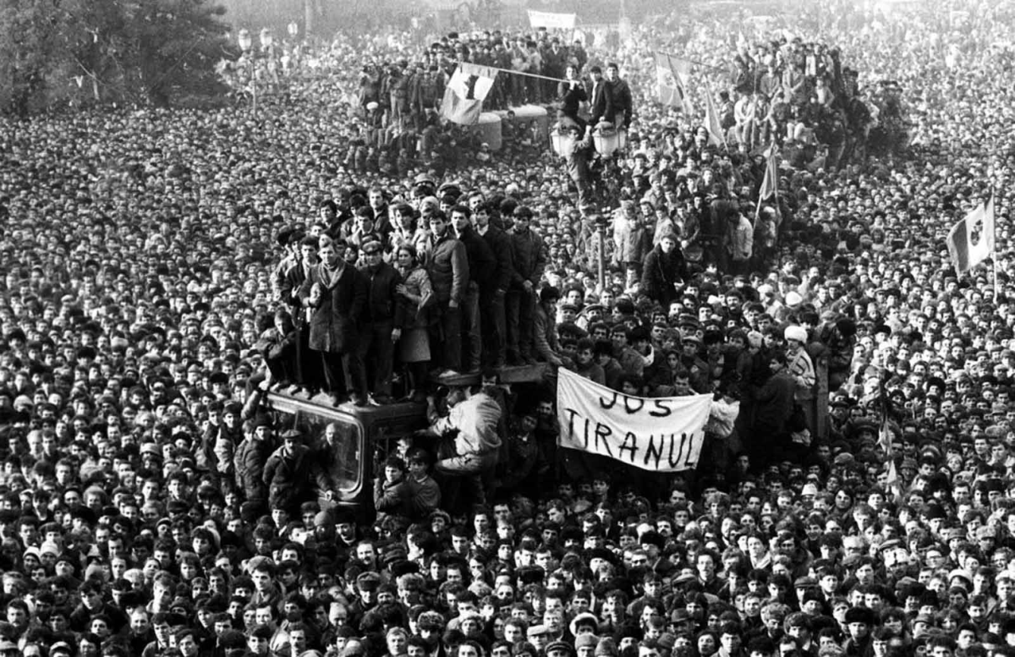
Romanian demonstrators gathered in front of the headquarter of Romanian Communist Party in Bucharest.
Cakes for the soldiers fighting against the government.

Slide 10
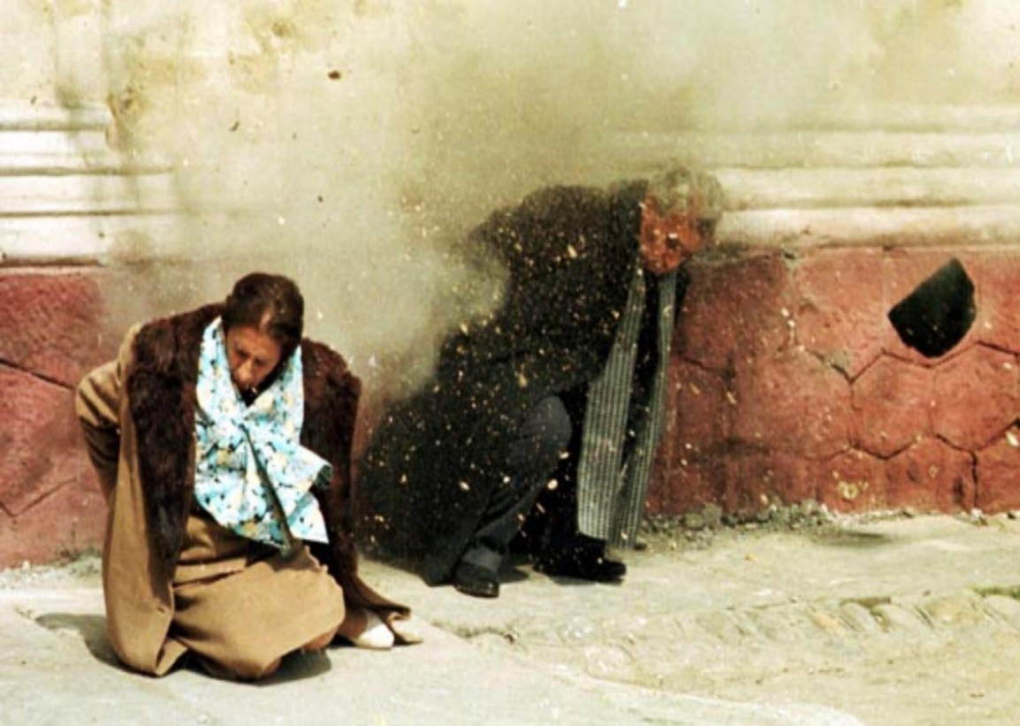
On Dec. 24, NSF leaders met secretly in a Defense Ministry bathroom and decided to try the Ceausescus before a military court in Tergoviste on Christmas Day. “The verdict, though not stated, was clear, since the firing squad traveled in the same helicopters with the judges”. After just a one-hour trial, with Iliescu present, the Ceausescus were found guilty of genocide and other crimes, and sentenced to death. They were placed against a wall and, before they could be blindfolded, shot multiple times by three soldiers. Others present would fire shots at the couple after the execution.
The Ceausescus were placed against a wall and, before they could be blindfolded, shot multiple times by three soldiers.
“They said they wanted to die together so we lined them up, took six paces back and simply opened fire”, described Octavian Gheorghiu, a member of the firing squad. “No one ordered us to start, we were just told to get it over with”.

Slide 11
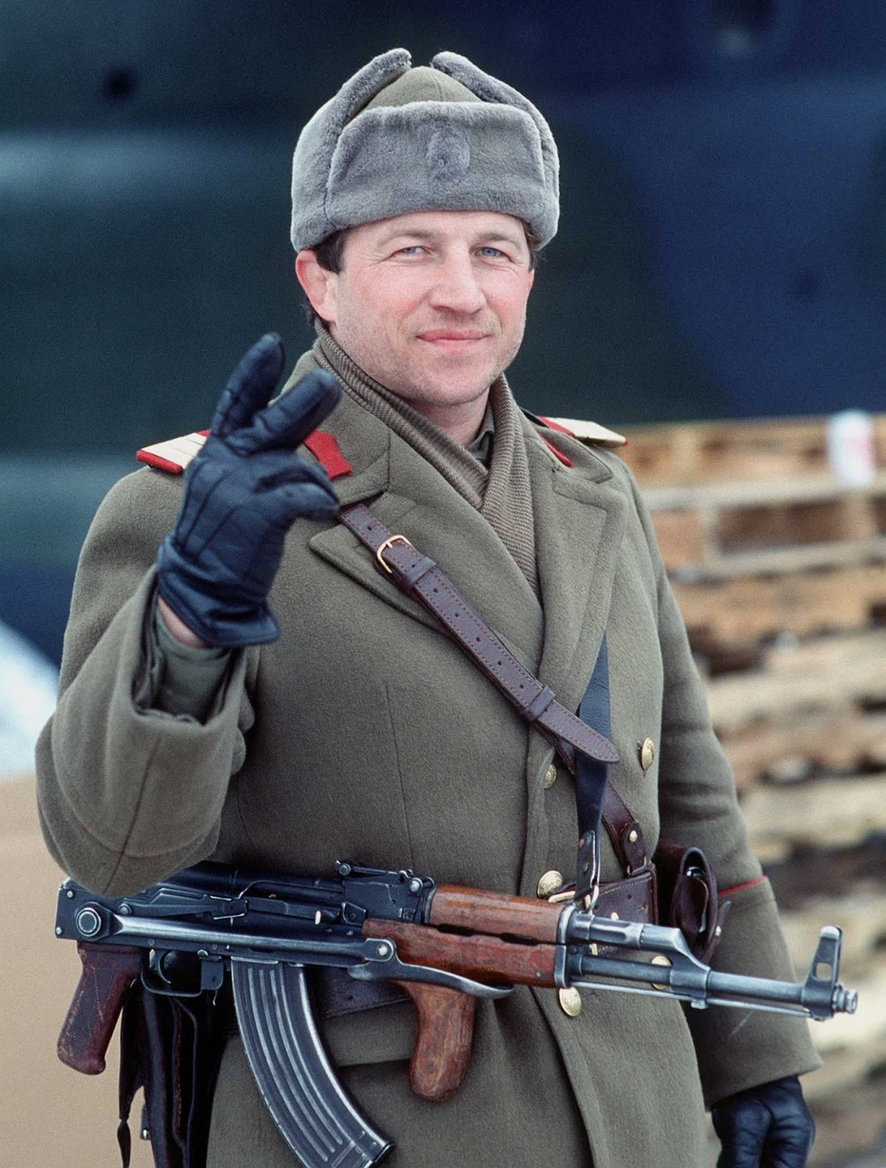
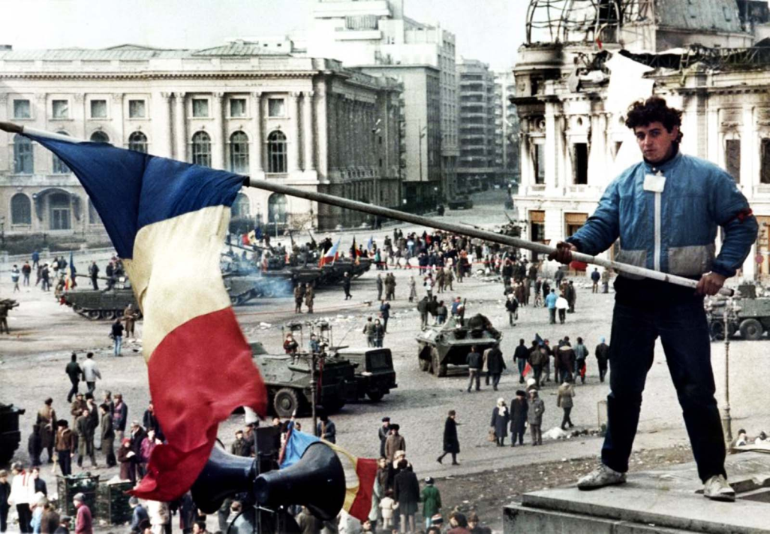
The next day, the NSF released video of the trial and pictures of the Ceausescus’ dead bodies. That same day, the lingering violence in Bucharest came to an end.
A young man waves a Romanian flag with the communist symbol cut out over Bucharest’s Republic Square on 26 December 1989, the day after Ceausescu was shot.
A Romanian soldier gives the victory sign on New Year’s Eve 1989, he has removed the communist insignia from his headwear.

Slide 12
The first year of freedom 1990

Slide 13
1990 The first year of freedom
The year’s milestones were the first free elections, held in May, and the violent crackdown of the protests in Universitatii Square, in June. 1990 was also the year when Romania made the first steps from a state-controlled and planned economy to a market economy.

