Slide 1
From Vlad Țepeș/Vlad the Impaler to count DRACULA Popa Alexandra Ștefănică Matei
Școala Gimnazială Nr. 92
Bucharest, Romania
April 2018
The European Commission support for the production of this publication does not constitute an endorsement of the contents which reflects the views only of the authors, and the Commission cannot be held responsi­ble for any use which may be made of the information contained therein.

Slide 2
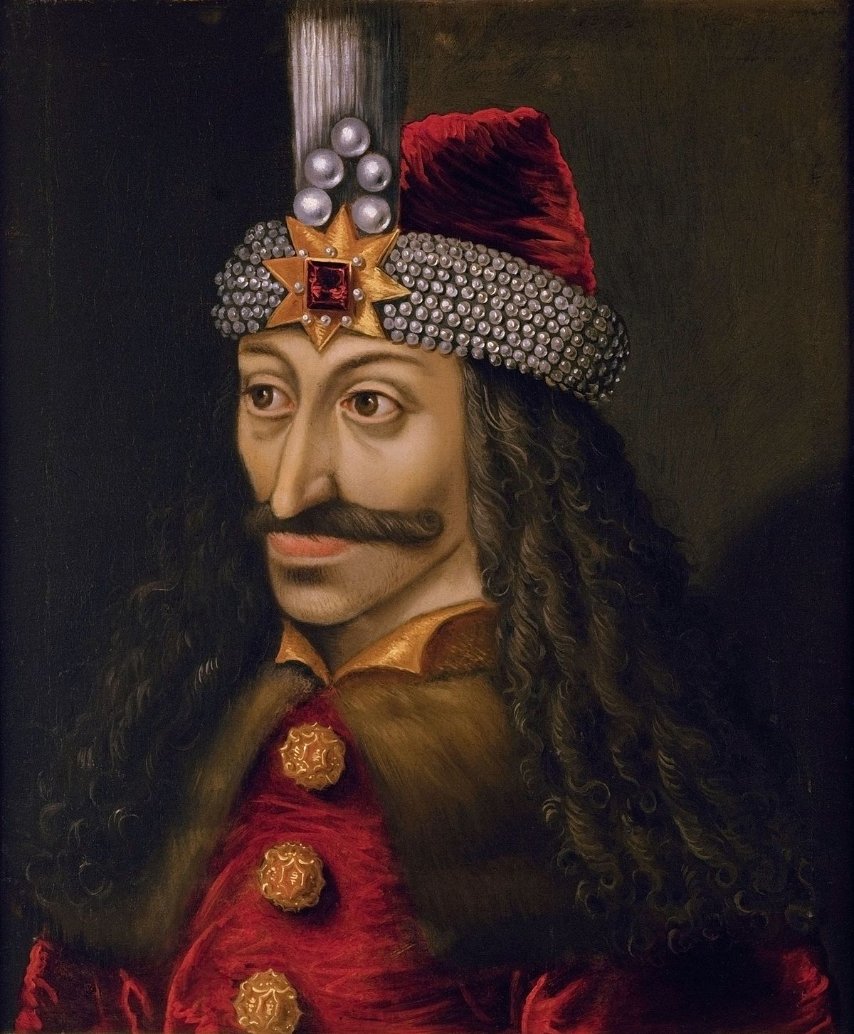
Vlad Țepeș/Vlad the Impaler
The most famous Romanian in the Middle Ages is Vlad Ţepeş. His name was known from the Ottoman Empire to the German space, being the subject of horror stories ever since his life.
His popularity was revived at the end of the nineteenth century thanks to Bram Stoker’s novel, and today we owe to Dracula the association of this character with Romania.

Slide 3
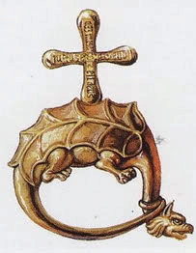
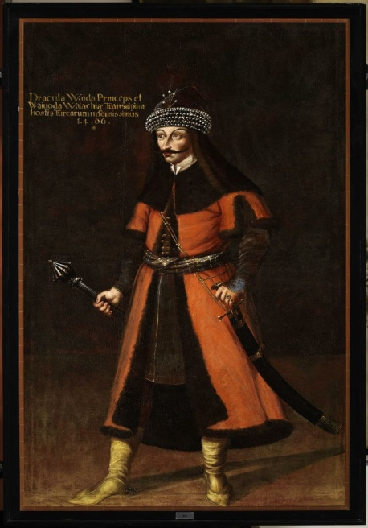
But who was he really?
Vlad Ţepeş was the son of Vlad Dracul, the ruler of Wallachia in the 15th century.
Vlad the Second, the father, had been received in the Dragon Order by Sigismund of Luxembourg, the king of Hungary and this is why he was called “DRACUL/The Dragon," from the dragon.
His son, Vlad III, was known under the name of "Dracula" or "Drăculea," in the sense of “belonging to the devil," while the Turks called him "The Impaler" because this was his favourite punishment.

Slide 4
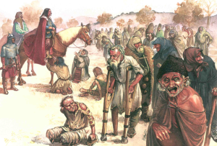
The stories about him kept in the collective memory some firm actions of the government:
In an attempt to clean up the streets of the city of Târgoviște (the capital of Wallachia), Dracula once invited all the sick, homeless and beggars over to one of his homes, under the pretext of a feast.

Slide 5
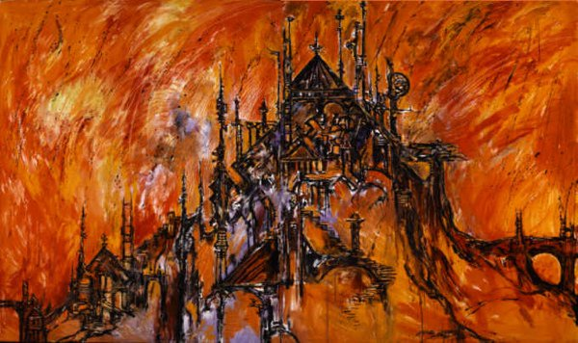
After they had eaten their fill, Dracula politely excused himself and had the entire court boarded up, then burnt the whole building to the ground while everybody was still inside.
According to the report, not a single person survived.

Slide 6
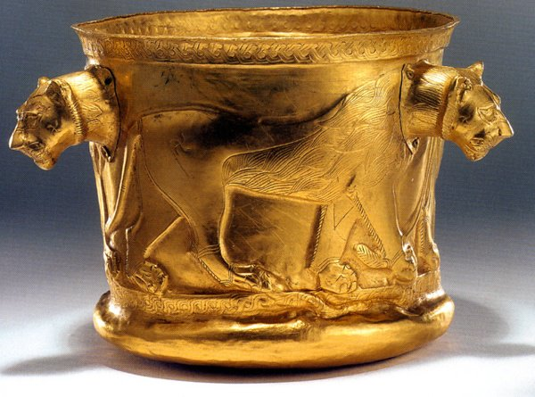
He cut off the thievery in the country
To prove how much his citizens feared him, Vlad III placed a cup made out of solid gold in the middle of the town square of Târgoviște.
The rule was that anybody could drink out of it, but it could not leave the square under any circumstances. It’s believed that during this time about 60,000 people lived in the town—yet during his entire reign, the priceless cup was never touched, even though it was in the full view of thousands of people living in poverty.

Slide 7
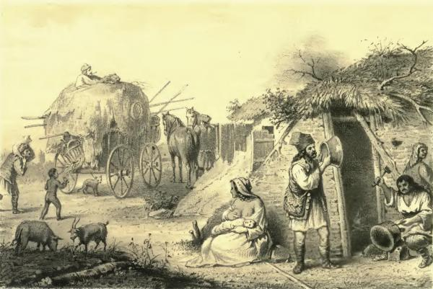
He tried to integrate the Gipsies by engaging them in the battles with the Turks.
Faced with the Ottoman threat, the voivode turned to the gipsies-slaves of the boyars and monasteries, promising them to be released if they would fight with him against the Turks.

Slide 8
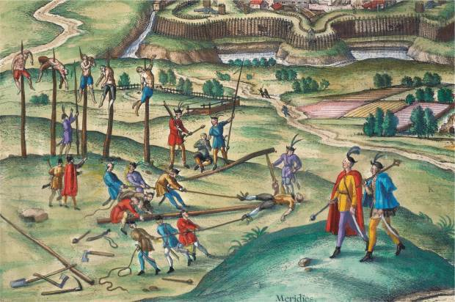
Vlad Ţepeş opted for an authoritarian rule and did not hesitate to punish the traitors, including those of the princely family.
Any suspicion of betrayal quickly ended with the punishment of the considered traitor, usually by killing and confiscating wealth.
He also punished the
enemies of the
country, Turkish
prisoners or
foreign ambassadors
who did not show him
the respect for a ruler.

Slide 9
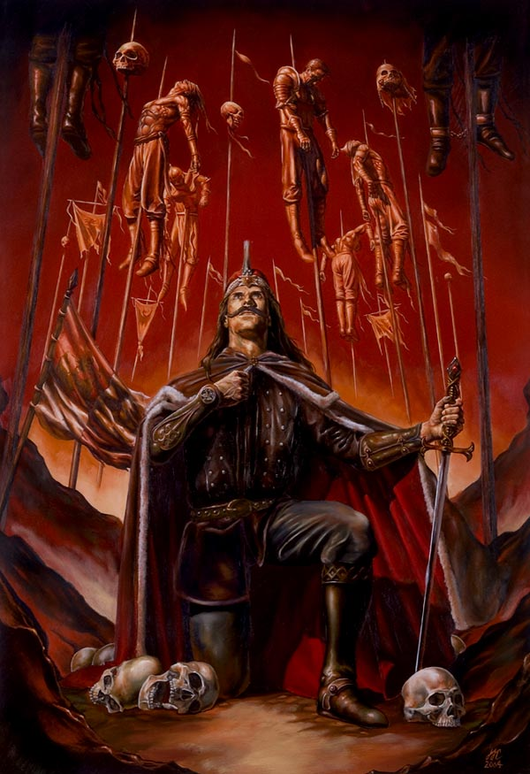
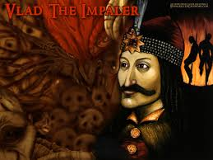
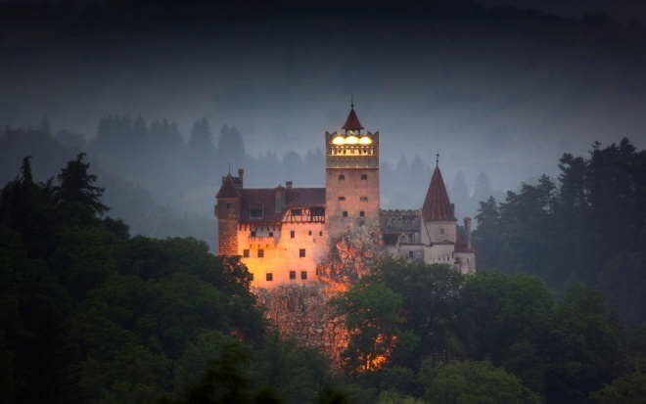
Stories about Vlad's brutal acts began circulating during his lifetime. Some of these have been exaggerated, others are completely false, and so the idea of ​​a blood-thirsty resident associated with the idea of ​​a vampire has emerged.

Slide 10
Thank you Popa Alexandra Ștefănică Matei
Școala Gimnazială Nr. 92
Bucharest, Romania
April 2018
The European Commission support for the production of this publication does not constitute an endorsement of the contents which reflects the views only of the authors, and the Commission cannot be held responsi­ble for any use which may be made of the information contained therein.

