Slide 1
Erasmus+ 2017-2019 “tracing our European spirit”

Slide 2
The First Day- Vouni
At the village we firstly had some traditional food for lunch. (souvla, koupepia, traditional salad, pourekia)
The games were the most exciting part of the day and everyone loved them. (Poland- Baba yaga, Greece-Pentavolo, Cyprus-Mantili, Romania- Casablanca, Spain-Musical chairs, Austria-Imaginary ball.)

Slide 3
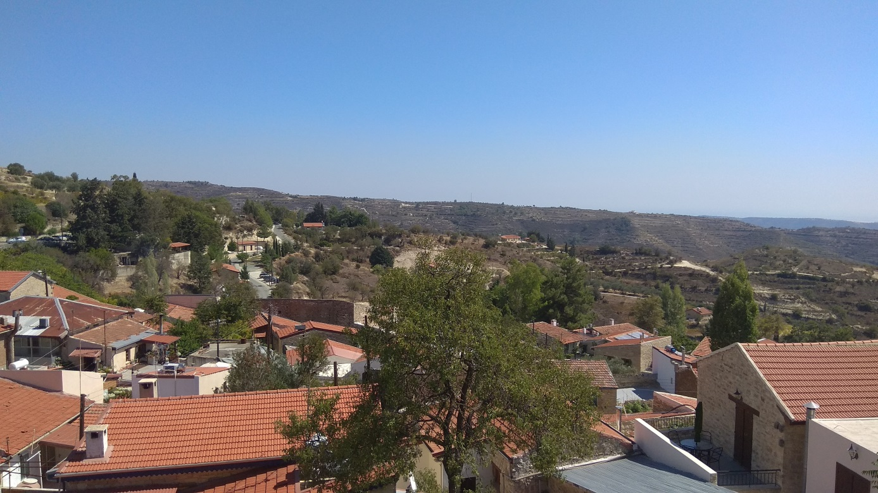
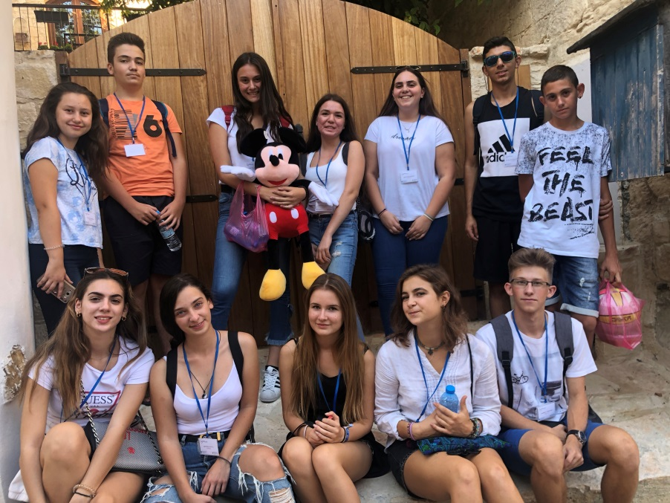
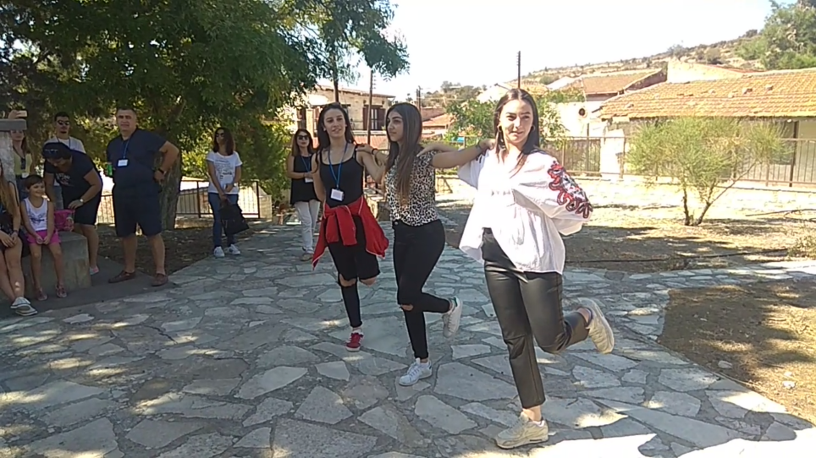

Slide 4
Day 2-Tour to Limassol
The graffiti of Pascal represents earth and it symbolises the nature and that we must respect the environment
The children and the teachers of the school are really friendly.
Everyone had the opportunity to learn the history of each country during medieval time
The medieval bowl made up from clay was an excellent chance for our art-talented students to show their skills

Slide 5
In the afternoon we went to the medieval castle of Limassol

Slide 6
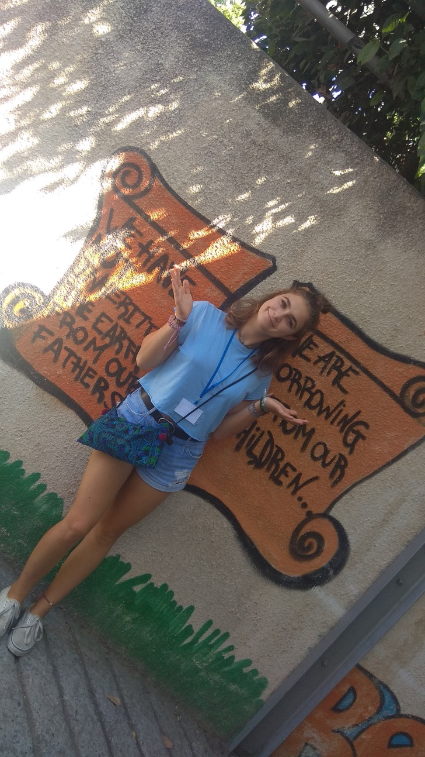
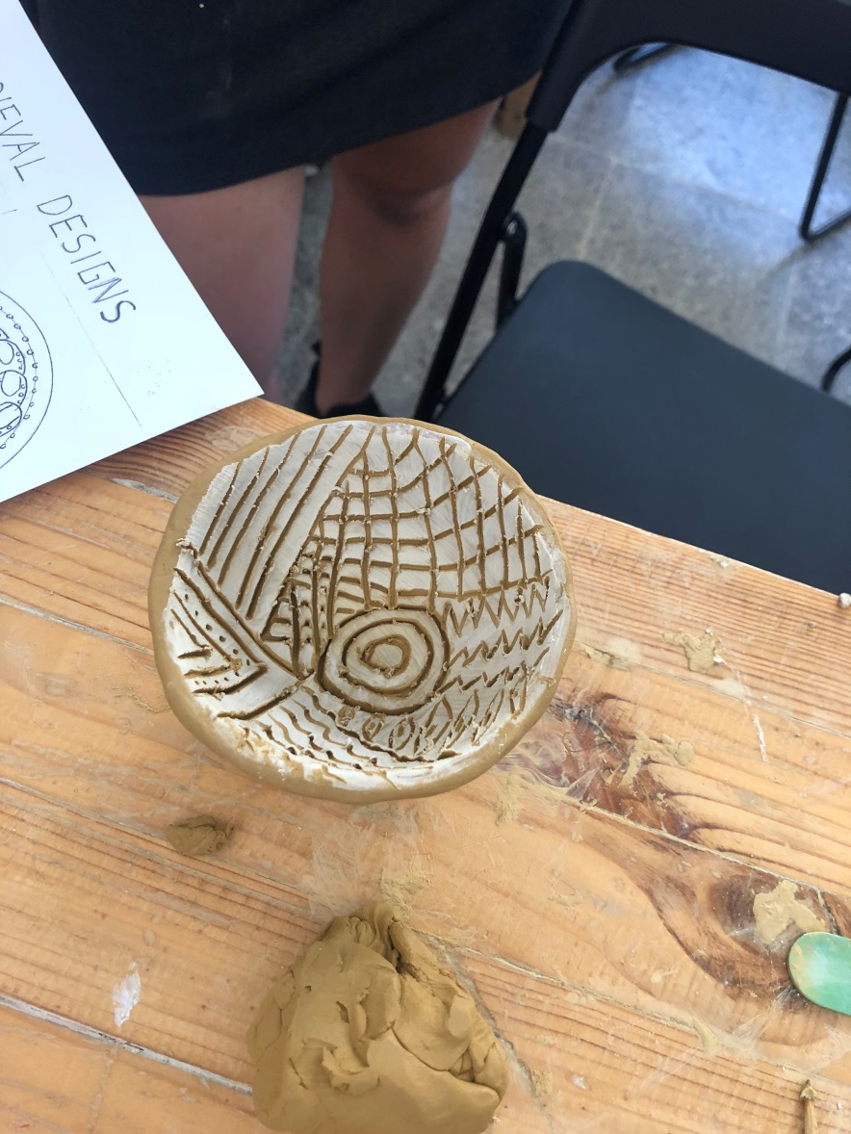

Slide 7
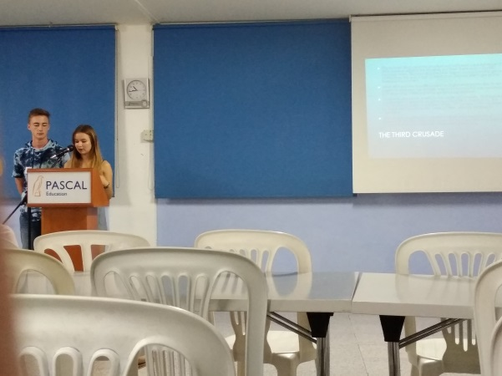
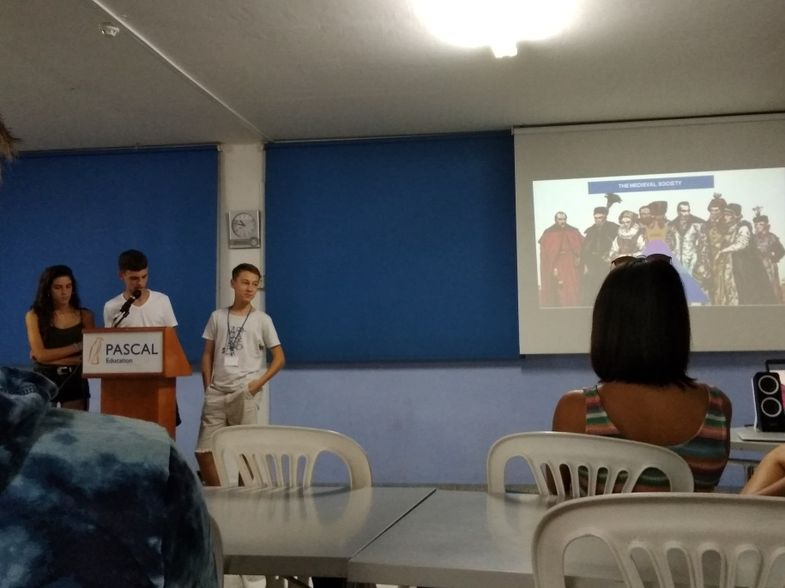
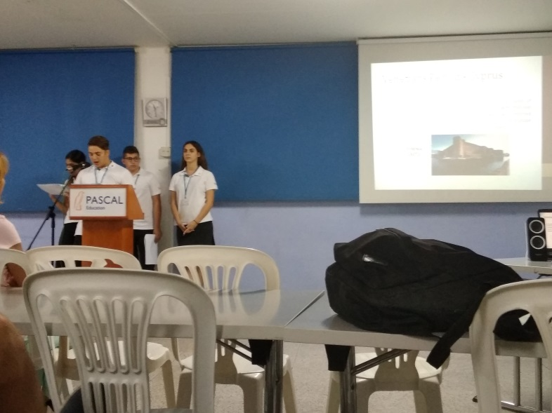
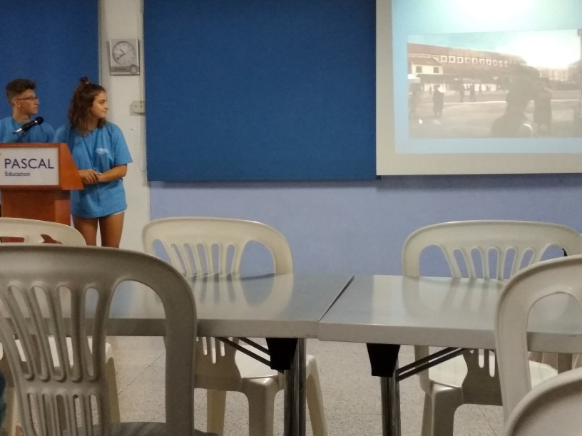

Slide 8
Day 3-Larnaka
The first place that we visited was the Folkore Museum of Kostas Kaimakliotis. There we represented how a traditional Cypriot wedding was back in that time
After we had a long tour in Larnaka; the tour included Kamares, Hala Sultan Tekke, medieval castle and the church of Saint Lazarus

Slide 9
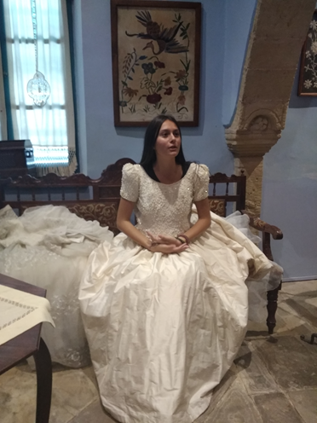
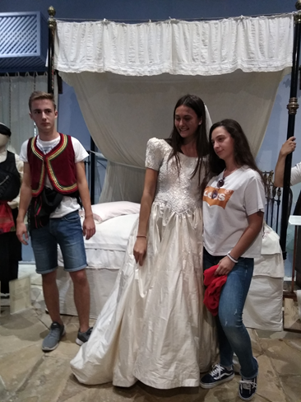
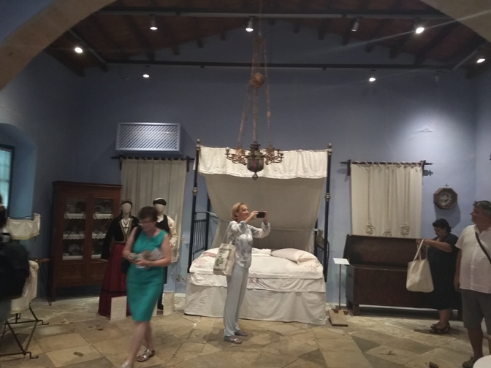

Slide 10
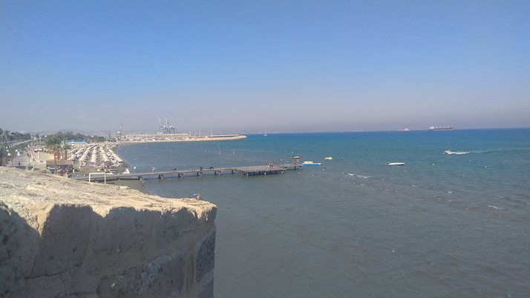
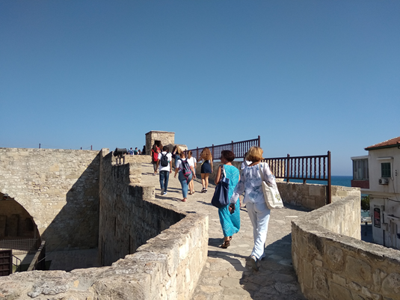

Slide 11
Day 4- Leukwsia
We had an amazing time visiting the capital city of Cyprus
We took many pictures of the Venetian walls, of the Shacolas Tower museum and of the house of Hadjigeorgakis Kornesios.
We had free time in Ledras, where we drank coffee, ate frozen yoghurt and of course bought souvenirs

Slide 12
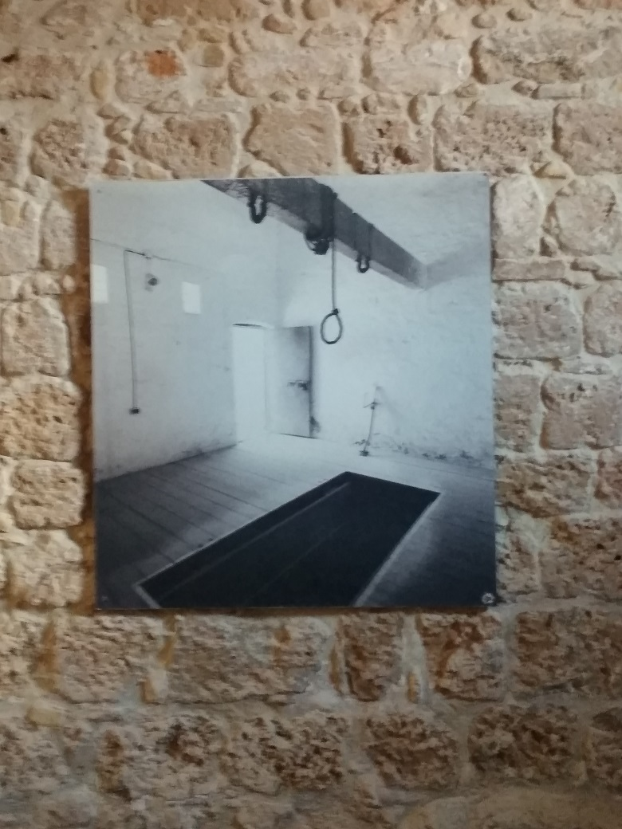
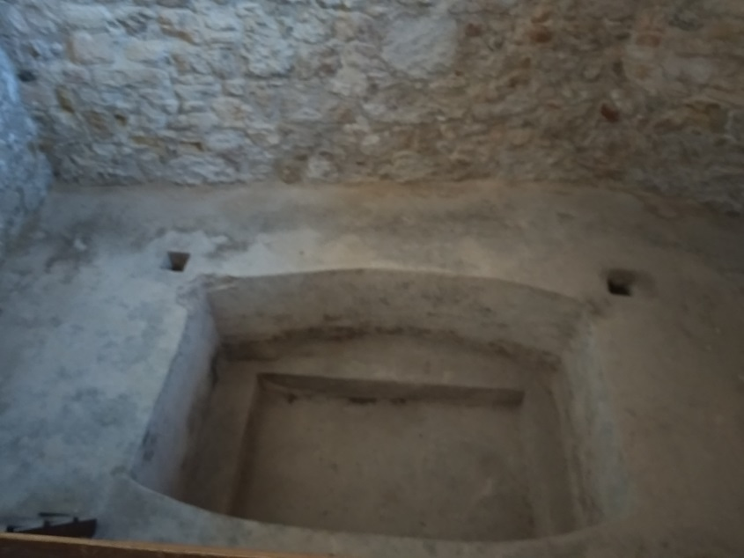

Slide 13
Day 5 mountains
An interesting activity was when we went on the teleferique.
We visited several churches which are protected by Unesco.
The restaurant where we had lunch was probably the best place we ate.

Slide 14
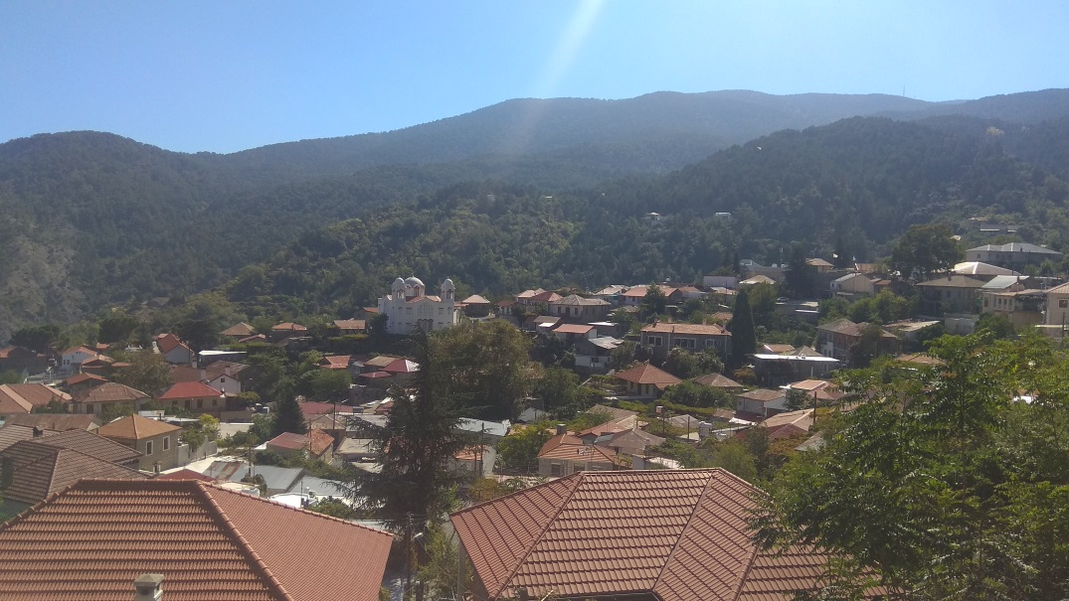
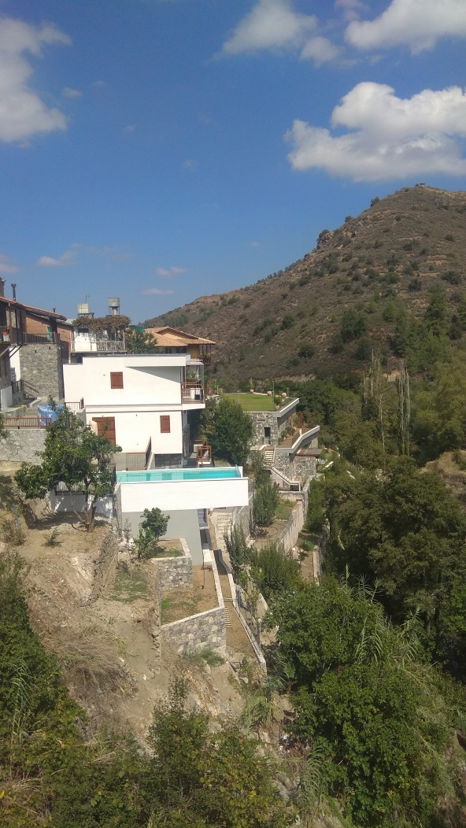

Slide 15
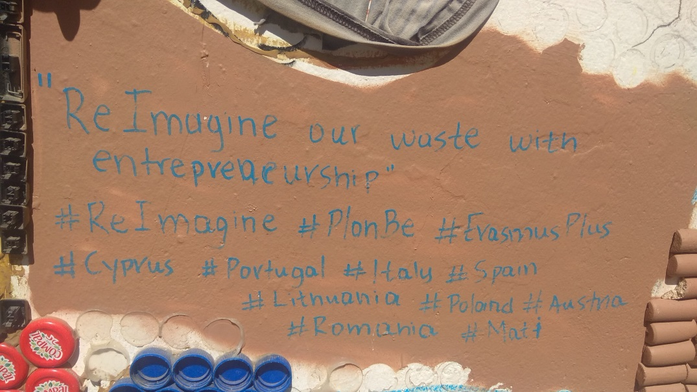
Last day in cyprus
We presented the information we gathered throughout the week.
Thank you for your attention and we hope you had a great time! ☺
Sofia Fitrolaki
Anastasios Aspris
Hubert Tymoszuk
Eirini Koumbarou
Loizos Chrysostomou
Alexander Ioana
Michalis Theocharous

