Slide 1
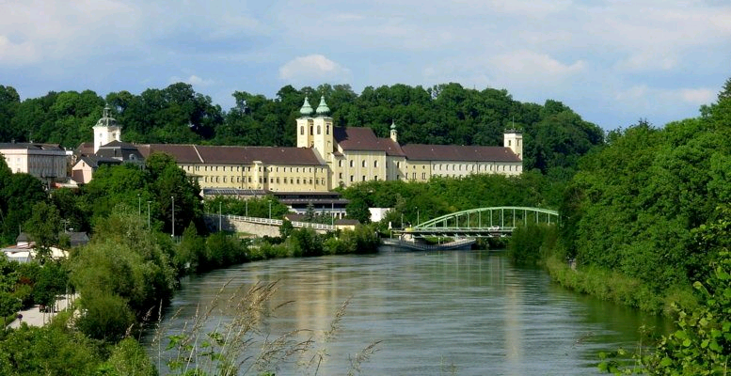
Lambach and its monastery in the Medieval Ages
Transnational Learning Activity in Lambach, Austria,
14-21 April 2018
Dieses Projekt wurde mit Unterstützung der Europäischen Kommission finanziert. Die Verantwortung für den Inhalt dieser Veröffentlichung (Mitteilung) trägt allein der Verfasser; die Kommission haftet nicht für die weitere Verwendung der darin enthaltenen Angaben.
This project has been funded with support from the European Commission. This publication [communication] reflects the views only of the author, and the Commission cannot be held responsible for any use which may be made of the information contained therein.

Slide 2
Founding history of our monastery
Founded by Graf Arnold II. 1046
Christian community
Bishop Adalbero
1056 Adalbero from Würzburg turned it into a Benedictine monastery
Bones of St. Adalbero are still resting in Lambach

Slide 3
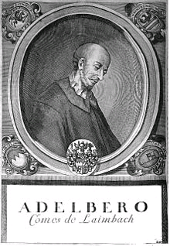
St. Adalbero
Important role in the investiture dispute
Died 1090
Was buried in Lambach

Slide 4
History of monasteries in general
5th century monasteries leading back to Benedikt from Nursia
Played an important role for everyone
People joined monasteries -> God dedicated life
Monks and nuns:
agricultural and spiritual work
took care of the sick and the ones in need
documented cultural events, did services for education
founded schools in their buildings
Lost their original meaning, still important today

Slide 5
Conflict of Investitures
(Investitures = power whom to put into church offices)

Slide 6
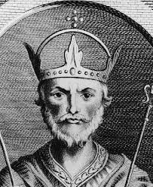
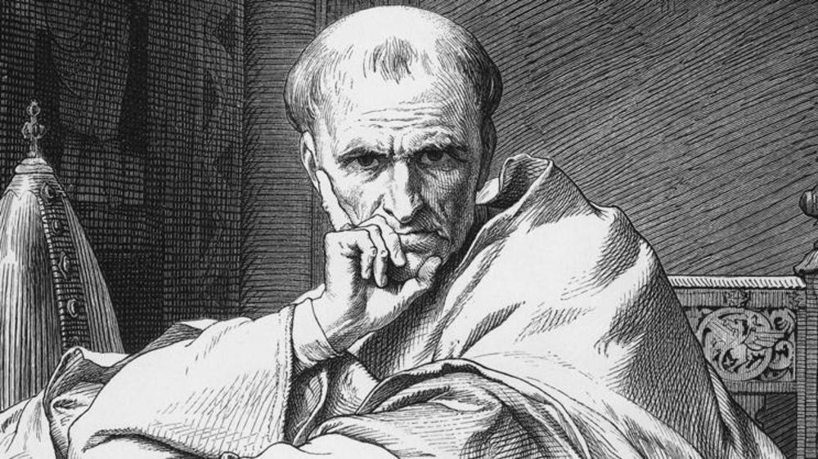
conflict between holy roman emperor and pope
Emperor Heinrich IV.
Pope Gregor VII.

Slide 7
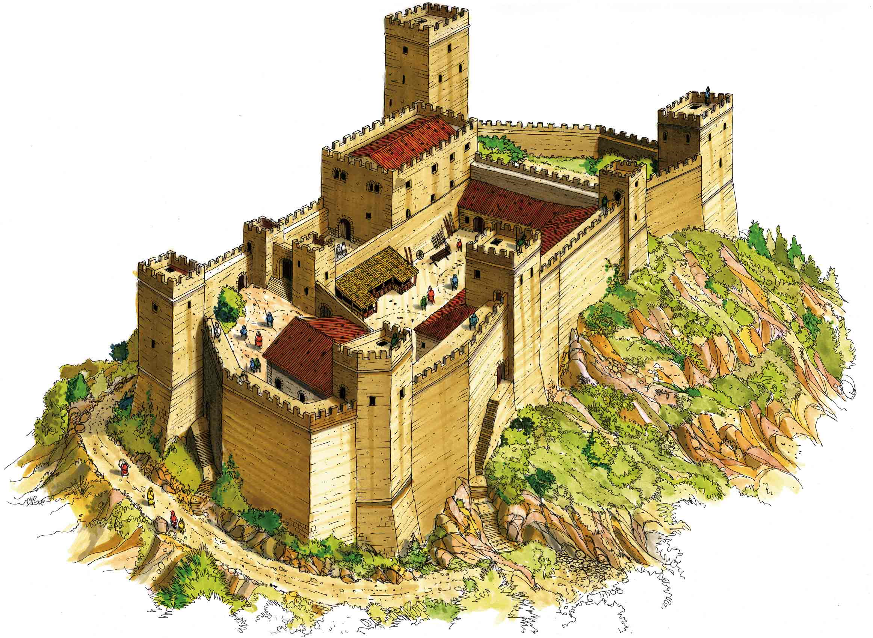
The conflict
Gregor wanted full control so he decided to take away Heinrich‘s power
Heinrich wrote him an insulting complaint letter
Gregor prayed and excluded him from church
Heinrich was humiliated, so he walked to Canossa to ask for forgiveness
Gregor gained more power, but Heinrich expelled him as a revenge and chose someone else as a second pope
Castle of Canossa

Slide 8
Conflict of Investitures concerning Lambach

Slide 9
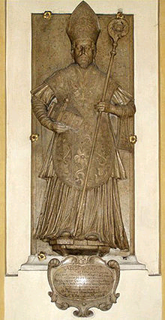
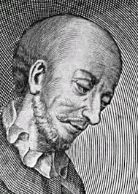
Adalbero
Supported the pope
Caused controversy since Heinrich was
his local ruler
The frescos in Lambach show biblical
scenes which refer to important events
between Adalbero and Heinrich

Slide 10
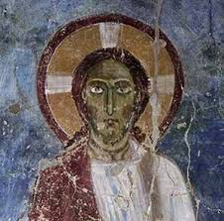
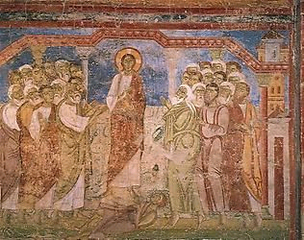
Frescos in Lambach
Seperated through three rays of light (represents the three times he got expelled from the church)

Slide 11
Gmunden– Tuesday

Slide 12
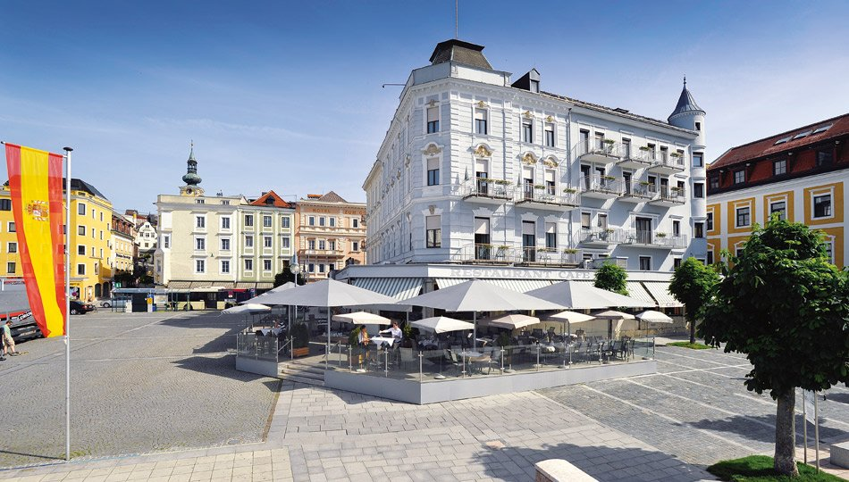
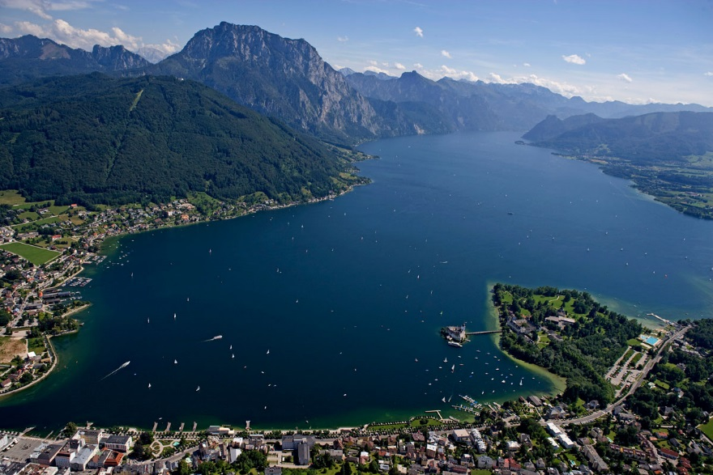
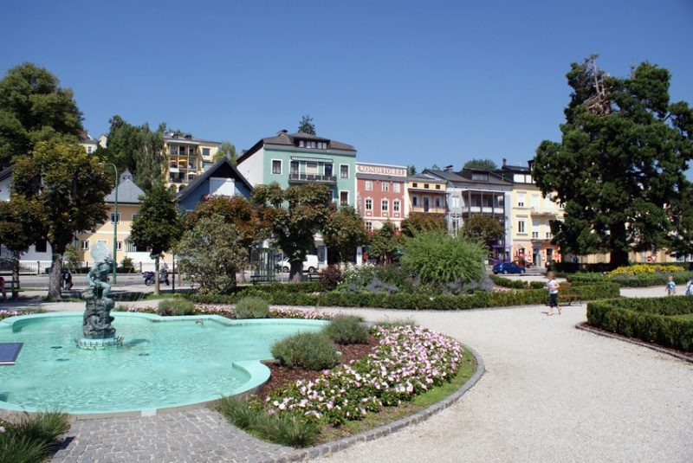
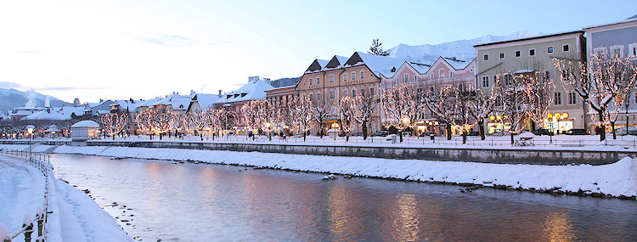

Slide 13
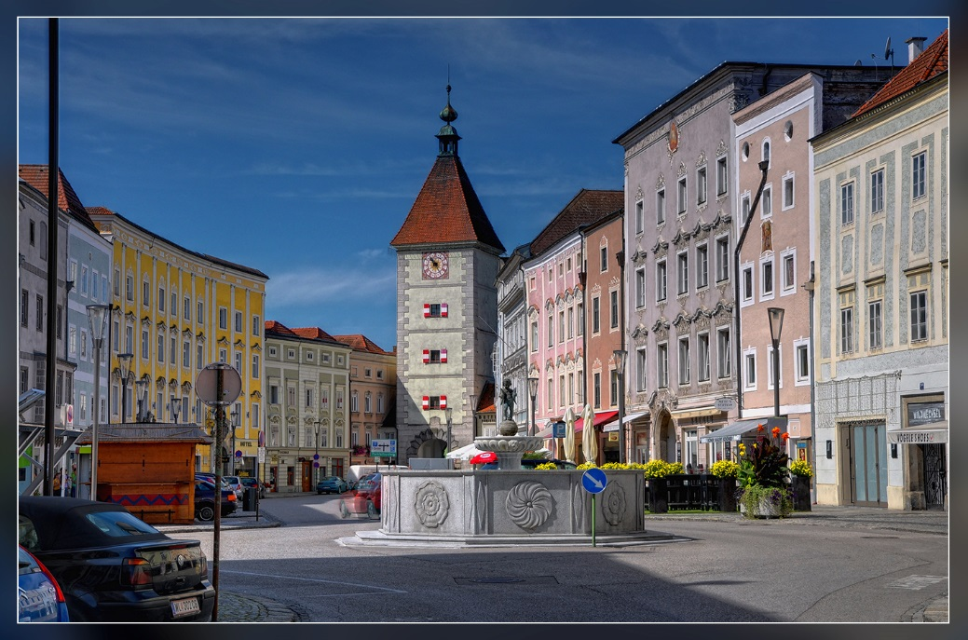
Wels- Wednesday

Slide 14
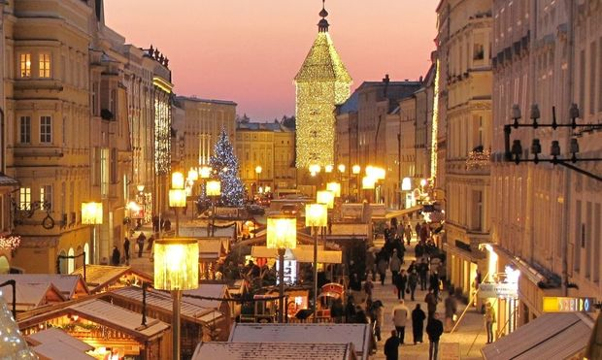
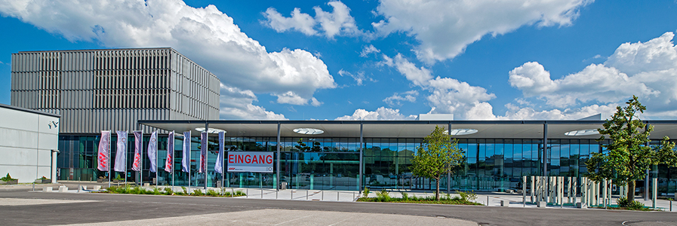
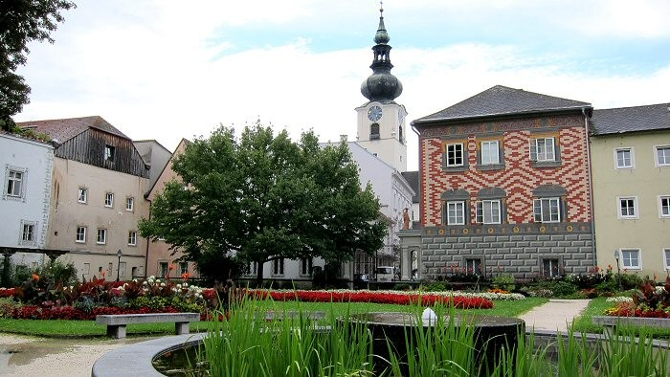
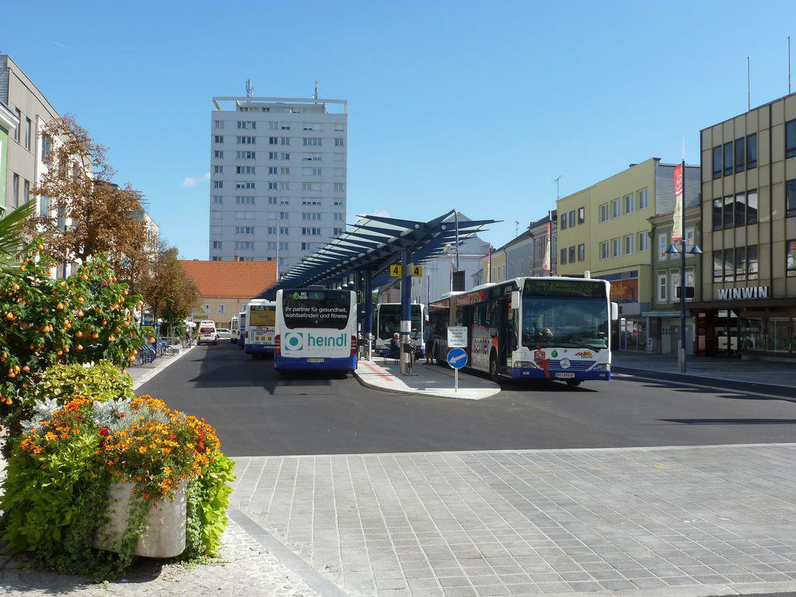

Slide 15
Salzburg - Thursday

Slide 16
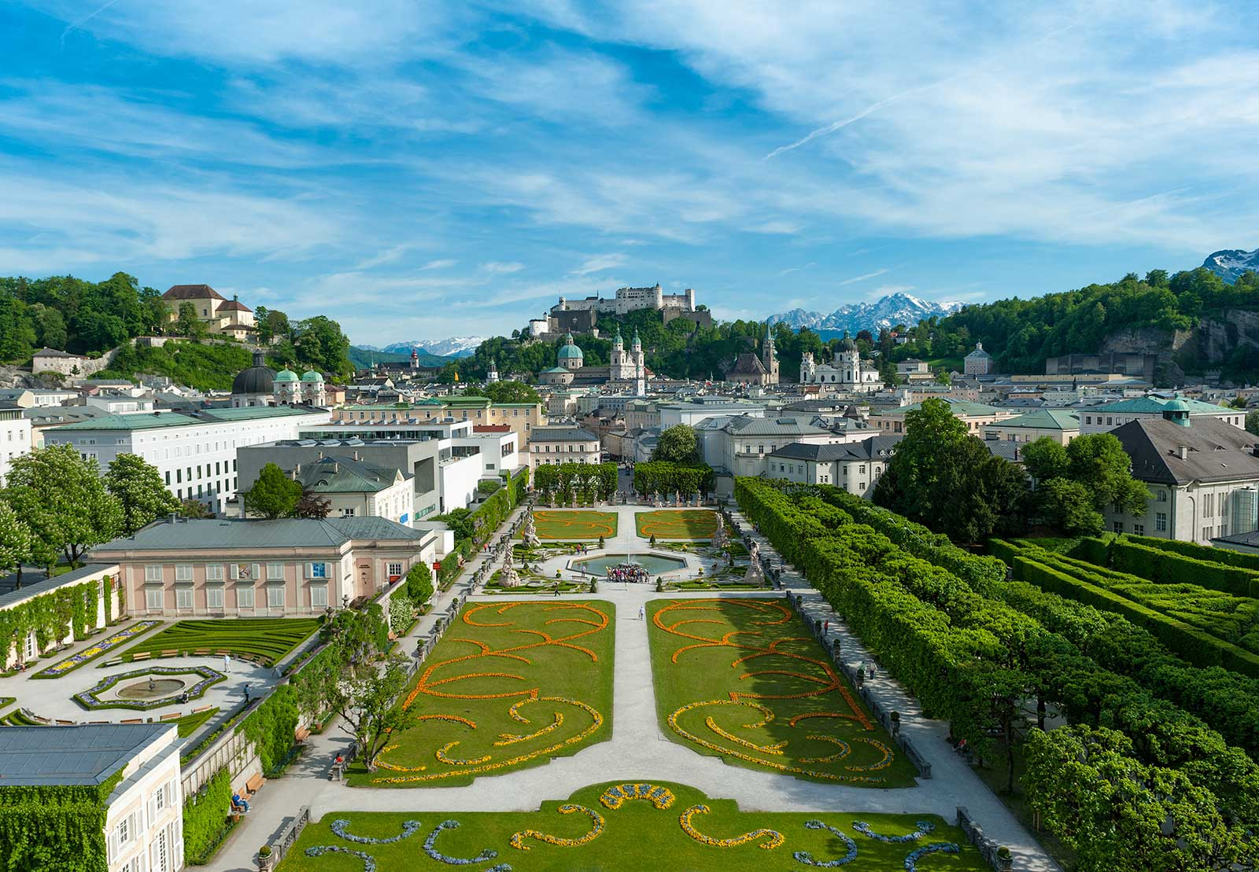
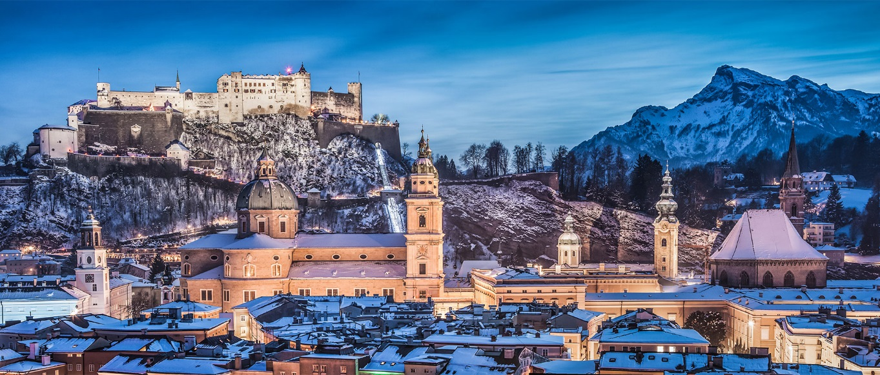
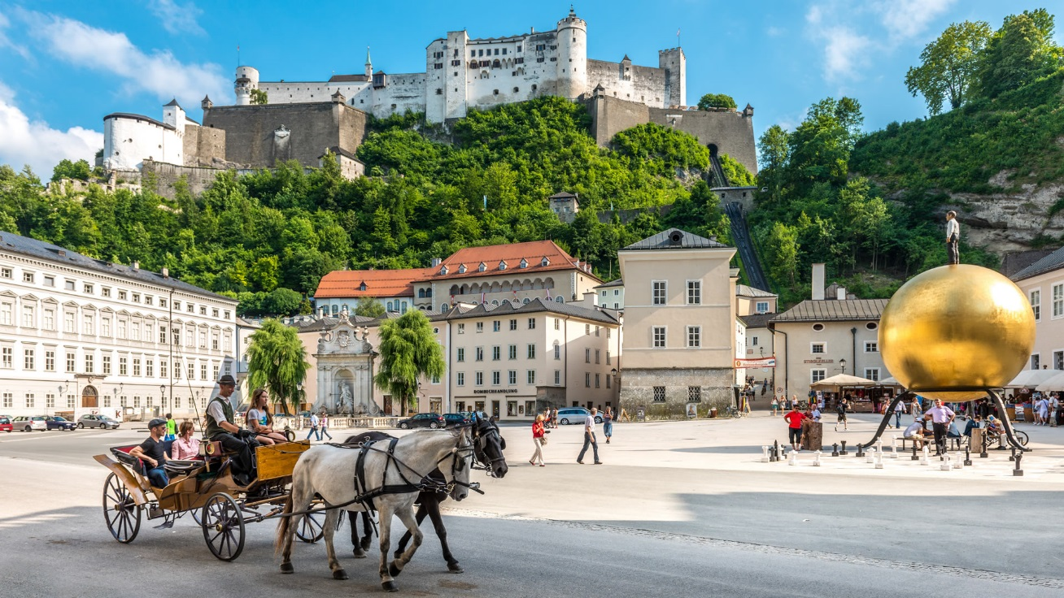
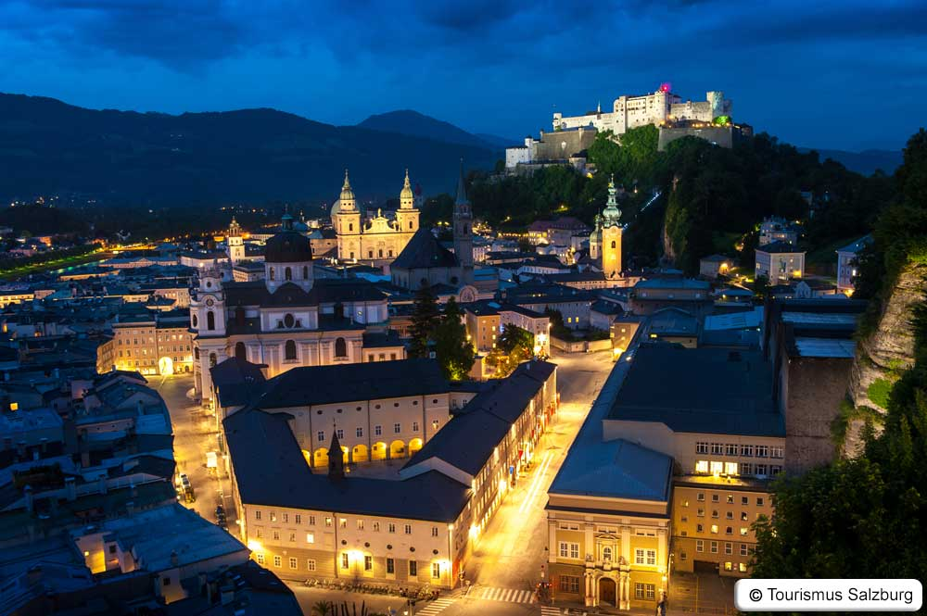

Slide 17
Thank you
Transnational Learning Activity in Lambach, Austria,
14-21 April 2018
Dieses Projekt wurde mit Unterstützung der Europäischen Kommission finanziert. Die Verantwortung für den Inhalt dieser Veröffentlichung (Mitteilung) trägt allein der Verfasser; die Kommission haftet nicht für die weitere Verwendung der darin enthaltenen Angaben.
This project has been funded with support from the European Commission. This publication [communication] reflects the views only of the author, and the Commission cannot be held responsible for any use which may be made of the information contained therein.

