Slide 1
Erasmus Week In Cyprus
By: Maria Adamidou ( Cyprus )
Marios Neofytou ( Cyprus )
Nicole Demetriou ( Cyprus )
Gloria Salhofer ( Austria )
Manel Perez ( Spain )
Cirstea Catalina ( Romania )

Slide 2
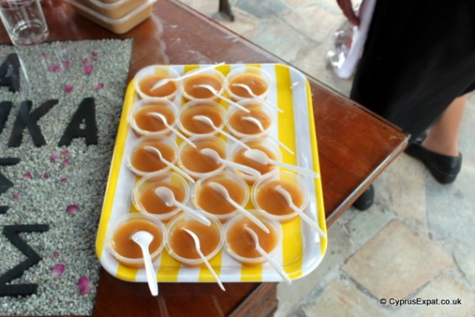
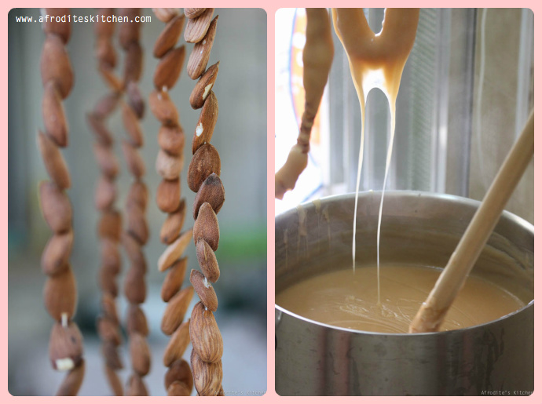
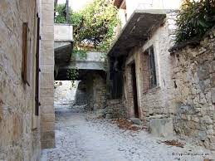
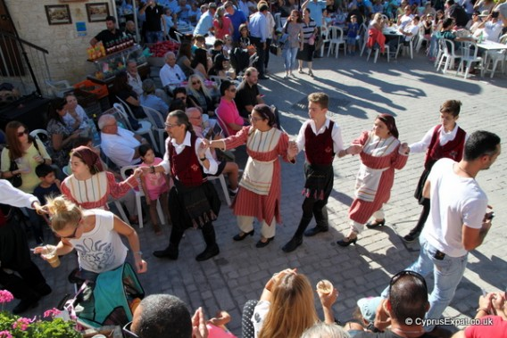
Day 1 : Vouni
Traditional Food :
Traditional Dances
Traditional Games from all the countries
Palouze Festival

Slide 3
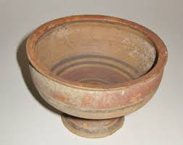
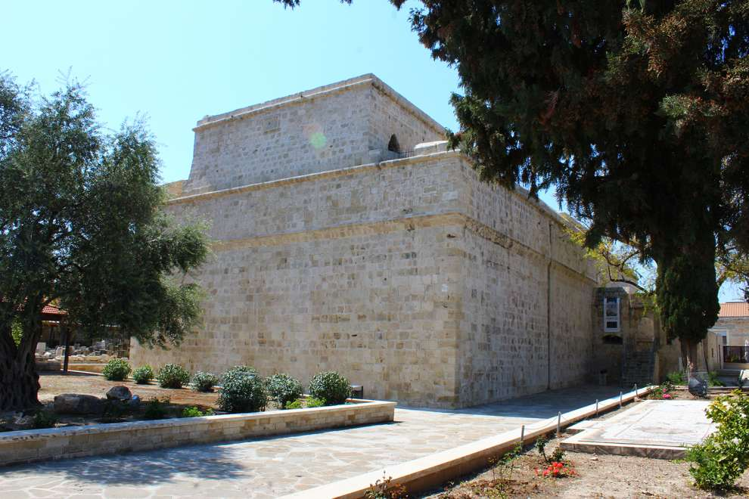
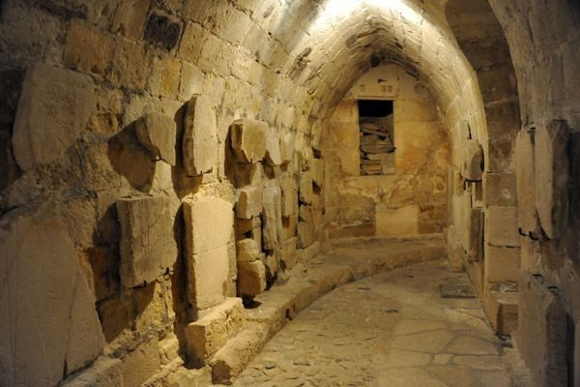
Day 2: Medieval Time
Medieval time in all 6 countries
Cypriot Medieval Pottery Class
Tour of the Medieval Castle in Limassol

Slide 4
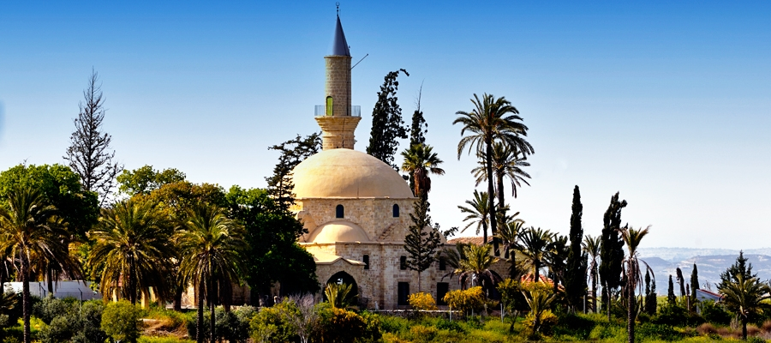
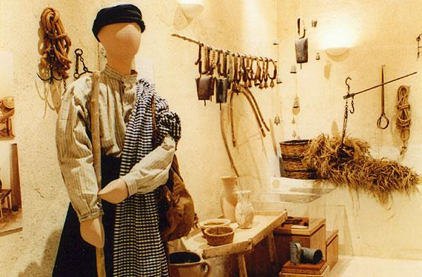
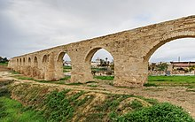
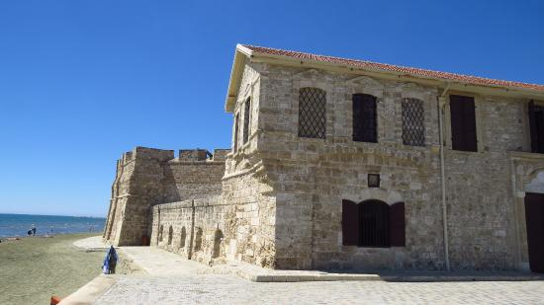
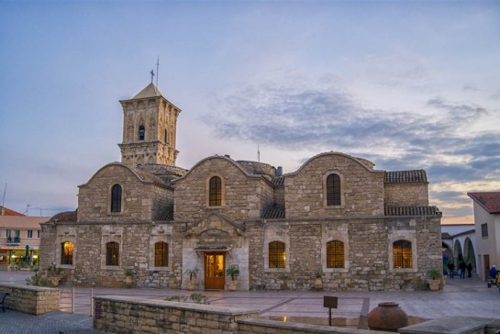
Day 3: Larnaka
Powerpoint Workshop in the morning
Trip to Larnaka:
Folklore Museum, Kamares, Hala Soultan Tekke, Medieval Castle,
Church of Saint Lazarus

Slide 5
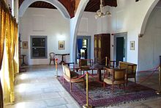
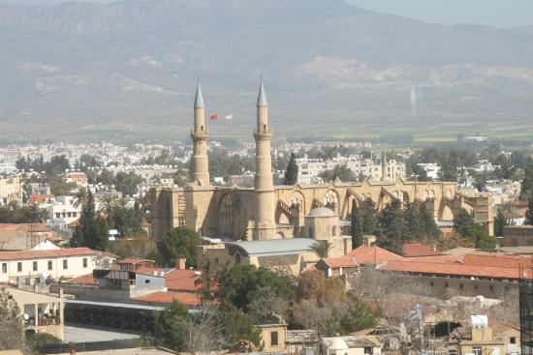
Day 4: Nicosia
Visit the Venetian Walls , the Shacolas Tower
Visit the Shacolas Tower Museum and Observatory
Visit the House of Hadjigeorgakis Kornesioa

Slide 6
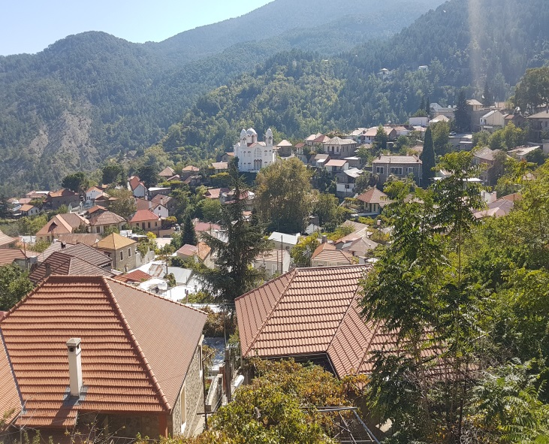
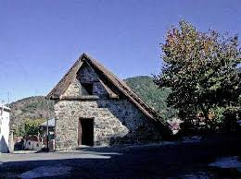
Day 5: Mountains
Visit to Kalopanagiotis, Pedoulas and Kakopetria
Visit Byzantine Churches which are protected by UNESCO
Farewell lunch at Kalopanagiotis

