Slide 1
Erasmus+ 2018
Sunday -Saturday

Slide 2
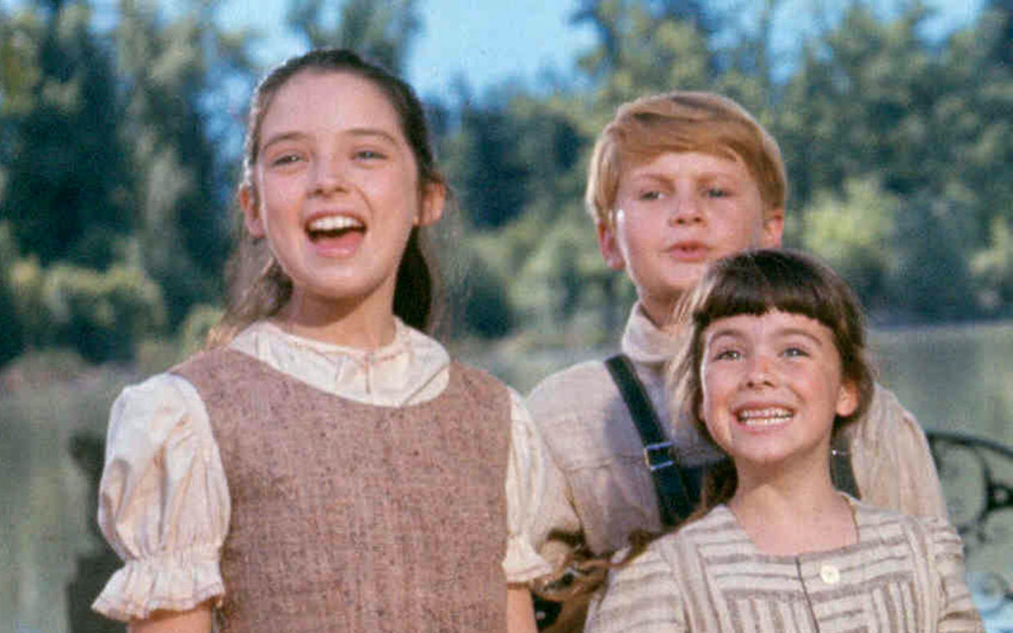
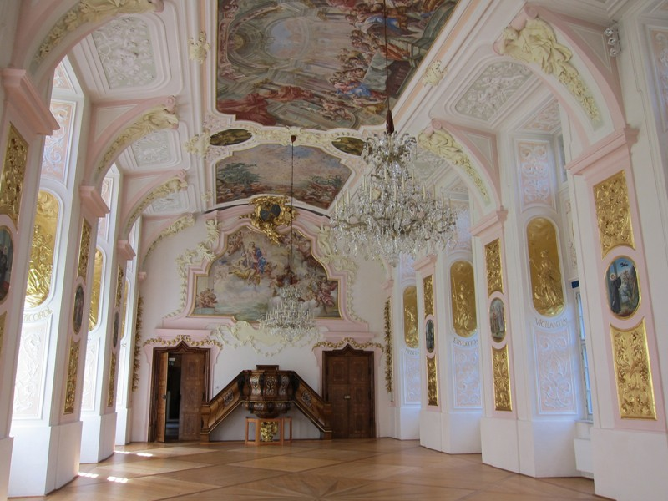
Sunday
Various activities
Traditional dances in the Sommerrefektorium

Slide 3
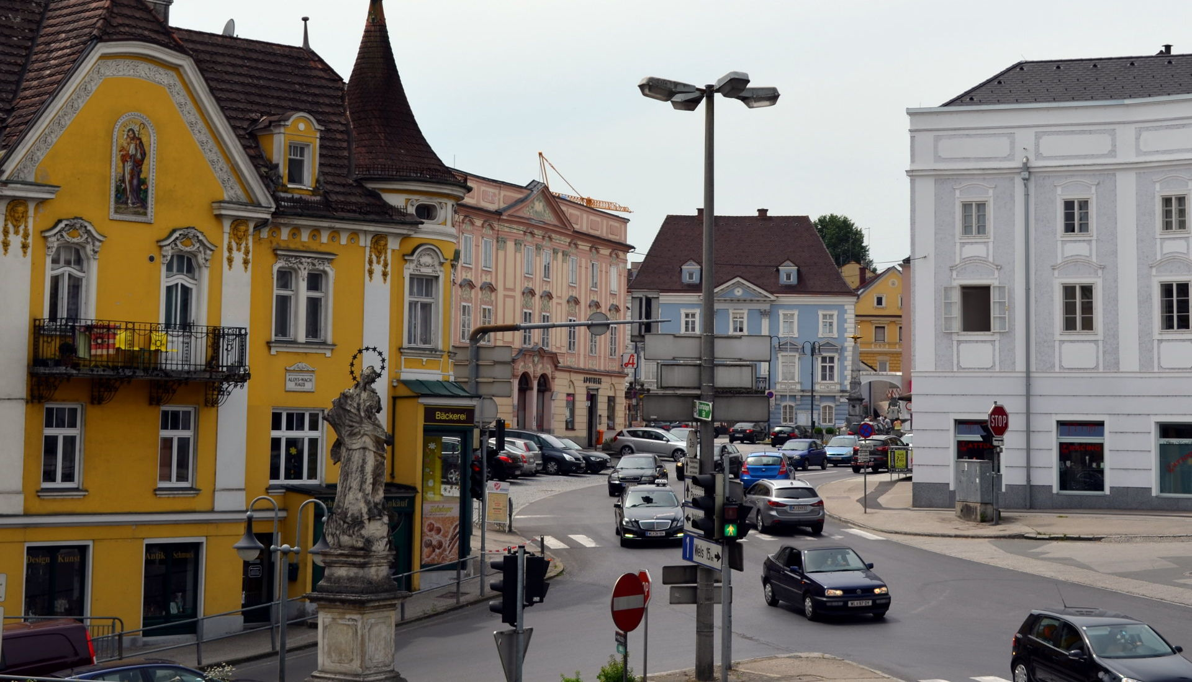
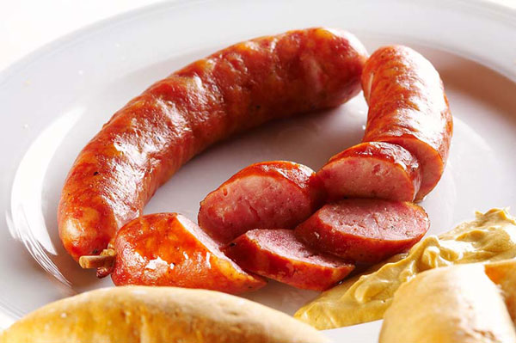
Various Activities
Ice breaking games
Town walk
Eating traditional Austrian food

Slide 4
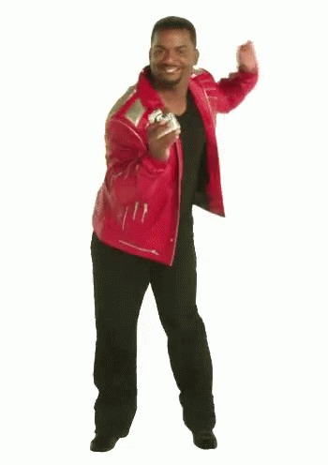
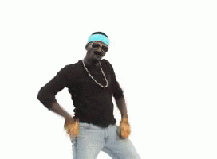
Traditional Dances
Austria – Schuaplattln, Waltz
Cyprus – Sousta
Greece – Siganos
Poland – Krakowiak
Romania – Ciuleandra
Spain - Makarena

Slide 5
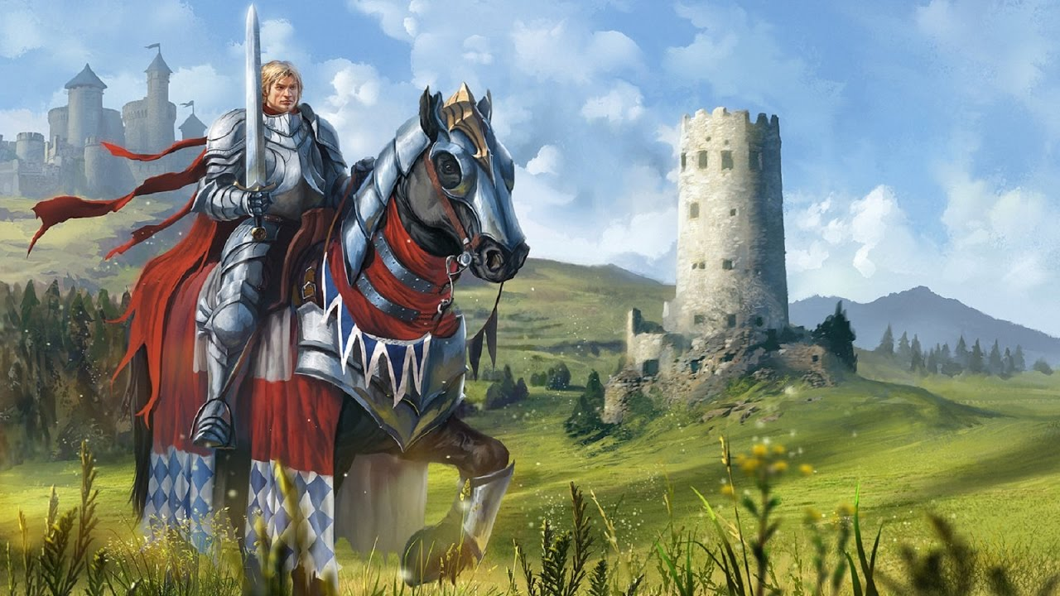
Monday
Medieval Ages in Europe
Seasons workshop

Slide 6
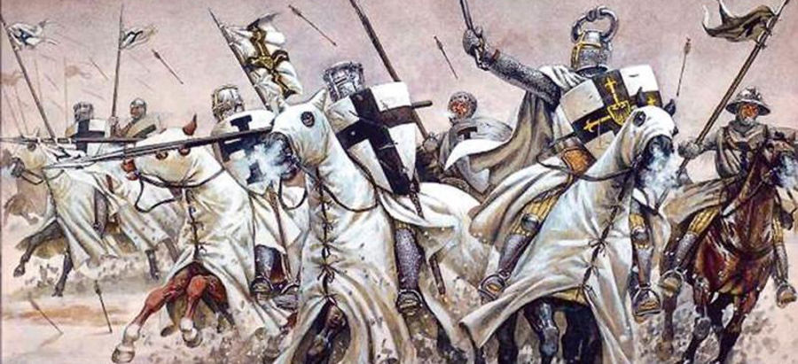
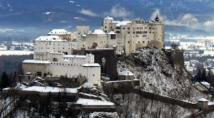
Medieval ages in Europe

Slide 7
Seasons workshop

Slide 8
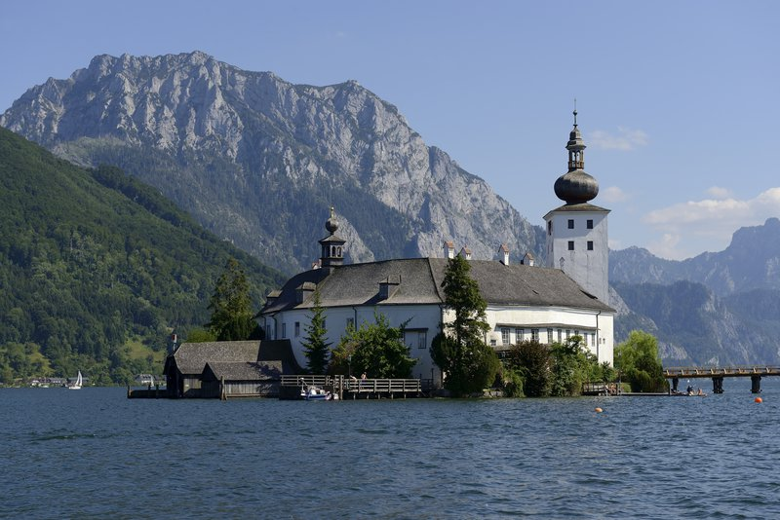
Tuesday
Gmunden
Writing workshop

Slide 9
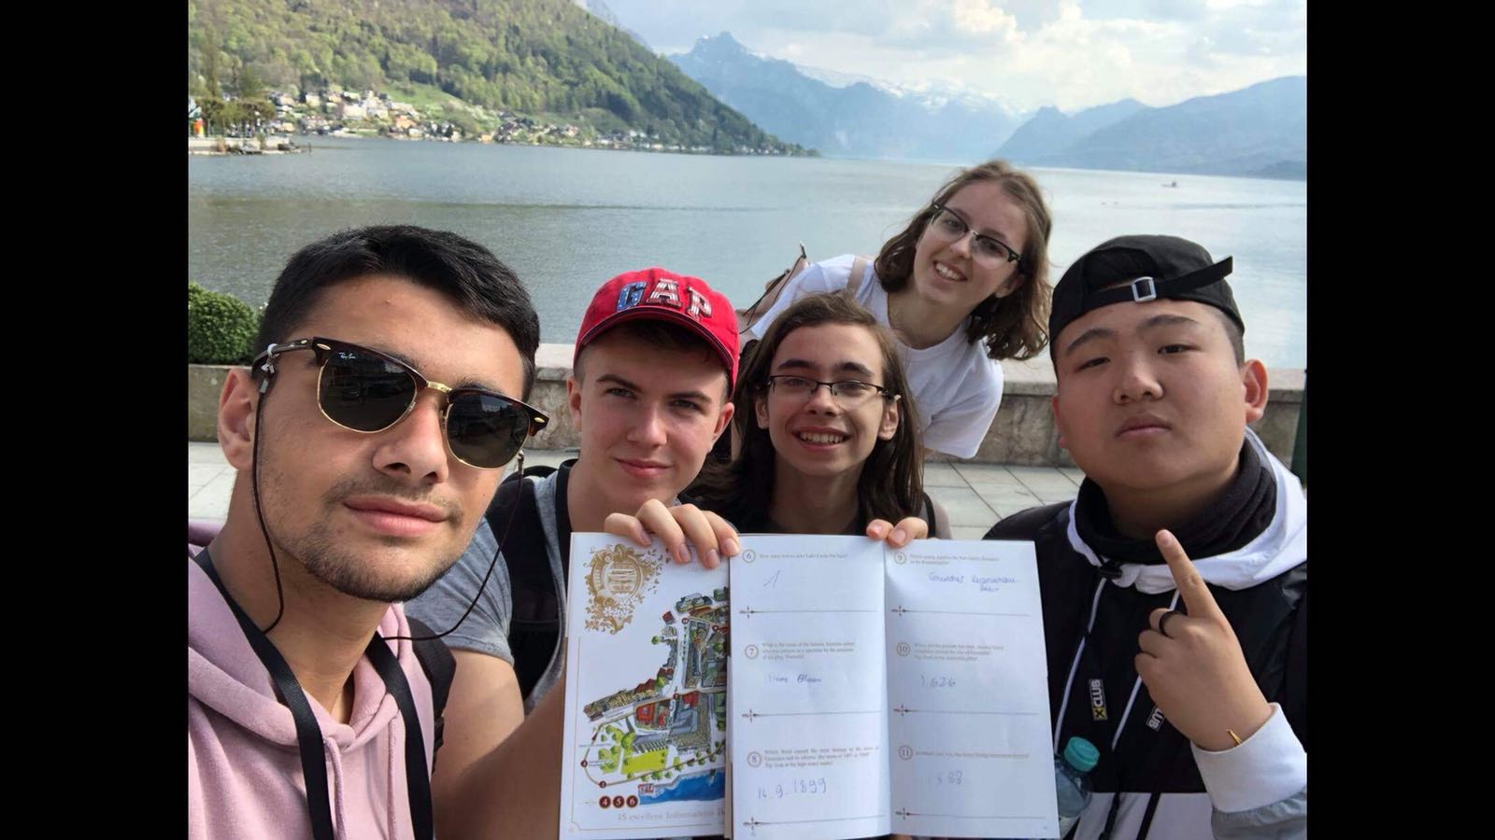
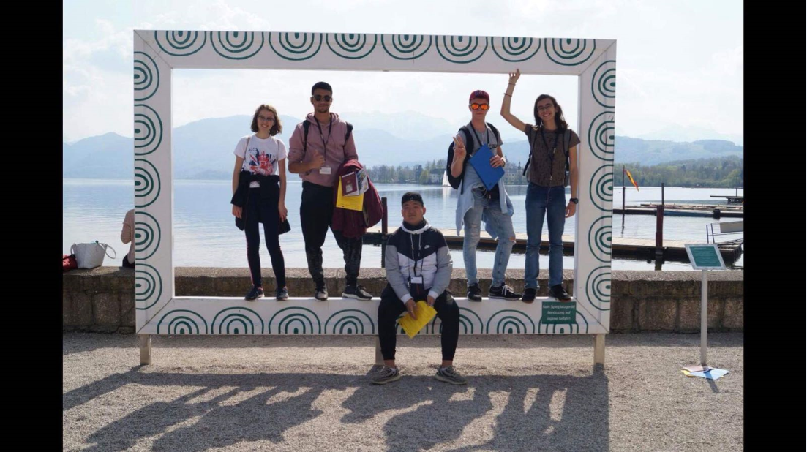
Gmunden

Slide 10
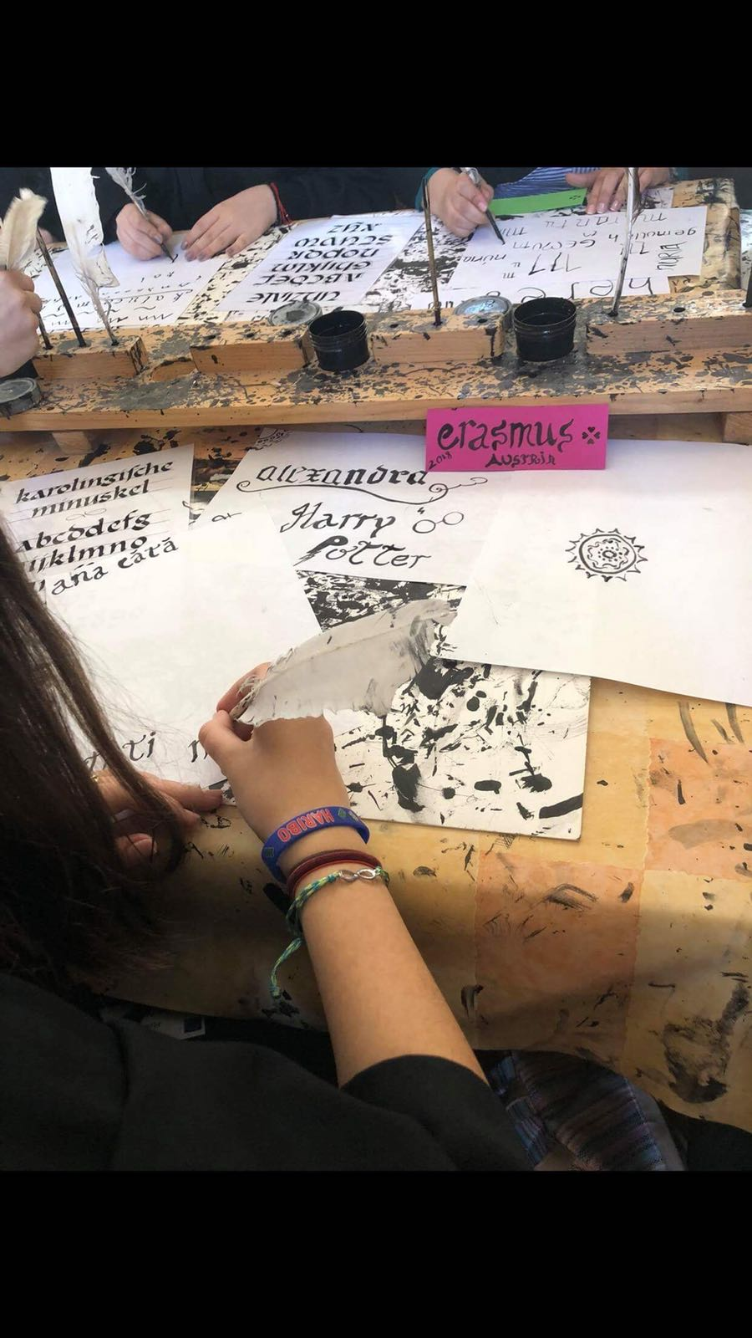
Writing workshop

Slide 11
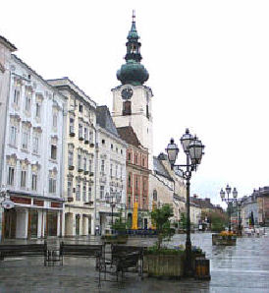
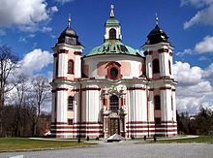
Wednesday
Trinity Church of Stadl-Paura
Wels

Slide 12
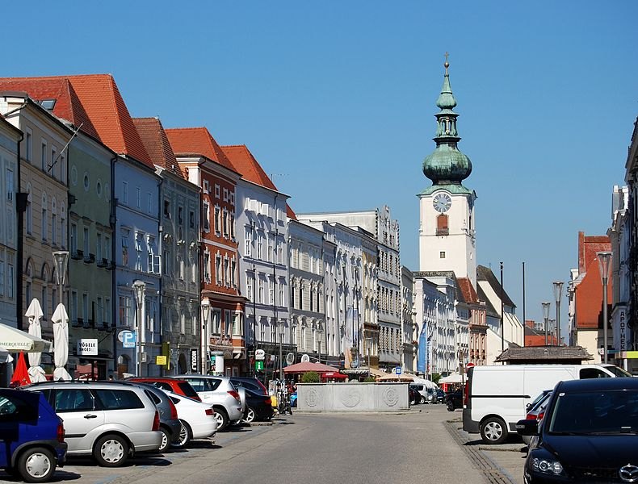
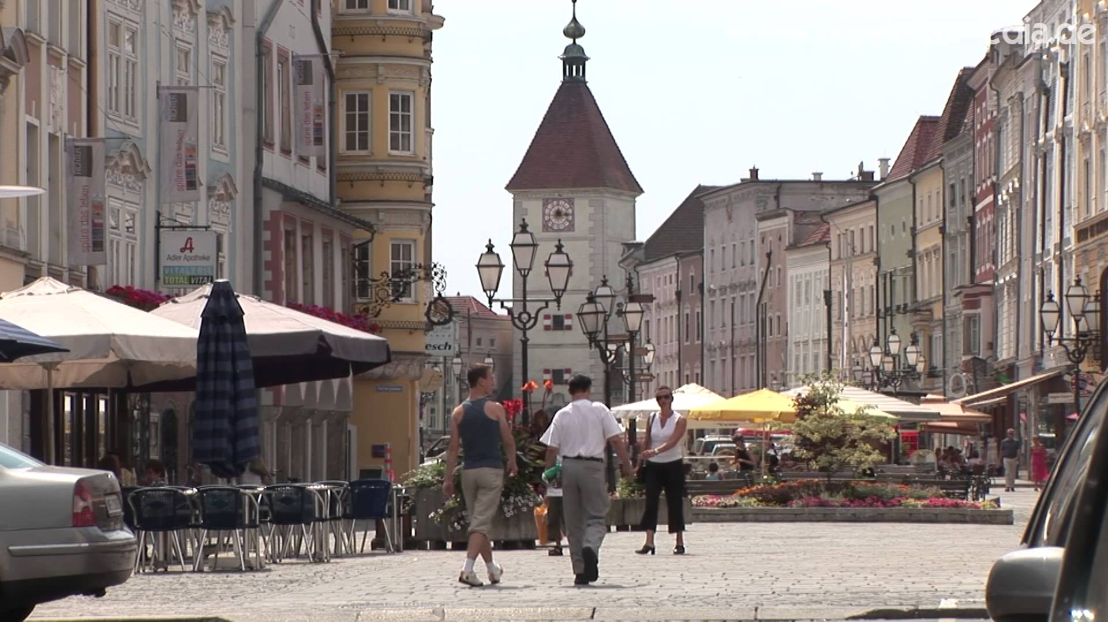
Wels

Slide 13
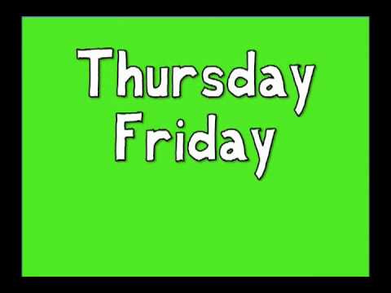
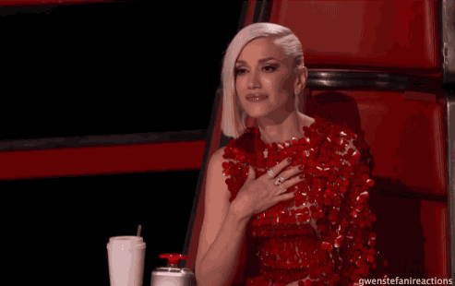
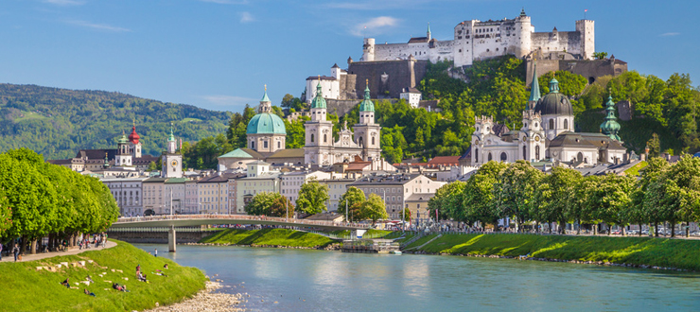
EMOTIONAL DAYS and Salzburg

Slide 14
WE LOVE YOU

