Slide 1
CRETE
IN THE MIDDLE AGES
Transnational Learning Activity in Lambach, Austria,
14-21 April 2018
Το σχέδιο αυτό χρηματοδοτήθηκε με την υποστήριξη της Ευρωπαϊκής Επιτροπής.
Η παρούσα δημοσίευση (ανακοίνωση) δεσμεύει μόνο τον συντάκη της και η Επιτροπή δεν ευθύνεται για τυχόν χρήση των πληροφοριών που περιέχονται σε αυτήν.
This project has been funded with support from the European Commission. This publication [communication] reflects the views only of the author, and the Commission cannot be held responsible for any use which may be made of the information contained therein.

Slide 2
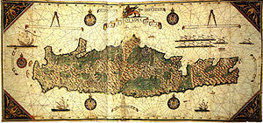
CRETE IN THE MIDDLE AGES
DurING THE FIRST CENTURIES A.d. and the middle ages, crete goes through several stages successively. In the centuries to come, the island is constantly becoming a target for several peoples, due to its important position in the Mediterranean sea.

Slide 3
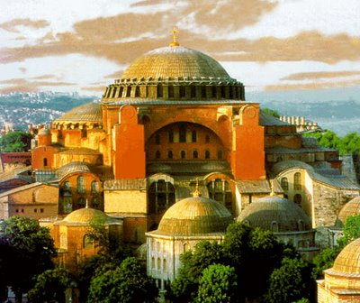
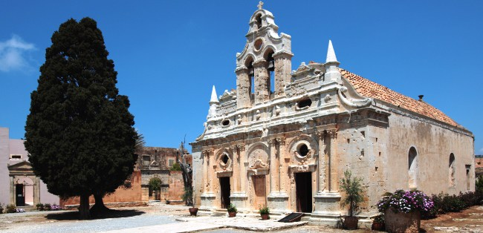
THE FIRST BYZANTINE PERIOD (330 - 824 A.D.)
During this period, Crete was part of the Byzantine Empire, the capital of which was Instanbul. As soon as the Roman State was divided into two parts (the Eastern and the Western one) Crete became part of the Byzantium, whose emperor was Theodosios the great in 395 B.C. During this period, Christianity was spread and the church of Crete became a part of the Patriarchate of Instanbul.
Saint Sofia in Instanbul
Arkadi Monastery

Slide 4
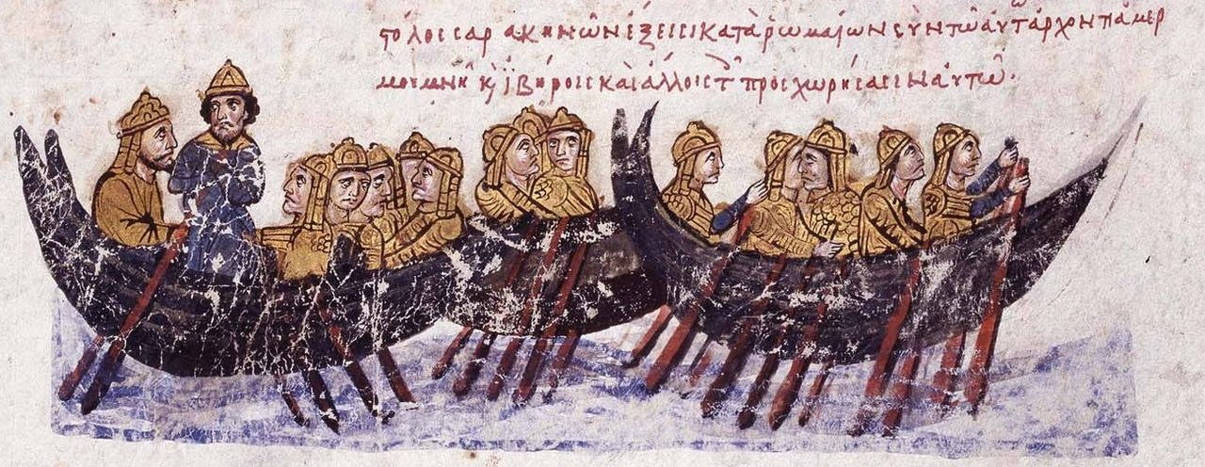
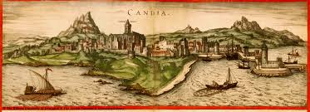
ARABIC DOMINATION (824 – 961 AD. )
In 824 AD, the Saracen Arabs managed to conquer Crete, after ruining its capital-Gortyna and transferring it into a different place which is today known as Heraklion. The period of the Arabic domination was marked by constant raids by pirates and the island had been turned into a big slave bearer of the East. Candia, a town today known as Heraklion, was fortified and surrounded by a deep ditch (which was called El Khandak) in order to become the capital of the Arabic state of Crete.
Saracenes sailing to Crete…

Slide 5
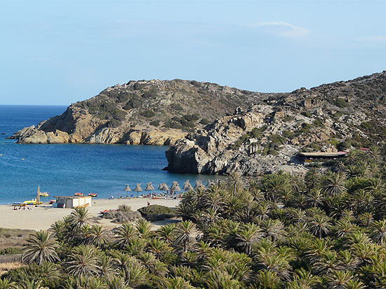
The palm forest of vai
Tradition says that when Crete was Arabic, some Arab soldiers, after eating dates, threw the seeds on the ground and in this way, palm trees were planted. Eventually, the palm forest of Vai was created. Today it occupies about 250 acres and has been the biggest and most famous self sown palm forest in Europe until today.

Slide 6
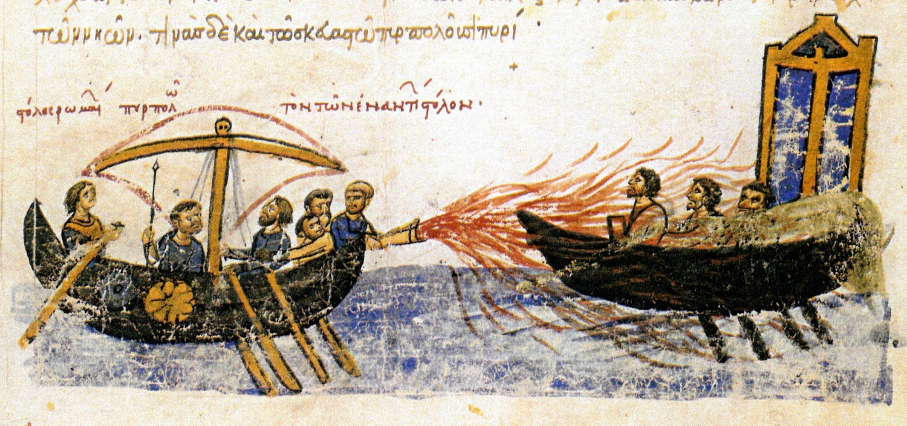
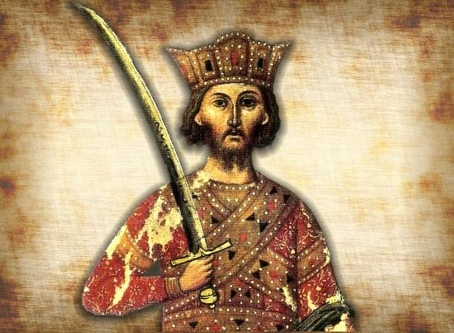
2ND byzantine period (961 – 1204 μ.Χ.)
The island’s fate changes in 961A.D after being recaptured from the Byzantines by Nikiforos Fokas who managed to capture Chandakas, the capital of the Arabs of the island , after having besieged it for four months.
Liquid Fire: incendiary weapon of the Byzantine Empire. It was used mostly against the Arabs.
Nikiforos Fokas

Slide 7
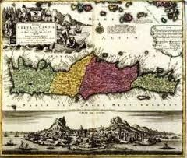
.
Since then and for 250 years, a new era of development and prosperity has taken place on the island. Crete becomes an independent part of the empire and due to its important position, it gets quite autonomous.

Slide 8
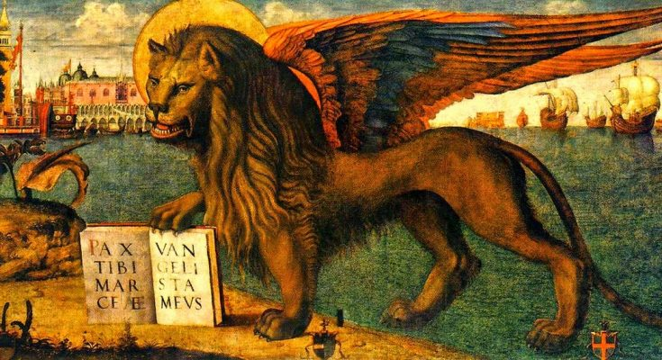
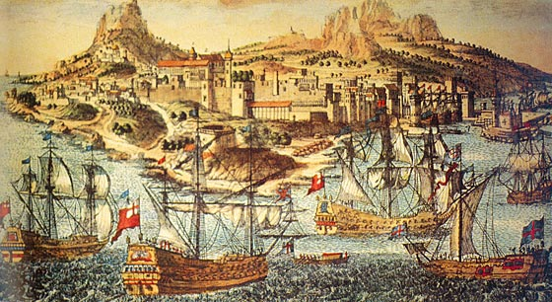
Venetian domination (1204 – 1669 μ.Χ.)
The Venetian domination period started after the conquest of Instambul by the Francs in 1204 and the concession of Crete by the Latin emperor Bonifatius Monferatico, who sold the island to the Venetians in 1210. Crete was precious to the Venetians, since, due to its location, it would contribute to the development of Venetian commerce in East.

Slide 9
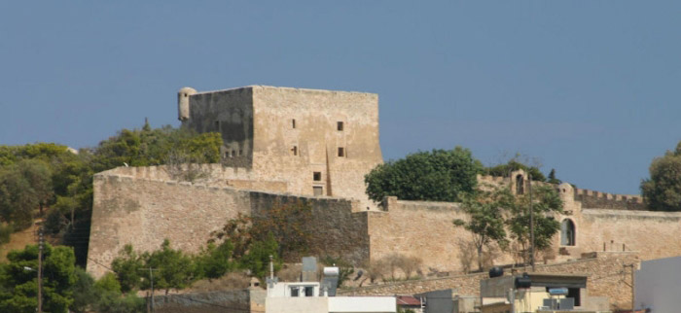
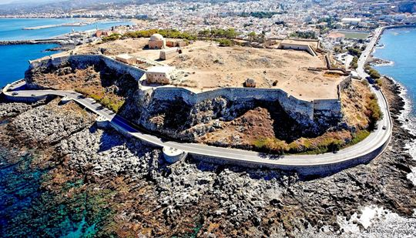
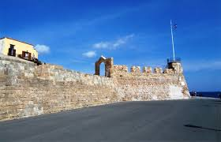
Venetian castles in Crete
Koules - Heraklio
Casarma- Sitia
Fortezza Rethimno
Firkas Chania

Slide 10
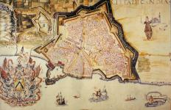
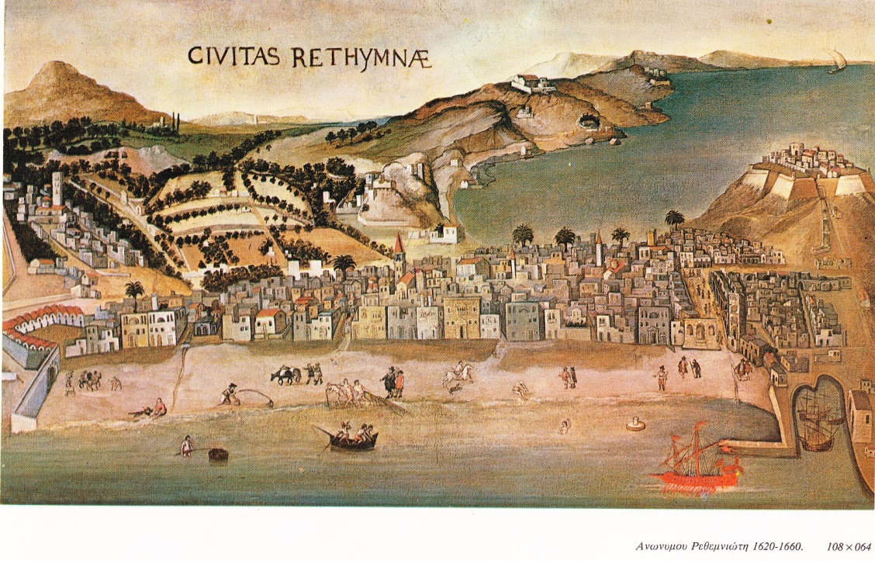
Venetian domination
The Venetian system of governance was oppressive. Consequently, a lot of liberal movements burst out during the Venetian domination. Although the particular movements didn’t manage to liberate the island, they contributed to the improvement of the living conditions of the local population as well as the lightening of the way that the Venetian governors ruled.

Slide 11
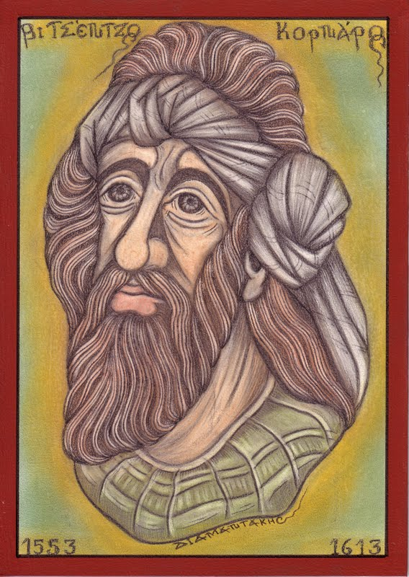
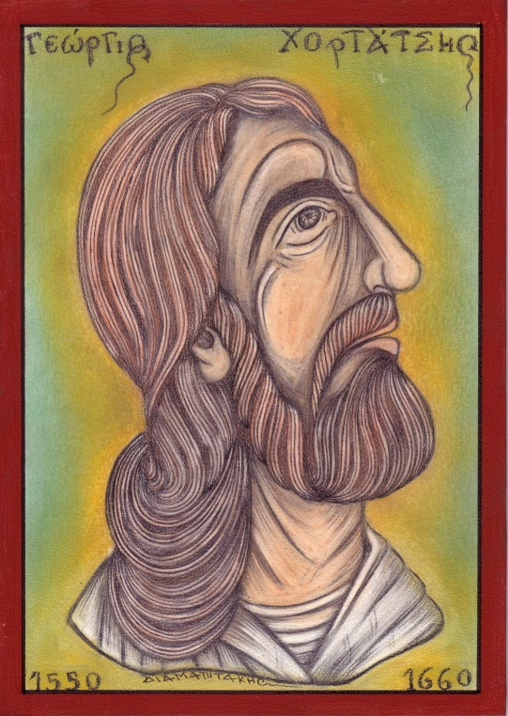
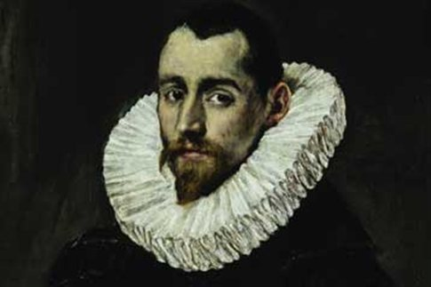
Intellectual development
Despite the fact that Crete was enslaved, Arts and Literature had been blossoming, before its conquest by the Turks. The most important personalities of Cretan Literature of that period were: Georgios Chortatsis, the writer of the dramatic play Erofili and Vitsentzos Kornaros, the writer of Erotokritos. Dominikos Theotokopoulos, known as El Greco was a distinguished painter.
El Greco
VitsentzosKornaros
Georgios Chortatsis

Slide 12
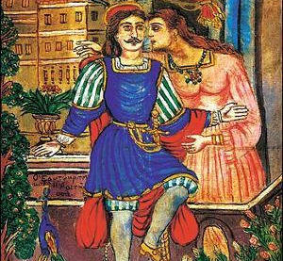
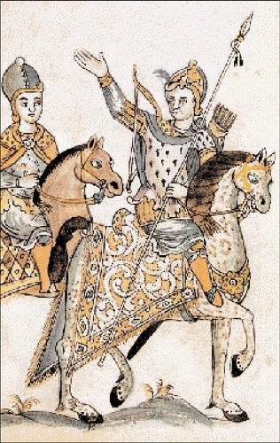
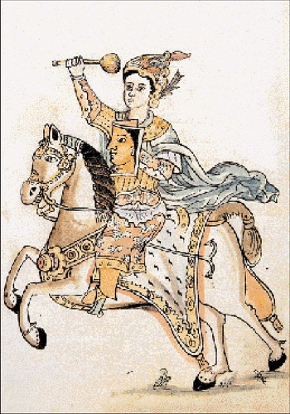
EROTOKRITOS
Vitsentzos Kornaros, who comes from Sitia (our own hometown) is the writer of Erotokritos, a deeply erotic poem which is the most important creation of Cretan Literature and which has been sung and recited all over the island until today.

Slide 13
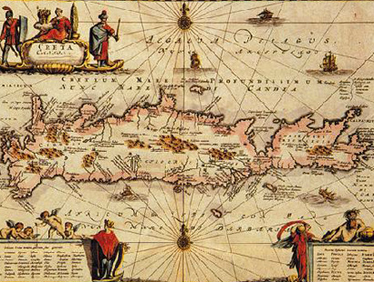
1669: CAPTURE OF CRETE BY THE ottomans
On September 27th 1669 A. D. The “Big Castle” was captured by the Ottoman Turks after the longest siege in the history of Europe.
The financial and cultural blossoming of the previous years is abruptly interrupted
Many historians and researchers consider that the Cretan development during the Venetian domination was so great that if Crete was not captured by the Turks in 1669, the whole Greek population would speak the Cretan dialect today.

Slide 14
Thank you
Transnational Learning Activity in Lambach, Austria,
14-21 April 2018
Το σχέδιο αυτό χρηματοδοτήθηκε με την υποστήριξη της Ευρωπαϊκής Επιτροπής.
Η παρούσα δημοσίευση (ανακοίνωση) δεσμεύει μόνο τον συντάκη της και η Επιτροπή δεν ευθύνεται για τυχόν χρήση των πληροφοριών που περιέχονται σε αυτήν.
This project has been funded with support from the European Commission. This publication [communication] reflects the views only of the author, and the Commission cannot be held responsible for any use which may be made of the information contained therein.

