Slide 1
Traditional Jobs

Slide 2
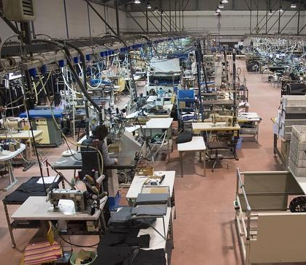
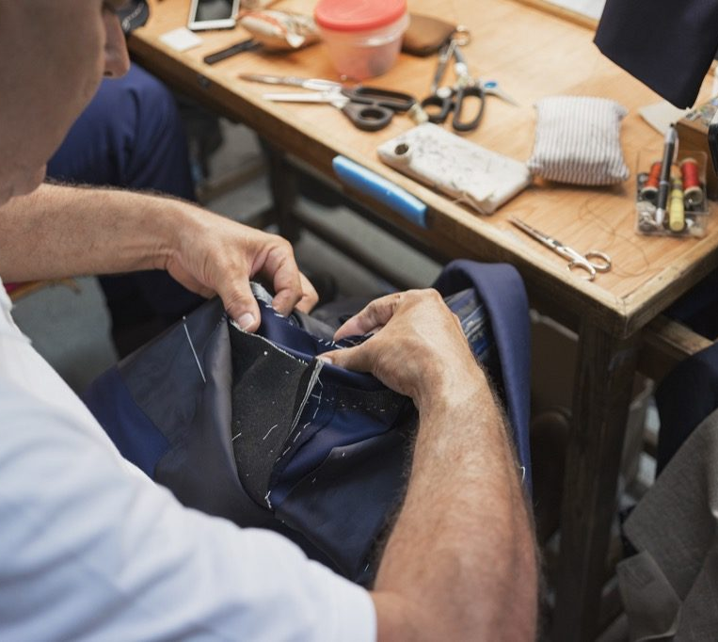
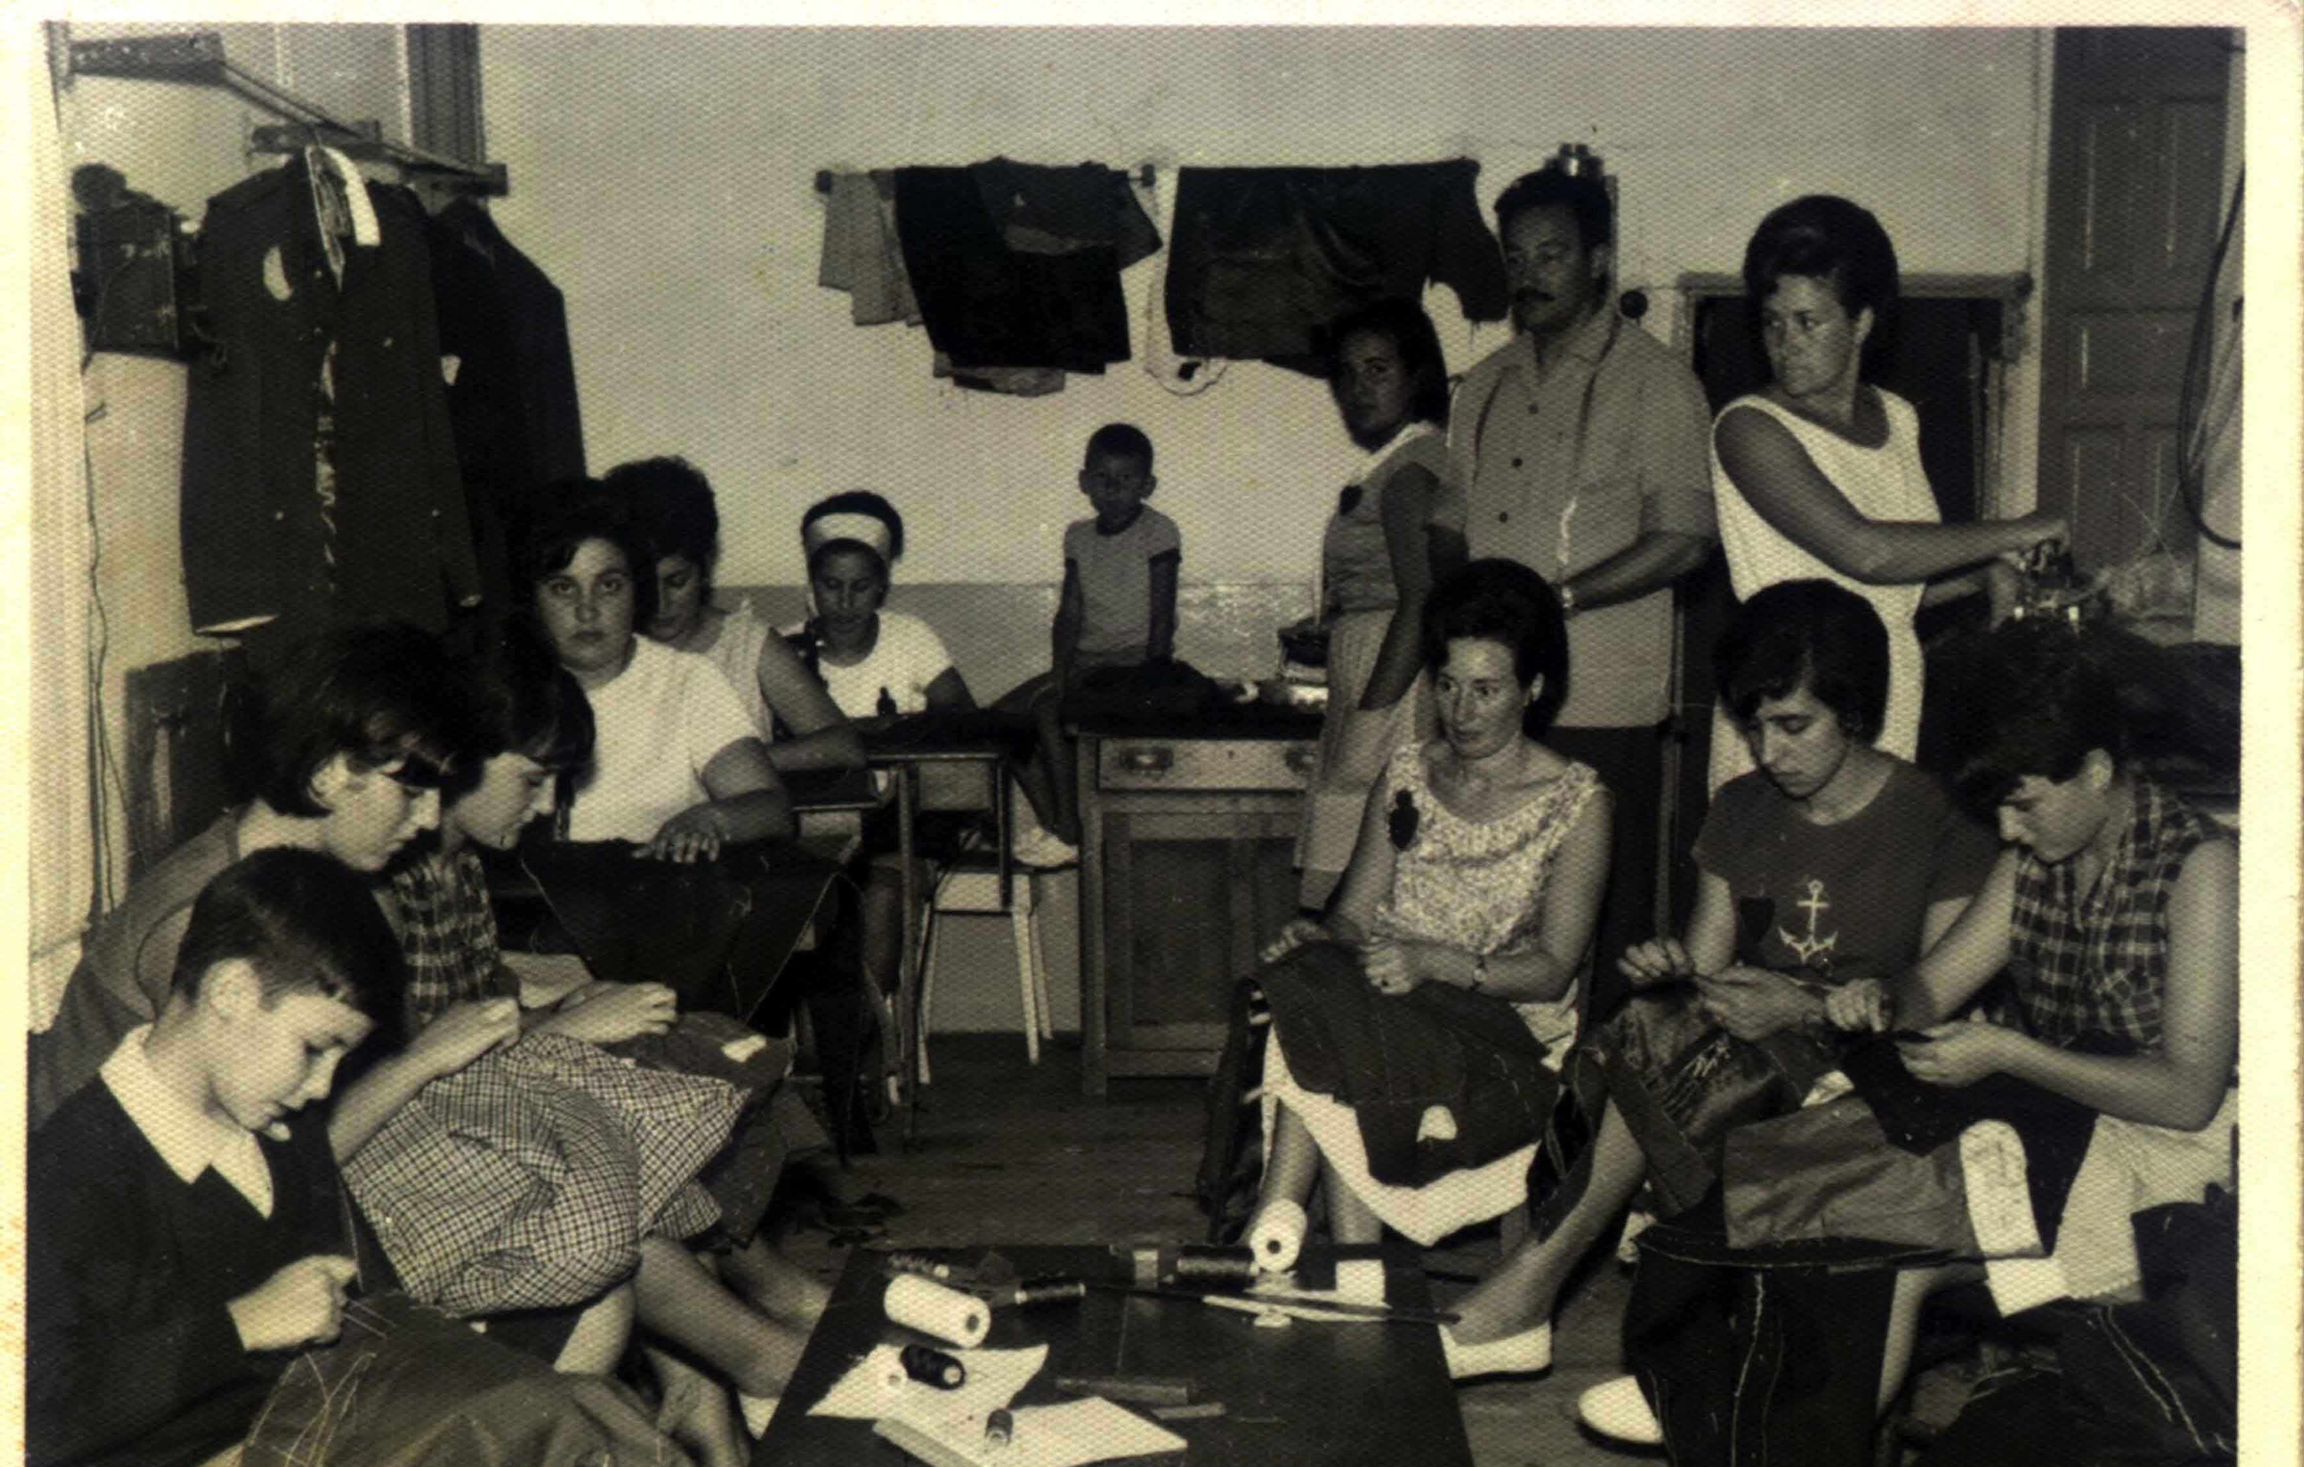
Tradition and innovation
Constant changes in history, society, economy and technology have evolved to a continuous transformation in work, jobs and trades.

Slide 3
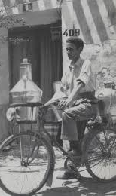
Old trades & jobs

Slide 4
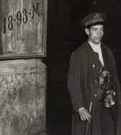
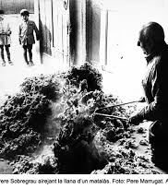
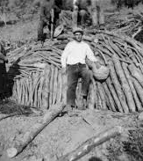
Some old jobs have been vanishing throughout history
It is the case of milkmen, blacksmiths, tailors and dressmakers, night watchman, mattresses, stonemasons, weavers, sharpeners or carriers, others.

Slide 5
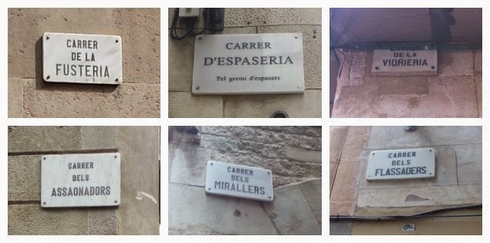
most of them remembered in some street names in Barcelona (gothic Quarter)

Slide 6
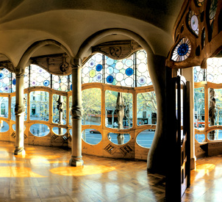
modernism
Gave great prominence to craftsmen.
In order to exploit the plastic potential of woodwork, ceramic work, iron and glass work, amongst other materials.

Slide 7
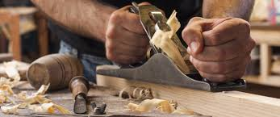
carpentry

Slide 8
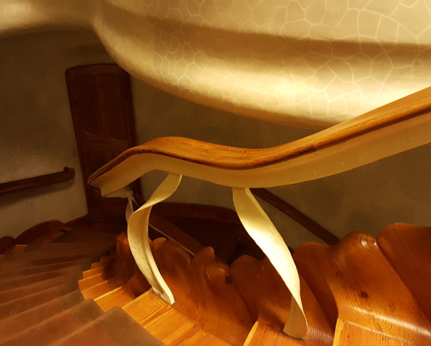
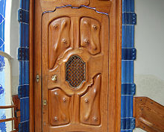
Wood carving is found in most emblematic buildings

Slide 9
Glassmakers

Slide 10
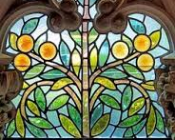
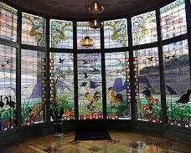
Stained glass is an important trait in the architectural heritage

Slide 11
Iron forger

Slide 12
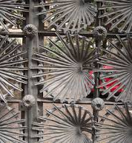
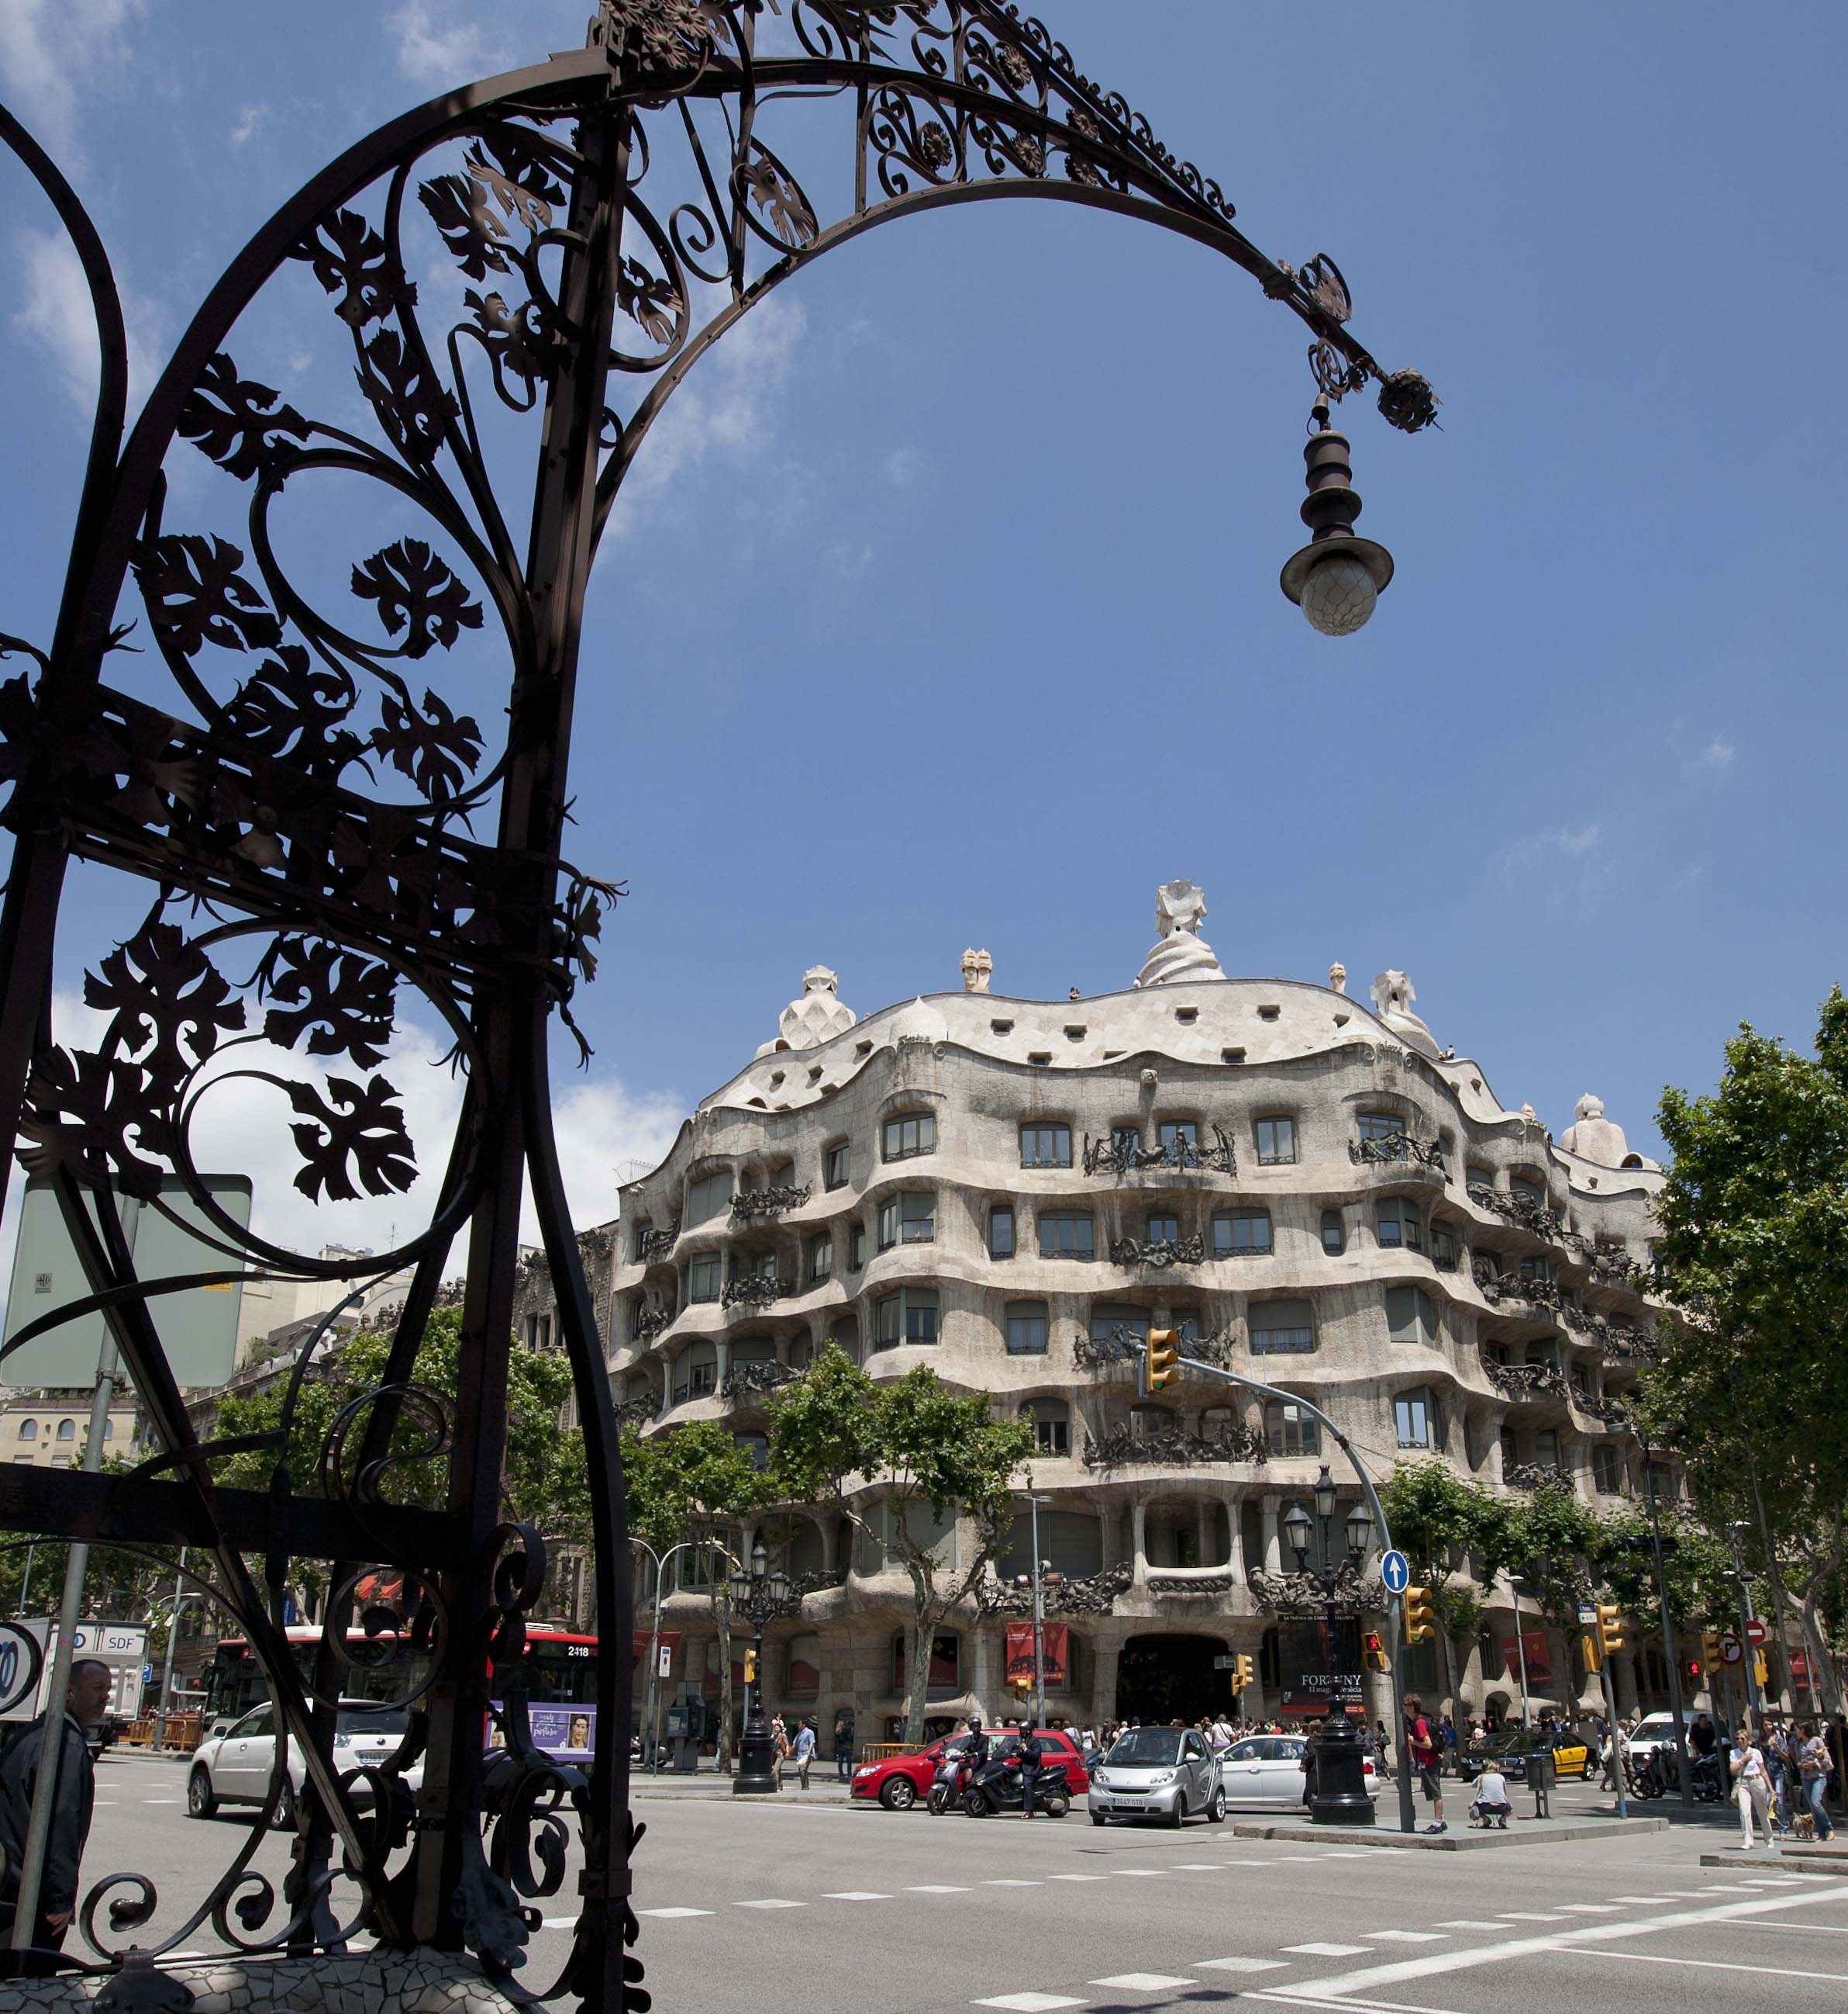
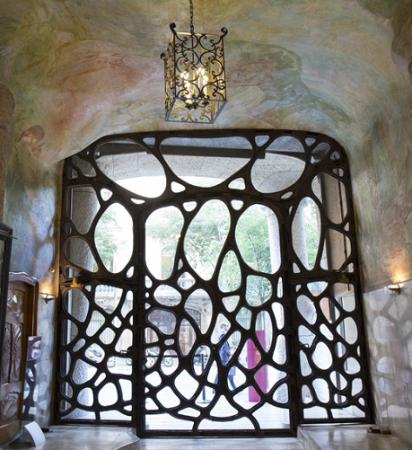
Forged iron is a basic element of modernism

Slide 13
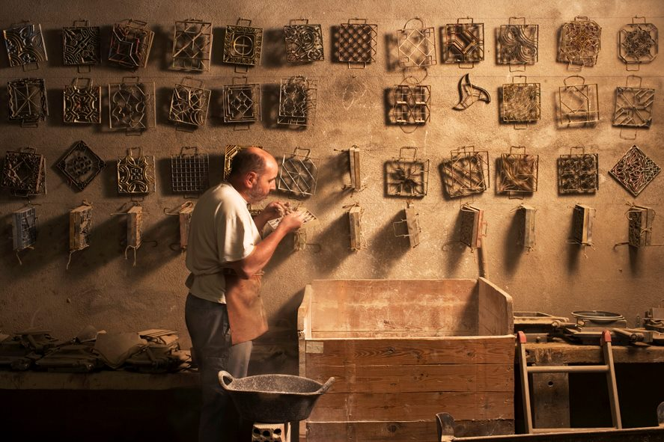
Mosaic ateliers

Slide 14
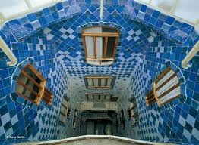
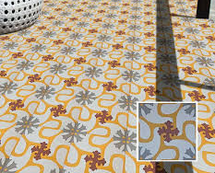
Typical tiles cover walls and floors of houses in barcelona

Slide 15
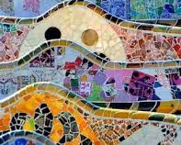
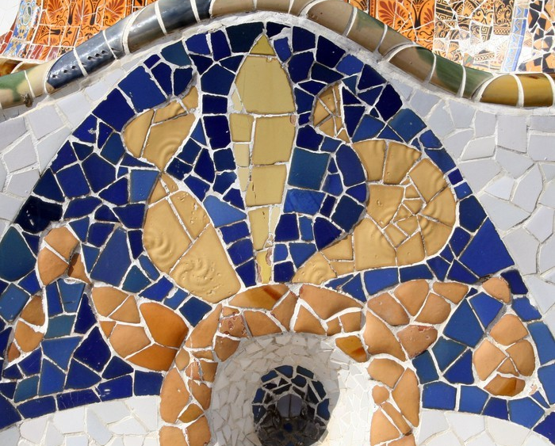
“trencadís” broken tile mosaics give colour to parks and facades

Slide 16
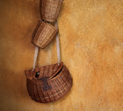
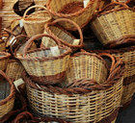
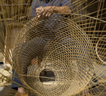
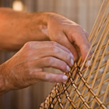
Cisteller
Makes works of wicker
Mainly baskets

Slide 17
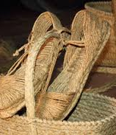
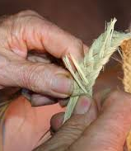
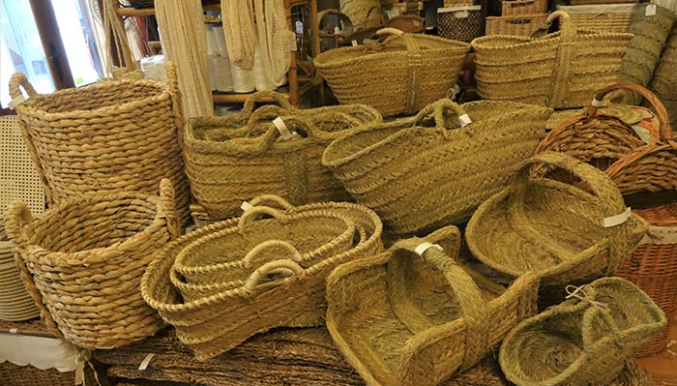
Esparter
Esparto grass crafts

Slide 18
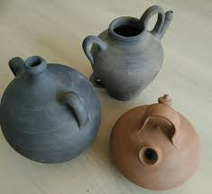
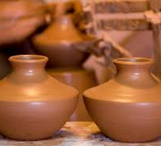
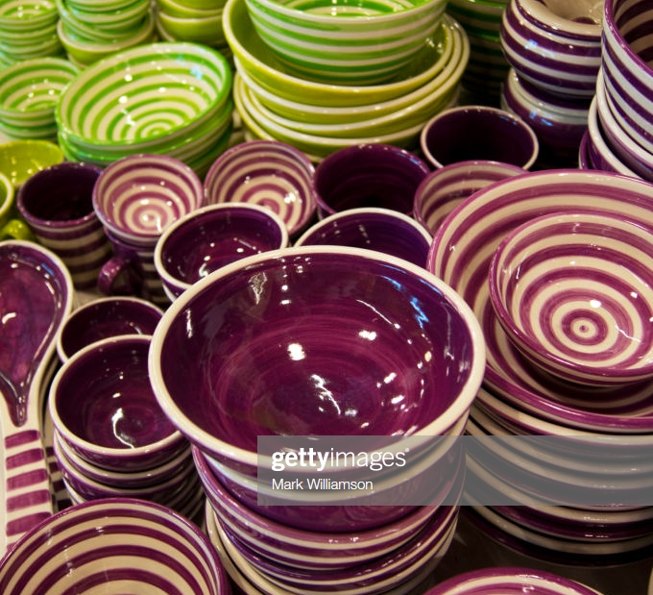
terrissaire
Traditional Catalan pottery

Slide 19
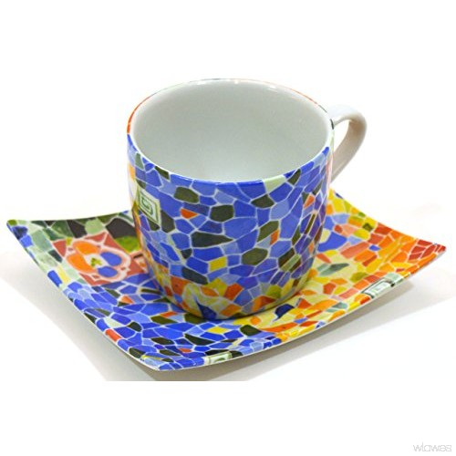
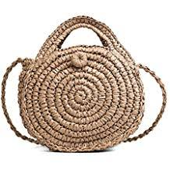
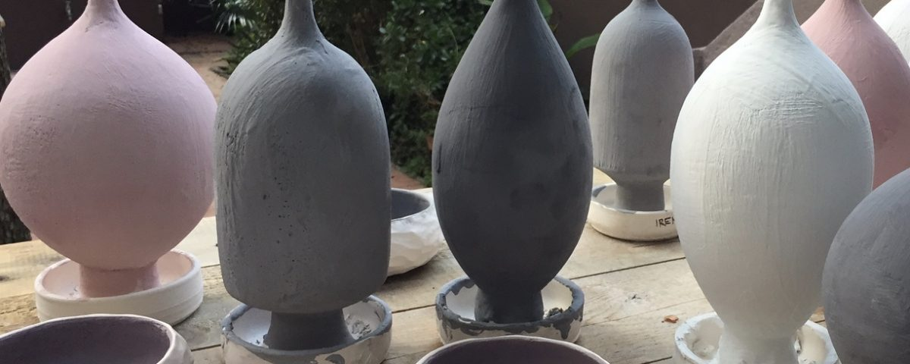
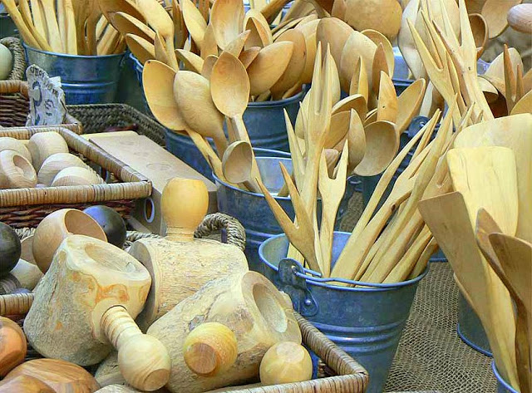
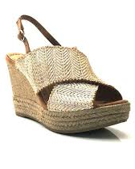
Contemporary tradition
Some of the traditional jobs are still surviving nowadays and they are combining tradition and innovation, as well as reinventing new products based on traditional materials and crafts.
Some others are developing contemporary products and objects made using traditional techniques that are able to meet the demands of the current market.

Slide 20
"The European Commission support for the production of this publication does not constitute an endorsement of the contents which reflects the views only of the authors, and the Commission cannot be held responsible for any use which may be made of the information contained therein."

