Slide 1
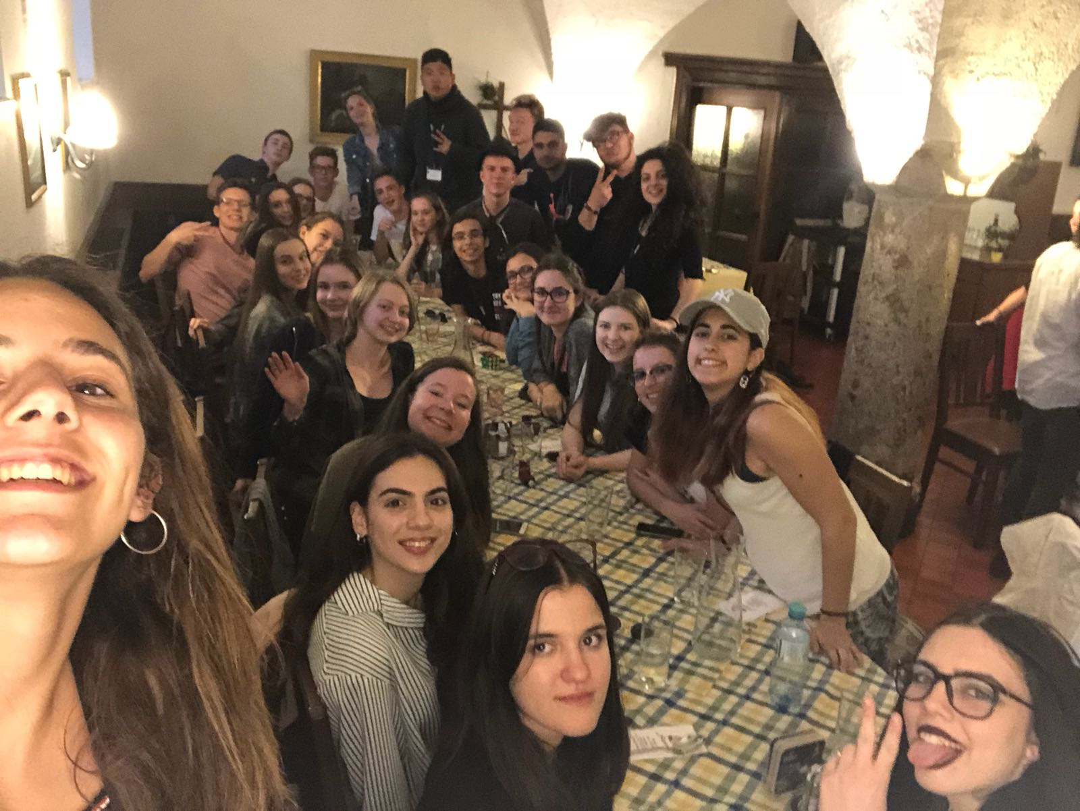
Erasmus Presentation
Sunday-Friday

Slide 2
Programm
Sunday:Traditonal dances and exploring Lambach

Slide 3
Monday
Presentations about medival times in europe and the different seasons

Slide 4
Tuesday
City trip to Gmunden and the Traunsee

Slide 5
Wednesday
Trip to wels
-Ledererturm
-Burggarten
Were the biggest attractions

Slide 6
Thursday
Big trip to Salzburg and Mondsee where we saw the settings of the movie
“Sound of Music” and more

Slide 7
Friday
Finnishing our presentations

Slide 8
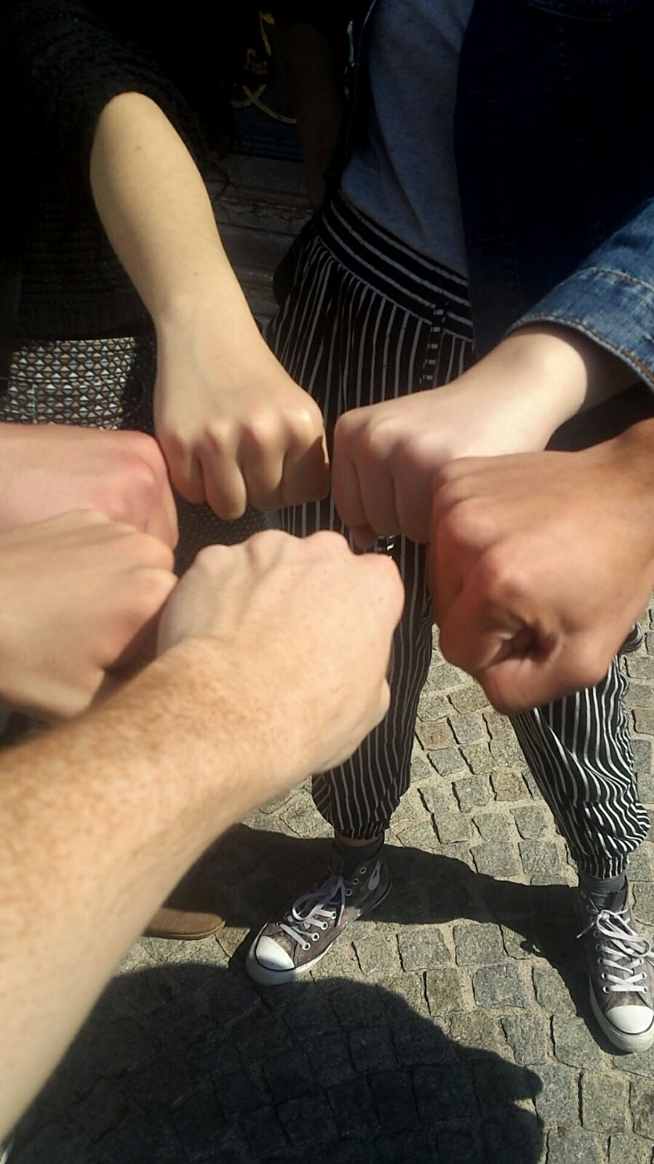
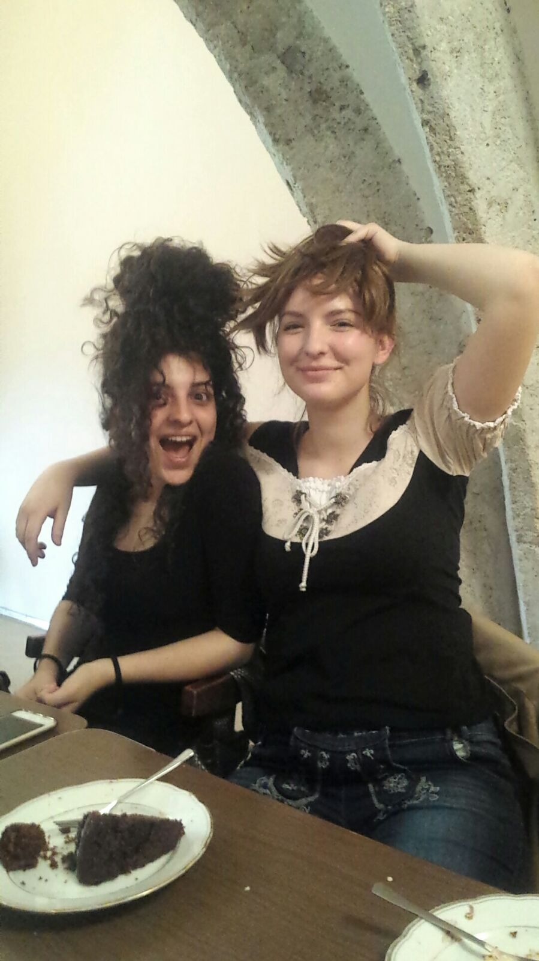
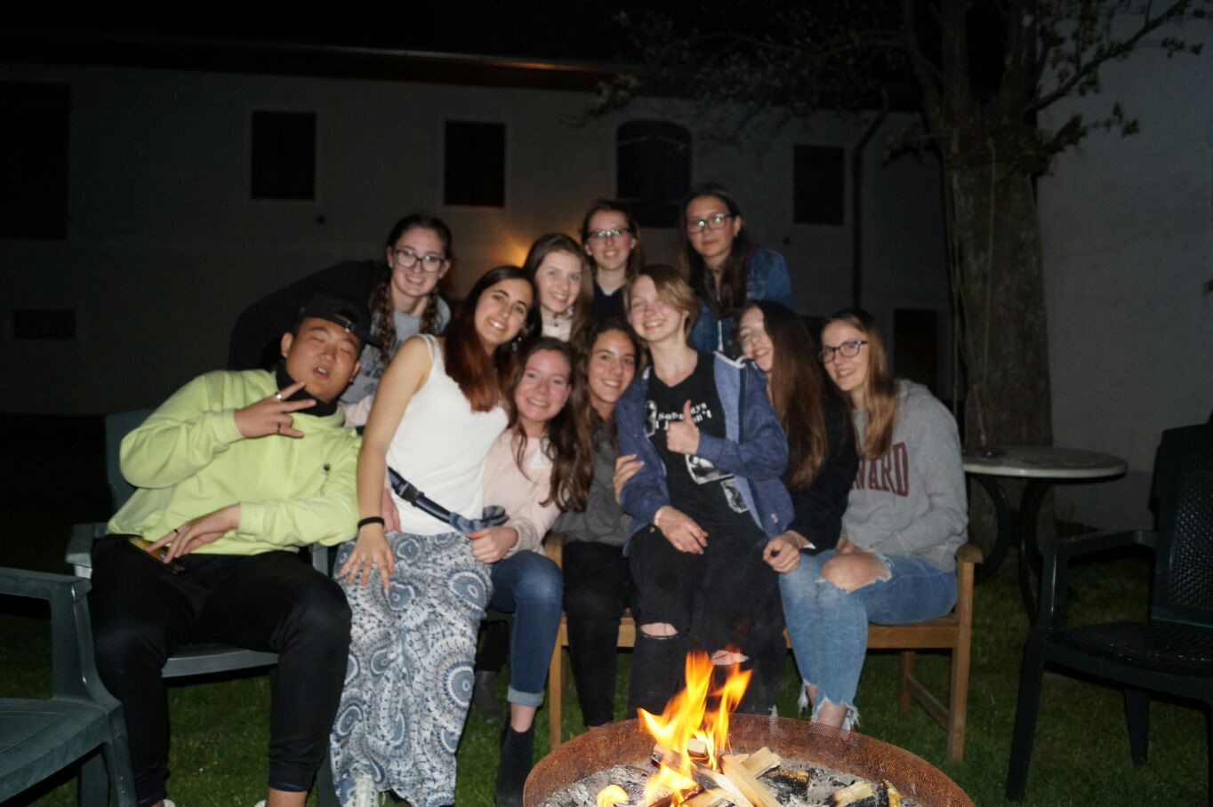
Activities out of the programm
We had much fun everyday but especially with out of the programm activities
On Sunday some people had a barbecue together
On monday we visited Linz where we went to the Haribo shop
While we didnt do anything special on Tuesday some people stayed in wels longer while others had pizza in Lambach
On thursday we celebrated the end of a hard day with some ice cream, cake and music

Slide 9
