Slide 1
Architectural Heritage of Austria
Julia Springer, Sophie Kasper, Christiane Ortner, Beatrice Humer

Slide 2
Architectural Styles in Austria
Romanesque (from 1000)
Gothic (1140-1500)
Renaissance (15th century)
Baroque (1600-1760)
Rokoko (1735-1790)
Classicism (1750-1830)
Art Nouveau (19th/20th century)

Slide 3
Romanesque
The Romanesque describes the historical era in the European medieval art between the pre-Romanesque and the following Gothic era in painting, sculpture and architecture.
The Romanesque architecture began around the year 1000 and was present in entire Europe. It was the time of the crusades and the big debate between the emperor and the pope.
The over 300-years lasting epoch is split in the early Romanesque (ca. 950-1050), high Romanesque (ca. 1050-1150) and late Romanesque (ca.1150) epoch.

Slide 4
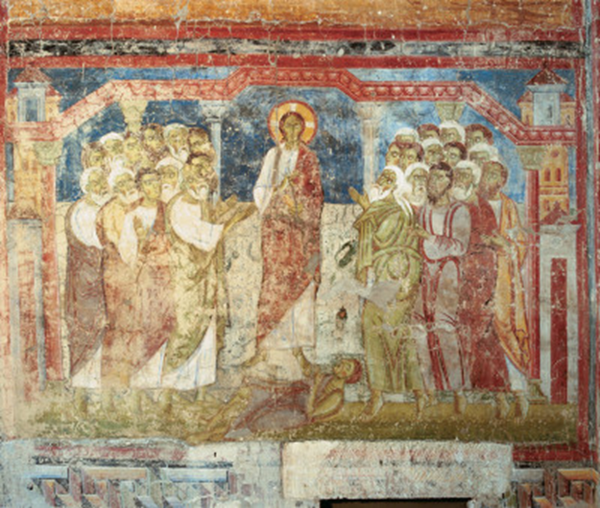
Romanesque Frescos of Lambach
wet plaster wall
natural colours
biblical scenes
colourful pictures due to illiteracy

Slide 5
Fresco
Fresco is the Italian word for “fresh”. The name derives from the fact that painters apply fresco painting on fresh, wet plaster walls. That way the colours really sink in to the plaster, and you get a glowing kind of colour.
Natural colours are used, for example the blue stone.
The first frescos in Austria date back to the Romanesque era. In Lambach the first frescos were created around 1070-90.

Slide 6
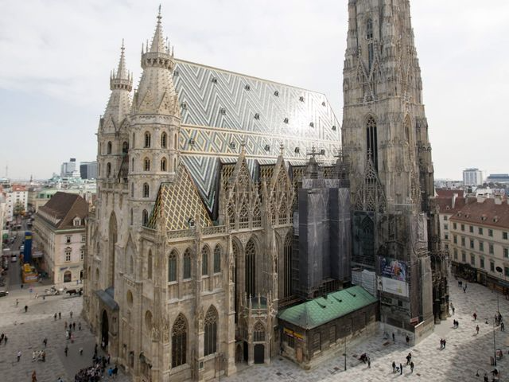
Gothic Stephansdom – St. Stephen‘s Cathedral
St. Stephen’s Cathedral in Vienna is one of the most important sacred buildings of the Gothic time.
It contains styles of the Romanesque art and the Baroque.

Slide 7
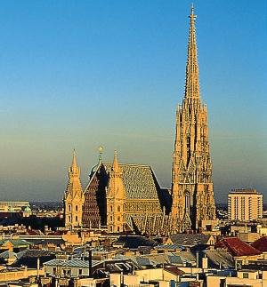
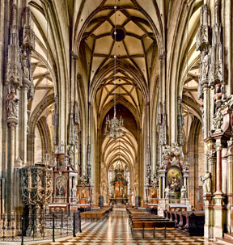
Stephansdom
building as high as possible --> to be close to God
pointed arch
cross-ribbed vault
rectangular layout
lots of decorations

Slide 8
Stephansdom
Because of its Gothic style, the Cathedral seems higher than it actually is.
The northern tower was built in the Baroque style.
In the inside, one can see a mixture of three styles:
the western gallery was built in the Romanesque style
the windows are a typical Gothic style and
the altar and the other decorative elements are built in the Baroque style

Slide 9
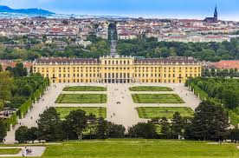
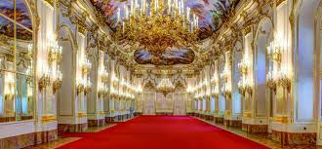
Baroque Schloss Schönbrunn Schönbrunn Palace
17-18th century
tries to impress

Slide 10
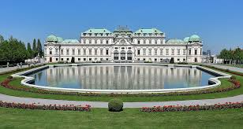
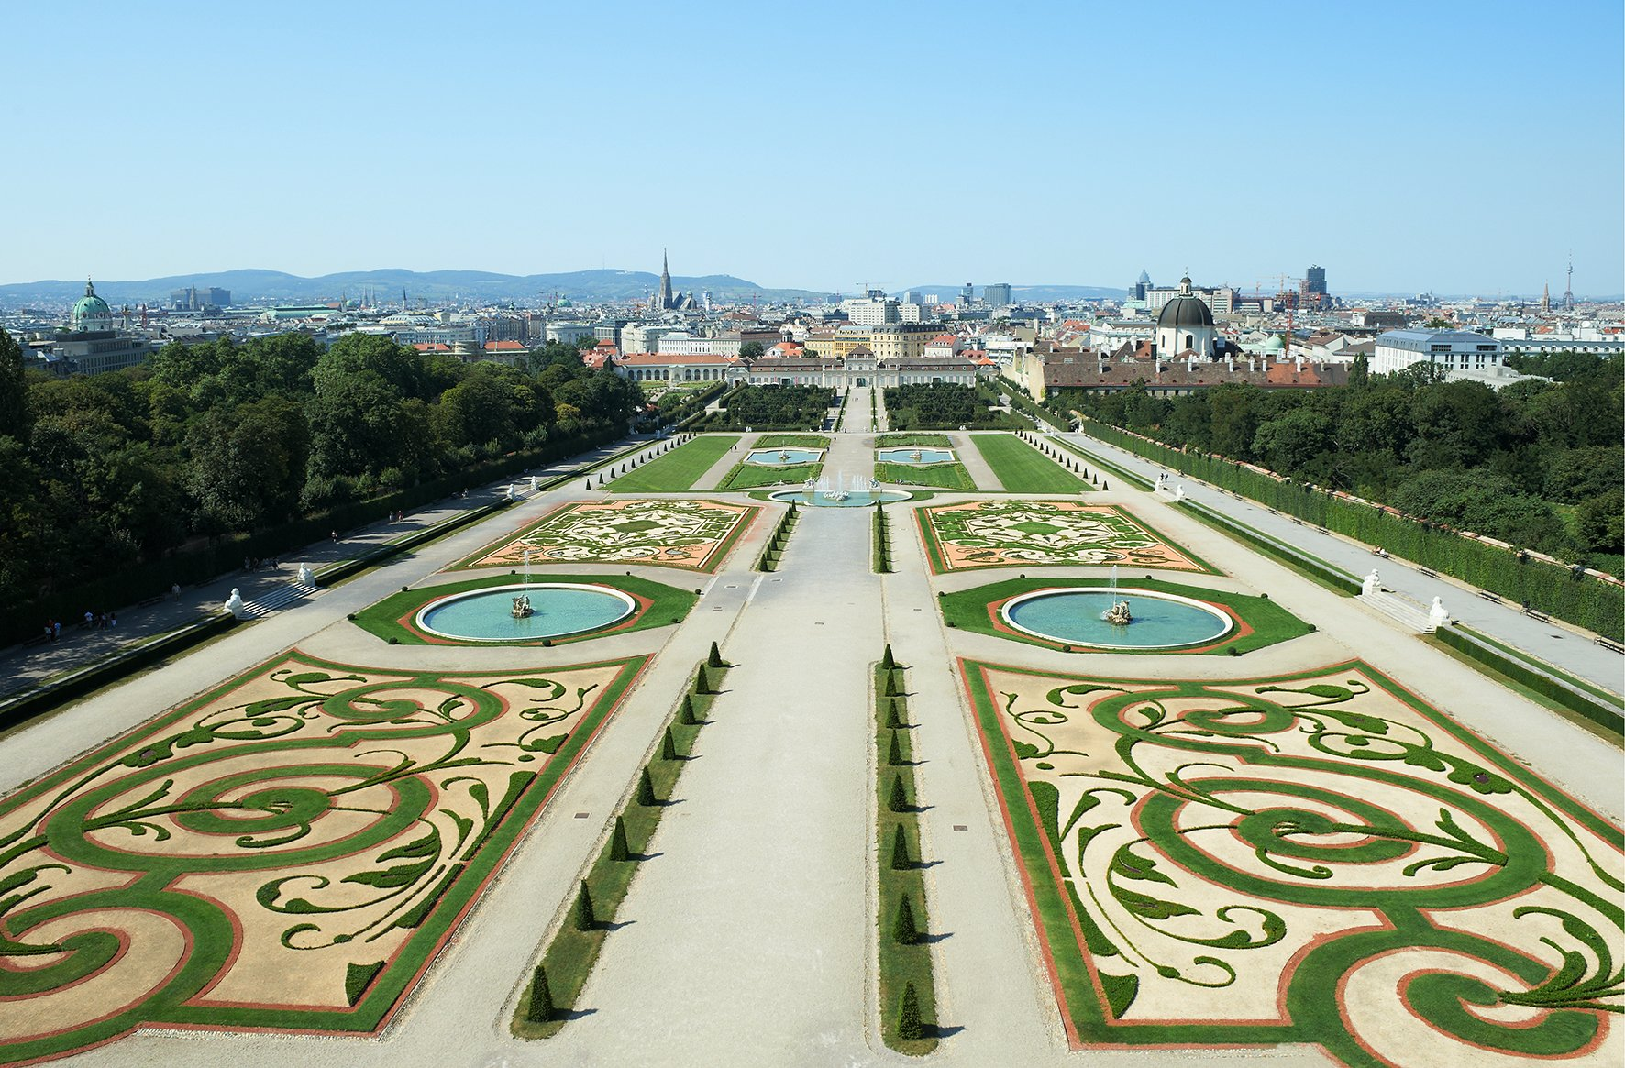
Baroque Belvedere
Wien-Landstraße
built by Johann Lucas von Hildebrand for Prince Eugene
Lower and Upper Belvedere
garden

Slide 11
Baroque
The Baroque Castle Belvedere is located on Wien-Landstraße and consists of two parts, the Upper and the Lower Belvedere, which are separated by a garden.
It was built by Johann Lucas von Hildebrandt for Prince Eugen von Savoy.
The name Belvedere is a general term of architectural history that refers to a building or a part of a building, which provides a beautiful and expansive view.

Slide 12
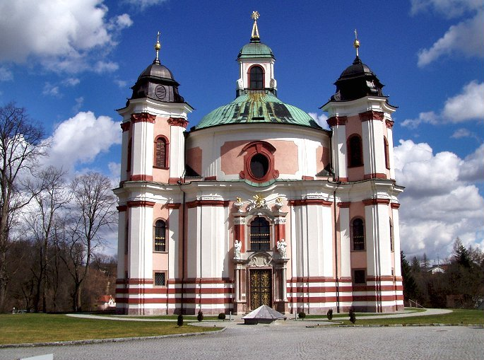
Baroque Trinity Church
placed in Stadl-Paura (Upper Austria)
3 marble portals, 3 altars, 3 towers
Built by Johann Michael Prunner (at the time of the plague).

Slide 13
Trinity Church
The whole structure is dominated by the figure three:
The Church is triangular in shape.
There are three marble portals, three altars, three organs and three towers.
It was built by Johann Michael Prunner from Linz, 1714-1717, after an idea by abbot Maximilian Pagl of Lambach.
The church was built after a vow made by Pagl at the time of the plague in 1713. If the plague (black death) does not hit the area this church is built.
The abbot wished for a place of worship the One God and the Holy Trinity.

Slide 14
Sources
https://www.google.at/search?q=stephansdom&source=lnms&tbm=isch&sa=X&ved=0ahUKEwig773OsvvdAhVSL1AKHQwbAGcQ_AUIDigB&biw=1280&bih=638#imgrc=EUmXGkh2gn1NWM:
https://www.google.at/search?q=stephansdom&source=lnms&tbm=isch&sa=X&ved=0ahUKEwig773OsvvdAhVSL1AKHQwbAGcQ_AUIDigB&biw=1280&bih=638#imgrc=14d8Y8x1kjb0pM:
https://www.google.at/search?q=stephansdom&source=lnms&tbm=isch&sa=X&ved=0ahUKEwig773OsvvdAhVSL1AKHQwbAGcQ_AUIDigB&biw=1280&bih=638#imgrc=cNi1d6JAHWZ7iM:
https://www.google.at/search?q=schloss+sch%C3%B6nbrunn&source=lnms&tbm=isch&sa=X&ved=0ahUKEwjEvbvUtfvdAhVOZFAKHbloDUYQ_AUIDigB&biw=1280&bih=638#imgrc=-ldGQhQtuawQlM:
https://www.google.at/search?biw=1280&bih=638&tbm=isch&sa=1&ei=8rS9W-68O87JwQKNxo3IBw&q=SChloss+belvedere&oq=SChloss+belvedere&gs_l=img.3..0j0i67k1j0l2j0i67k1j0l5.3707.4626.0.4983.8.8.0.0.0.0.124.681.5j3.8.0....0...1c.1.64.img..3.5.482...0i7i30k1.0.d5FCoDoK4PU#imgrc=LwiXPfaOJkhp8M:
https://www.google.at/search?q=Belvedere+Garten&source=lnms&tbm=isch&sa=X&ved=0ahUKEwi4ztjAt_vdAhUBK1AKHRhiBGwQ_AUIDigB&biw=1280&bih=638#imgrc=UxilxS1AQdubRM:

Slide 15
Thank you for your attention

