Slide 1
The founding of the romanian medieval states
Transnational Learning Activity in Lambach, Austria,
14-21 April 2018

Slide 2
Before 1859, the Romanians lived in three different states: Transylvania, The Romanian Country (or Wallachia) and Moldova.

Slide 3
The founding of ALL Romanian medieval states was strongly influenced by Hungary, which tried to conquest to the East. Practically, they apeared either after a defeat or a victory against the Hungarians...
1. TRANSILVANIA (în German Siebenbürgen)
In the 11th-13th centuries the Hungarians conquered Transylvania and organised here a new state, vassal to the Hungarian King.
The ruling elite was formed by Hungarian nobles.
Romanians in Transylvania, although were two third of the population, have fallen to the "tolerated" status, being deprived of their rights, practically slaves on their own land.

Slide 4
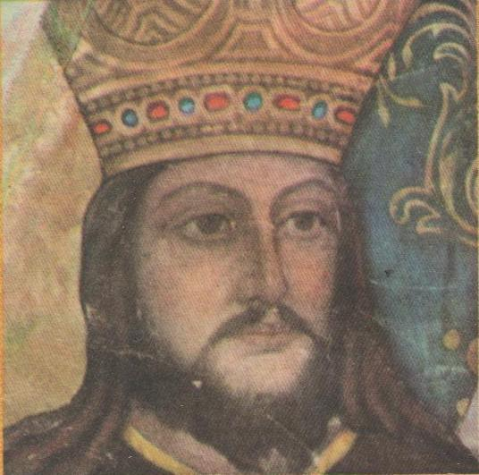
2. TARA ROMÂNEASCĂ (The Romanian Country )
or WALACHIA or Muntenia
The legend:
The ”dismounting” of Radu Negru (Radu The Black), a Trasylvanian Romanian voievod, who crossed the Carpathian to the South and ”dismounted” of his horse here, meaning that he settled down and founded a new country at the beginning of XIX century.
Radu Negru

Slide 5
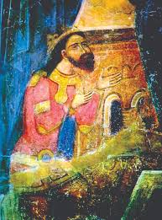
2. TARA ROMÂNEASCA (The Romanian Country )
or WALACHIA, later Muntenia
The historical facts:
Walachia was founded by Basarab I voievod at the beginning of the 14th century.
The kingdom of Hungary attempted to impose its rule on the new state, but the Hungarian king suffered a terrible defeat at Posada in 1330.

Slide 6
The battle for independence from POSADA - 1330
It is described in the famous
”Painted Chronicle from WIEN”;
Almost the entire Hungarian army was crashed in a very narrow canyon;
The Hungarian king itself has hardly escaped and survived dressed in the clothes of poor soldier;

Slide 7
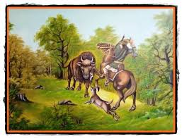
3. MOLDOVA
The legend:
DRAGOȘ, a Romanian voievod from North Transylvania, crossed the Carpathian to the Est when he was hunting an aurochs (a wild bull), together with his fellows and his dog, Molda.
Molda was killed by the bull at the shore of a river, and eventually Dragos killed the beast.

Slide 8
3. MOLDOVA
The legend:
Dragos named the river MOLDOVA, after Molda, his faithful dog.
He liked so much the landscape here, that he decided to ”dismount”, to settle down here with his men in order to found a new country, named after the river – Moldova.

Slide 9
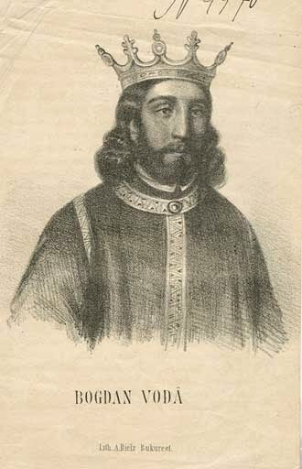
3. MOLDOVA
The historical facts:
MOLDOVA was founded in the middle of the 14th century on the shores of river Moldova.
Dragos was a real person, being sent by his senior, the king of Hungary, to organize a defensive county against the Tatars on the Eastern slopes of the Carpathians.

Slide 10
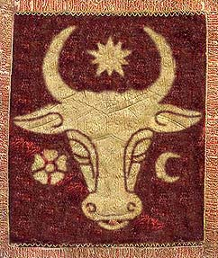
3. MOLDOVA
The historical facts:
But the Moldavians have raised in rebellion against Dragos' descendants and, led by BOGDAN (a rebel Transylvanian princeps), opposed resistance to the Hungarian and gained the independence in 1364/1365.
The real coat of arms of Moldavia remember the legendary bull hunted by Dragos

Slide 11
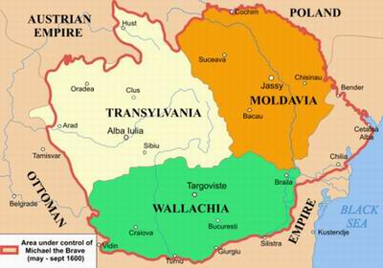
Between the 3 Romanian states there have been permanent ties – trade and a common struggle against the Ottomans.
In 1600, Mihai The Brave united them in one, as you saw in the movie.
The union lasted only one year, Mihai being killed after a betrayal by his Habsburg allies in 1601.
But the memory of the union realised by Mihai has animated all the patriots until the Romanian have been united again in 24 January 1859, the birthday of modern Romania!!

Slide 12
Thank you for your atention, dear Erasmus + friends…
Liceul Tehnologic ”Sfântul Pantelimon”, Bucharest
Dobre Raluca, IX B
Dutu Izabela, IX B
The European Commission support for the production of this publication does not constitute an endorsement of the contents which reflects the views only of the authors, and the Commission cannot be held responsi­ble for any use which may be made of the information contained therein.

