Slide 1
ERASMUS+ 2018
“ Tracing our European Spirit”
Marissa Andronicou, Christina Polyviou, Menexia Savva, Zuzanna Muhsam, Nuria Perez, Ana Nae, Michael Schoeffmann

Slide 2
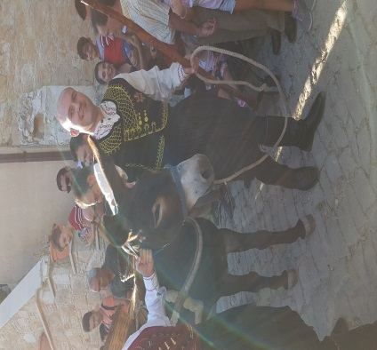
DAY 1 - SUNDAY 23RD OF SEPTEMBER: VOUNI
WHAT WE LIKED ABOUT VOUNI WAS, THE TRADITIONAL DANCES WHICH STUDENTS FROM CYPRUS AND GREECE SHOWED US AND WHICH WE SAW AT THE FESTIVAL. WE ALSO LIKED THE TRADITIONAL FOOD AND OUTFITS.
SOME TRADITIONAL GAMES WE PLAYED WERE: PENTOVOLO, IMAGINARY BALL AND CASABLANCA.
WE TRIED PALOUZE WHICH WE REALLY LIKED ALTHOUGH IT WAS A LITTLE BIT TOO SWEET.

Slide 3
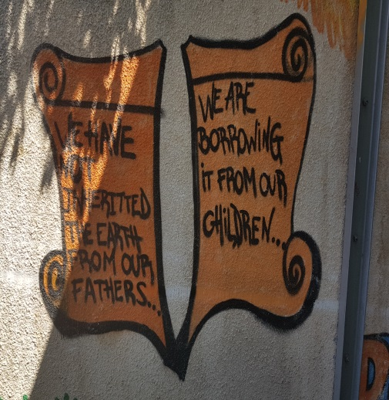
DAY 2- MONDAY 24TH OF SEPTEMBER: LIMASSOL
WE REALLY LIKED THE GRAFFITI IN TH SCHOOL YARD BECAUSE OF THE MEANINGFUL MESSAGE BEHIND IT. IT SAYS THAT WE HAVE TO RESPECT AND TAKE CARE OF OUR ENVIRONMENT.
WE REALLY LIKED THE ATMOSPHERE AND THE VIBE THAT THE SCHOOL GAVE AND HOW PEOPLE WERE VERY KIND TO OTHER EXCHANGE STUDENTS.
ALL THE PRESENTATIONS WERE INTERESTING BUT THE MOST INTERESTING ONE IN OUR OPINION WAS THE SPANISH ONE.
AFTERWARDS WE WENT TO THE MEDIEVAL ART WORKSHOP AND WE REALLY LIKED MAKING OUR OWN POTTERY. IT WAS FUN AND ORIGINAL.
WE REALLY LIKED ALL THE DIFFERENT PAINTINGS.
WE ALSO REALLY LIKED THE MEDIEVAL CASTLE OF LIMASSOL AND HOW OLD IT WAS AND THE HISTORY BEHIND IT.

Slide 4
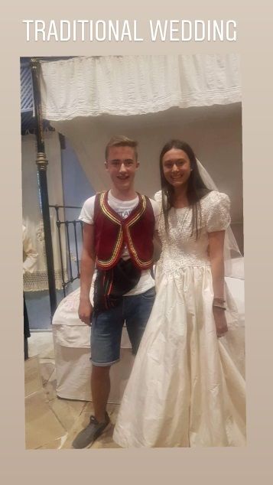
Day 3 – Tuesday 25th of September: LARNACA
WE SAW A TRADITIONAL CYPRIOT WEDDING AND WE REALLY LIKED THE MUSIC AND THE WAY PEOPLE CONNECTED BY DANCING AND SINGING WHIL JOINING THE COUPLE
WE ALSO FOUND OUT THAT ANOTHER NAME FOR ‘HALA SULTAN SEKKE’ IS MASQUE OF UMM HARAM
WE ALSO VISITED THE SAINT LAZARUS CHURCH. IT WAS A MIRACLE OF JESUS IN THE GASPEL OF JOHN, IN WHICH JESUS RESTORE HIM TO LIFE FOUR DAY AFTER HIS DEATH.
THE MEDIEVAL CASTLE THAT WE VISITED IN LARNACA IS LOCATED AT THE END OF THE FOINIKOUDES PROMENADE.

Slide 5
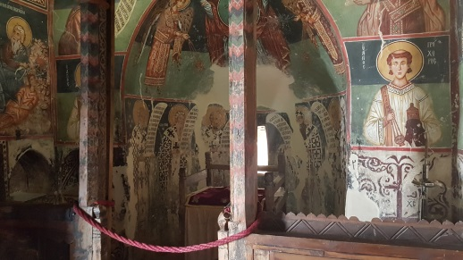
DAY 4- WEDNESDAY 26TH OF SEPTEMBER: NICOSIA
FROM THE “ SHACOLAS TOWER MUSEUM” WE CAN SEE THE BORDER WITH TURKISH PART AND THE MOUNTAINS WITH THE TURKISH FLAG.
WE ALSO VISITED OTHER MONUMENTS LIKE THE HOUSE OF HADJIGEORGAKIS KORNESIOS AND LEDRAS.

Slide 6
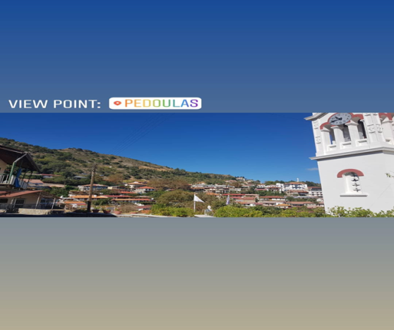
DAY 5- THURSDAY 27TH OF SEPTEMBER: KALOPANAGIOTIS
WE VISITED DIFFERENT OLD AND TRADITIONAL CHURCHES SUCH AS AGIOS NIKOLAOS STEGIS, ARCHANGELOS MICHAEL IN PEDOULAS AND ST. JOHN LAMPADISTIS.

Slide 7
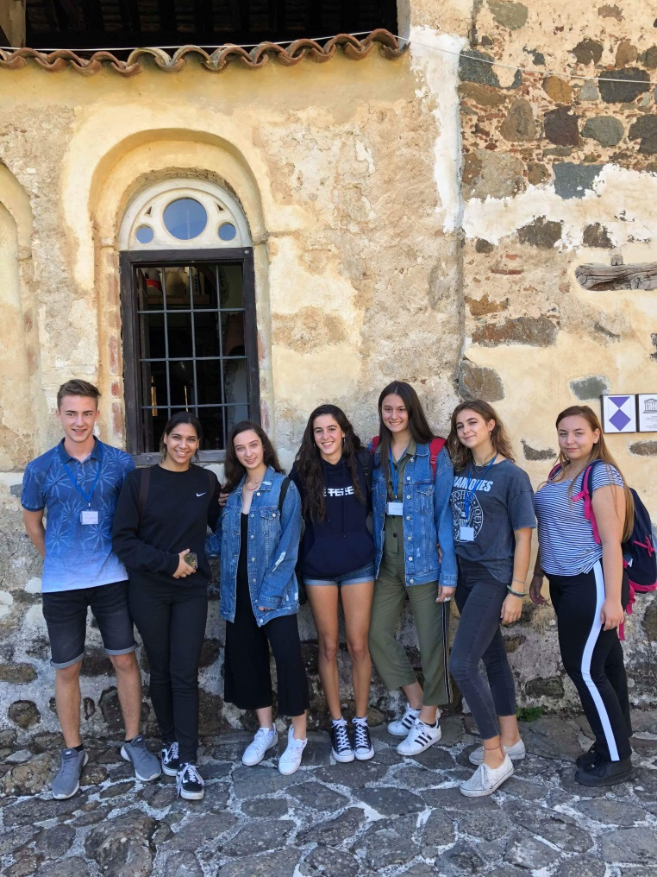
THE END!!!!
P.S. PHOTOS TAKEN BY US

