Slide 1
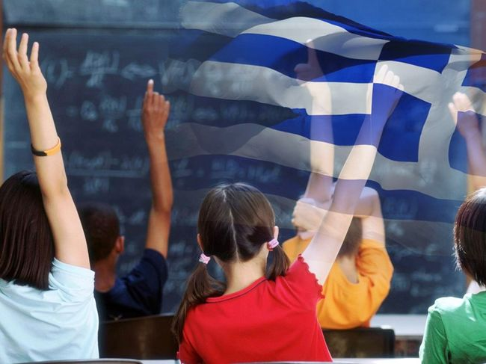
EDUCATION IN GREECE
Erasmus+ 2017-2019
“tracing our European spirit”

Slide 2
three levels of the educational system
The Greek educational system is mainly divided into three levels: primary, secondary and tertiary.
Primary education is divided into kindergarten lasting one or two years, and primary school spanning six years (ages 6 to 12).
Secondary education comprises two stages: Gymnasio (variously translated as Middle or Junior High School), a three-year school, after which students can attend General Lykeion (Lykeion translated as Senior High School) or Technical Lykeion.
Higher Tertiary education is provided by Universities (A.E.I), Technological Universities (T.E.I.) and Academies which primarily cater for the military and the clergy.
All levels are overseen by the Ministry of Education, Research and Religious Affairs.

Slide 3
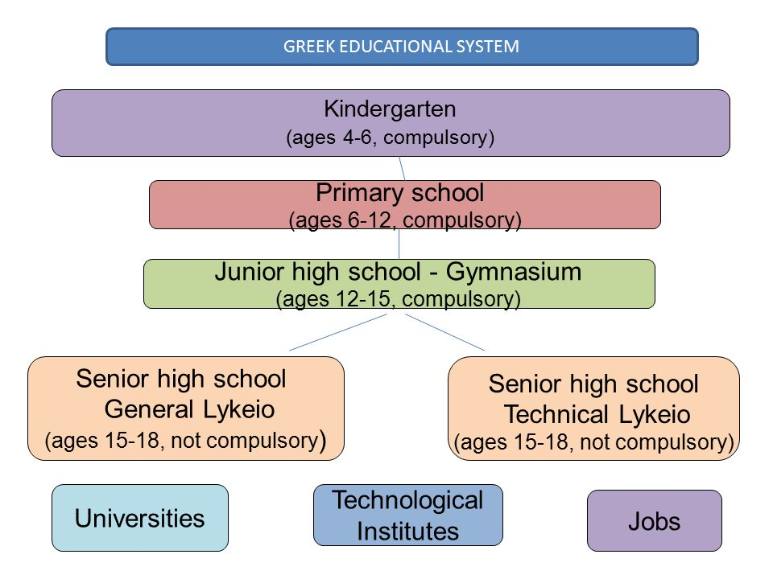

Slide 4
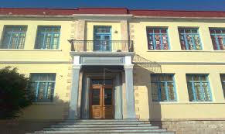
Primary education
Before the Elementary school, kids must attend the Kindergarten from age 5 to 6 before moving to the Elementary School. Elementary schools are called "Dimotiko" (demotic, meaning municipal).The name remains although it has been obsolete for decades. Graduating from one year to the next is automatic, and pupils with deficient performance are given remedial tutoring. Years are six and called "classes", from first to sixth.
A normal school-day starts at 8.15 and finishes in 13.15. The classes last between 45 and 90 minutes with 3 breaks. The school year always starts on September 11th and ends on June 15th . The students have summer vacation (about 3 months), Christmas vacation (2 weeks) and Easter vacation (2 weeks).
Some of the subjects are: Modern Greek language, Mathematics, Music, Physics, Geography, Environmental Studies, History, Computers, Art and English Language etc.

Slide 5
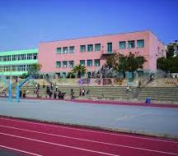
Secondary education Gymnasio
Starts on September 11th and ends on early June before the first day of the Panhellenic exams. The lessons end in 31st May so that the students will be able to study for their examinations in early June. The classes start at 8.15 and end from 13.55 to 14.15 according to the type of school. Classes last from 30 min. to 45 min. and there are breaks of 10 and 5 minutes between them.
Gymnasio has three “classes” and the attending is obligatory.
The lessons that the students will be exanimated in early June are Modern Greek Language/Modern Greek Literature, History, Mathematics and Physics. The duration for every exam is 2 hours except Modern Greek Language/Modern Greek Literature which is 3 hours.
Of course there are more subjects like Ancient Greek Language/Literature, Biology, Chemistry, Foreign Languages but they are examined through hourly tests during the school year.

Slide 6
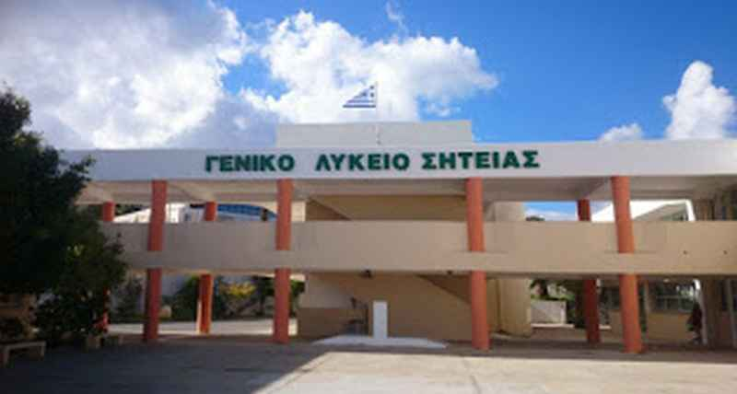
Secondary education Lyceum
Starts on September 11th and ends on 15th June. The lessons end in late May so that the students will be able to study for their examinations in June. The classes start at 8.20 and end from 13.55 to 14.20 according to the type of school. Classes last from 35 min. to 45 min. and there are breaks of 10 and 5 minutes between them.
There are 7 types of lyceums in Greece:
1. General Lyceum
2. Athletic Lyceum (to enter this type of school students must pass certain exams on a sport like football, basketball, volleyball etc.)
3. Musical Lyceum (to enter this type of school students must pass certain exams on a musical instrument)
4. Art Lyceum (to enter this type of school students must pass certain exams on either arts, dance, or theater)
5. Experimental Lyceum (to enter this type of schools students must pass certain exams on Mathematics, Science, Reading Comprehension and Writing
6. Church Lyceum
And the 7th is the Technical/Vocational Lyceum.
The six first types have a lot of similarities in the curriculum and they have the same Panhellenic exams. The Technical differs both in the curriculum and the exams.

Slide 7
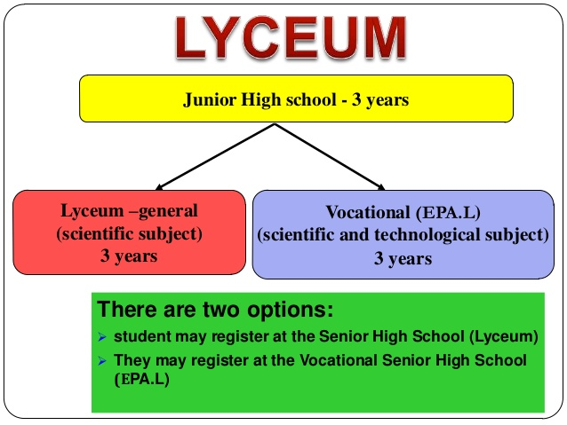

Slide 8
General Lyceum- General High School
1st Grade of General Lyceum : Subjects of General Education (Ancient/Modern Greek, Algebra, Geometry, Physics, Biology, History, Chemistry etc)
2nd Grade of General Lyceum: a. Subjects of General Education
b. The students can choose 1 of the 2 Orientation Groups:
1. Subjects of the Humanities Orientation Group ( Ancient Greek and Social Science)
2. Subjects of the Sciences Orientation Group (Physics and Mathematics)
3rd Grade of General Lyceum : a. Subjects of General Education
b. The students can choose 1 of the 3 Orientation Groups:
1. Subjects of the Humanities Orientation Group (Ancient Greek, History, Latin, Sociology)
2. Subjects of the Economical and Computer Studies Orientation Group (Mathematics, Economy, Computers, History)
3. Subjects of the Science Studies Orientation Group (Biology, Chemistry, Physics, Mathematics)

Slide 9
As mentioned above, the students must take the Panhellenic national Examinations in order to proceed to the Higher Tertiary education. These exams are held after the students have received their Apolytirion. The students pass into a specific Higher Educational Institute based on the Orientation and Group chosen. Starting from 2018, the students of the 3rd grade will give 4 subjects for the school exams because of the Panhellenic Exams. These subjects are Greek Language, History, Mathematics and Biology. The duration for every exam is 2 hours. The students of 1st and 2nd grades, will give some of the theory subjects.

Slide 10
Technical/ Vocational High School
1st Grade of Vocational Lyceum: Subjects of General Education
2nd Grade of Vocational Lyceum: The students can choose 1 of the 9 Sectors:
1. Sector of Αgriculture, Food and Environment 6.Sector of Administration and Economy
2. Sector of Structural Works, Structural Environment and Architectural Design 7. Sector of Applied Arts
3. Sector of Electrical Engineering, Electronics and Automation 8. Sector of Engineering
4. Sector of Information Technology 9. Sector of Health-Providence and Well-Being
5. Sector of Shipping Professionals
3rd Grade of Vocational Lyceum: According to the Sector that the students selected in the 2nd grade, the students must take the Panhellenic national Examinations in order to proceed to the Higher Tertiary education. These exams are held after the students have received their Apolytirion which is same with the General's Lyceum.

Slide 11
Τhank you for your attention!!!

