Slide 1
ARCHITECTURAL
HERITAGE
Wooden churches in Romania
– architecture, history, tradition
4rd Transnational Learning Activity SPAIN, 10-17.11.2018

Slide 2
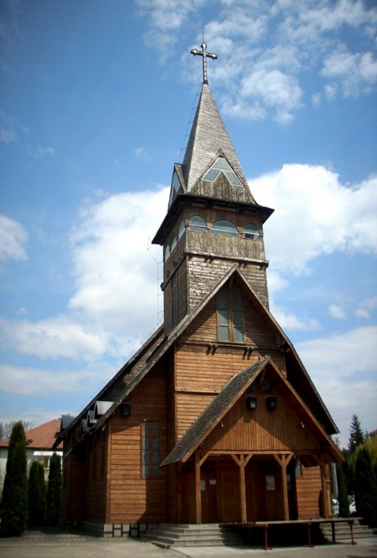
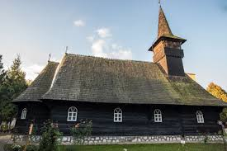
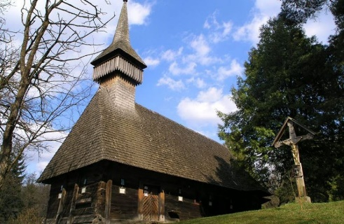
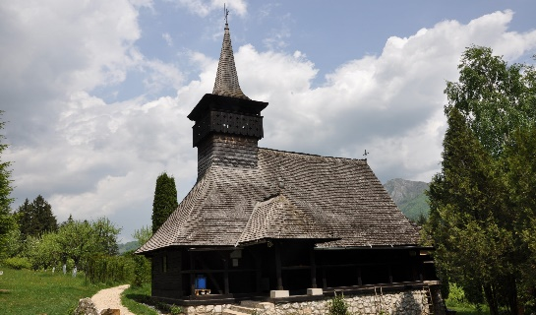
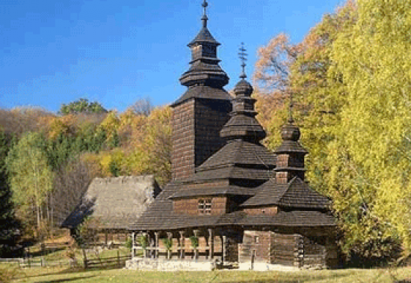
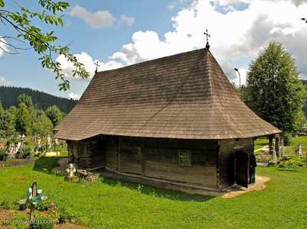
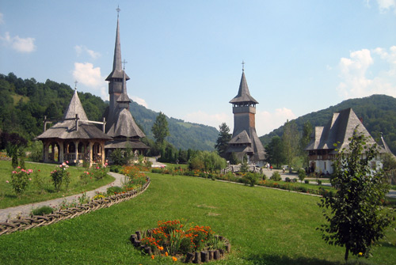
The wooden churches in Romania represent a valuable heritage of the national and world culture, an expression of a rich, various and remarkably refined civilization of wood manifested for centuries. In Romania there are more than 1,400 wooden churches built before 1918. Their historical and cultural value is inestimable, being a landmark for the Romanians' national identity.

Slide 3
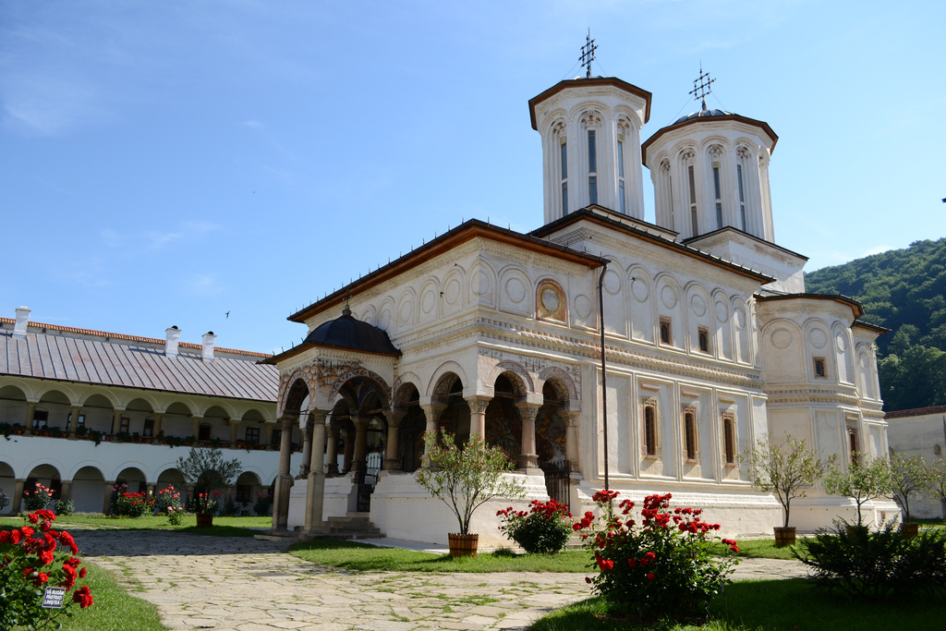
In all medieval Romanian space, in all villages and fairs, the first places of worship were made of wood. While the stone and brick churches, which started being built in the fourteenth and fifteenth centuries, were built by rulers and boyars, the small wooden churches were erected on the initiative and collective effort of the village communities.

Slide 4
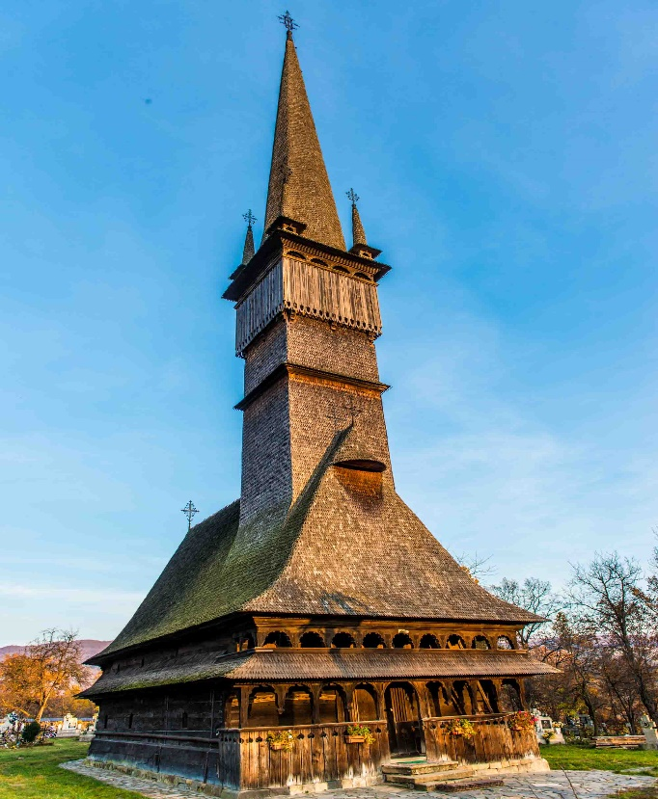
The wooden churches have a significant historic value, being witness to some very important historical events that happened in the Transylvanian settlements. Until the nineteenth century, the Romanians in Transylvania were forbidden, either by the Hungarian or the Austrian domination, to build orthodox churches made of stone or bricks.
As a result, wooden churches became a symbol - reflected even in the elongated architectural form - of the national aspiration for freedom of the Transylvanian Romanians.
Transylvania is the place where the wood architecture developed, a type of architecture that gave birth to the most beautiful Romanian Orthodox churches, a proof of the continuity of the Romanians in Transylvania.

Slide 5
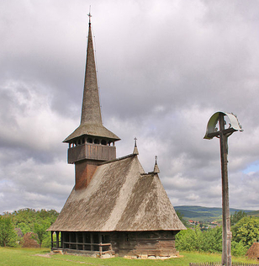
Wooden churches are generally rectangular in shape, elongated between sunrise and sunset and consist of four parts:
The narthex or "The Women's Church", above which a tower with a small balcony is built where the belfry is located.
The nave or "The Men's Church".
The altar or the shrine.
The porch with carved pillars on the south side.

Slide 6
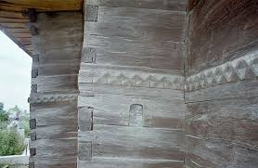
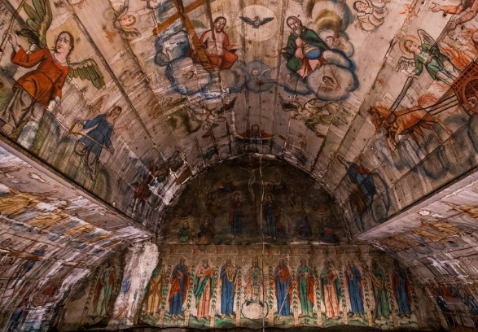
The walls are made of fir or oak beams, trimmed by axe and fixed only in wooden nails. Iron nails are not used.
The vault/dome reproduces the image of the heavenly world and the sacredness of this space.

Slide 7
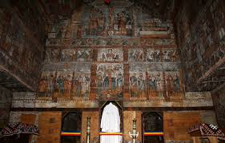
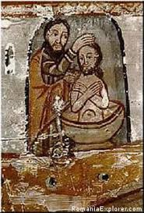
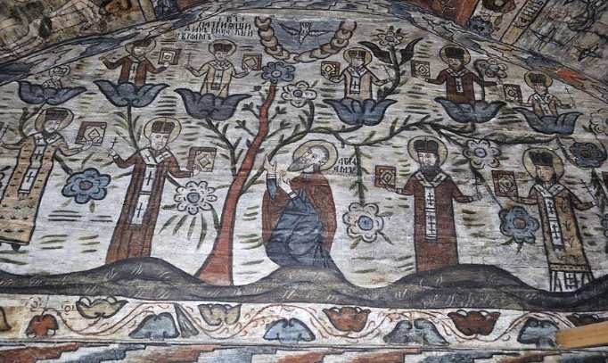
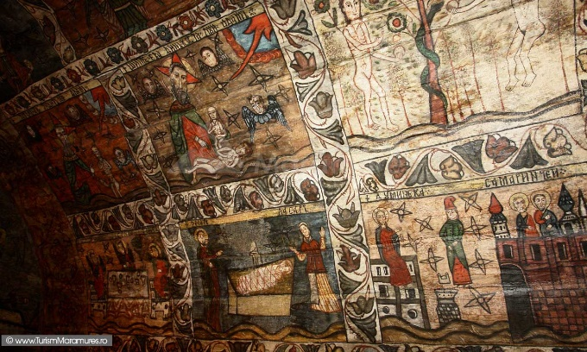
The wooden churches were painted in the vivid colourful style of the Byzantine architecture. They depicted faces of saints and biblical scenes suggestive for the Romanian peasants - who were largely illiterate-, but also aspects of local life and images of the traditional costumes.

Slide 8
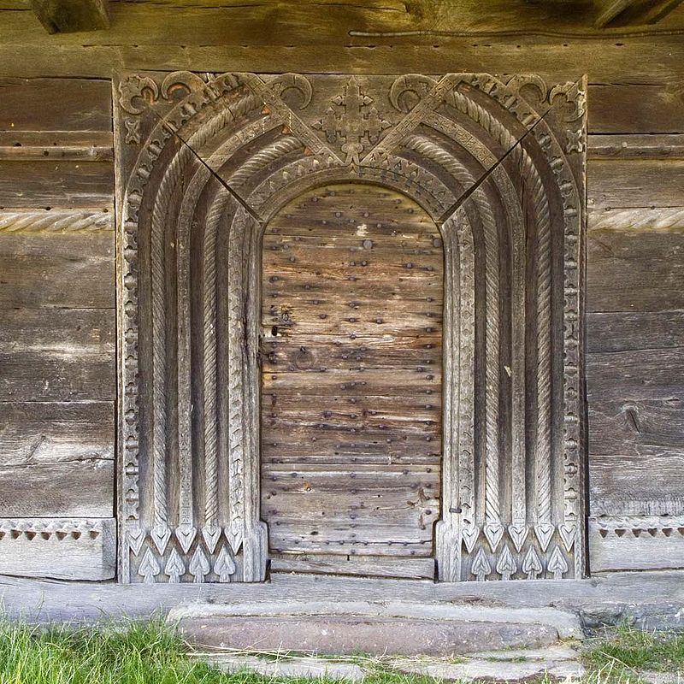
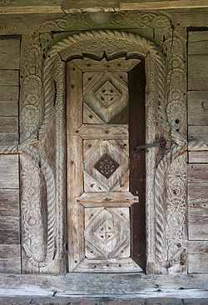
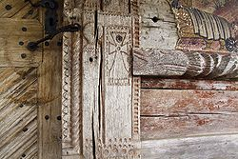
One of the most interesting and mysterious features of the Romanian wooden churches is the sculptured language of the portals, portals both in physical and symbolic ways. They feature a wide variety of symbolic and decorative carvings, which can be compared to the portals of the Gothic cathedrals.
The language of the portals betrays a veiled religious symbolism, difficult to understand, its defining elements being often geometric (rosettes, ropes, diamonds), completed by figurative-descriptive elements: crosses, fir trees, flowers, animals, birds, celestial and terrestrial objects, human figures.

Slide 9
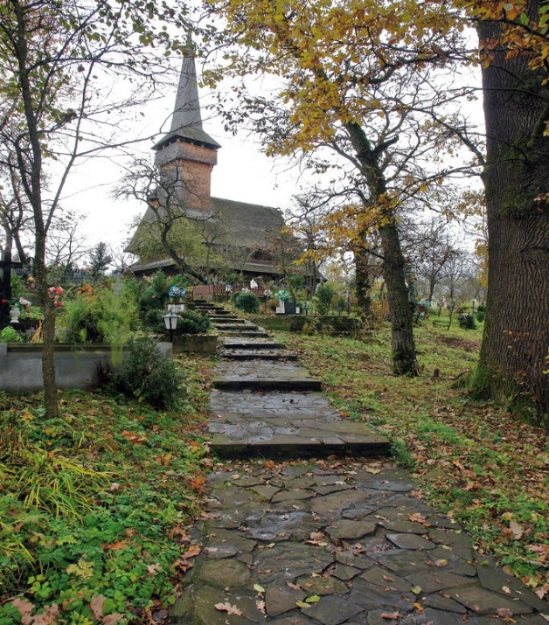
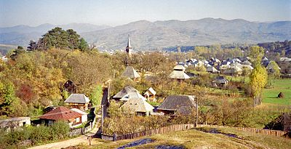
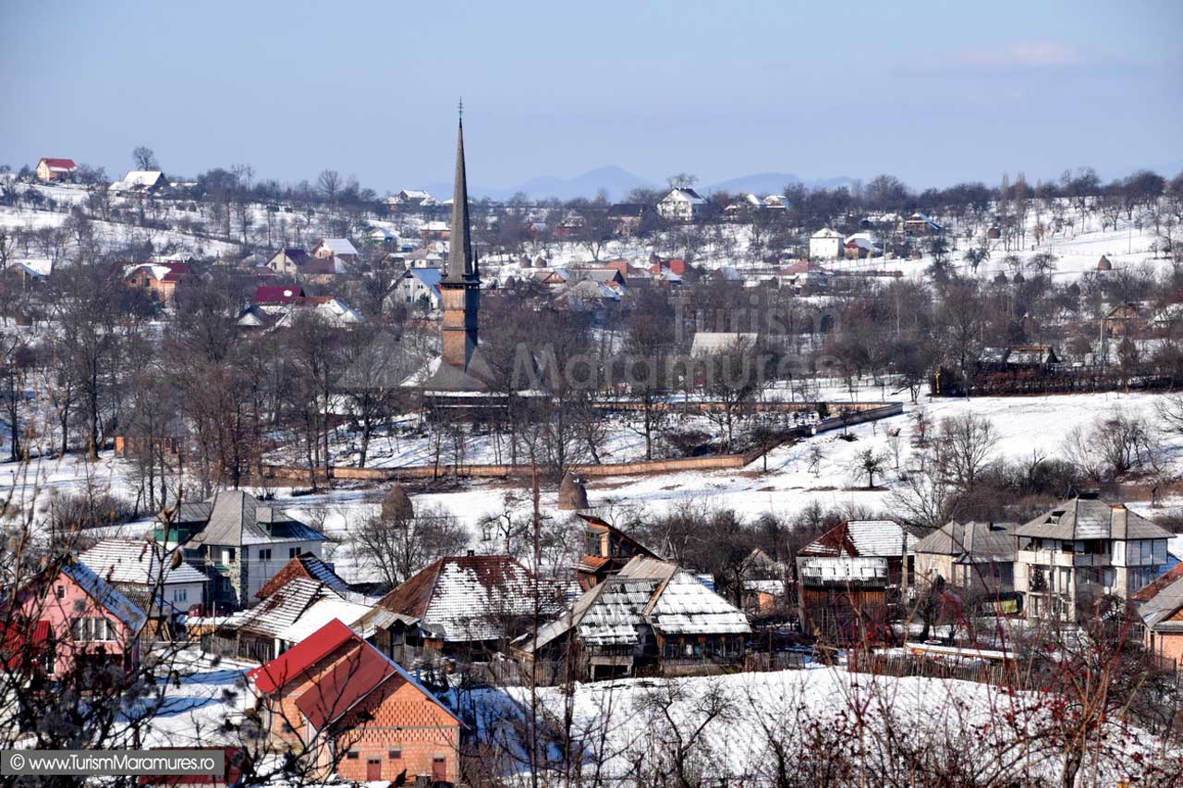
The wooden churches were raised in the most important place of the village, usually, the highest, from where they dominated the settlements (in plain areas they were situated in the centre of the village). The entire rural life took place around these places of worship. They had the value of "axis mundi" (the centre of the world) in both the spiritual and the material life of the Romanian village.

Slide 10
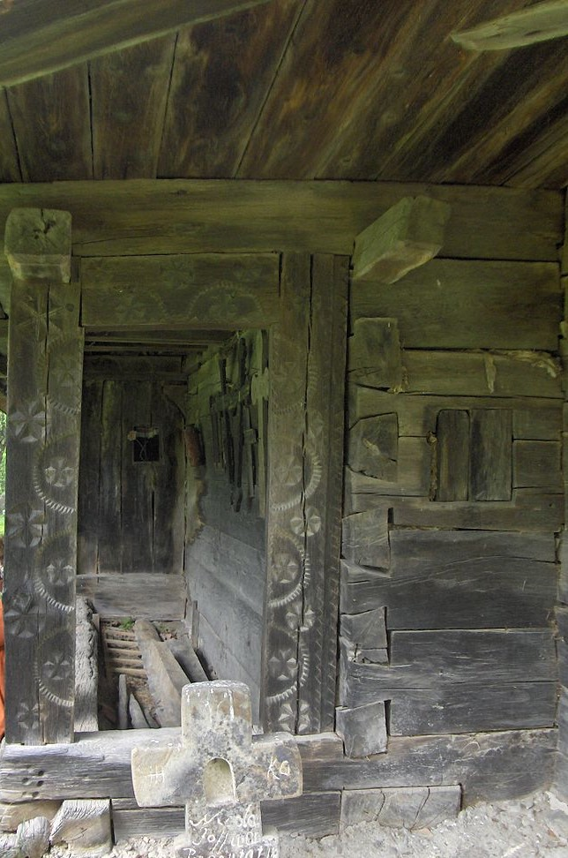
Beyond the historical and religious dimension, the church is also a valuable witness of the past traditions. It was not only a place of worship, but a place of judgement for those who committed bad deeds.
The guilty were subjected to the moral conviction of the village, the punishment instrument being the "pranger", meaning "the pillar of infamy" - in fact a kind of yoke in which the hands and the head of the guilty person were blocked for 1 -2 days.
Generally, the thieves and the adulterous women were punished this way, being at the same time subjected to public opprobrium.
The judgement took place on a celebration day, when the whole village was present at the church.

Slide 11
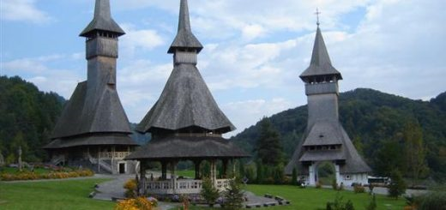
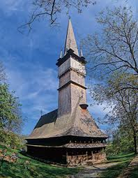
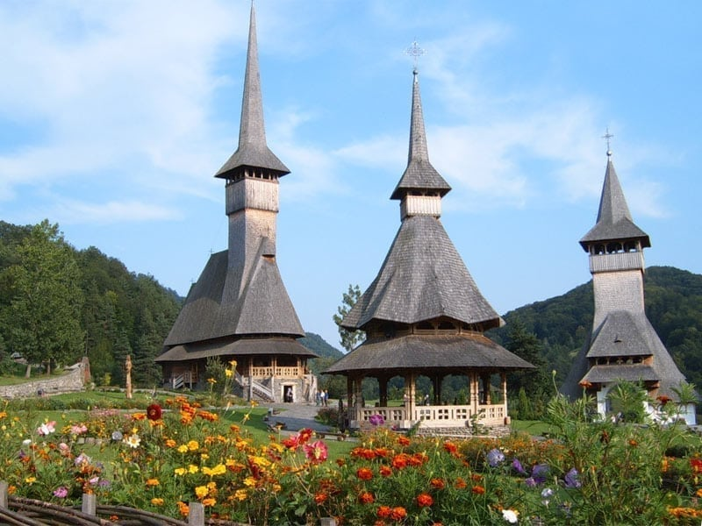
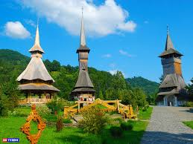
Beyond the harmony of their proportion and the architectural beauty, these buildings are remarkable for their high artistic value and originality.
In Maramureş there is still a real chain of wooden churches, because the locals have resisted the test of time and preserved their traditions.

Slide 12
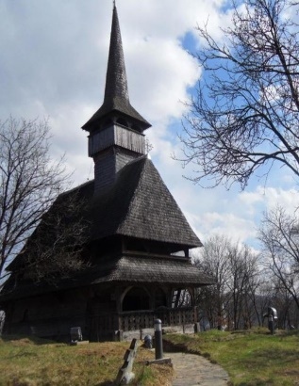
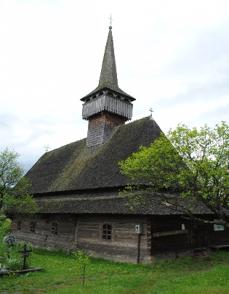
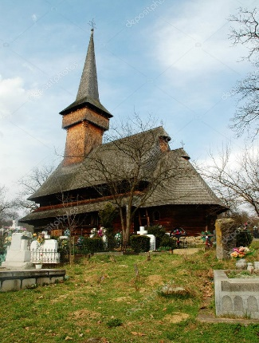
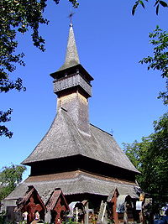
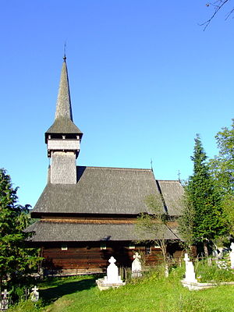
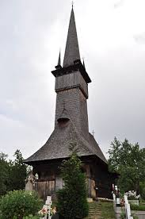
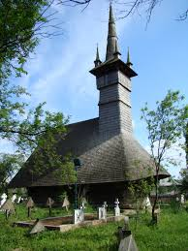
Eight wooden churches - masterpieces of the wood architecture in Maramureş County - have been on the UNESCO World Heritage List since 1999, being a remarkable Romanian contribution to the cultural treasure of humanity.
1. The Church of the Presentation of the Virgin in the Temple, Bârsana
2. The Church of Saint Nicholas, Budești
3. Saint Parascheva Church - Desești
4. The Ieud Hill Church, Ieud
5.The Church of the Archangels Michael and Gabriel, Plopiș
6. Saint Parascheva Church, Poienile Izei
7. The Church of the Holy Archangels, Rogoz
8. The Church of the Archangels Michael and Gabriel, Șurdești

Slide 13
THANK YOU!
The European Commission support for the production of this publication does not constitute an endorsement of the contents which reflects the views only of the authors, and the Commission cannot be held responsi­ble for any use which may be made of the information contained therein.

