Slide 1
THE OTHER MEDIEVAL EUROPE: The Romanian case
3rd Transnational Learning Activity LEMESOS, Cyprus, 22-29.09.2018

Slide 2
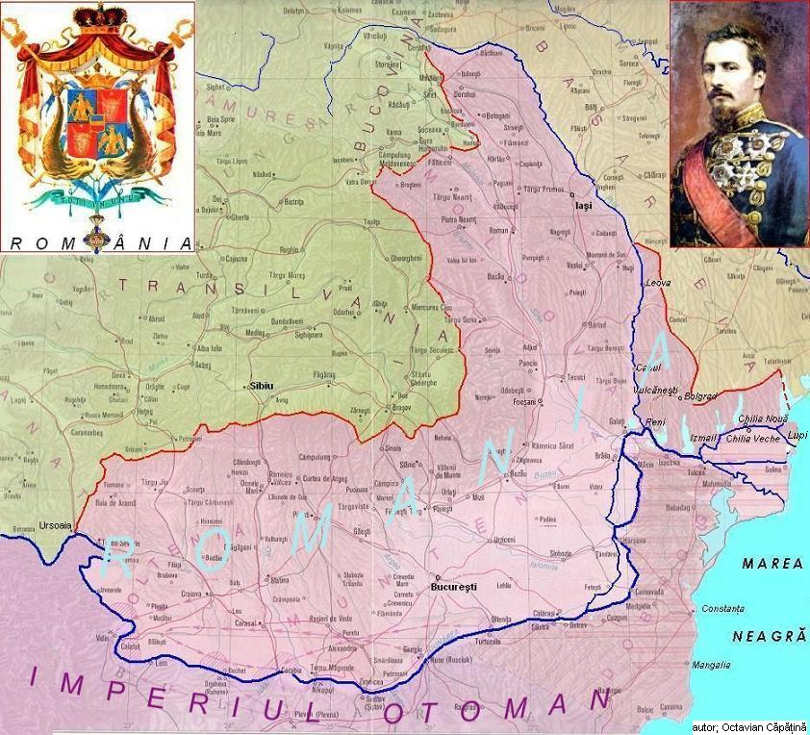
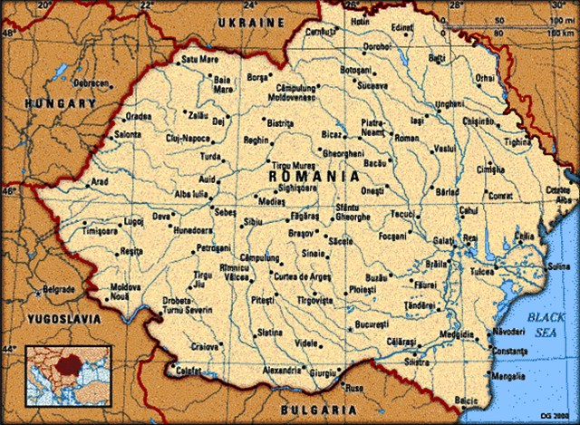
Until 1859, there were no country named ”România”!
Instead of a single state, there were three Romanian countries: Transilvania, Walachia and Moldova.
The union of Moldova and Walachia on 24 January 1859 is the birth moment of Romania.
In 1918, it followed the great unification of Transylvania.

Slide 3
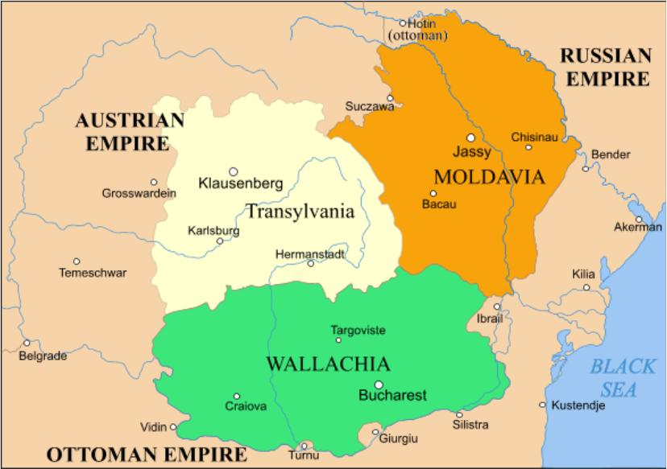
But, until that moment, it was a long journey:
The Romanians and the Ottomans
For more than a half of a milenium, the Ottoman Empire was the main foriegn threat for the Romanian countries.
The Romanian states were the only ones in Eastern Europe to survive; they entered under the Ottoman domination (a very heavy one), but always outside the Empire borders.
The capitulations signed with the Ottomans didn’t allow the Turks to live on Romanian soil and to build mosques there.

Slide 4
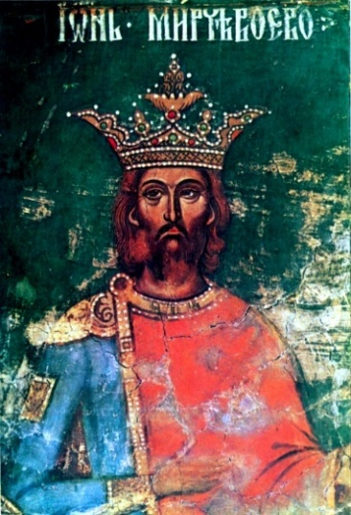
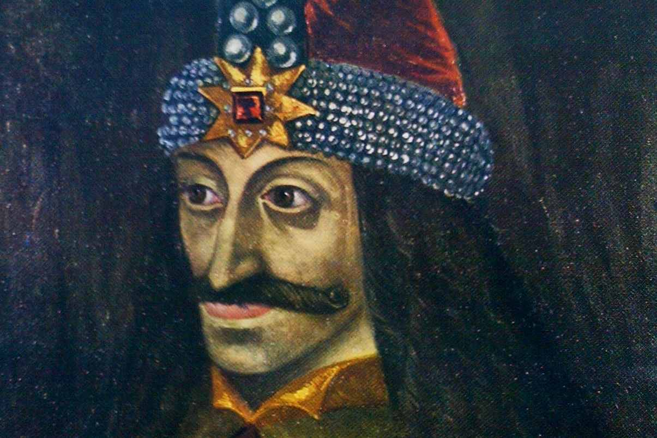
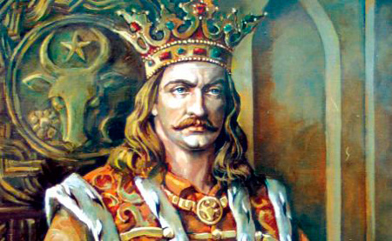
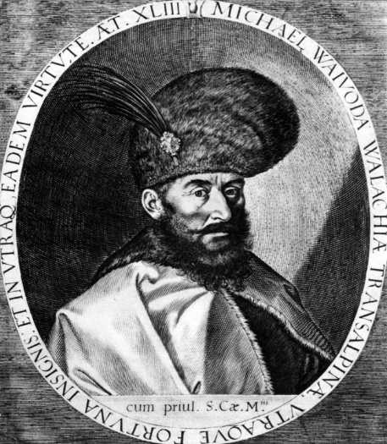
The Romanians and the Ottomans
From time to time, the Romanian Princeps started again the freedom war against the Turks: Mircea the Old, Vlad the Impaler, Stefan the Great, Mihai the Brave

Slide 5
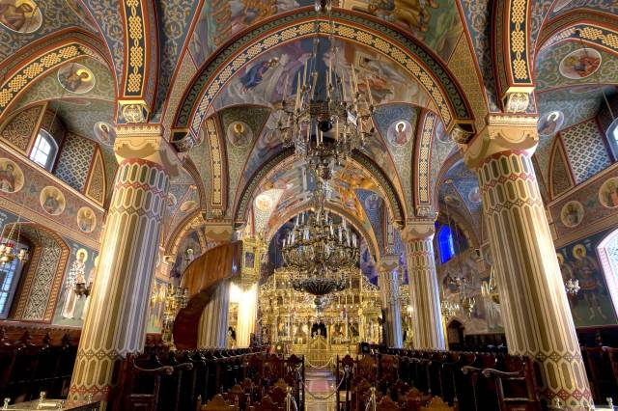
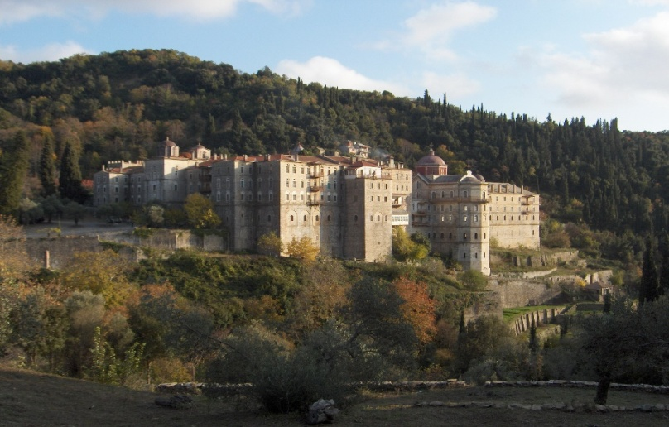
Being the only Orthodox rulers in Europe, they were also the main helpers of their Orthodox brothers (Greeks, Serbs, Bulgarians)...
For example: Kikkos Monastery in Cyprus or Mount Athos Monasteries were subsidised by the Romanian Princeps.
Zografu Monastery, at Athos, were entirely rebuild by Stefan the Great, princeps of Moldavia.

Slide 6
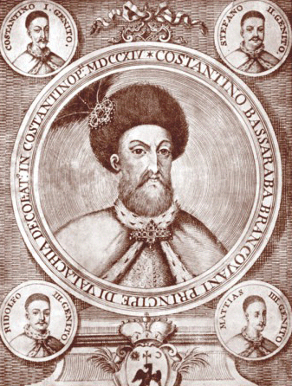
An enlightened ruler and a Christian martyr:
CONSTANTIN BRANCOVEANU

Slide 7
Constantin Brâncoveanu was
Prince of Wallachia between 1688 and 1714, the country being under Ottoman domination.
During his reign of 26 years,
C. Brâncoveanu proved to be a perfect ruler and a good manager of the wealth of the country, establishing an era of prosperity and peace.

Slide 8
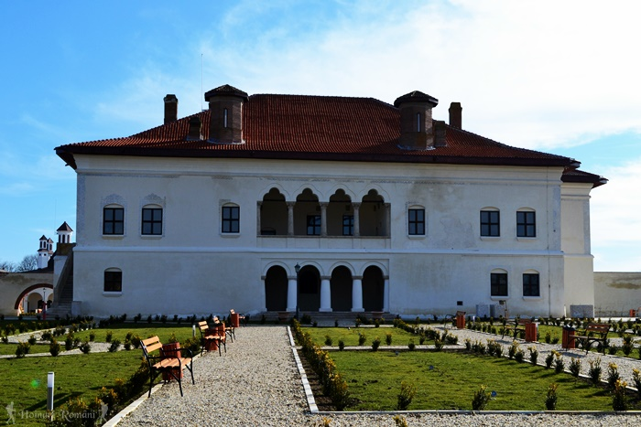
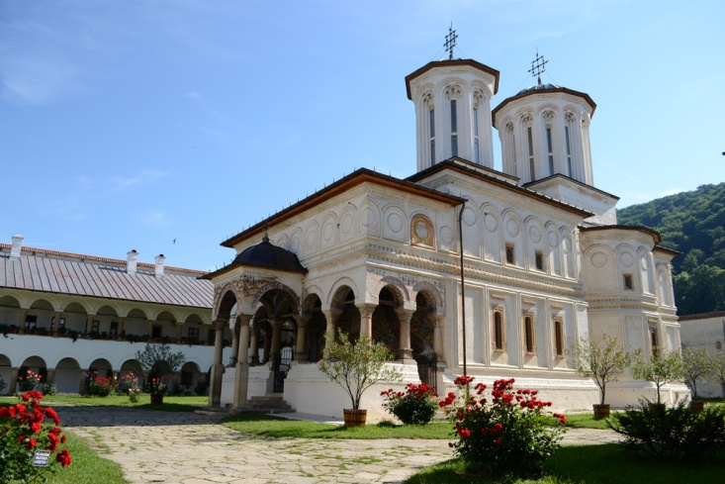
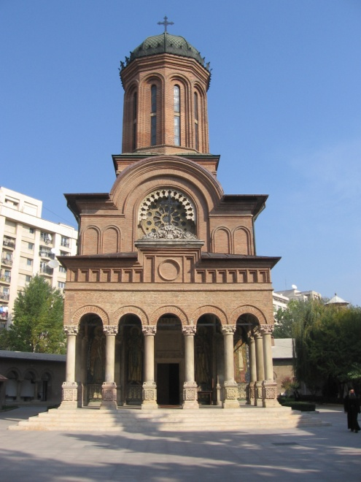
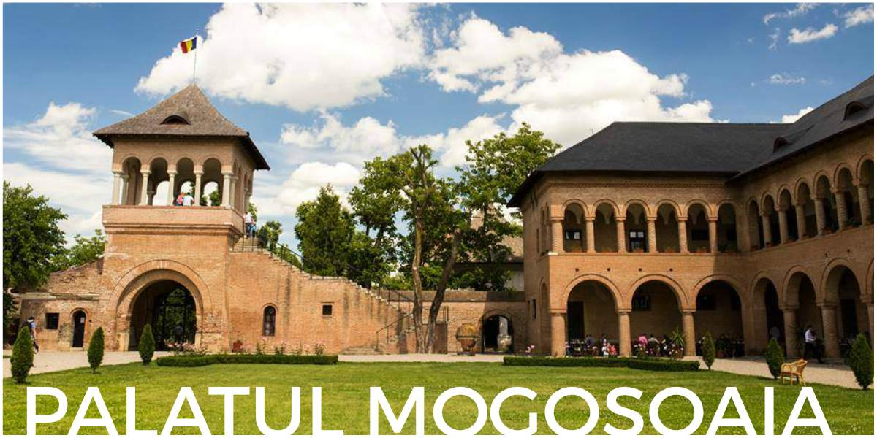
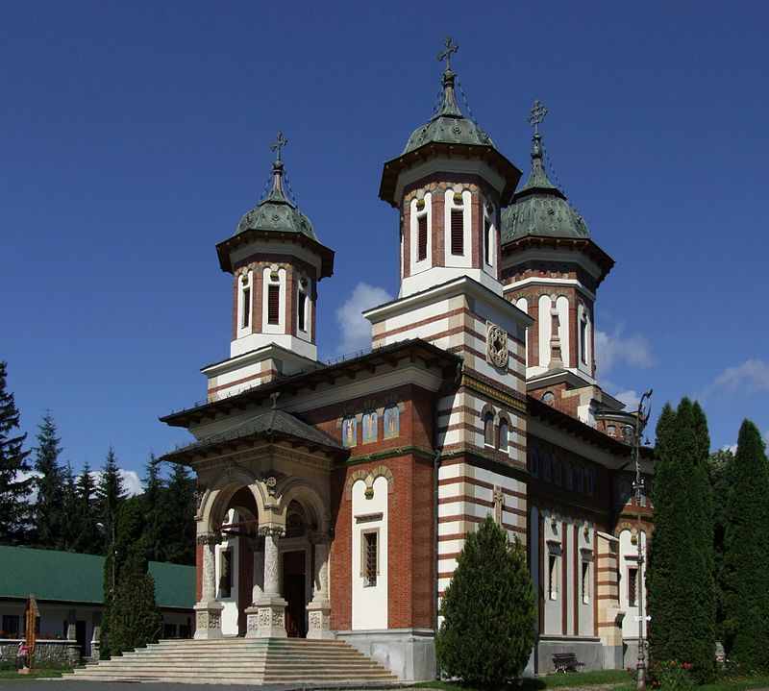
In his religious and secular constructions, Brâncoveanu succeeded to harmoniously combine the local tradition, the neo-Byzantine style and the innovative ideas of the Italian Renaissance in a new architectural style called the "Brâncoveanu Style".
HUREZI MONASTERY
POTLOGI PALACE
SINAIA MONASTERY
The Church of ANTIM Monastery

Slide 9
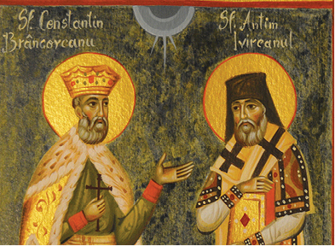
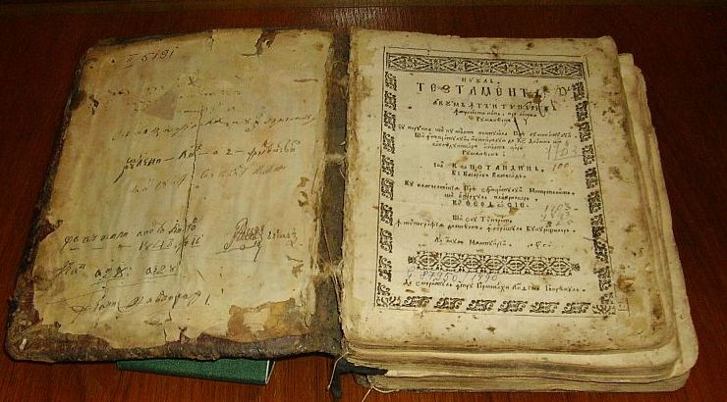
Under his reign, Wallachia experienced a period of cultural flourishing.
The ruler was the protector of the printing press and schools.
In 1689 he brought Antim Ivireanul from Istanbul, who became the future Metropolitan of Bucharest. Under the Metropolitan’s guidance many books of theology, morals, anti-Catholicism and anti-Calvinism were printed, all in Romanian, Greek, Slavonic and even Arabic.
The New Testament, printed in Bucharest in 1703

Slide 10
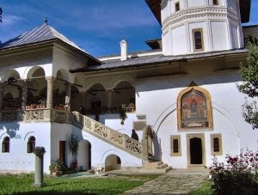
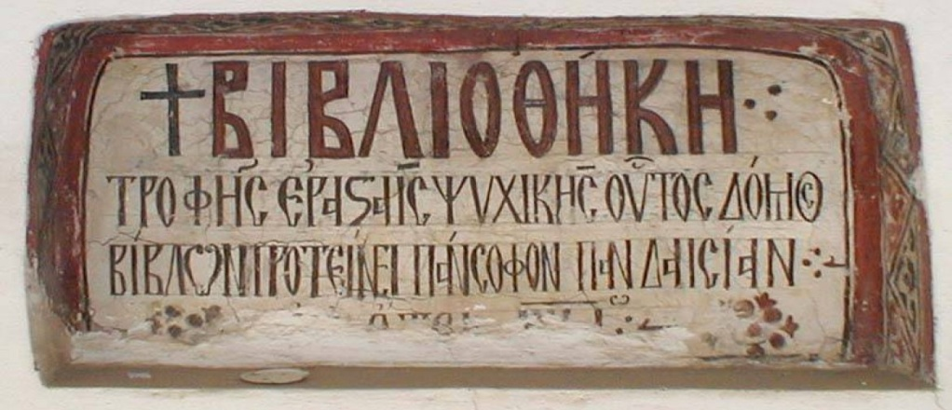
In 1694,C-tin Brâncoveanu founded the Royal Academy in Bucharest, the first form of higher education in Wallachia, which functioned in the buildings of Saint Sava Monastery, where Bucharest University is today.
The language of study was Greek, the universal language of culture in the Orthodox world. Most of the teachers were of Greek origin. Students came from all corners of the Orthodox world. The ancient and Christian literature and philosophy were studied, among others.
Alongside the Royal Academy, there were also other schools which
functioned in monasteries, where they taught in Slavonic and Romanian.
In some monasteries libraries were created, with works brought from large cultural centres from Western Europe; among them the library of Hurezi Monastery, founded by Constantin Brâncoveanu.

Slide 11
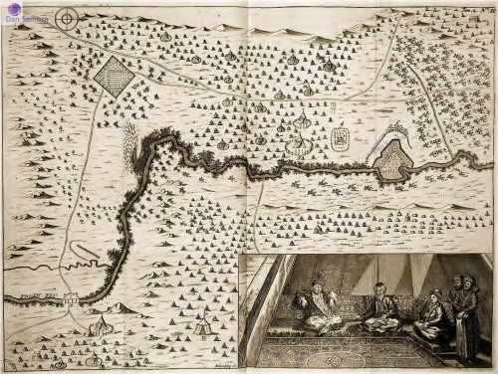
The Battle of Stănilești was won by the Turks, who took revenge a few years later.
But an unfavorable European turn and some political mistakes led to Brâcoveanu's tragic end and the disaster of his family.
In the context of the Russian-Turkish war of 1711, C-tin Brâncoveanu tried, in a cautious way, to maintain the balance between the two, but several Wallachian boyars switched to the Tsar.

Slide 12
In Constantinople several charges were filed against Prince Brâncoveanu, including:
that he kept secret correspondence with the Emperor of Austria, with Russia, with Poland and the Republic of Venice, to whom he provided information about the Turks.
that he had accumulated considerable wealth, which is why he was named ALTÎN BEY, "the prince of gold".
that, under the pretext of a change of scenery, more than half a year he lived in the former capital, Târgovişte, from where one day he could easily run away with all his family and wealth in Transylvania, where he had bought many estates.
that he had deposited large sums of money in Vienna, as well as in Venice.
that the betrayal of the boyars in 1711 was done with his consent.

Slide 13
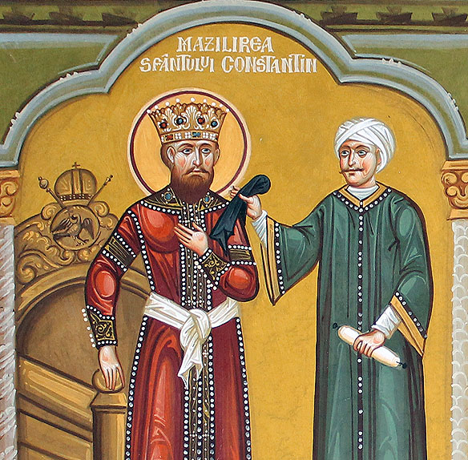
THE DETHRONEMENT
In the spring of 1714 , Mustafa Aga - the Sultan's messenger -, arrived in Bucharest.
Being received by the ruler, Mustafa Aga put a black silk scarf on Brâncoveanu's shoulder, saying: "mazil," meaning "dethroned".

Slide 14
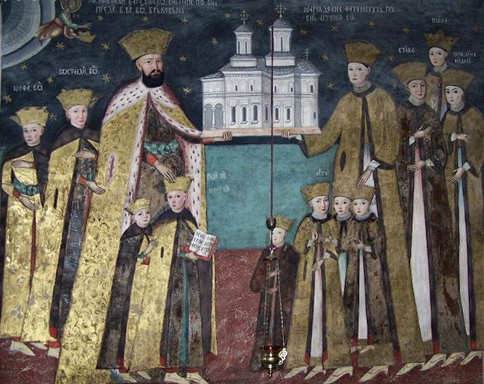
THE DETHRONEMENT
In front of the great boyars and of the Metropolitan, the dethroning act was read: C-tin Brâncoveanu and his whole family was declared rebellious and, therefore, deposed from his throne.
Then, his entire fortune was confiscated and loaded into 40 carts which left for Istanbul alongside Brâncoveanu and his family.
Prince Brâncoveanu and his wife - princess Marica - and their children

Slide 15
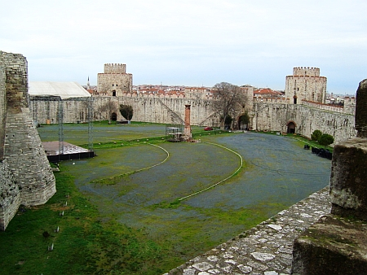
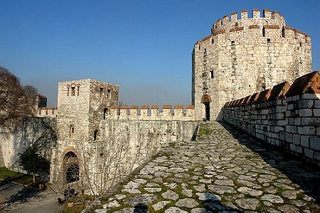
THE TORTURE
In Istanbul, the entire family (13 prisoners) was taken to the Yedikule prison (The Fortress of the Seven Towers) in the big tower called The Blood Pit. Here, for three months, they were tortured by the Ottomans who hoped to locate the immense fortune Brâncoveanu had supposedly hidden outside the country.

Slide 16
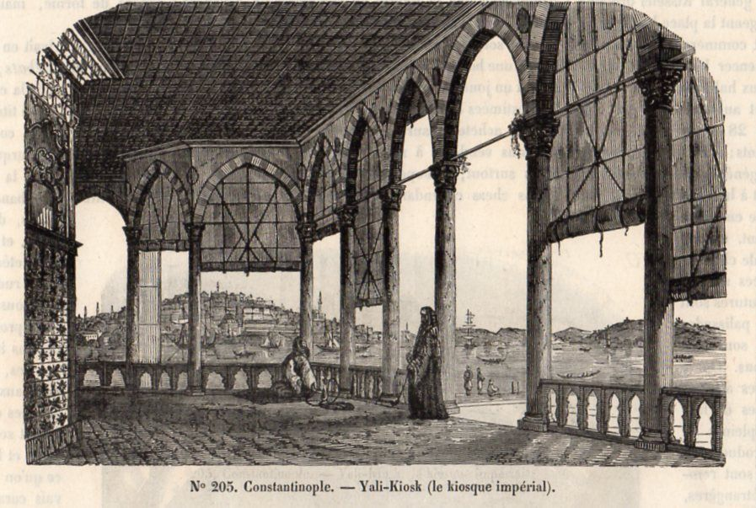
THE MARTYRDOM
On the morning of August 15, 1714, on the Feast of the Assumption of Mary, on the prince’s birthday (60 years old) and while Mrs. Marica was celebrating her name, the men were taken to the scaffold: voivode Constantin Brâncoveanu, his four sons (Constantin, Ștefan, Radu and Matei) and grand treasurer Ianache Văcărescu.
Sultan Ahmet III, Grand Vizier Gin Ali, the ambassadors of the Christian countries - France, England, Russia, Austria - were present at the punishment place: Yali Kiosk

Slide 17
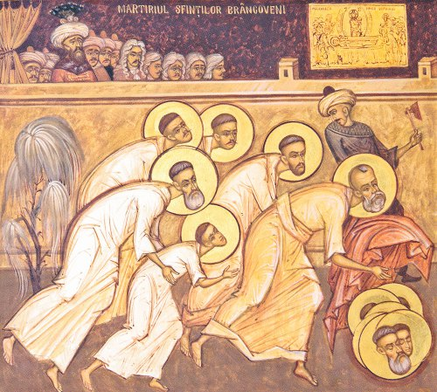
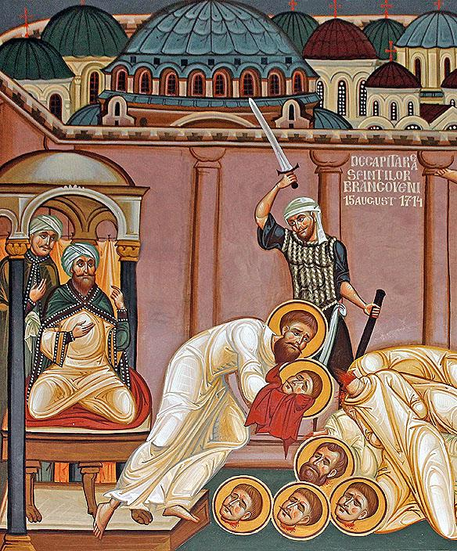
THE MARTYRDOM
That day, the Sultan was sure to witness an act of humiliation for all Christendom. The prisoners were allowed to say their last prayer, and then the Sultan offered them freedom in return for giving up their Orthodox faith and embracing Mahometanism.
But the voivode encouraged his sons not to give up faith, as faith was the only thing left for them. Angrily, the sultan ordered that the first to be beheaded to be his four sons, and then the grand treasurer Ianache, believing that, this way, Brâncoveanu would lose his faith.

Slide 18
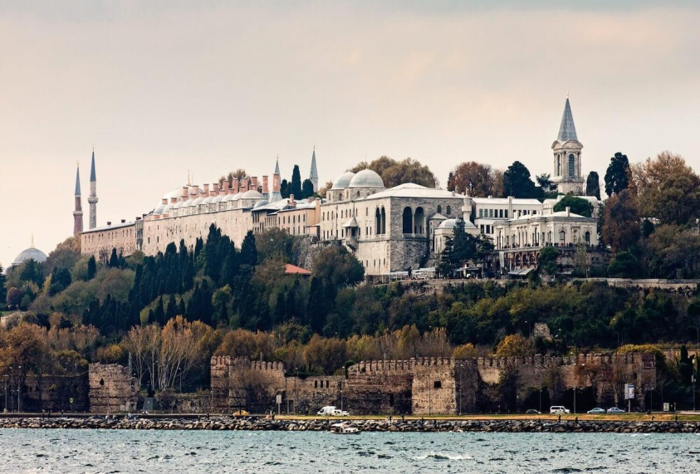
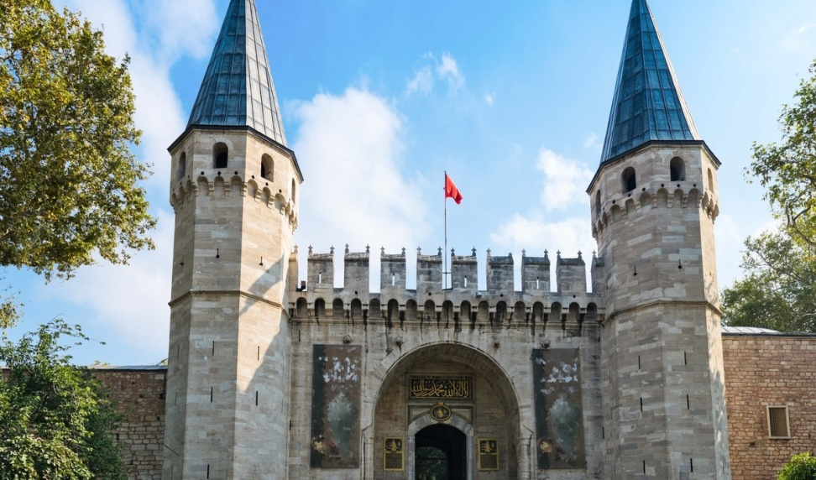
The six beheaded bodies were thrown into the Bosphorus, and their heads were "carried on poles" through the streets and then hung on Serai᾿s gate for three days. After that, the heads were thrown into the sea. Christian fishermen took the bodies from the water, and buried them at the Halki Monastery.
Topkapî Palace
The gate of Topkapî Palace

Slide 19
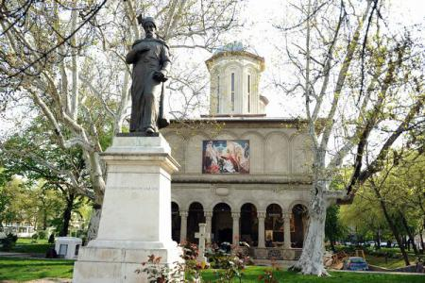
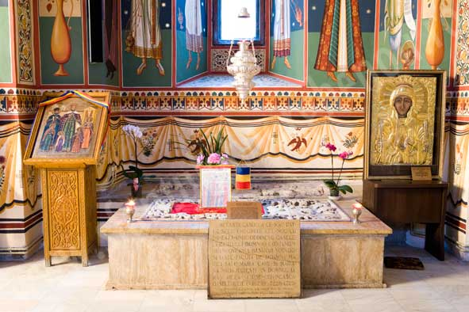
After witnessing her own family martyr, Mrs. Marica was exiled for a while, and after two years she returned to the country. In 1720 she succeeded to bring the remains of the martyrs into the country and buried them secretly in St. George New Church in Bucharest, the last church built by the ruler.

Slide 20
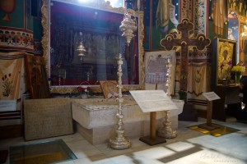
The tomb was covered with a white marble plaque without a name. The identification was made after almost 200 years, when the inscription "The remains of the blessed Lord, Io, Constantin Brâncoveanu Basarab Voievode" were found on the silver candle above the grave.

Slide 21
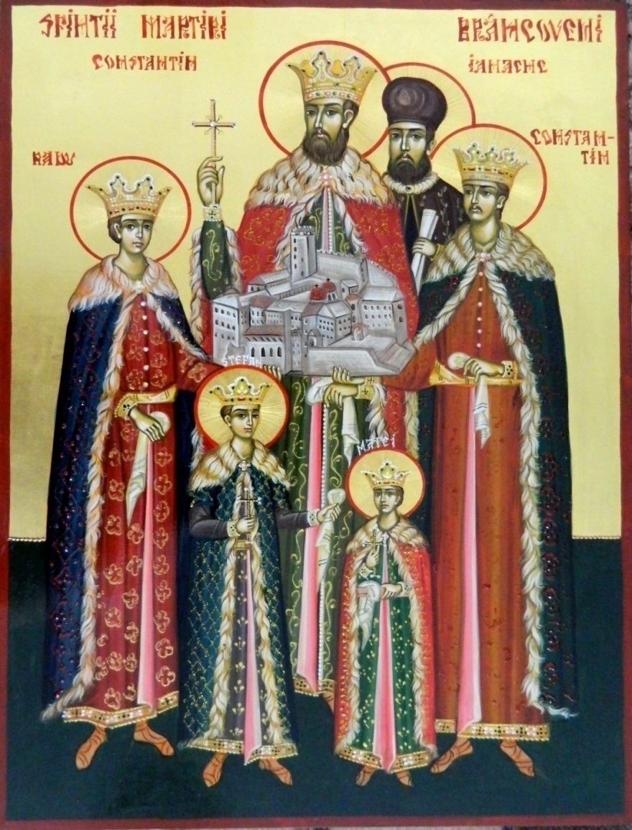
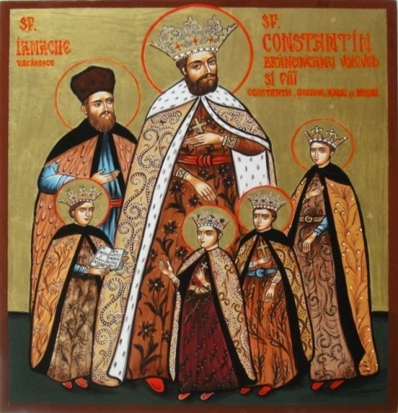
THE CANONIZATION
On June 20, 1992, the Sinode of the Romanian Orthodox Church decreed the canonization of Brâncoveni Martyrs, setting them a memorial day on August 16 (not to coincide with the Feast of the Assumption).

Slide 22
THANK YOU!
The European Commission support for the production of this publication does not constitute an endorsement of the contents which reflects the views only of the authors, and the Commission cannot be held responsi­ble for any use which may be made of the information contained therein.

