Slide 1
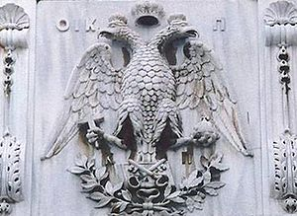
Greece during the Middle Ages
During the Middle Ages the lands of the modern Greek state belong to the Byzantine Empire.
The Byzantine Empire, also known as the Eastern Roman Empire, Romania or simply Byzantium, was an empire with its capital Constantinople, it was the continuation of the Roman Empire as the emperors (from Heraklion and beyond) were titled "King of the Romans". The time limits of the Byzantine Empire began from the inauguration of Constantinople on May 11, 330, and reached its final fall, the capture by the Ottomans, on 29 May 1453.

Slide 2
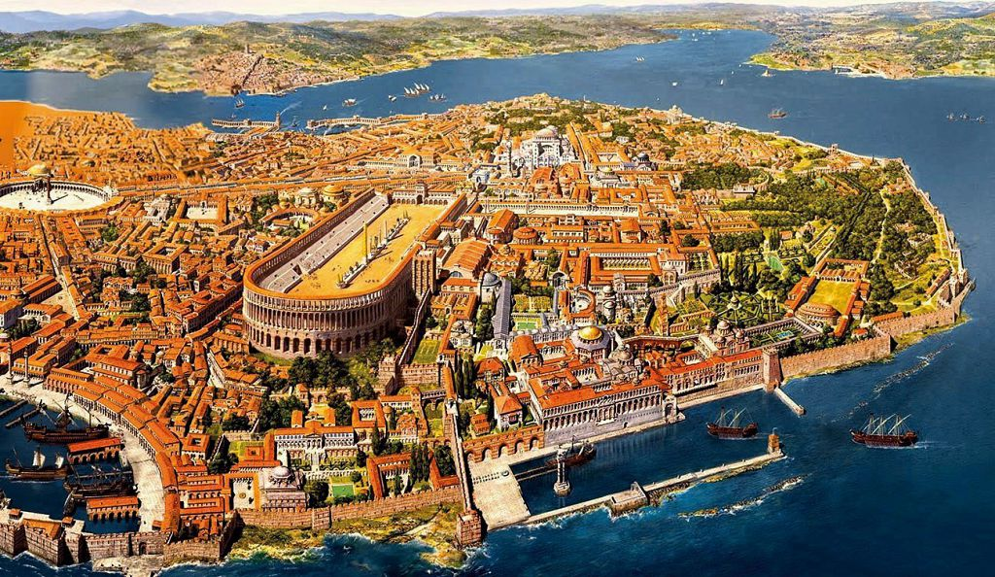
.
Byzantium was a multinational empire, but it was a Greek-speaking empire. The fact that Byzantium was a Greek-speaking voice saved all Greek civilization.
Istanbul, the largest and richest urban center in the eastern Mediterranean, mainly as a result of the strategy of location between the Aegean Sea and the Black Sea, but also as a hub between the continents of Europe, Asia and Africa, in the 7th century became Greek speaking for over one Millenium.

Slide 3
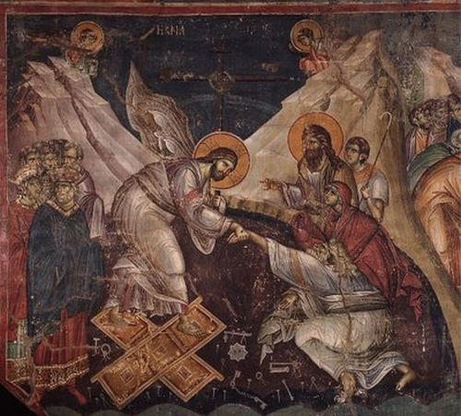
BYZANTINE ART
Constantinople (or otherwise City = because it was the most important city) beyond an economic center was an important spiritual and artistic center of the time. Byzantine art developed as a result of the interaction between ancient Greek tradition and Christianity.
Strong Christian figures appear in painting. One of the most important painters was Manuel Panselinos.

Slide 4
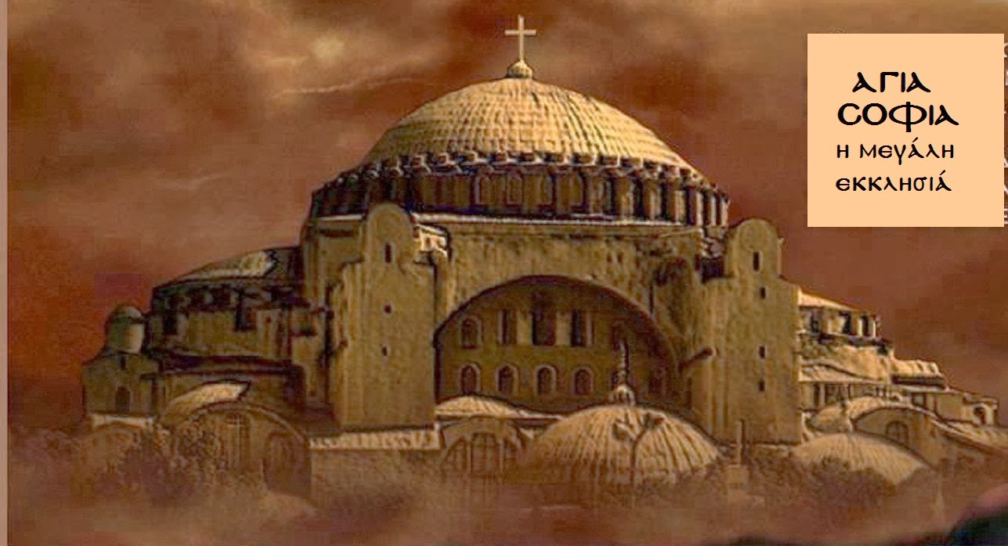
.
A typical form of expression of Byzantine architecture is a new temple of the ecclesiastical temple, the basilica. The construction of Hagia Sophia in the city is probably the most important example, a model for all the later Byzantine temples, but also a symbol of power of the Byzantine Empire. Architects of the temple were Anthemios and Isidorus, on Justinian's empire.

Slide 5
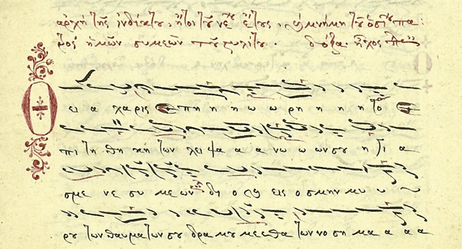
.
Byzantine music is the music of the Byzantine Empire that translates and consists exclusively of Greek texts as a melody. Greek and foreign historians agree that these melodies are closely linked to the ancient Greek musical system. The Byzantine hymns are chanting to the present day during the execution of the mysteries of the Greek Orthodox Church.

Slide 6
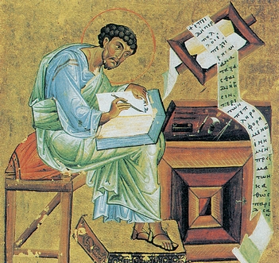
BYZANTINE SECRETARIAT
The idea of ​​the Byzantine secretariat is indissolubly tied to education, like literature.
It is noteworthy that many works of ancient classical Greek literature were rescued by the monks of the Byzantine monasteries who copied the ancient texts in books.

Slide 7
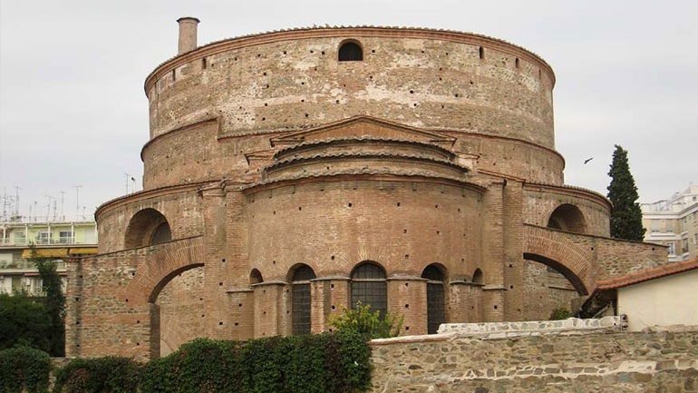
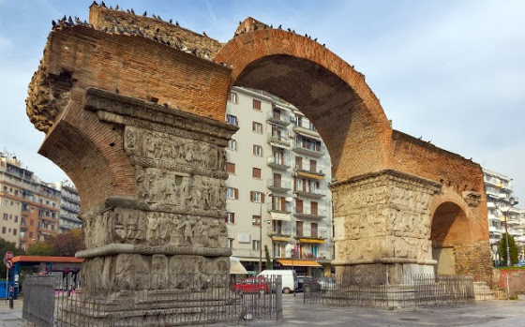
THESSALONIKI
One of the most important cities of Byzantium was Thessaloniki. (2nd largest city of today's Greece and the capital of Macedonia). Byzantine Thessaloniki is undoubtedly the first city to have the characteristics of Europe. This is because, first, being Greek-born, having a glorious Roman past, first in Europe, accepted Christianity from the Apostle Paul, thus completing the elements that make up the European world.

Slide 8
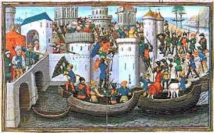
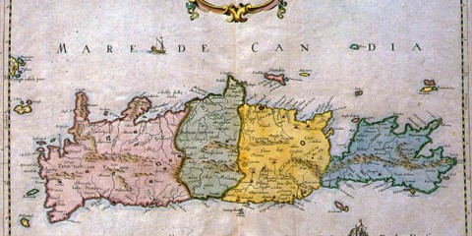
FALL CITY FROM THE STAVROPHORUS IN 1204
In 1204, the 4th Crusade fleet arrived at the harbor of the city, famous for its wealth, and conquered it.
Many areas of today's Greece, such as Crete and the Ionian Islands, were placed under Venetian occupation. (The 1311 Catalan mercenaries defeated the Frankish dukes of Athens and founded a Catalan state that survived about 80 years - until 1388)
In 1261 the Byzantines rebuilt the city without the Empire ever regaining its old power and glory.

Slide 9
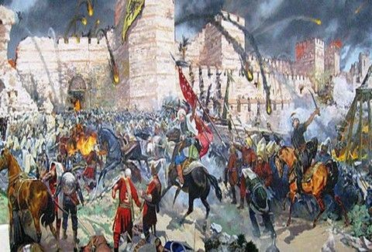
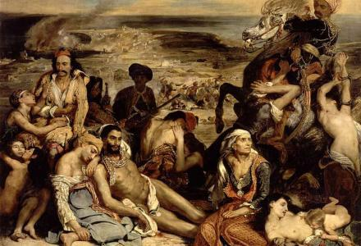
FALL OF CITY FROM OTHOMANS IN 1453
On 29 May 1453 the city was occupied by the Turks. This fall also means the end of the hyperchannel Byzantine Empire.
All areas of present-day Greece except the Ionian Islands (Crete occupied in 1669) are placed under the Turkish yoke.
The Greek Middle Ages are the Ottoman domination. The 400 years of Ottoman domination.

