Slide 1
Austria and its role in the Crusades
By Gloria and Michael

Slide 2
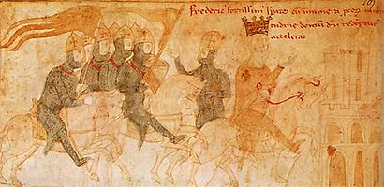
General Info
The crusades were a series of religious wars between Christians and Muslims over control of holy sites in the Middle East
They were sanctioned by the pope in the medieval period and organized by western European Christians in response to centuries of Muslim wars of expansion
Their objectives were to check the spread of Islam, to retake control of the Holy Land and to recapture formerly Christian territorities

Slide 3
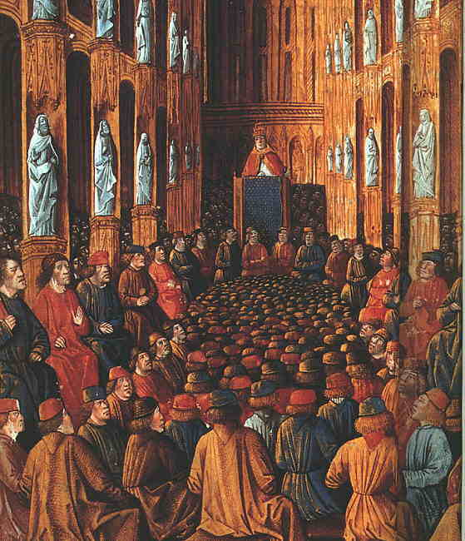
The beginning
Pope Urban II. made a speech calling for crusade at the council of Clermont in November 1095
There was a promise of forgiveness of sins for whoever took part in the crusade, which increased motivation of the soldiers and helped the pope to persuade them
It‘s disputed, that the famous slogan „It’s God’s will“ (Deus vult) was established as a catch-cry during the council
Urban II. died on July 29th 1099, 14 days after the fall of Jerusalem to the crusades

Slide 4
Reasons
Official and inofficial reasons
Power and glory
Emancipation of Jerusalem from the Muslims and the conquest of the Holy Land
Official reasons were used for persuasion of soldiers – church was well-esteemed at that period of time

Slide 5
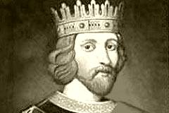
Richard lionheart
King of England
In Cyprus: Richard Lionheart landed in Cyprus during the third crusade because his ship was wrecked, The emperor Isaak Komnenos refused to help them. He also insulted Richard´s sister. So Richard attacked Komnenos.
Participated in the third crusade

Slide 6
The third crusade
The Austrian King Leopold and Richard Lionheart were fighting in the third crusade against the Muslims, but then there was a conflict between them. Richard dropped the flag of Leopold on the ground, at that time this was a sign of insult and Leopold didn’t get all the treasures he wanted.
When Richard was travelling back to England he pretended to be a pilgrim to hide who he actually was. But because he was wearing a pompous ring, a follower of Leopold recognized him.
So he was arrested in Austria in the castle of Dürnstein. That was the punishment of Leopold. Leopold reported this to Heinrich VI., the Holy Roman Emperor at the end of the 12th century (1191-his death). He captured Richard in the castle of Trifel, which is situated in Germany.
After several negotiations with the Austrian King Leopold and Heinrich VI. the Holy Roman Emperor, Richard was released, but his brother had to pay a ransom. It was a great amount.

Slide 7
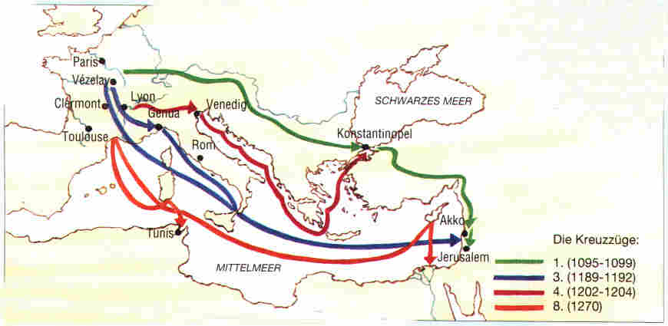

Slide 8
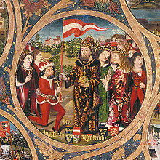
the story of the Austrian Flag
The Austrian King Leopold fought in the battle of Akkon, city near Jerusalem, to free the holy land from the Muslims
He lost his banner
His white uniform was full of blood, but under his belt the uniform was still white.
Emperor Heinrich gave him a new banner with those colours.

