Slide 1
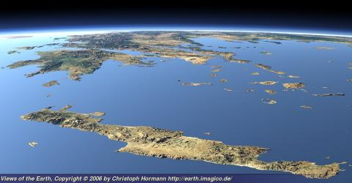
MYTHOLOGY IN CRETE
The word «Κρhτη» (Crete) possibly originates from the word «κραταιά» which means “mighty” or “powerful deity”.

Slide 2
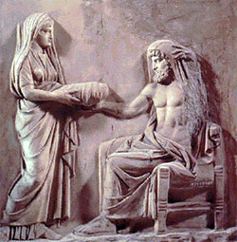
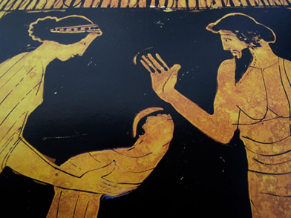
Birth of Zeus Cronus, son of Uranus (the sky) and Gaia (the earth), marries his sister Rhea, who gives birth to many children. Uranus had predicted that one of Cronus’s sons would dethrone his father, so Cronus devours his children immediately after birth to avert destiny. When Rhea gives birth to Zeus she hides him in Dictaeon Andron (Psychro Cave) in Lasithi Plateau. Cronus had previously swallowed a rock wrapped in swaddling clothes believing he was swallowing his newborn son.

Slide 3
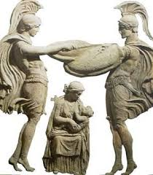
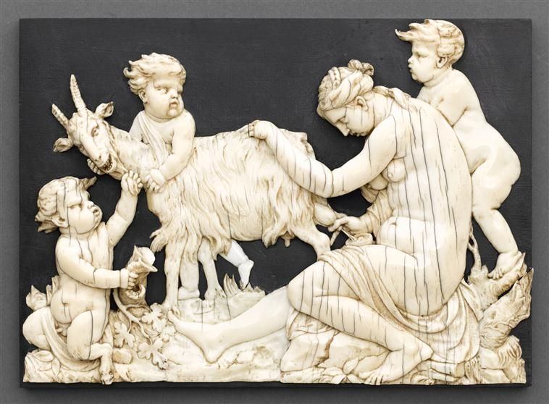
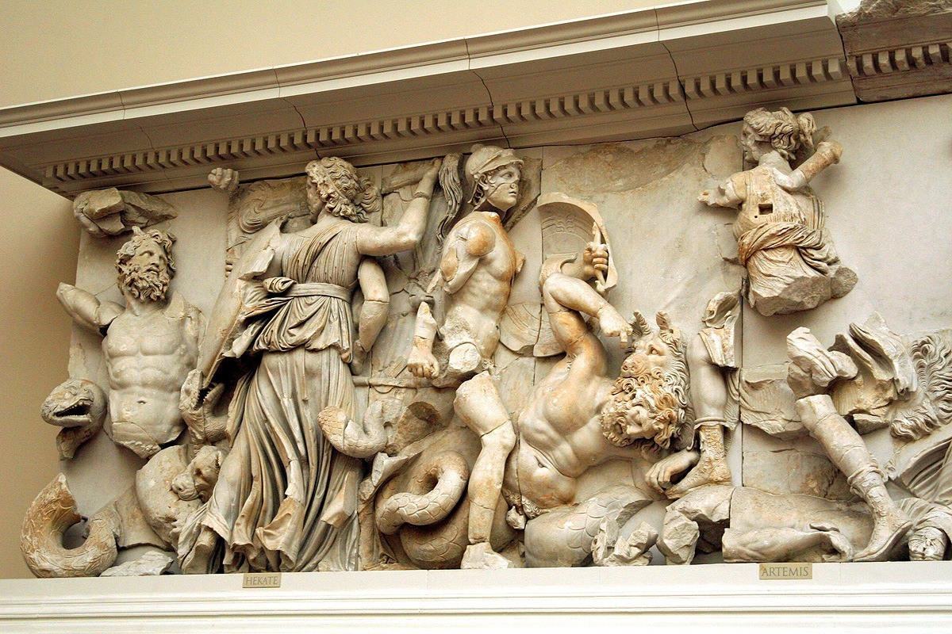
Zeus was raised by nymph Adrasteia and her sister Ida, drinking the milk of a nymph-goat, Amalthea, while Kourites, men who were half-gods, were dancing a war dance, shouting and striking their shields with their swords, so that Cronus would not hear baby Zeus crying. He grew up in a cave among shepherds on top of mount Ida (Psiloritis) and eventually he killed Cronus releasing Hera, Poseidon, Demeter, Hades and Hestia, who were disgorged from their father’s stomach. Soon Zeus and his brothers and sisters started a war against the Titans which they won.
Kourites
Amalthea
Battle of the Titans

Slide 4
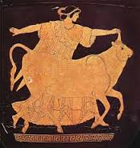
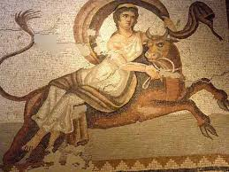
Zeus and Europa Europa (eurus+ops = wide countenance) was daughter of Agenor and Telephassa, rulers of Phoenix, and sister of Cadmus, founder of Thebes. Zeus fell in love with her and when he approached her in the form of a white bull, she was charmed and ,riding on the bull’s back she was flown over to the shores of Crete, where she gave birth to Minos, Rhadamanthys and Sarpedon.

Slide 5
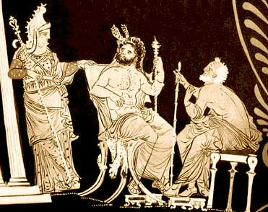
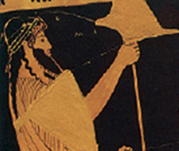
When Zeus left, she married king Asterion who adopted her three sons. These myths are probably inspired by real military attacks of Crete in the East Mediterranean.

Slide 6
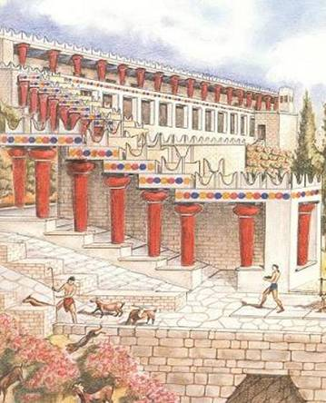
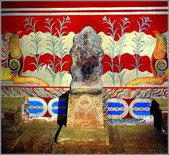
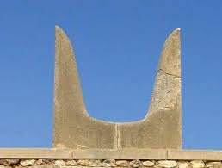
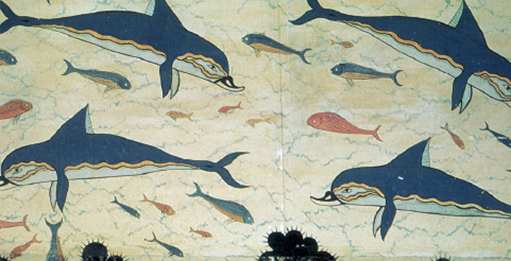
Minos the king of Crete After Asterion’s death Minos became king of Crete and ruled for many years from his Knossos palace. During his reignCrete gained wealth and power and the Minoan fleet dominated in the Mediterranean Sea trade. Minos was an honest man and the Cretan culture was named ‘Minoan’ after him, by archaeologist A. Evans who excavated the site of Knossos.

Slide 7
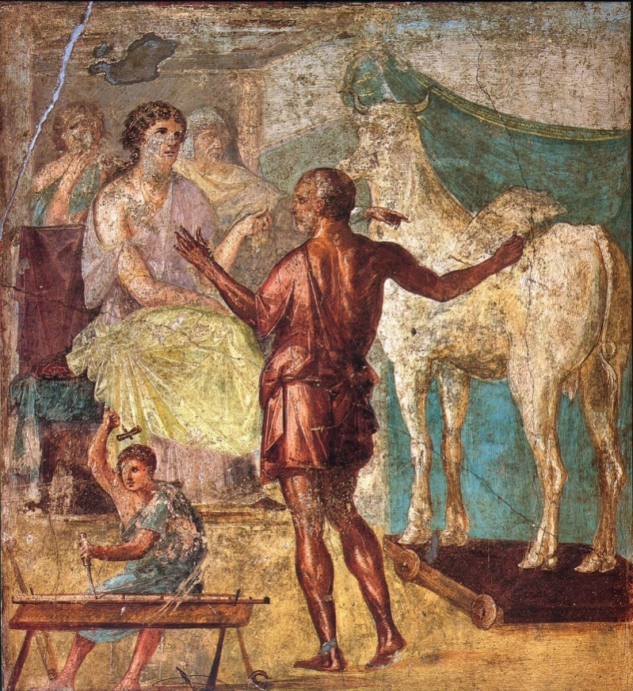
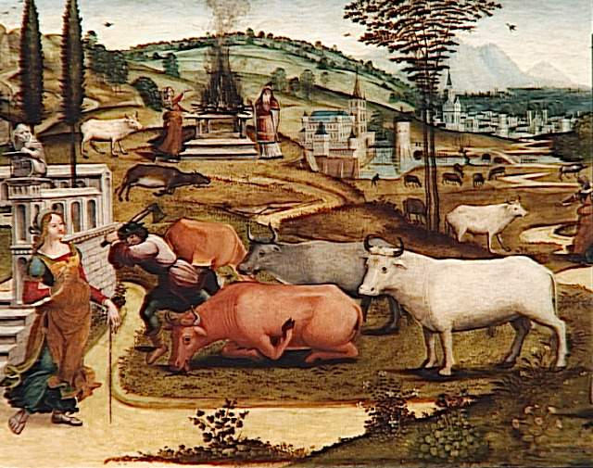
Minotaur and Labyrinth Minos prayed to gods to be sent a bull which he would sacrifice to honor them. Indeed, a magnificent snow-white bull emerged from the sea, sent by god of the sea Poseidon. Dazzled by its beauty, Minos kept the beast and sacrificed one of his own bulls instead. Poseidon was deeply insulted and, to punish Minos, he made his wife, Pasiphae, fall in love with the bull.

Slide 8
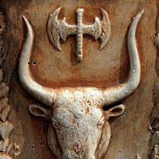
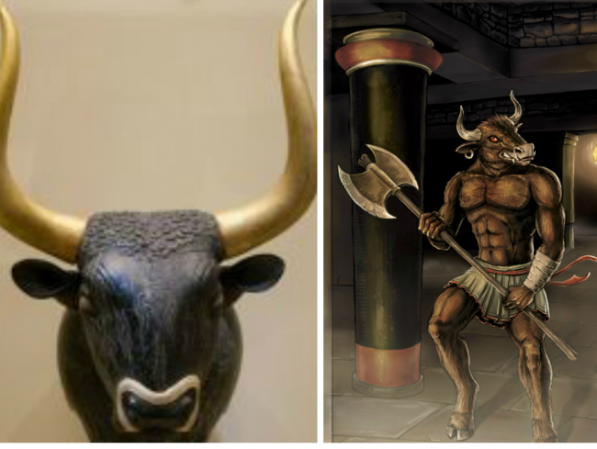
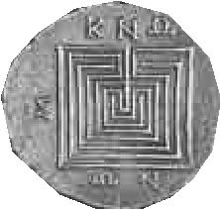
The white bull mated with the cow and Pasiphae gave birth to Minotaur, a monster with the head of a bull and human body. Minos asked Daedalus to create an intricate building, a labyrinth (a maze), where he kept Minotaur. Some historians believe that the labyrinth was in fact the palace of Knossos due to its magnitude and compexity. The bull as well as the double axe were the symbols of Minoan civilization.

Slide 9
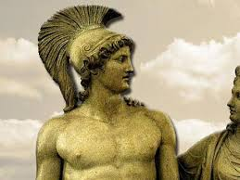
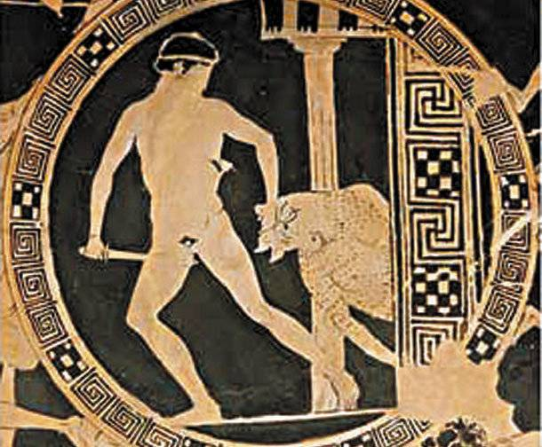
The War of Minos against Athens Minos was the first king to dominate the Mediterranean Sea. When his son was killed by Athenian men he demanded that seven young men and seven young women be sent to him as tribute every nine years. They were eventually given as food to Minotaur. Theseus, son of king of Athens Aegeus, offered to join the young men and women who would be sacrificed in Crete. If he could destroy Minotaur with his bare hands alone, the reparatory sacrifices would be terminated.

Slide 10
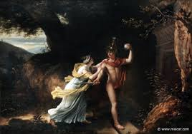
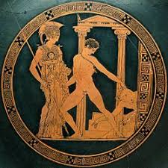
Ariadne, daughter of Minos, fell for Theseus and gave him a ball of thread to find his way out of the labyrinth, as well as a sword with which Theseus killed Minotaur.

Slide 11
On leaving the island of Crete, Theseus failed to change his ship’s black sails to white as an indication of his victory. Aegeus desperate that his son had been killed by Minotaur jumped into the sea and drowned. Ever since the sea carries the name Aegean sea.

Slide 12
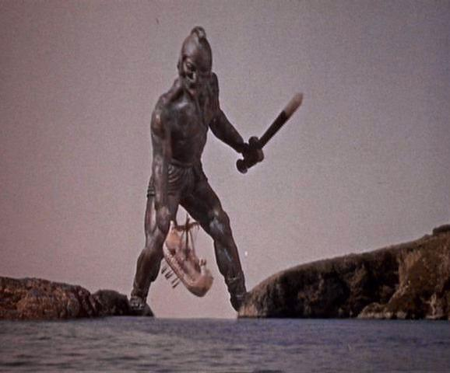
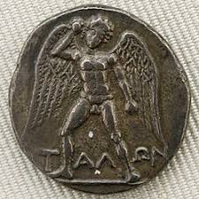
Talos Talos is another mythical creature connected to Cretan mythology. He was a bronze giant given to Minos by Zeus to protect the island of Crete. He had a single vein that went from his neck to his ankle. It was sealed with a bronze nail. He patrolled the shores of Crete three times a day offering protection from enemy ships. He also went to the villages demonstrating the rules of king Minos written on a bronze plaque. When the Argonauts approached Crete, Talos hurled huge rocks against them. He was killed by Medea, protector of the Argonauts, when she managed to displace the nail that sealed his vein. His blood run out of his body like melted lead and died.

