Slide 1
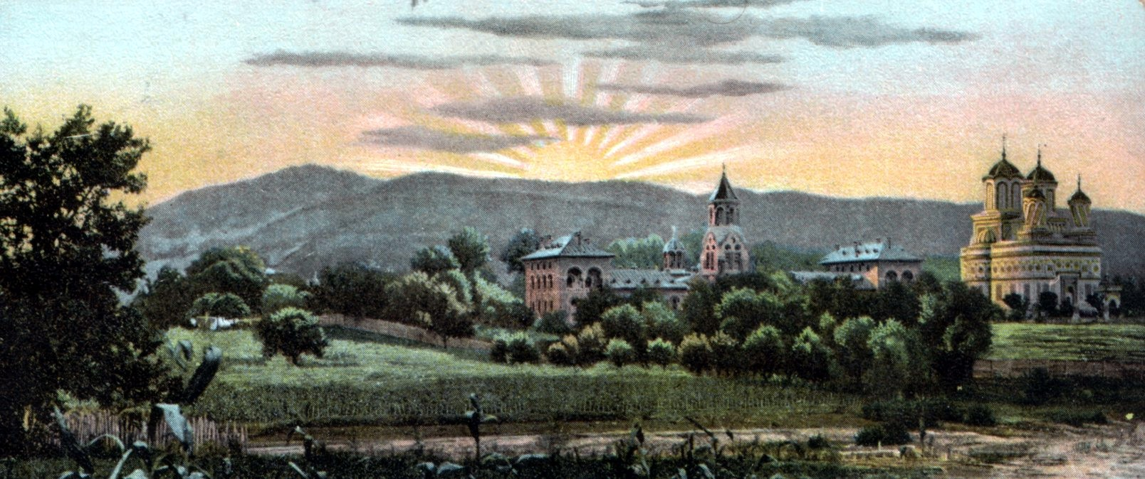
A Romanian mith – the sacrifice for creation
MANOLE THE CRAFTSMAN

Slide 2
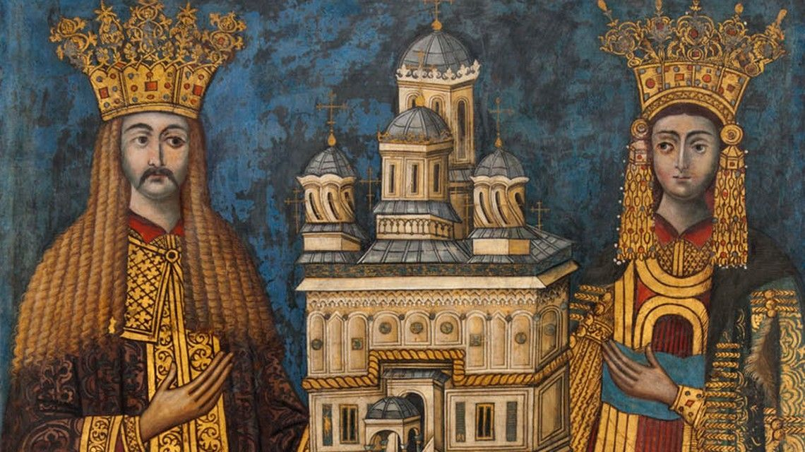
Curtea de Argeș was the first capital of Wallachia, one of the 3 medieval countries which have composed Romania.
Curtea de Argeș Monastery was built between 1515 and 1517 by the voivode Neagoe Basarab.

Slide 3
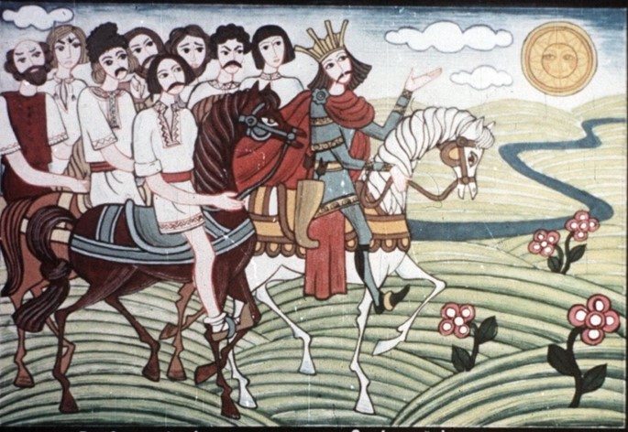
THE LEGEND OF MANOLE SACRIFICE FOR CREATION
Negru Voda gave an order to Manole and his team to build a monastery as never saw before.
MANOLE
WAS ONE OF THE
GREATEST MASTER
BUILDERS OF HIS TIME

Slide 4
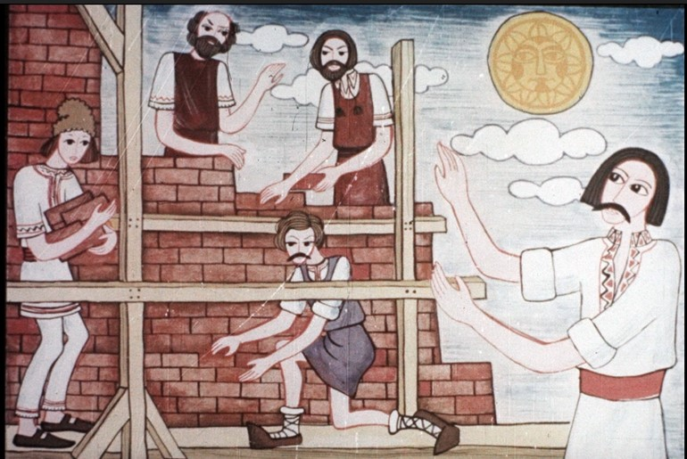
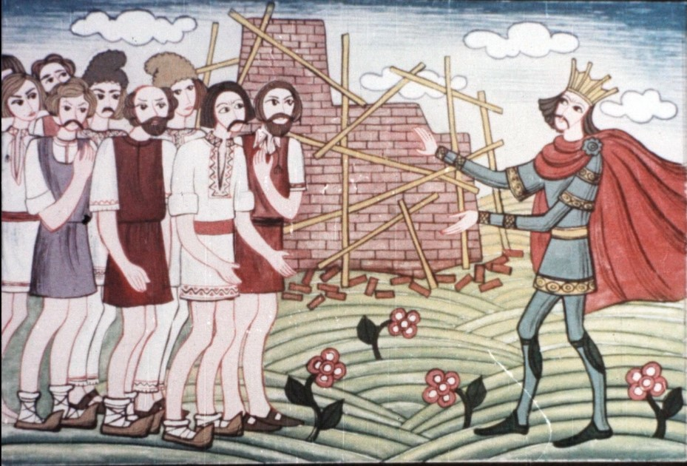
The chosen place to build was considered cursed, because what they zealously build during the day, were collapsing during the night

Slide 5
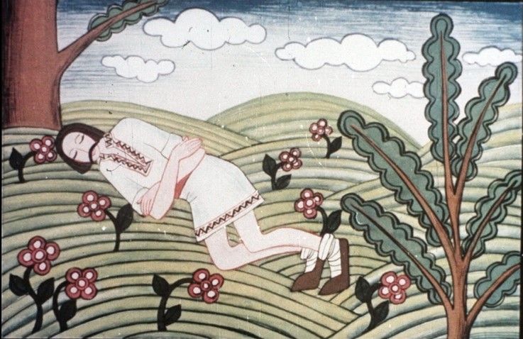
One time, Manole had a strange dream; a “whisper from above” was speaking with him:
”The first woman to come in the morning to bring them food will be sealed in the wall and it will not collaps again.”

Slide 6
The carpenters have swear to build in the wall the first of their women who will come to bring food

Slide 7
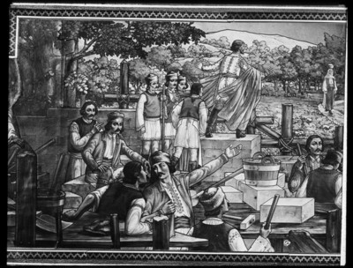
but Manole saw Ana, his pregnant wife, coming.

Slide 8
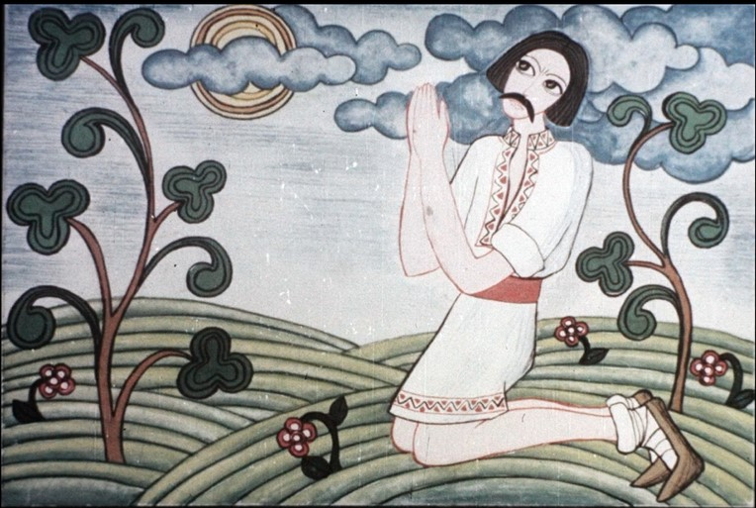
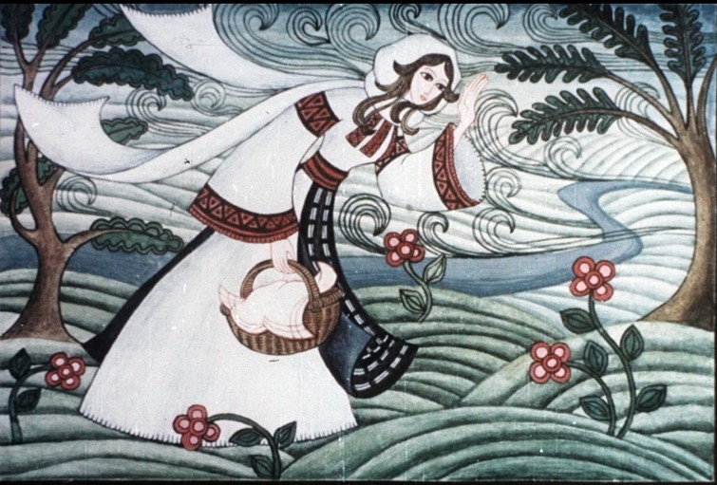
Manole started praying to God to stop her by starting storms and winds..

Slide 9
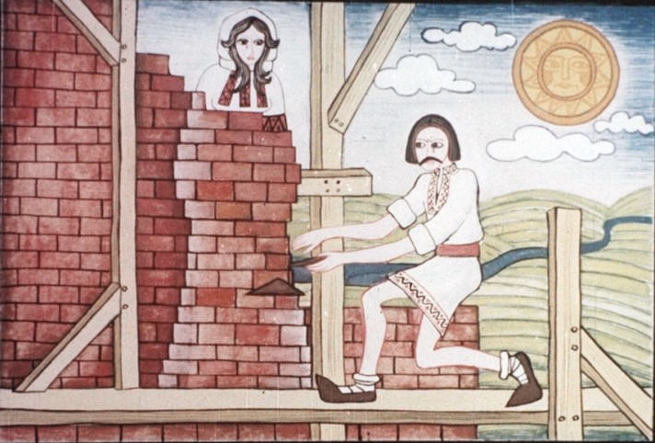
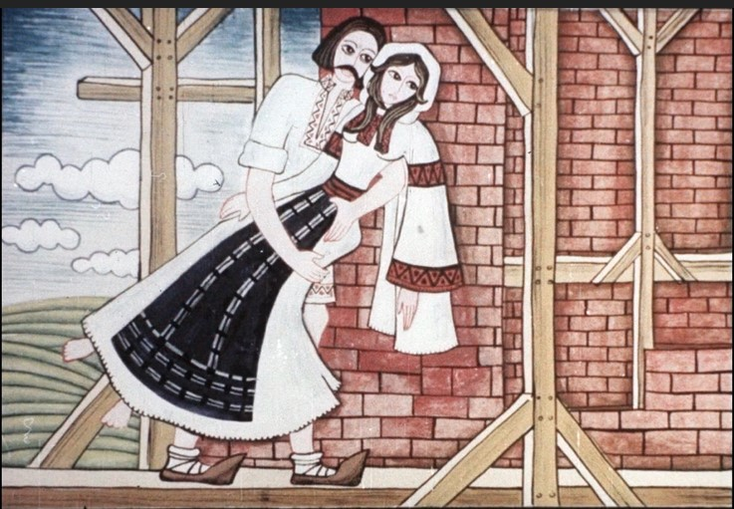
He started laying bricks around her.
Soon, he was completely surrounded her by bricks.

Slide 10
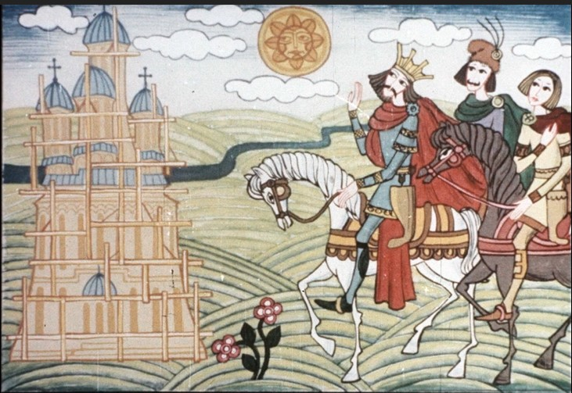
The monastery has been, finally, erected.
It was beatiful as never saw before, but the voivode has a suprising reaction:

Slide 11
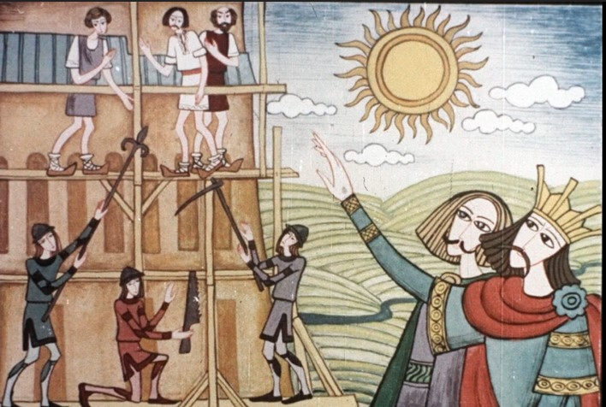
He asked Manole if he can build again something so beautiful. The answer was YES.
Then, Negru voda gave order to take all the scaffolds, letting the craftsmen on the roof.

Slide 12
Eventually they made themselves wooden wings to fly from there, dying all of them.

Slide 13
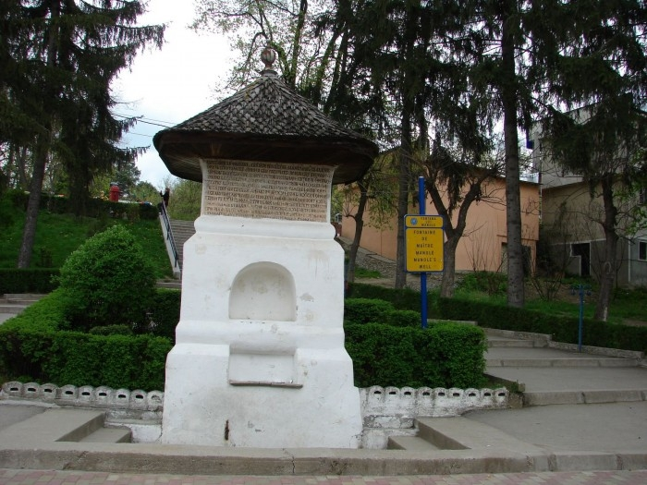
On the spot where Manole has fell, it apeared a spring and today, there is still a fountain

Slide 14
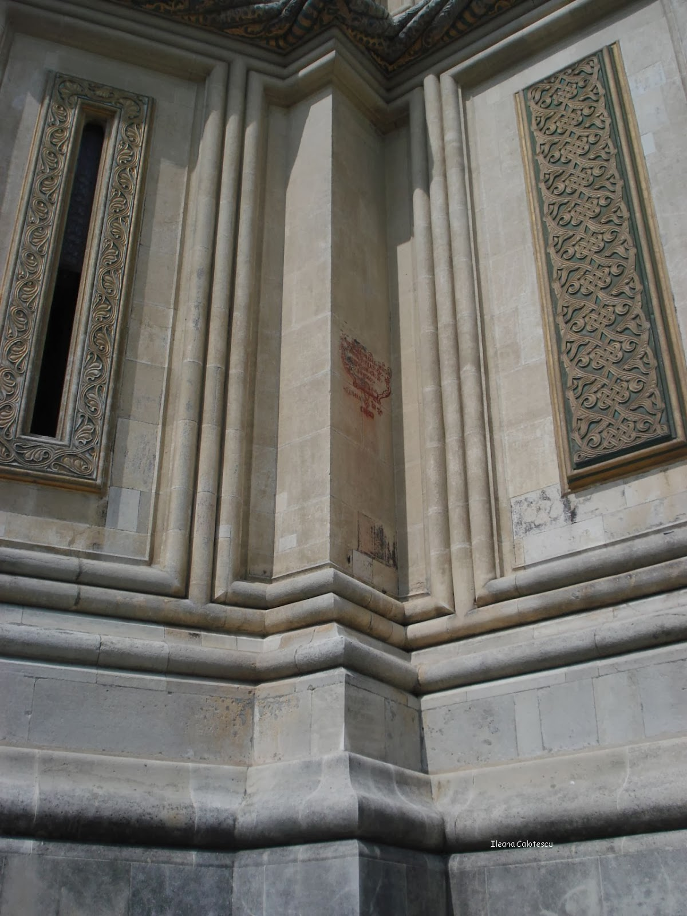
This is the place on the monastery wall were Ana was suposedly embed in the wall

Slide 15
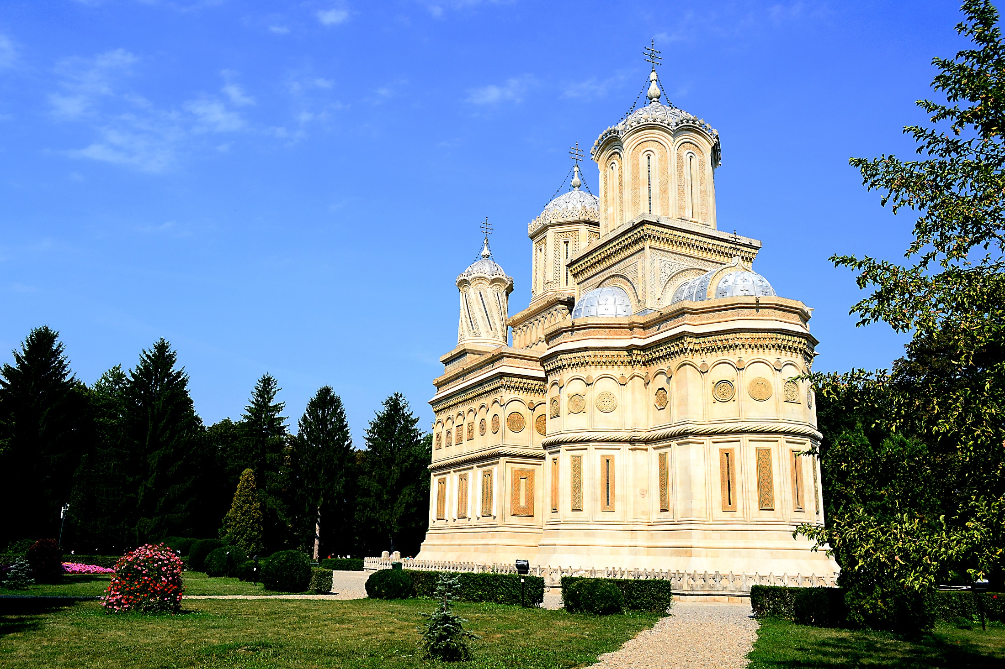
The monastery is one of the most impresive in Romania

Slide 16
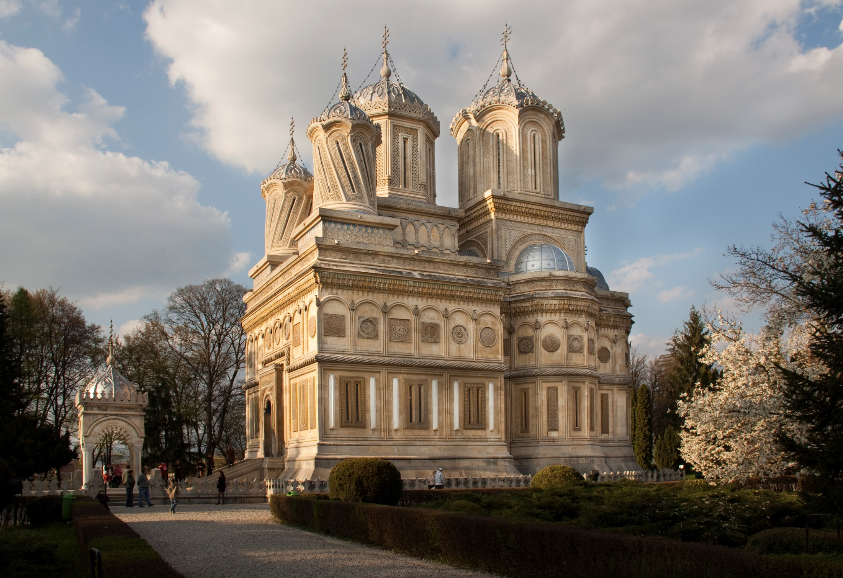

Slide 17
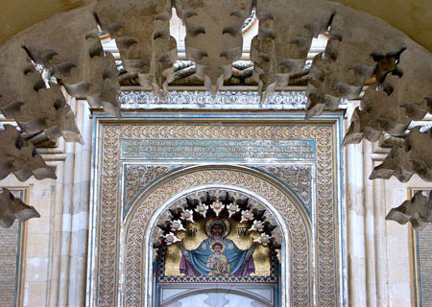
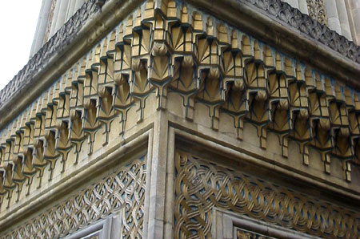

Slide 18
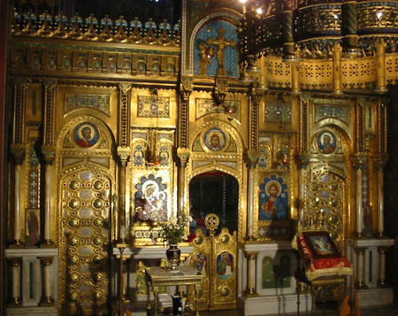

Slide 19
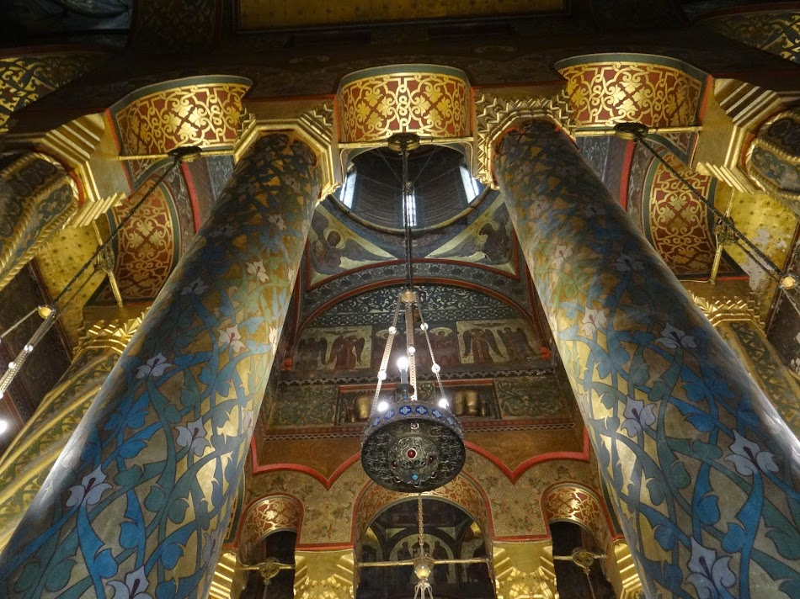

Slide 20
Thank you for your atention, dear Erasmus + friends…
Liceul Tehnologic ”Sfântul Pantelimon”, Bucharest
Costache Iulian, XI E
Mustățea Ștefan, X B
The European Commission support for the production of this publication does not constitute an endorsement of the contents which reflects the views only of the authors, and the Commission cannot be held responsi­ble for any use which may be made of the information contained therein.

