Slide 1
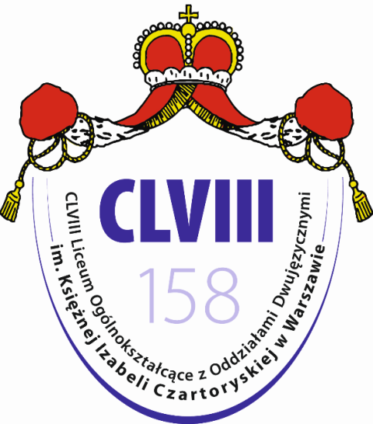
Tracing Our European Spirit Erasmus+ project
Poland in 15th and 16th centuries
Cyprus 22nd-29Th September 2018
Notes:
1.Hello everyone, we are from Poland: My name is Zuzia/Hubert. And we are going to present you how the Middle Ages looked like in Poland.

Slide 2
Poland in the 15th century
Jagiellonian dynasty 1384-1572
Polish-Lithuanian Union
Polish/Lithuanian–Teutonic Conflict
Polish/Lithuanian–Teutonic Wars
Battle of Grunwald
Cultural developement
Great monarchy
Notes:
2.We will focus on the 15th century. The 15th century is the time of a new dynasty and Polish – Lithuanian – Teutonic conflict and wars, but also the time when Poland changed in terms of culture. At the end of the 15th century the Kingdom of Poland became one of the strongest and powerful monarchies in Europe.

Slide 3
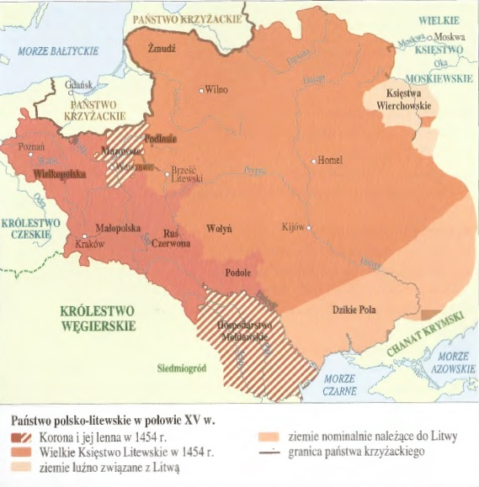
Poland in the 15th century
The State of the Teutonic Order
mutual enemy
Grand Duchy
of Lithuania
allies
The Kingdom of Poland
allies
Source: https://en.wikipedia.org/wiki/Polish_Golden_Age
Notes:
3.This map shows the geopolitical situation in the central Europe in the 15th century. The Kingdom of Poland was quite small and it was weakened after the age of fragmentation.
The Grand Duchy of Lithuania was a great territory but it didn’t belong to christian culture. The State of Teutonic Order was getting bigger and bigger trying to incorporate both Polish and Lithuanian territories. It was a mutual enemy for both countries and that is why Poland and Lithuania came closer.

Slide 4
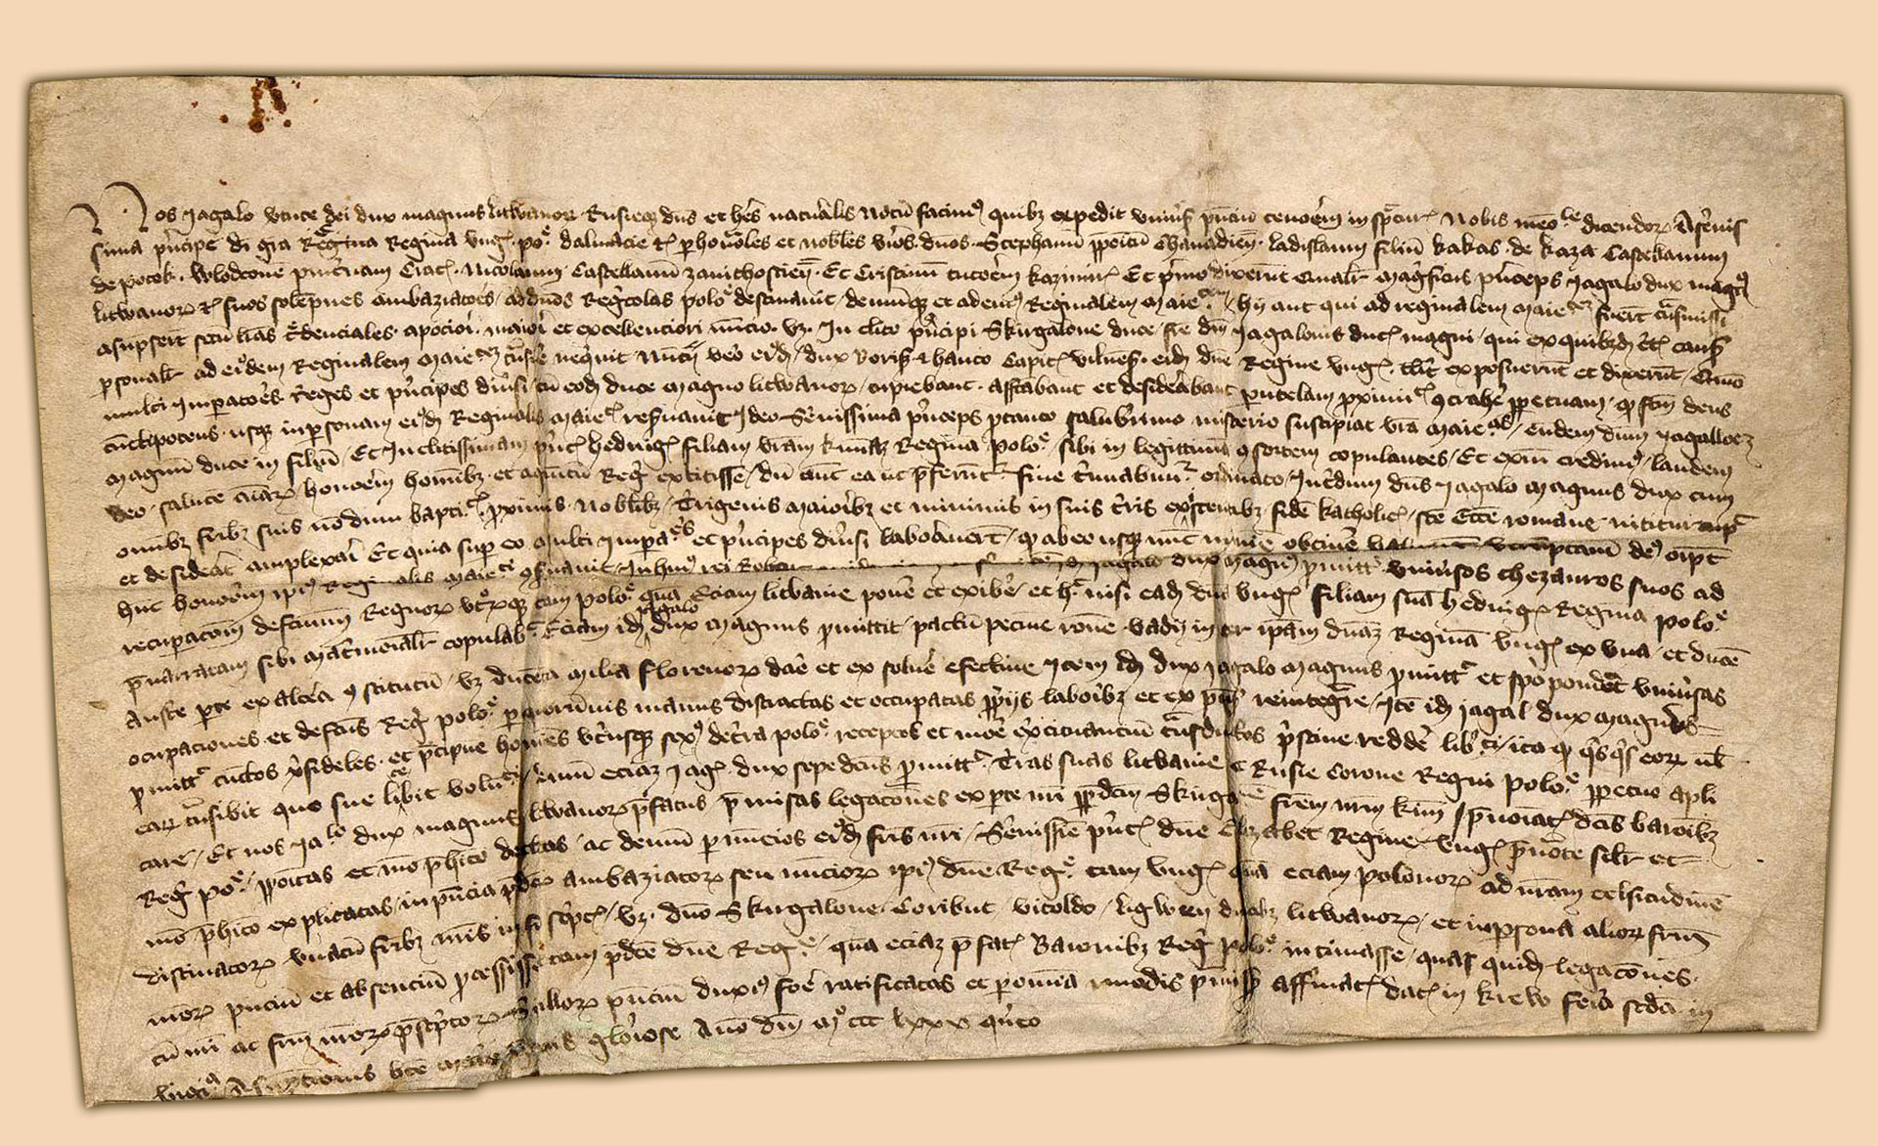
1385 - Union of Krewo
Władysław Jagiełło the Grand Duke of Lithuania becomes the King of Poland
Source: http://dziedzictwo.polska.pl/katalog/slide,Akt_unii_polsko-litewskiej_wystawiony_w_Krewie_dnia_14_VIII_1385_r,pid,183415,gid,183401,cid,177.htm
Notes:
4.In 1385 the Union of Krewo took place. The Grand Duke of Lithuania became the King of Poland, and the Grand Duchy of Lithuania became baptized, what gave the country more power and took away the right to invade pagan territories from the Teutonic State.

Slide 5
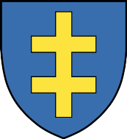
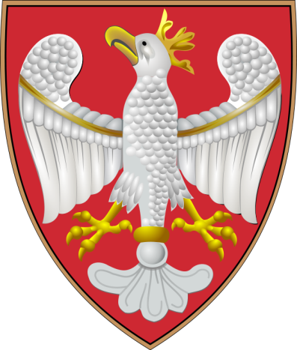
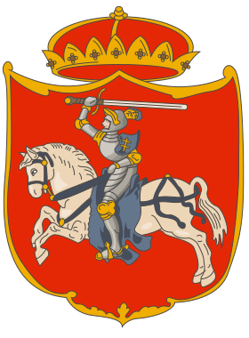
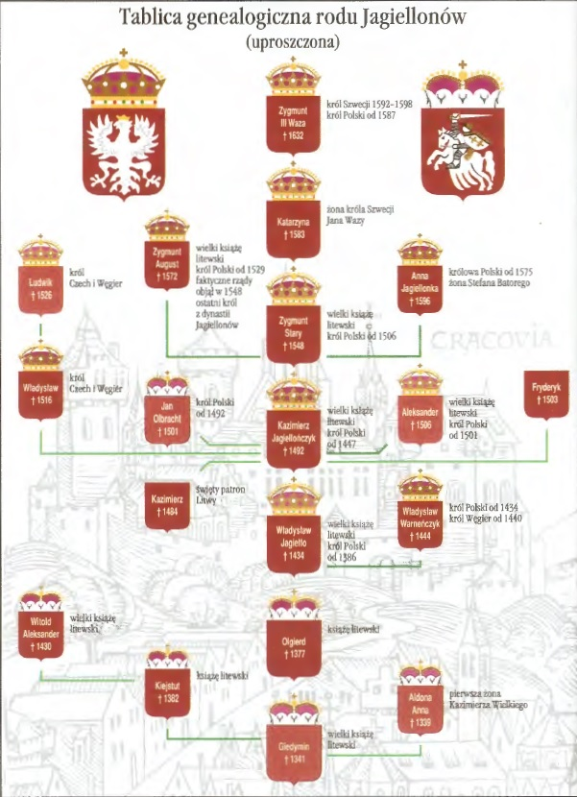
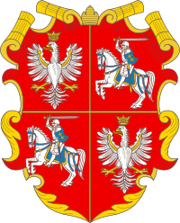
Jagiellonian dynasty
Kingdom
of Poland
Grand Duchy of Lithuania
Polish-Lithuanian Commonwealth (after 1569)
Source: Klusek J. ,,Polska i świat Jagiellonów XIV-XV wiek. Podręcznik dla gimnazjum, Warszawa 2000, p.6. https://en.wikipedia.org/wiki/Jagiellonian_dynasty#/media/File:Jagiellonian.png
Notes:
5.Here you can see the genealogical tree of the Jagiellonian dynasty which over the course of the 15th century became one of the most powerful and influential families in Europe. They ruled Poland and Lithuania but also Bohemia and Hungary. Here are coats of arms of both states and this one is a symbol of the Polish-Lithuanian Commonwealth after 1569 when two countries became the real union.

Slide 6
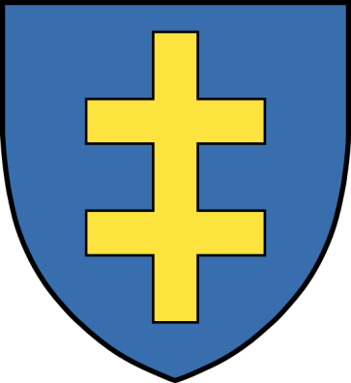
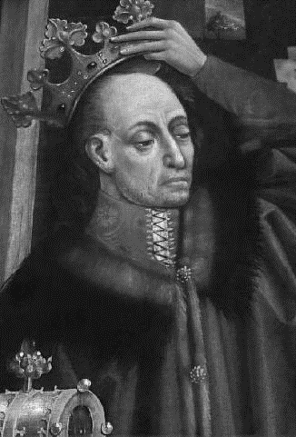
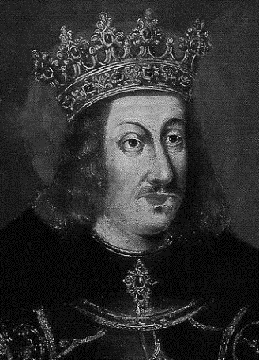
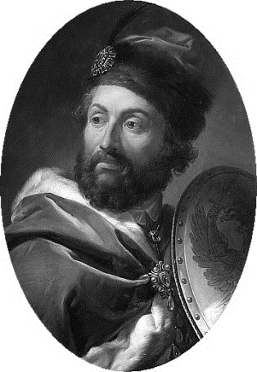
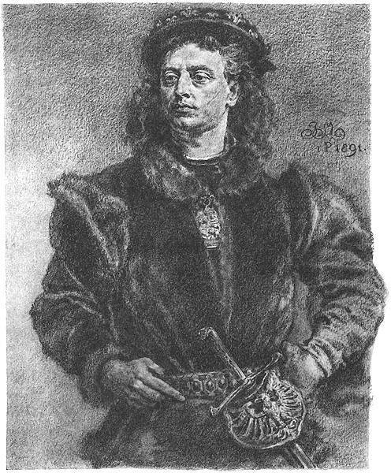
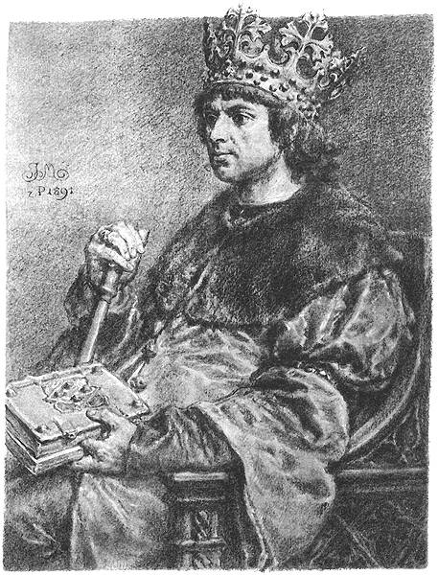
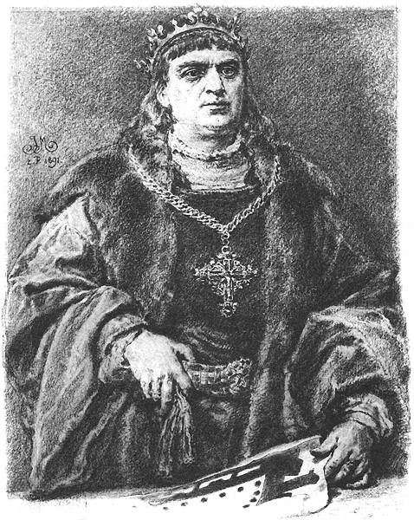
Władysław II Jagiełło – the winner of the Battle of Grumwald
Władysław Warneńczyk
(Władysław III of Poland)
King of Poland
King of Hungary and Croatia
died in the battle of Warna 1444
Kazimierz Jagiellończyk
(Casimir IV Jagiellon)
King of Poland
Grand Duke of Lithuania
He had many children, his three sons became Kings of Poland and Grand Dukes of Lithuania
Jan Olbracht
(John I Albert)
Zygmunt Stary (Sigismund I the Old)
Aleksander
Jagiellończyk
(Alexander I Jagiellon)
Source: https://en.wikipedia.org/wiki/Jagiellonian_dynasty#/media/File:Jagiellonian.png
Notes:
6.The first Jagiellonian King was Wałdysław Jagiełło. He had two sons: Władysław Warneńczyk, King of Poland and Hungary and Croatia, and Kazimierz Jagiellończyk, who gave the Kingdom many children among whom three kings. Zygmunt’s son was the last Jagiellonian king (he died in 1572).

Slide 7
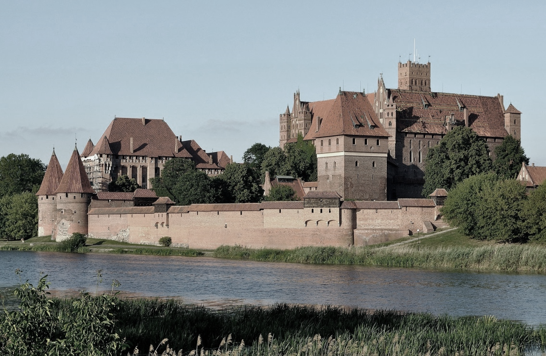
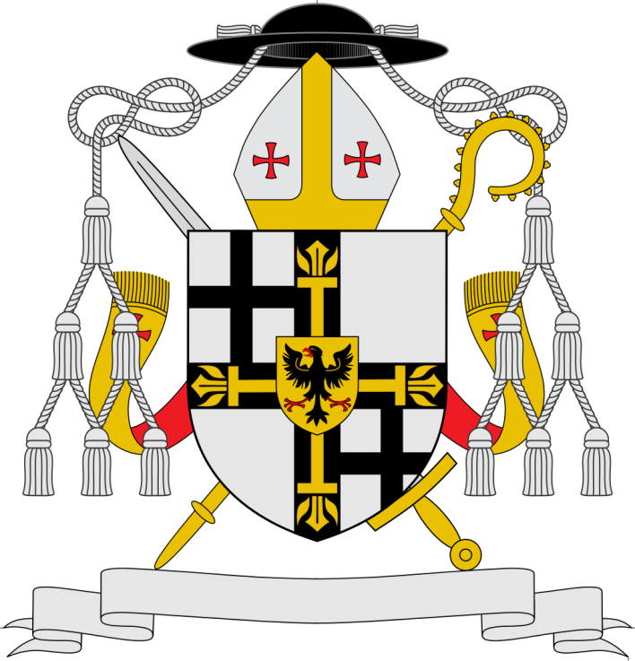
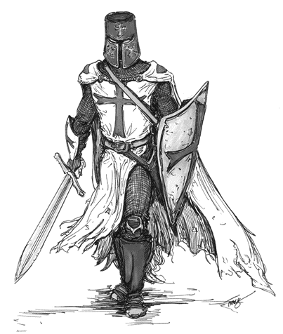
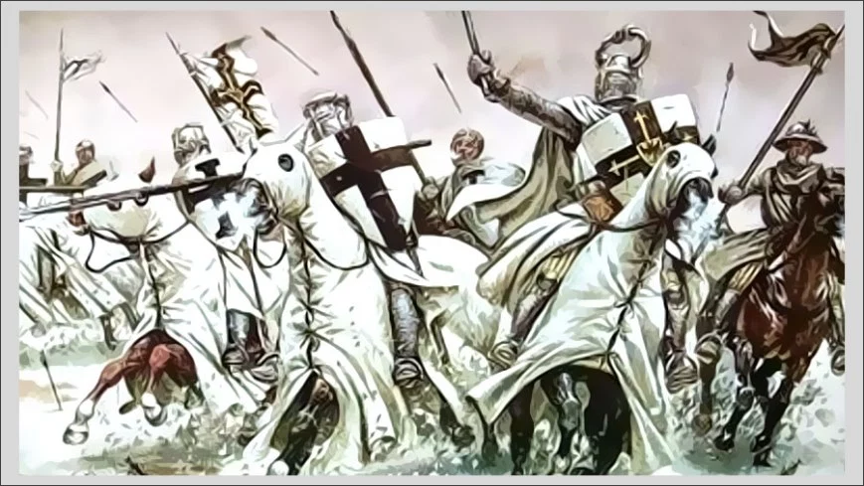
Teutonic Order – the main enemy
Malbork Castle – the capital
The Order of Brothers of the German House of Saint Mary in Jerusalem
A Catholic religious order founded as a military order c. 1190 in Acre, Kingdom of Jerusalem.
In 1230, following the Golden Bull of Rimini, Grand Master Hermann von Salza and Duke Konrad I of Masovia launched the Prussian Crusade, a joint invasion of Prussia intended to Christianize the Baltic Old Prussians.
It was the beginning of the Teutonic State in the northern Europe and of the conflict with the neighbours.
Source: https://pl.wikipedia.org/wiki/Plik:Coat_of_arms_of_Teutonic_Order.svg
Notes:
7.The main enemy of the Polish-Lithuanian State was The Order of Brothers of the German House of Saint Mary in Jerusalem, a Catholic religious order founded as a military order c. 1190 in Acre, Kingdom of Jerusalem. It was moved to Poland in 1230, following the Golden Bull of Rimini, when Grand Master Hermann von Salza and Duke Konrad I of Masovia launched the Prussian Crusade, a joint invasion of Prussia intended to Christianize the Baltic Old Prussians. It was the beginning of the Teutonic State in the northern Europe and of the conflict with the neighbours.

Slide 8
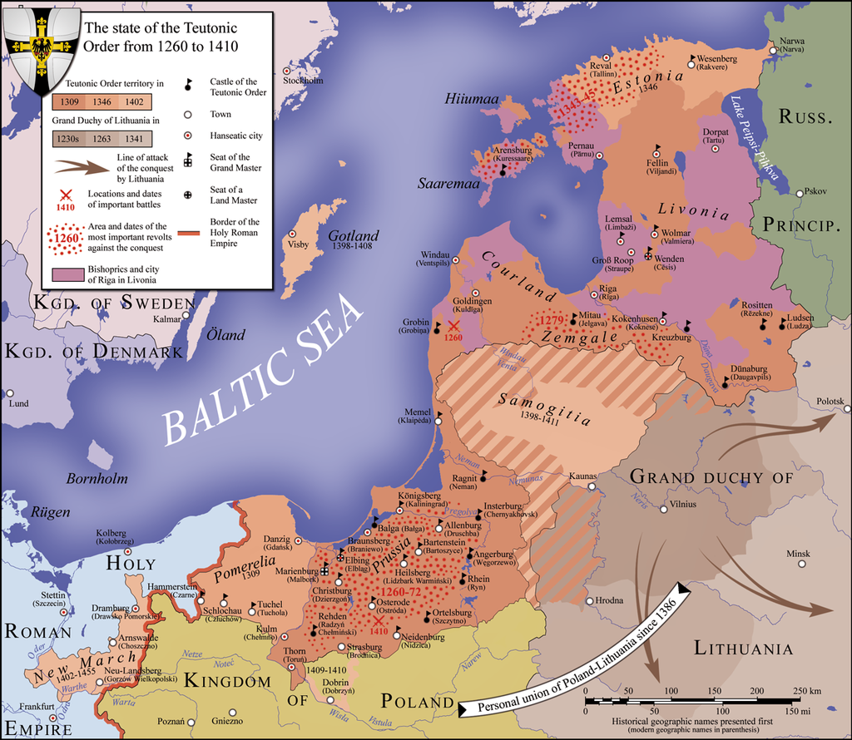
Teutonic Order – the main enemy
Source: https://en.wikipedia.org/wiki/Teutonic_Order#/media/File:Teutonic_Order_1260.png
Notes:
8.This map shows how the Teutonic State grew in territories and power.

Slide 9
Polish–Lithuanian–Teutonic Wars
1. The Polish–Lithuanian–Teutonic War or Great War
1409-1411
battle of Grunwald (Tannenberg) – the military-religious monks were decisively defeated. Most of the Teutonic leadership was killed or taken prisoner
siege of Marienburg
Peace of Thorn 1411
2. Thirteen Years' War also called the War of the Cities
1454–1466
ended in the victory of the Prussian Confederation and Poland
the Second Peace of Thorn (1466)
Notes:
9.That is why the 15th century was mainly the time of wars between joined Poland and Lithuania against the Teutonic Order. There were two great wars: in 1409-1411 and 1454-1466.

Slide 10
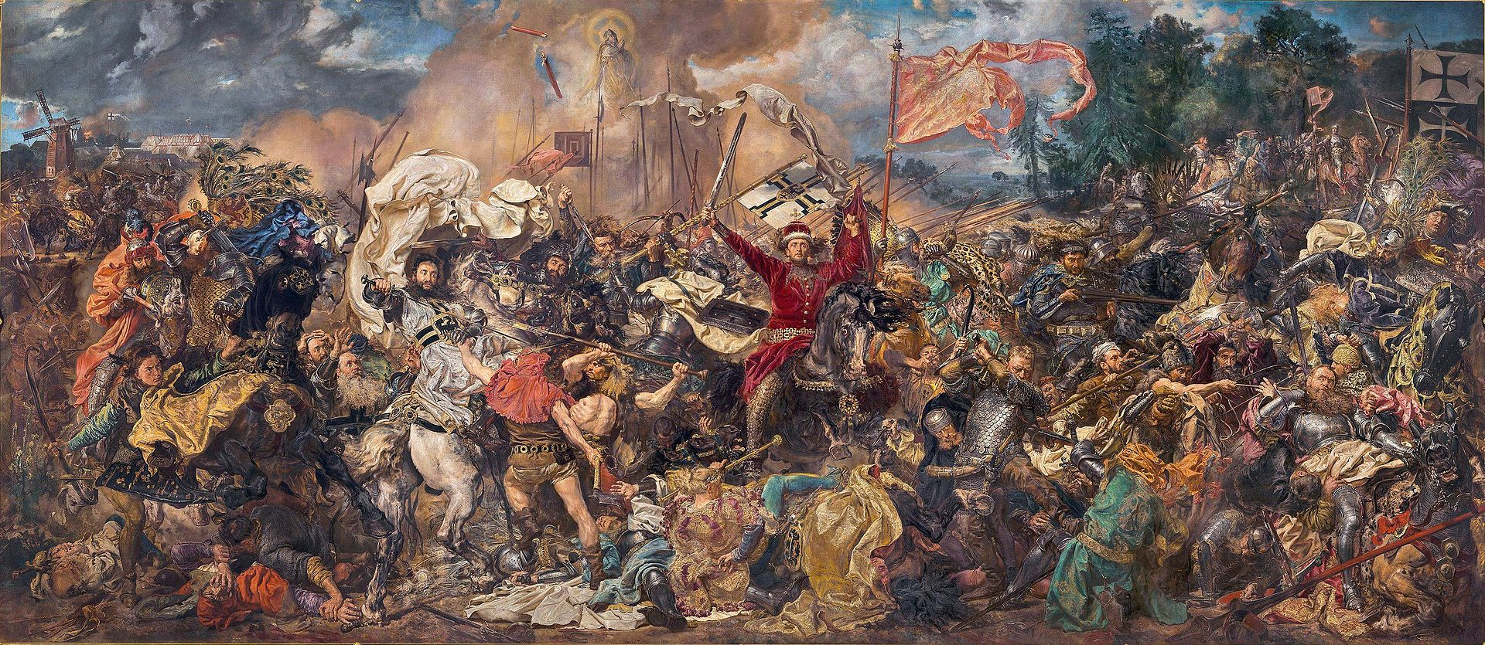
The Battle of Grunwald (Tennenberg) 1410
The battle was one of the largest in medieval Europe and is regarded as one of the most important victories in the histories of Poland and Lithuania.
Source: http://cyfrowe.mnw.art.pl/dmuseion/docmetadata?id=4799
Notes:
10. The most famous and important moment of the first war was the Battle of Grundwald on the 15 July 1410 – the great victory over the Teutonic State and the beginning of its decline and later secularization at the time of reformation.

Slide 11
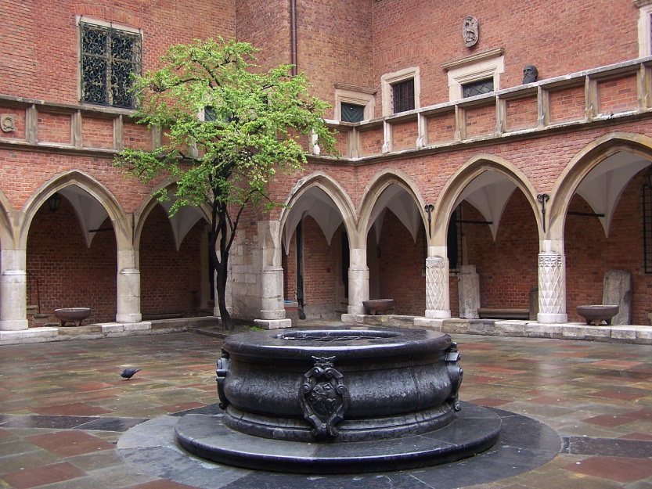
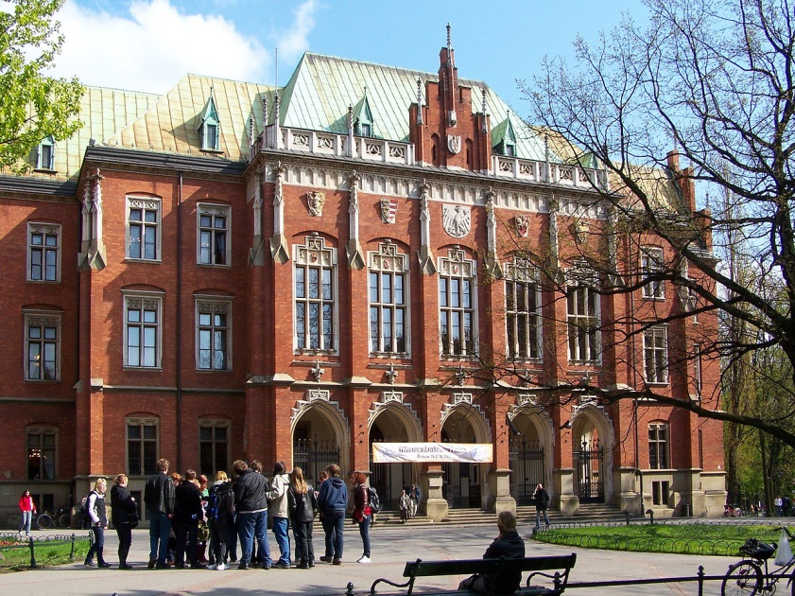
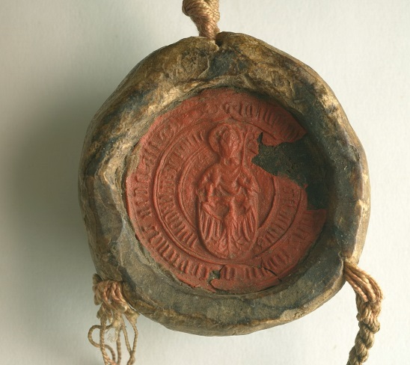
Cultural developement
Jagiellonian University
founded in 1364 by Casimirus the Great
the oldest university in Poland
the second oldest university in Central Europe
one of the oldest surviving universities in the world
after a period of disinterest and lack of funds, the institution was restored in the 1390s by King Władysław II Jagiełło and his wife Saint Hedwig
notable alumni: mathematician and astronomer Nicolaus Copernicus
Source: https://pl.wikipedia.org/wiki/Uniwersytet_Jagiello%C5%84ski#/media/File:Krak%C3%B3w_-_Collegium_Novum_01.JPG
Notes:
11.The 15th century is not only the time of war but also the time when the culture developed. The Jagiellonian University founded in 1364 by the last Piast king was restored thanks to Jagiellons’ financial support. It became one of the important cultural centres of Poland and Europe.

Slide 12
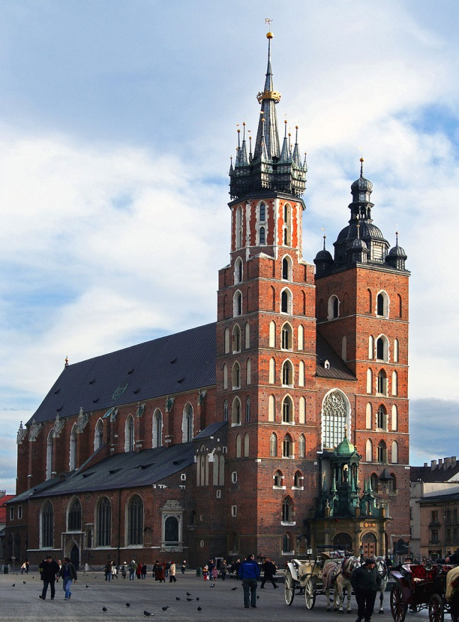
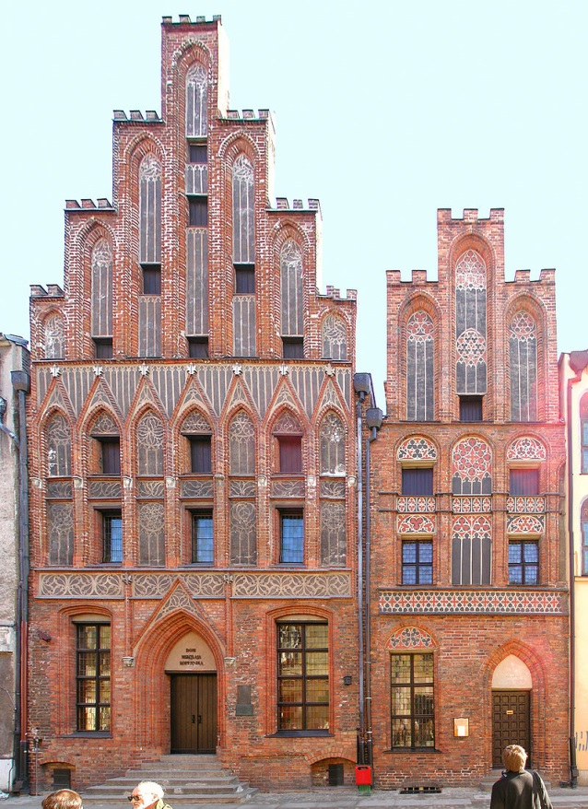
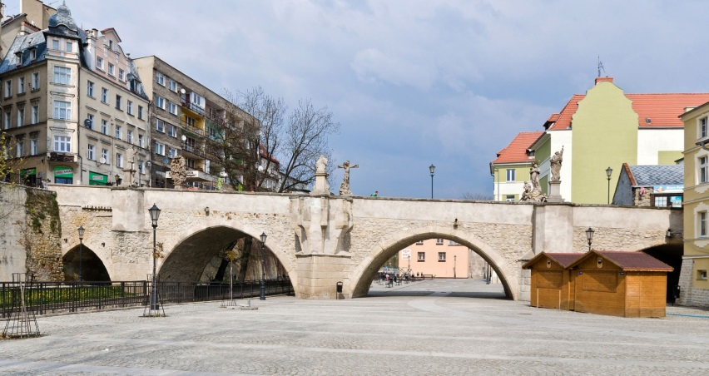
Cultural developement
Gothic Style in Architecture
Gothic bridge in Kłodzko
St Mary's Church in Cracow
Copernicus’ house in Toruń
Source: https://pl.wikipedia.org/wiki/Architektura_gotycka_w_Polsce
Notes:
12.In architecture the gothic style became significant. Here you can see some examples of gothic buildings in Poland.

Slide 13
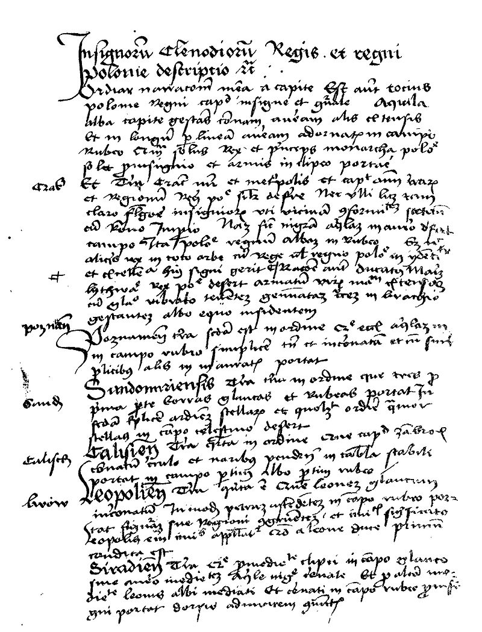
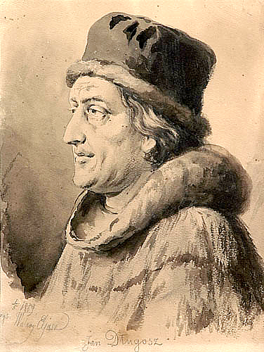
Cultural developement
Chronicler – Jan Długosz (1415-1480)
He is considered Poland's first historian
Annales seu cronici incliti regni Poloniae (Annals or Chronicles of the Famous Kingdom of Poland)
Source: https://pl.wikipedia.org/wiki/Jan_D%C5%82ugosz#/media/File:Insignia_seu_clenodia_Regis_et_Regni_Poloniae_1.jpg
Notes:
13.The chronicler Jan Długosz who is considered Poland’s firs historian, wrote ’’Annals or Chronicles of the Famous Kingdom of Poland’’.

Slide 14
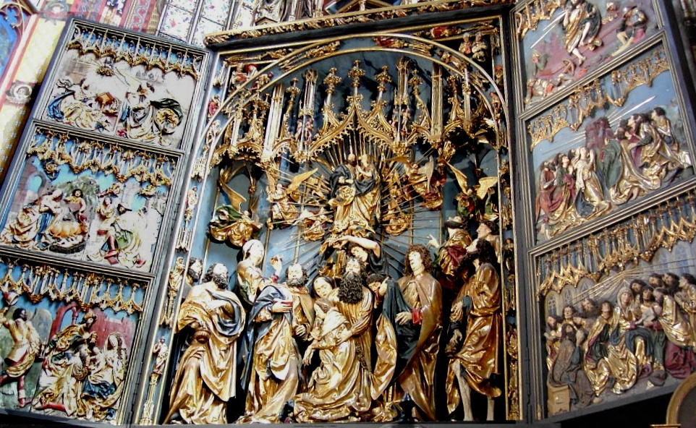
Cultural developement
Sculpture
wooden Altar of Veit Stoss at St Mary's Church in Cracow
Source: https://pl.wikipedia.org/wiki/O%C5%82tarz_Wita_Stwosza_w_Krakowie#/media/File:Gothic_altar_veit_stoss_bordercropped.jpg
Notes:
14.And Veit Stoss carved his wooden Altar at St Mary’s Church in Cracow.

Slide 15
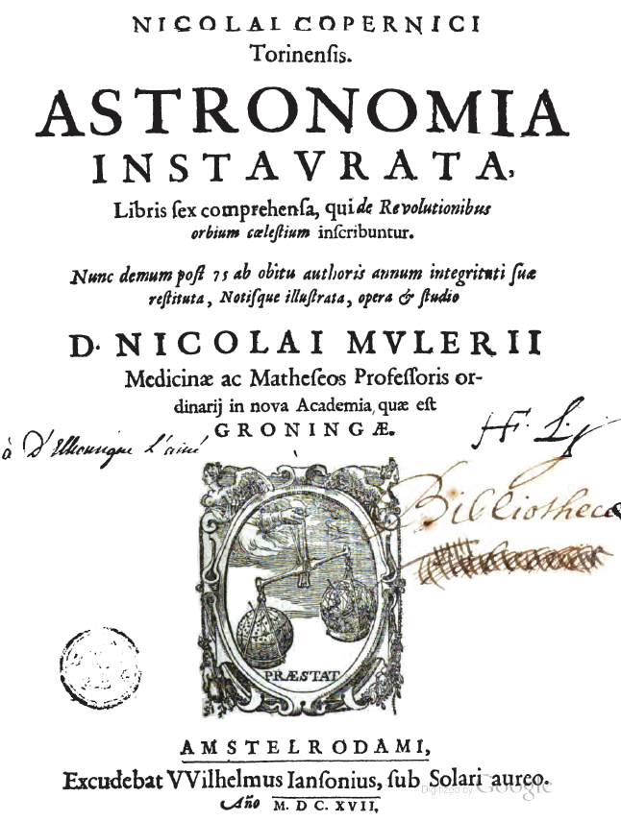
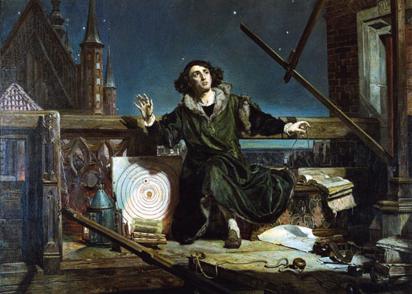
Nicolaus Copernicus Polish astronomer formulated the first modern heliocentric theory about the solar system (1473–1543)
Cultural developement
De revolutionibus
orbium coelestium
Source: https://en.wikipedia.org/wiki/Polish_Golden_Age
Notes:
15. Nicolaus Copernicus, an astronomer formulated the first modern heliocentric theory about the solar system.

Slide 16
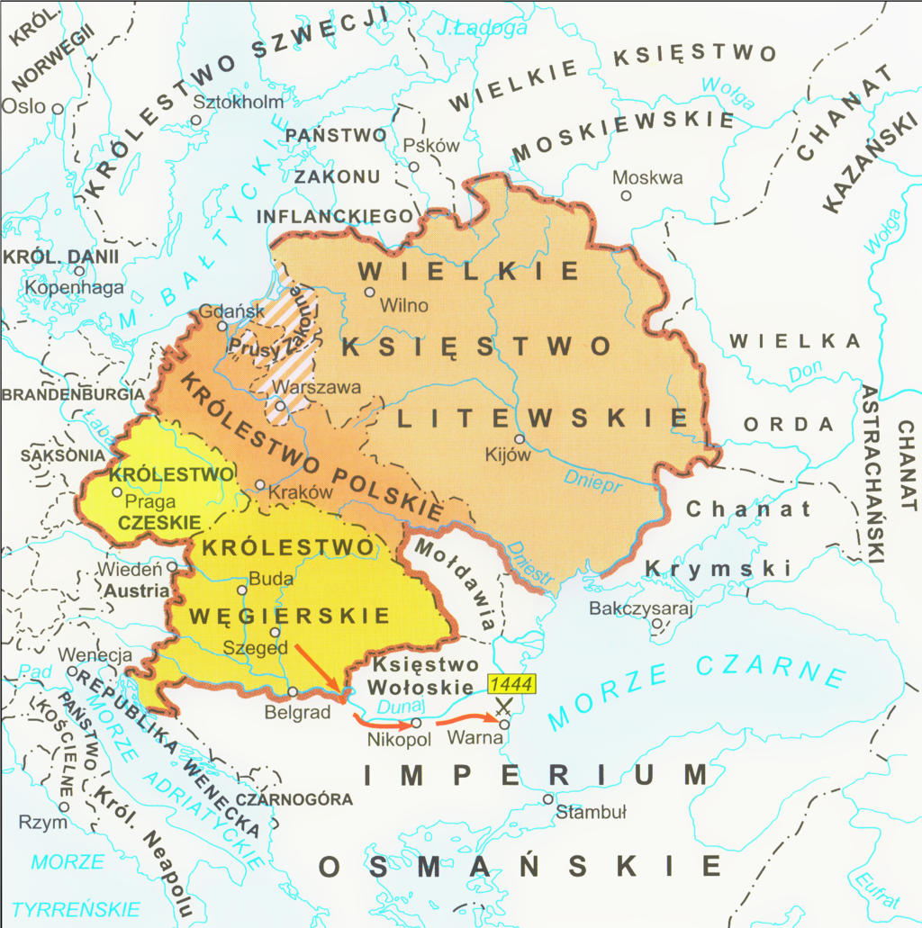
Poland in the 15th century
At the end of the 15th century, the Jagiellonians reigned over vast territories stretching from the Baltic to the Black to the Adriatic Sea.
Source: https://en.wikipedia.org/wiki/Jagiellonian_dynasty#/media/File:Jagiellonian.png
Notes:
17.To sum up, at the end of the 15th century, the Jagiellonians reigned over vast territories stretching from the Baltic to the Black to the Adriatic Sea.

Slide 17
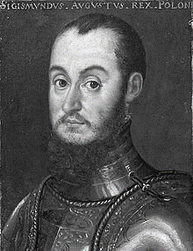
Polish Golden Age 16th century
The last of the Jagiellons, Sigismund August
and his father
Sigismund The Old
Source: https://commons.wikimedia.org
Notes:
18. The first half of the next century, when two last Jagiellonian kings ruled, brought further development in culture and it is called the Golden Age.

Slide 18
Thank you ☺
Ten projekt został zrealizowany przy wsparciu finansowym Komisji Europejskiej. Projekt lub publikacja odzwierciedlają jedynie stanowisko ich autora i Komisja Europejska nie ponosi odpowiedzialności za umieszczoną w nich zawartość merytoryczną.
This project has been funded with support from the European Commission. This publication [communication] reflects the views only of the author, and the Commission cannot be held responsible for any use which may be made of the information contained therein.
Notes:
19. Thank you for your attention.

