Slide 1
DIGENIS AKRITAS APHRODITE
Presenters:
Konstantinos Koliandris
Marilena Ktori
Crete – Sitia

Slide 2
AKRITES
Akrites is a term used in the Byzantine Empire in the 9th–11th Centuries to indicate the army units guarding the Empire's eastern border, facing the Muslim states of the Middle East.
Their achievements, inspired the Byzantine “National Epic" of Digenis Akritas and the cycle of the Acritic songs. The term is derived from the Greek word “akra”, meaning border.

Slide 3
DIGENIS AKRITAS
Byzantine epic hero celebrated in folk ballads relating his parentage, boyhood adventures, manhood, and death.
His epic: Based on historical events,
a blend of Greek, Byzantine, and Asian motifs,
originated in the 10th century and developed in the 12th century.
The ideal medieval Greek hero, a frontier warrior, the son of a Saracen emir converted to Christianity by the daughter of a Byzantine General.
He was a proficient warrior by the age of three and spent the rest of his life defending the Byzantine Empire from frontier invaders.

Slide 4
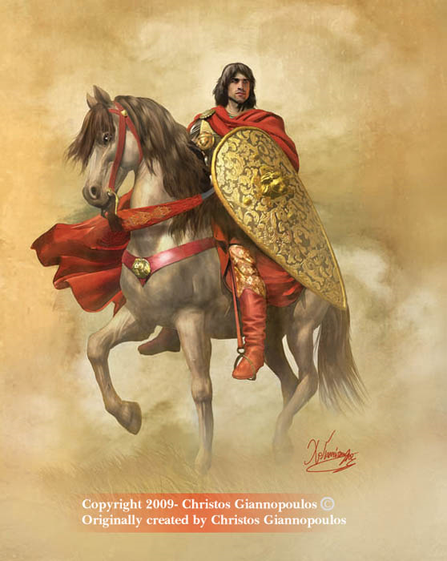
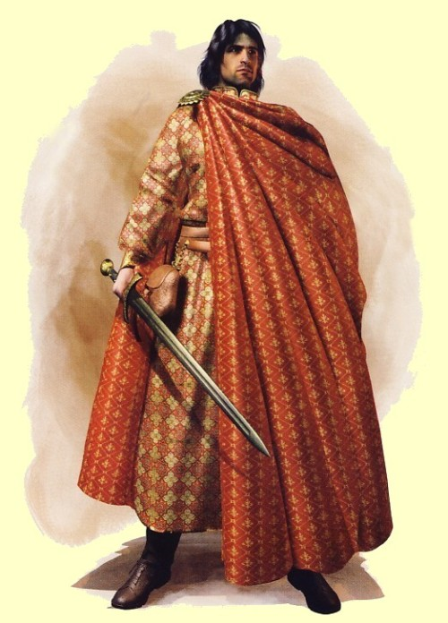

Slide 5
A LEGEND OF DIGENIS AKRITAS
The name “Petra Tou Romiou" is related to Digenis Akritas who, according to the legend, kept the Saracens Arabs back with his incredible power in the 7th-10th Century.
The legend says in his effort to escape from the enemy, Akritas grabbed onto the Kyrenia valley, as a result forming the "Pentadactylos", while the other hand raised a huge rock and threw it into the sea against the Saracens.
The area, which is in the city of Paphos, owes its name to this rock, which still exists.

Slide 6
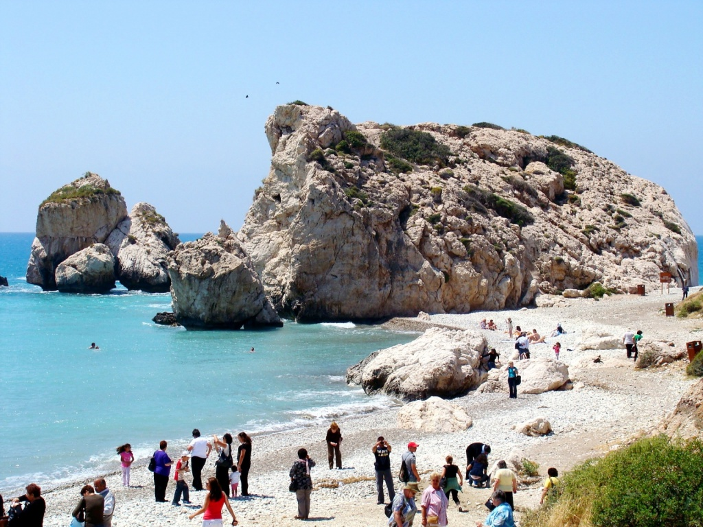
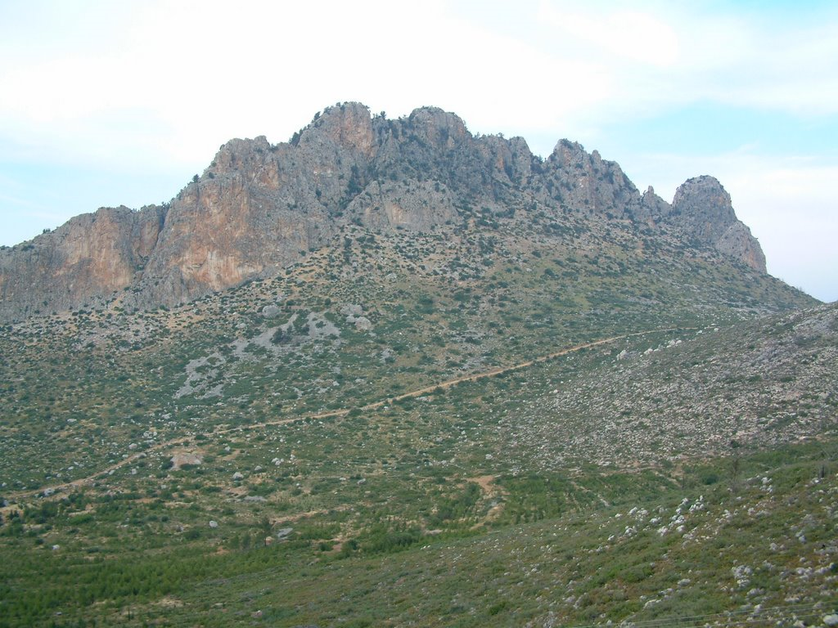
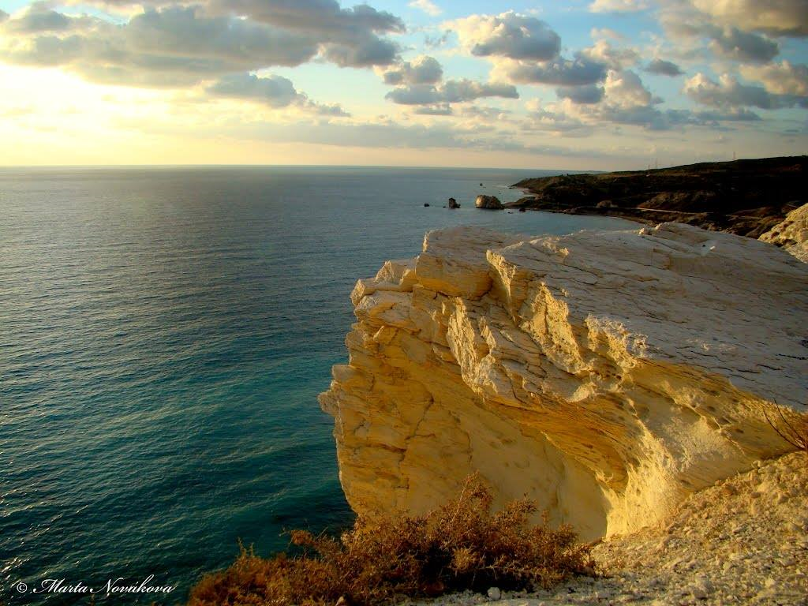
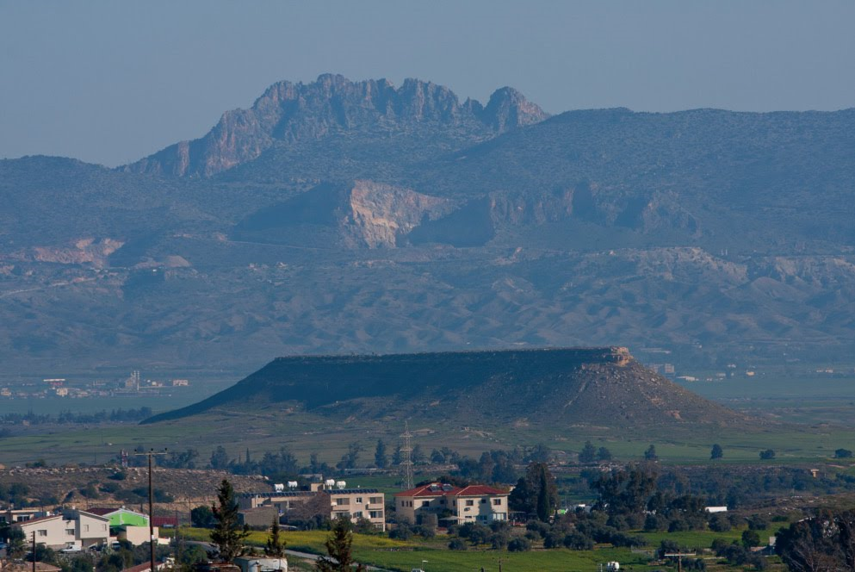

Slide 7
APHRODITE
The daughter of Uranus and sea.
She was referred to as Aphrodite, Cypris- which means the land she first appeared- by the Olympian gods.
She was the goddess of beauty, joy and laughter, queen of love, guardian of young girls and the fertility of animals and plants.
Her symbols included rabbits, sparrows, goats, pomegranates and apples.

Slide 8
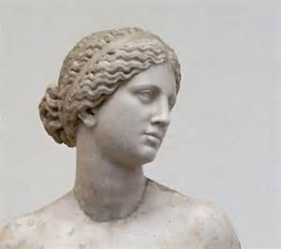

Slide 9
A MYTH OF APHRODITE
Aphrodite emerged from the foam of the sea at Paphos and went to Olympus accompanied by Eros and Pothos to claim her place among the assembly of the Gods.
According to the myth, she was born when Saturn cut off the genitals of his father, Uranus, and threw them into the sea. From the foam came the goddess, hence her name.

Slide 10
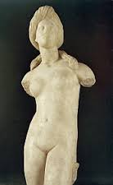
CYPRUS AND MYTH!
The ancient Greek tradition wants Cyprus to have been evolved through the sea, thus the land of Aphrodite the Goddess of beauty and LOVE!

