Slide 1
Carolina Boned
Rocío Funes
Marta Gómez
María Muñoz
Polish stereotypes and prejudices

Slide 2
INDEX
1. LOCATION
2. POLISH STEREOTYPES
3. POLISH PREJUDICES
4. CURIOSITIES OF POLAND

Slide 3
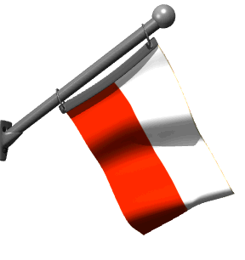
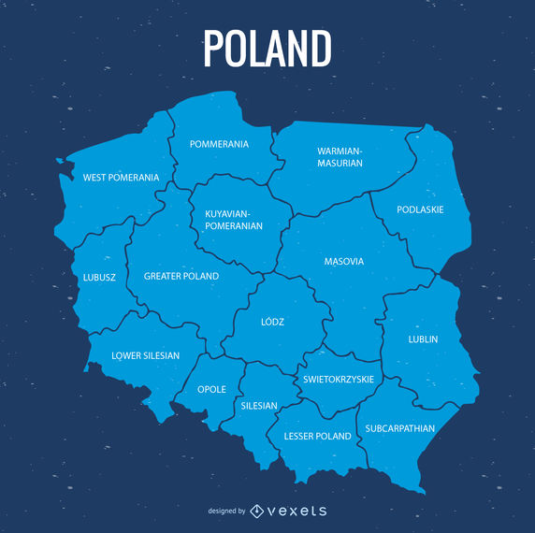
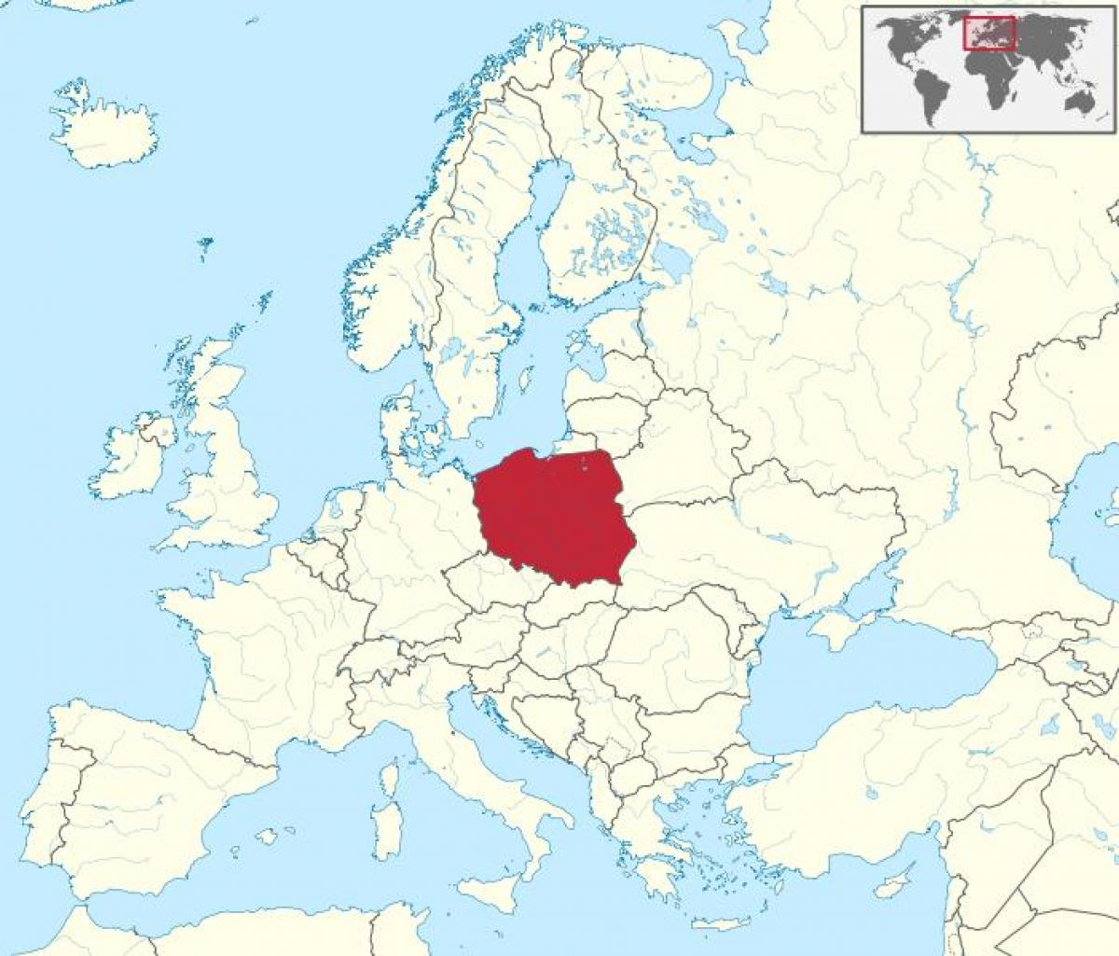
LOCATION
Capital

Slide 4
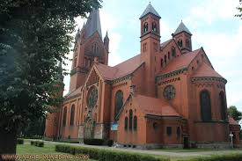
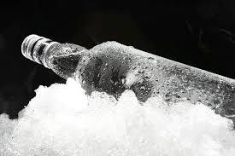
POLISH STEREOTYPES
Here are some of the ideas we have about Polish people.
They are very religious.
They really like vodka and they often get drunk.

Slide 5
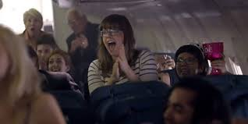
Polish applaud when their plane arrives at their destination.
People like leisure

Slide 6
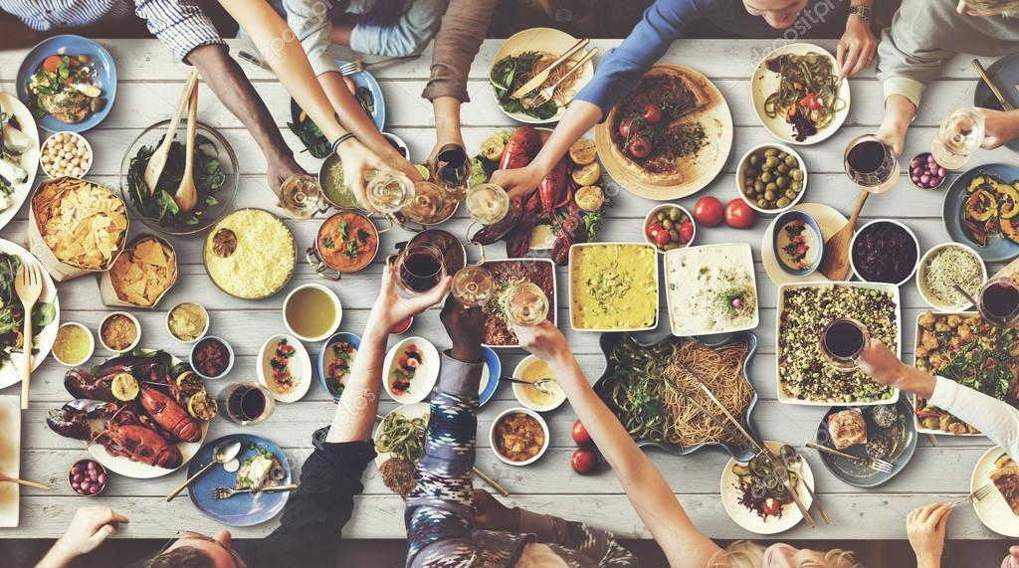
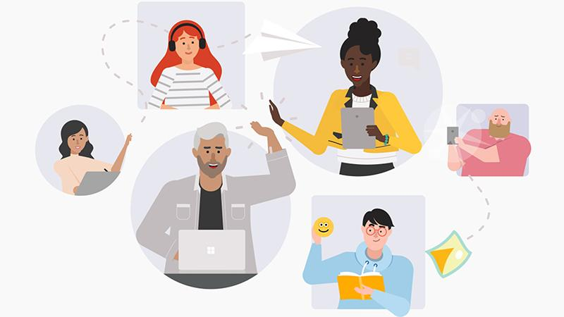
Polish seem to be hard-working people
Polish people eat so much

Slide 7
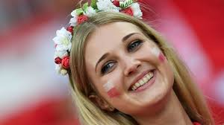
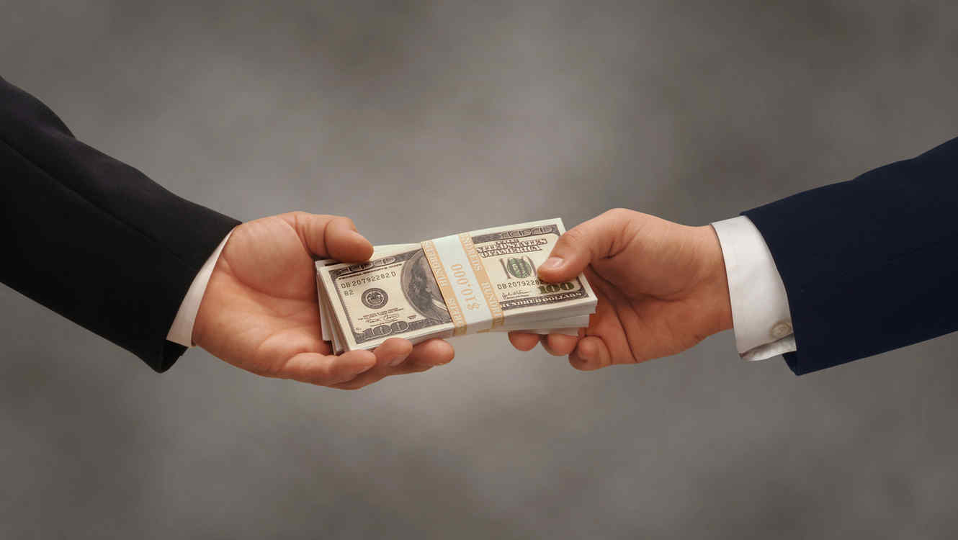
Everything is much cheaper there than in Spain
The girls are thin and blonde.

Slide 8
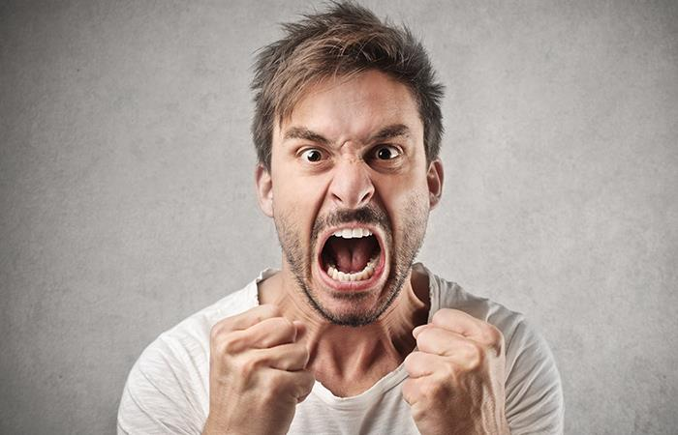
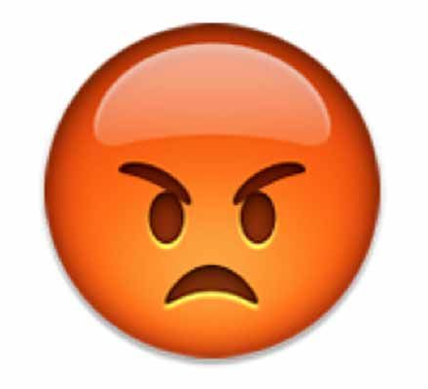
POLISH PREJUDICES
Sometimes people from other countries have prejudices against Polish people that sometimes are not true.These are some of them:
Polish people never smile and get angry over everything.
Polish men are aggressive.

Slide 9
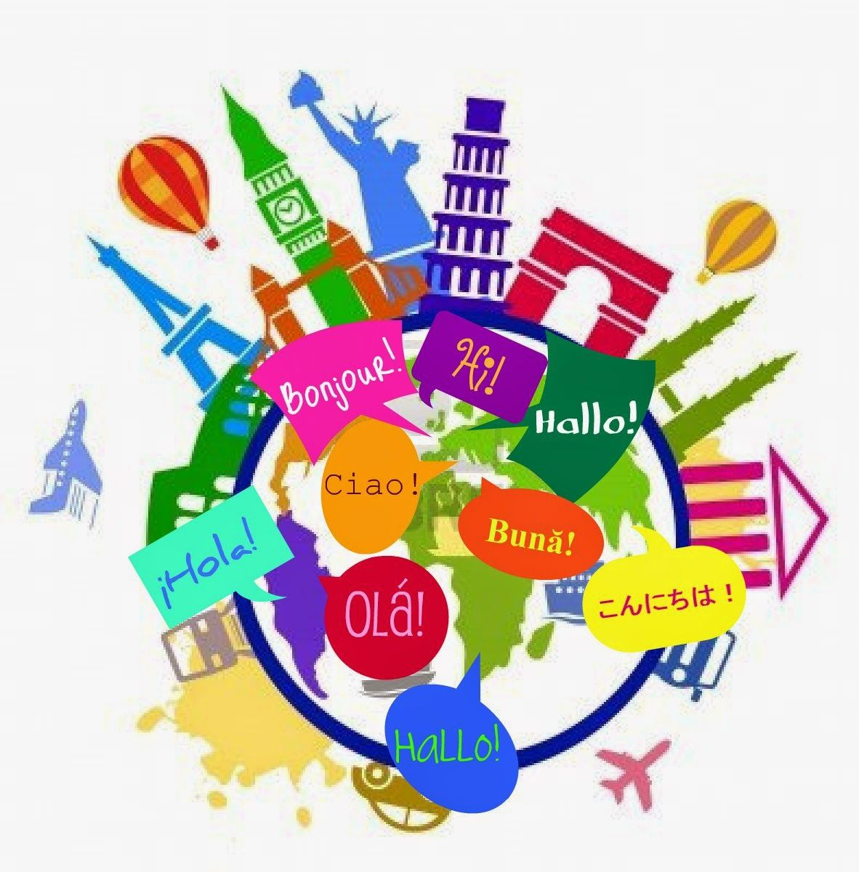
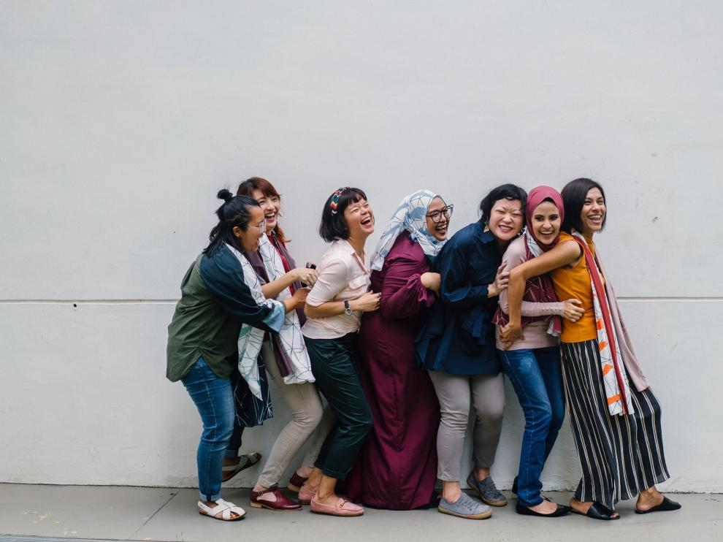
They can’t speak any foreign language.
Polish don’t like immigrants, they don’t understand them

Slide 10
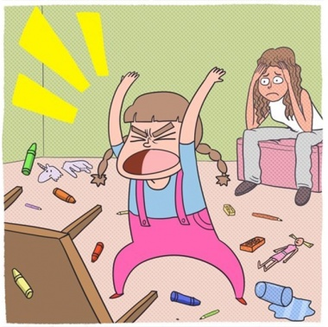
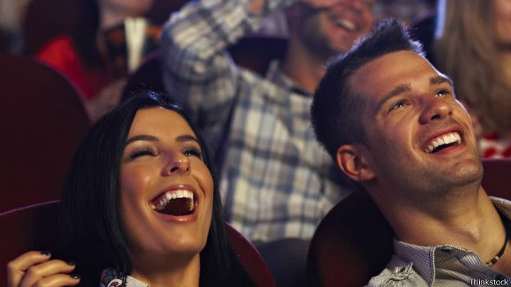
The Polish don't laugh at themselves
Polish people are very noisy.

Slide 11
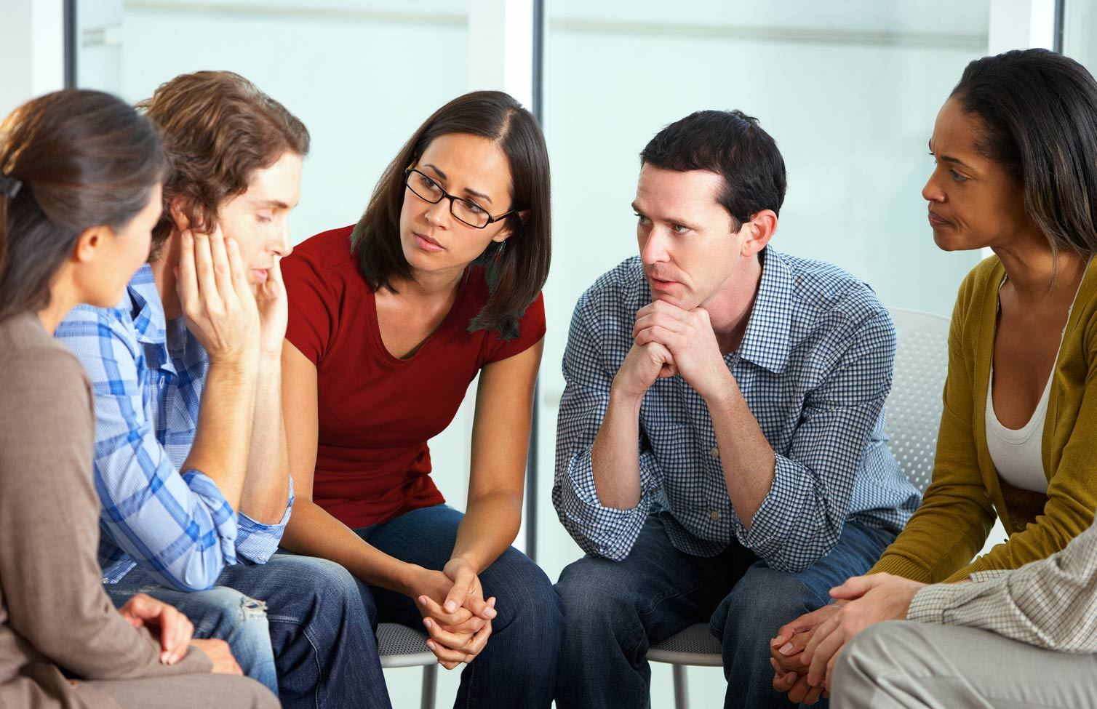
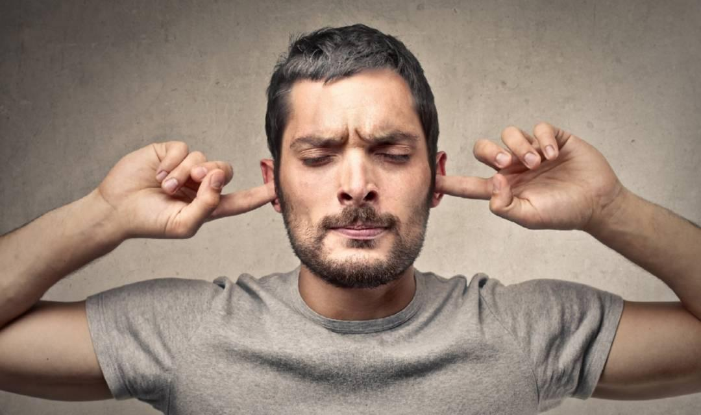
They're not as open as Spanish people
Polish are very stubborn

Slide 12
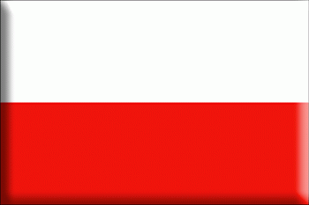
CURIOSITIES OF POLAND
You have at least one friend named Ola, Kasia, or Asia. Michał, Marcin or Tomek, as well.
The day of your name may become more important than your birthday
Foreigners have difficulty pronouncing your surname ( Strzelczyk)

Slide 13
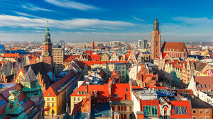
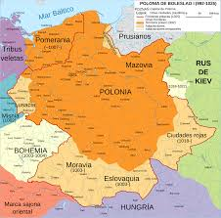
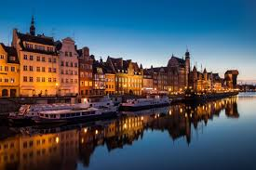
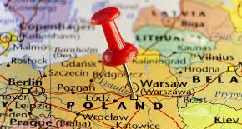
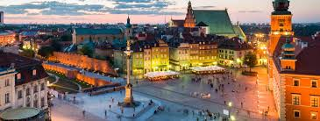
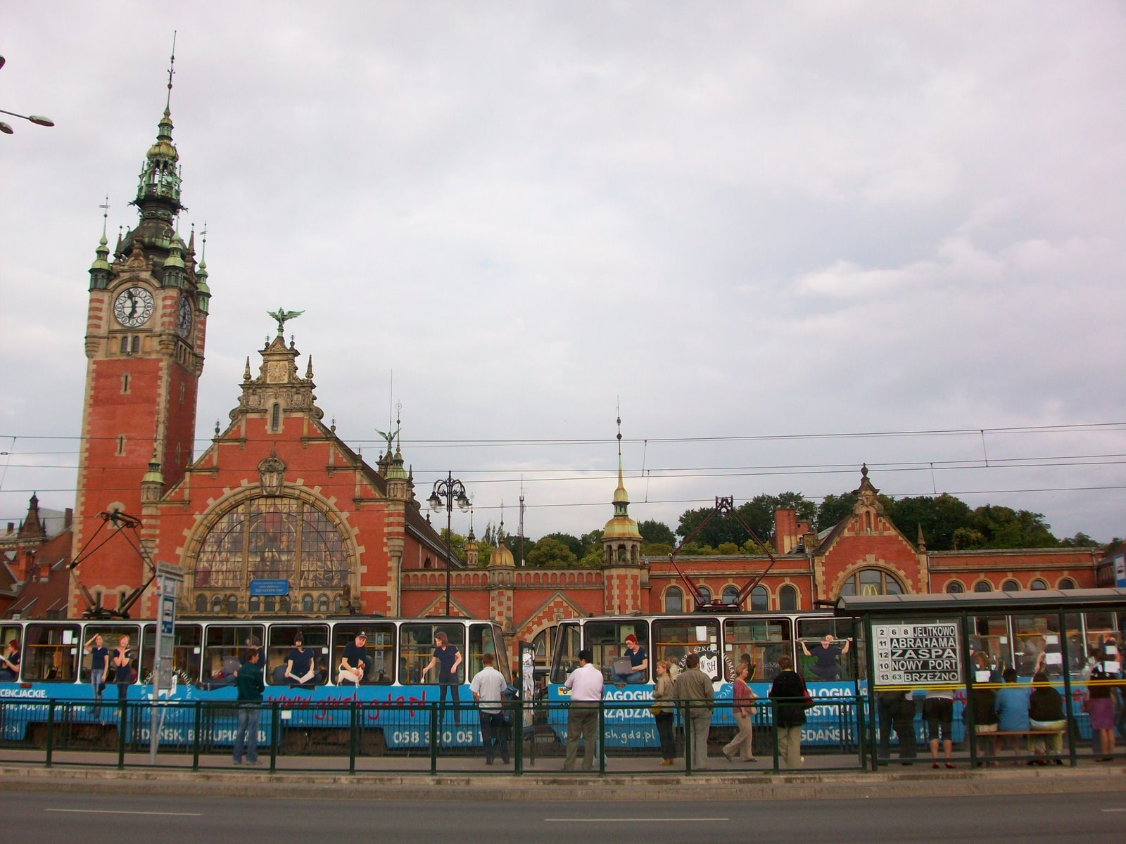
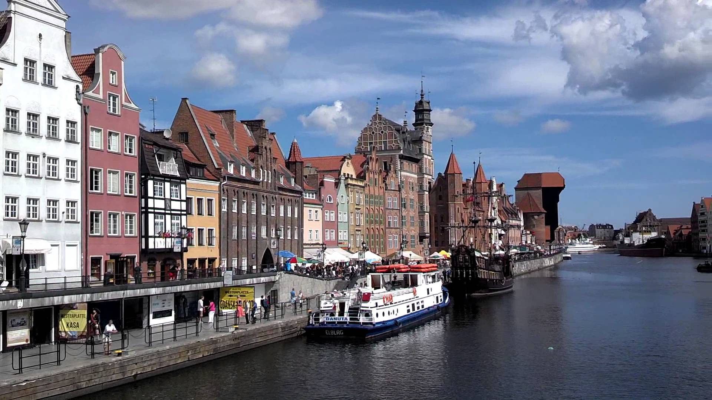
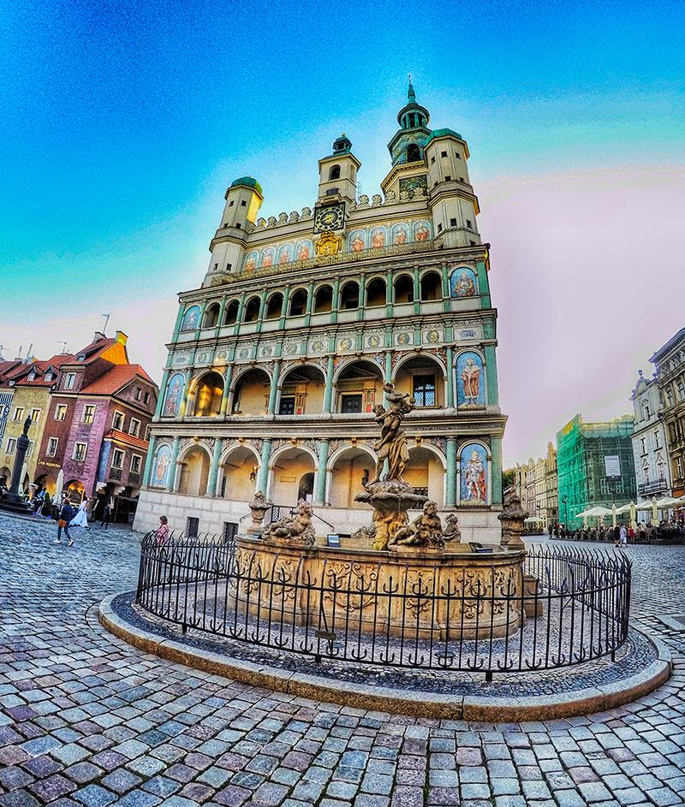
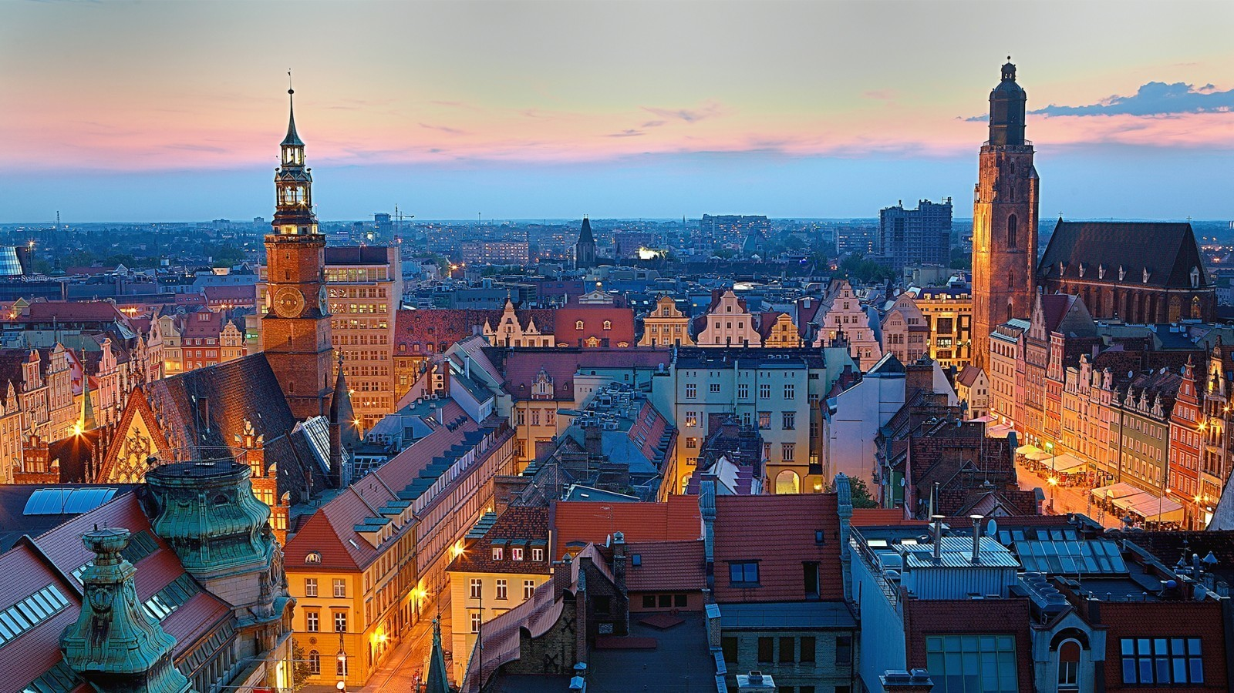
THE END
Notes:
Pay a look to the corrections, please.

