Slide 1
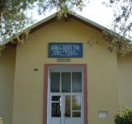
eTwinning project
Proud of being European
2018-2019
Activity : “Getting to know each other “
Class 5, Romania

Slide 2
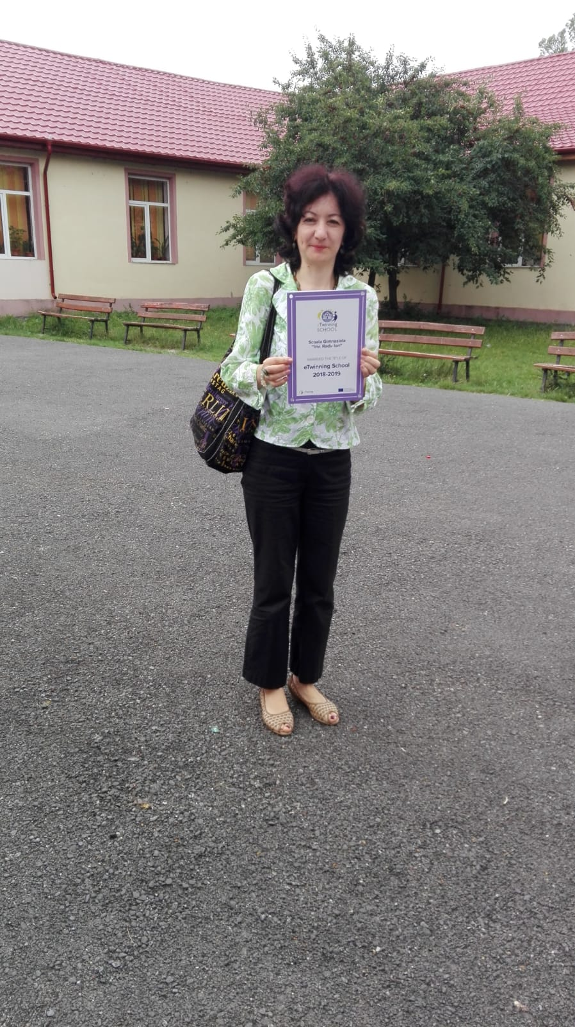
Scoala Gimnaziala “Inv. Radu Ion”, Vadu-Parului, Romania
This is the English Teacher
Emilia

Slide 3
I am Adina!

Slide 4
Hello from Edi !

Slide 5
It’s me, Catalina!

Slide 6
My name is Stefania!

Slide 7
I am Maria!

Slide 8
Thank you!
Romania , 2018
eTwinning project

