Slide 1
Talking about Portugal
By Julia Rodrigo, Antonio Totu and Sofia Gracia

Slide 2
INDEX
Portugal
stereotypes and prejudices
Culture and traditions of Romania
History of Portugal

Slide 3
STEREOTYPES
They don't talk so much, they are very formal.
They are very polite.
They are not very creative with names.
They are reserved.
They are very workers.

Slide 4
PREJUDICES
They live in a simple and poor form.
They don't have water.
They are so energetic, outgoing and so talkers.
They love go with their friends and go to parties.

Slide 5
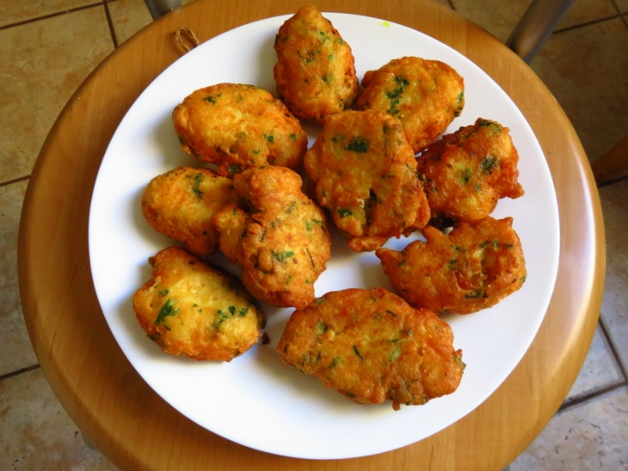
CULTURE AND TRADITIONS OF PORTUGAL
San Juan is a popular festivity that use hammers, leeks and balloons of San Juan
Portugal has a lot of delicious typical dishes, like ‘Buñuelos de bacalao’

Slide 6
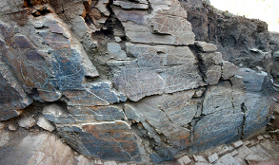
HISTORY OF PORTUGAL
In 1992 some workers found, accidentally, carvings in some rocks near Vila Nova de Foz Côa.
In 1415, Ceuta was conquered by Portugal

