Slide 1
Talking about romania
By Julia Rodrigo, Antonio Totu and Sofia Gracia

Slide 2
INDEX
Stereotypes and prejudices
Culture and traditions of Romania
History of Romania

Slide 3
STEREOTYPES
Romania is dracula’s land.
All the romanian hang up garlic in their houses.
There are so many dogs in the streets.
They are humble.

Slide 4
PREJUDICES
All Romanian are gypsies.
They don’t have so much money.
They often steal.
Everything is cheap there.
They are not polite.
It's a dangerous destination

Slide 5
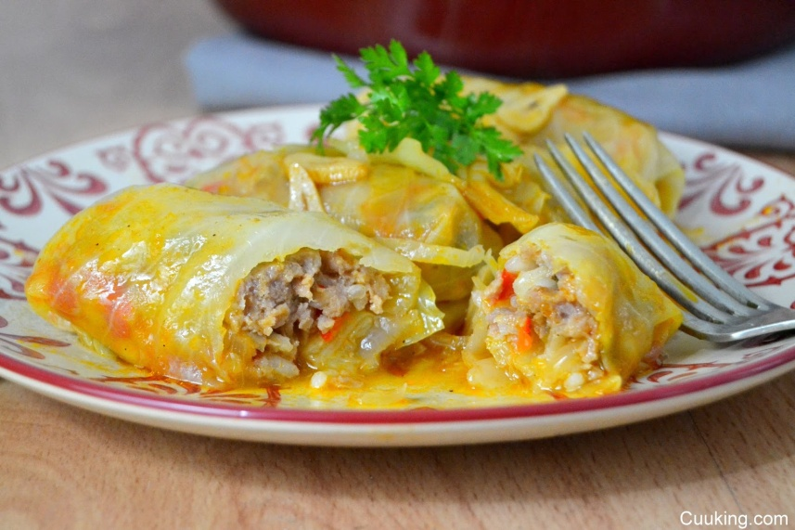
CULTURE AND TRADITIONS OF ROMANIA
They have a traditional dress which is different for men and women. The most colourful dress is for women and the darkest colours are for the men’s clothes.
There are so many common dishes, like ‘sarmale’

Slide 6
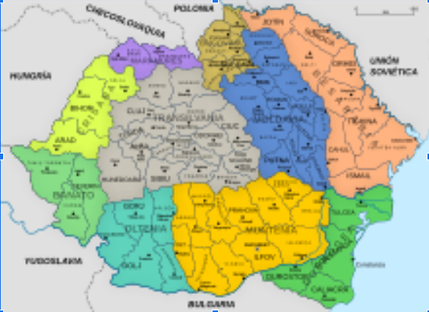
HISTORY OF ROMANIA
In Romania people found a skull of a Neanderthal man in Peştera cu Oase, near Anina (actual Romania).
After the 1st world war, Romania had many more territories, like Transilvania, Besarabia and Bucovina, but at the end of the 2nd World War, Romania lost the North of Transilvania
This image shows the territories of Romania after the 1st world war

