Slide 1
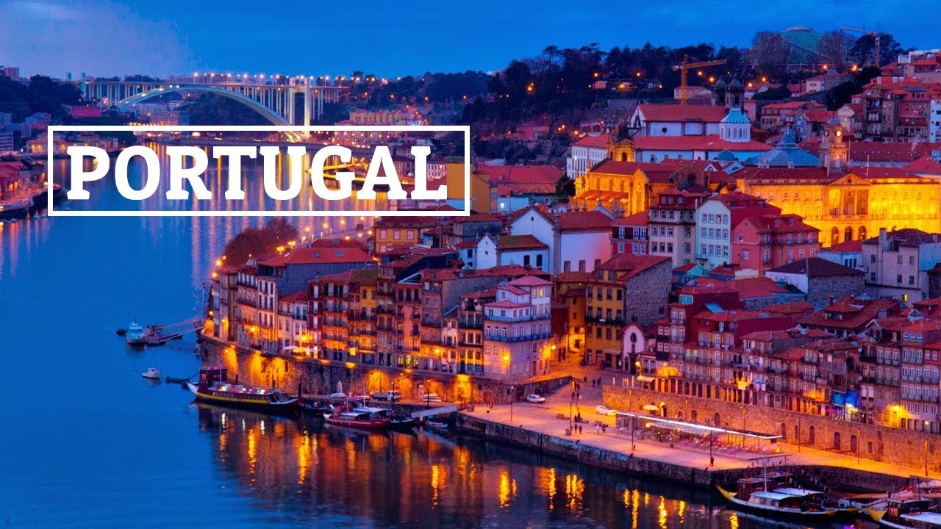
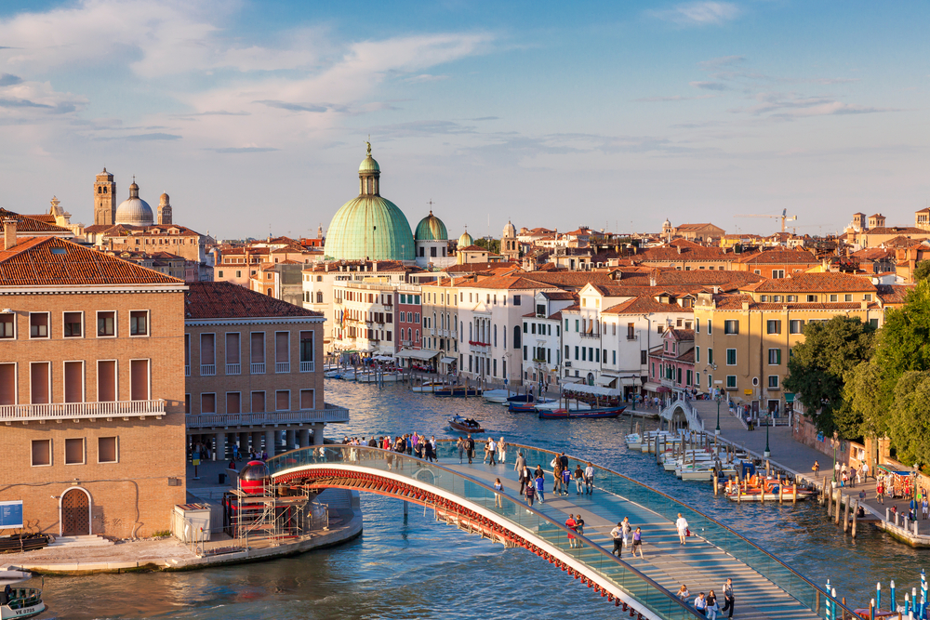
Things we have in common with Portugal and Italy:
Portugal
We share the same portion of land.
The Tajo river
Portuguese was originated in Galicia
Our gastronomy is similar
Portuguese is a language that has had many variations and one of them is Galician-Portuguese, which was used in Spain in the Middle Ages in the medieval Kingdom of Galicia. So the Galician and the Portuguese have a close relationship between them.
Italy
(The) olive oil
The Mediterranean Sea
We both love football / soccer
There is a lot of life in our streets
The Mediterranean climate
The Mediterranean climate is a warm climate characterized by very hot and dry summers and light and rainy winters. All the provinces that are in the Mediterranean region have this climate, so Spain and Italy have both these climate.
Words shared between Spanish and French :
- Spanish “Dama” and French “Dame” , both come from Latin (domina)
- “Baguette” is used in Spanish but it comes from French.
- “Boutique” is used in Spanish but it comes from French.
- “Canapé” is used in Spanish but it comes from French.
- “Croissant” is used in Spanish but it comes from French.
- “Perfume” is used in Spanish but it comes from French.

