Slide 1
Project 4
María García, Lucía Esteban and Sara Muriel

Slide 2
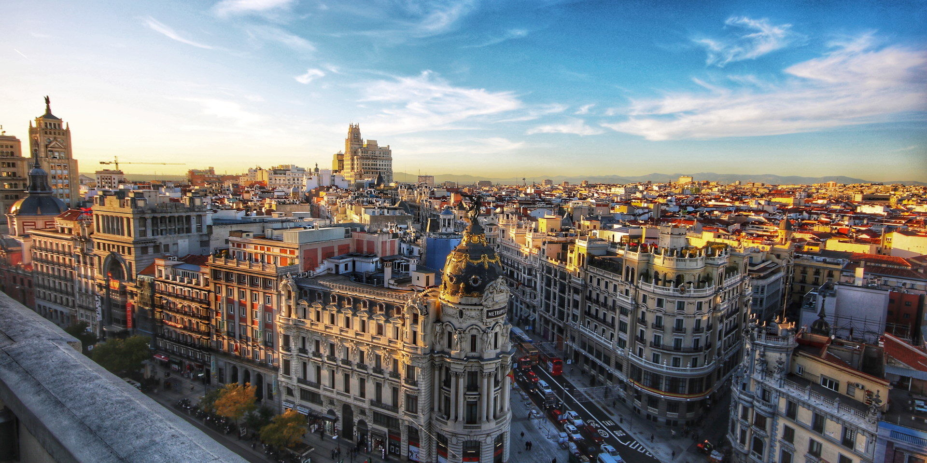
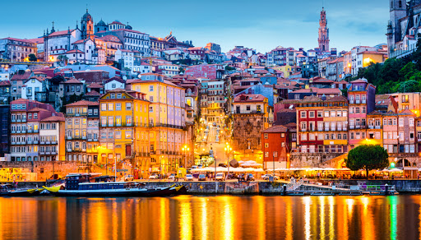
similarities between Spain and Portugal
-We live in the Iberian peninsula.
-The gastronomy is very similar.
-In the past, Portugal belonged to the kingdom of Spain.
-We also have rivers in common such as the Duero that flows into Oporto and the Tagus that flows into Lisbon.
-We speak a language that comes from Latin.

Slide 3
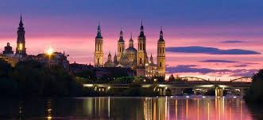
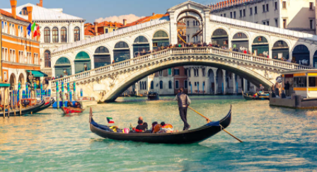
similarities between spain and italy
-Spanish people and Italians have very similar behavior and expressions.
-We share the Mediterranean Sea.
-Spain and Italy have had very similar coronavirus data.
-Spain and Italy are peninsulas.
-We speak too loud.
-Both countries have Romance languages ​​derived from Latin.

Slide 4
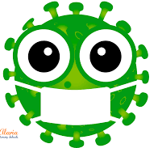
COVID-19 IN ITALY AND SPAIN
The first case of Covid-19 in Spain and Italy was the same day.
In this fight against Covid, Italy was a mirror of what was going to happen to Spain in the near future.
Spain and Italy have 44% of the total deaths from Covid’19.
Covid-19 has affected Italy and Spain more because they have an older population and furthermore because they are countries in which contact between people is very common.

Slide 5
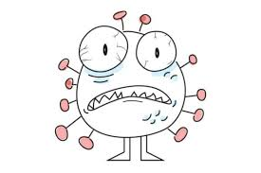
DEATHS AND INFECTED PEOPLE
Coronavirus deaths in:
Spain : 31.973.
Italy : 35.918.
People infected by coronavirus:
Italy : 317 million people infected.
Spain : 779 million people infected.

Slide 6
words in common in french with spain
SPAIN FRANCE
- Chalet - Chalet
- Cabaret - Cabaret
- Ballet - Ballet
- Élégant - Elegante
- Restaurant - Restaurante
- Chef - Chef
- Baguette - Barra de pan pequeña
- Gourmet - Gourmet
- Champagne - Champán
- Boutique - Tienda pequeña de souvenirs
- Crêpe - Crep
- Glamour - Glamur
- Croissant - Croissant
- Entrecôte - Entrecot
- Mousse - Mousse
- Foie-gras - Foie-gras

