Slide 2
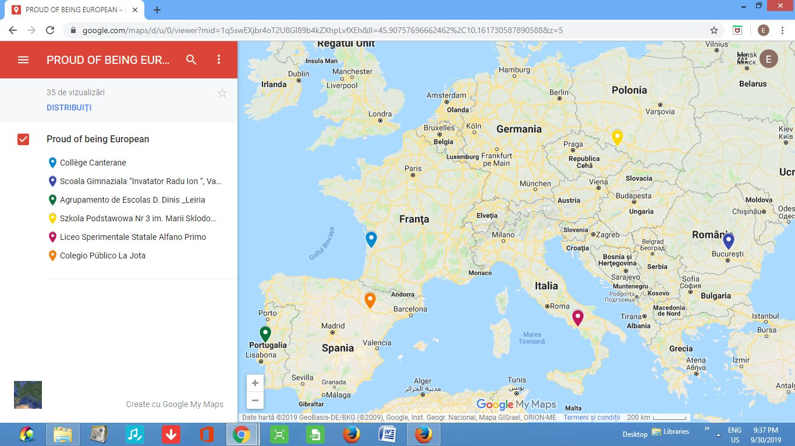

Slide 3
Obiectivele proiectului
Objectives
To understand diversity and develop social skills for students and teachers focusing on the European values.
To foster our students' understanding of European citizenship spirit of tolerance towards other people
To exchange different good practices in the participant schools, later to be implemented.
To support oral learning through creative activities.
To promote an intercultural dialogue to strengthen our students' peer empathy, integrity and knowledge about diversity and inclusion in multicutural society nowadays.
To give students a protagonist role in the teaching-learning process and encourage
empathy and interpersonal relations.

Slide 4
Beneficii pentru scoala
Benefices for school
- a higher awareness of cultural expression and a better acceptance of cultural diversity in all our schools,
- our schools become more open to the idea of multiculturalism and multilingualism,
- having an Erasmus+ project in school , they will gain prestige in the community and will be able to share good practices with other neighbouring schools,
- will integrate cultural heritage in their school curriculum,
- will gain knowledge to develop strategies of how to involve newly arrived students having a different culture in their educational system.

Slide 5
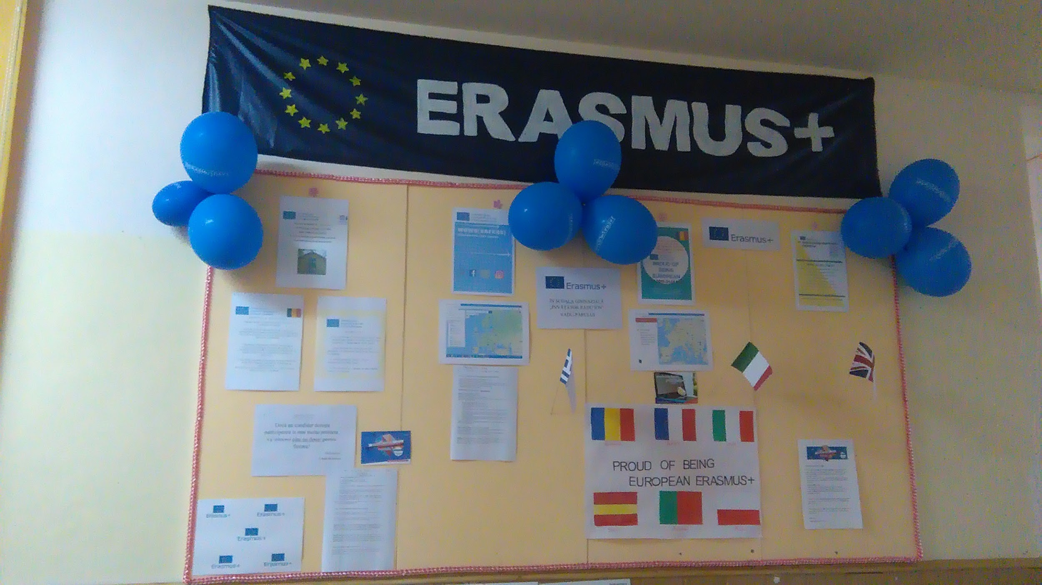

Slide 6
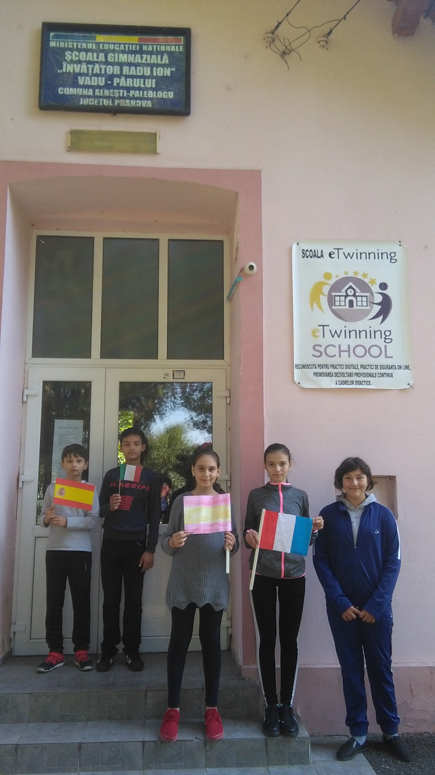
Prima mobilitate
9-15 Decembrie 2019
Liceo Alfano I, Salerno, Italia
Participanti :
-2 elevi cls. a IV a , 3 elevi cls. a VI a
-2 cadre didactice

Slide 7
Activitati:
Welcome activities
Stereotypes and prejudices
eTwinning project
Cultural trip to Naples.
Europically me
Voice of my country
Dance me to the end
Historical trip to Pompei and to the virtual museum Ercolano

Slide 8
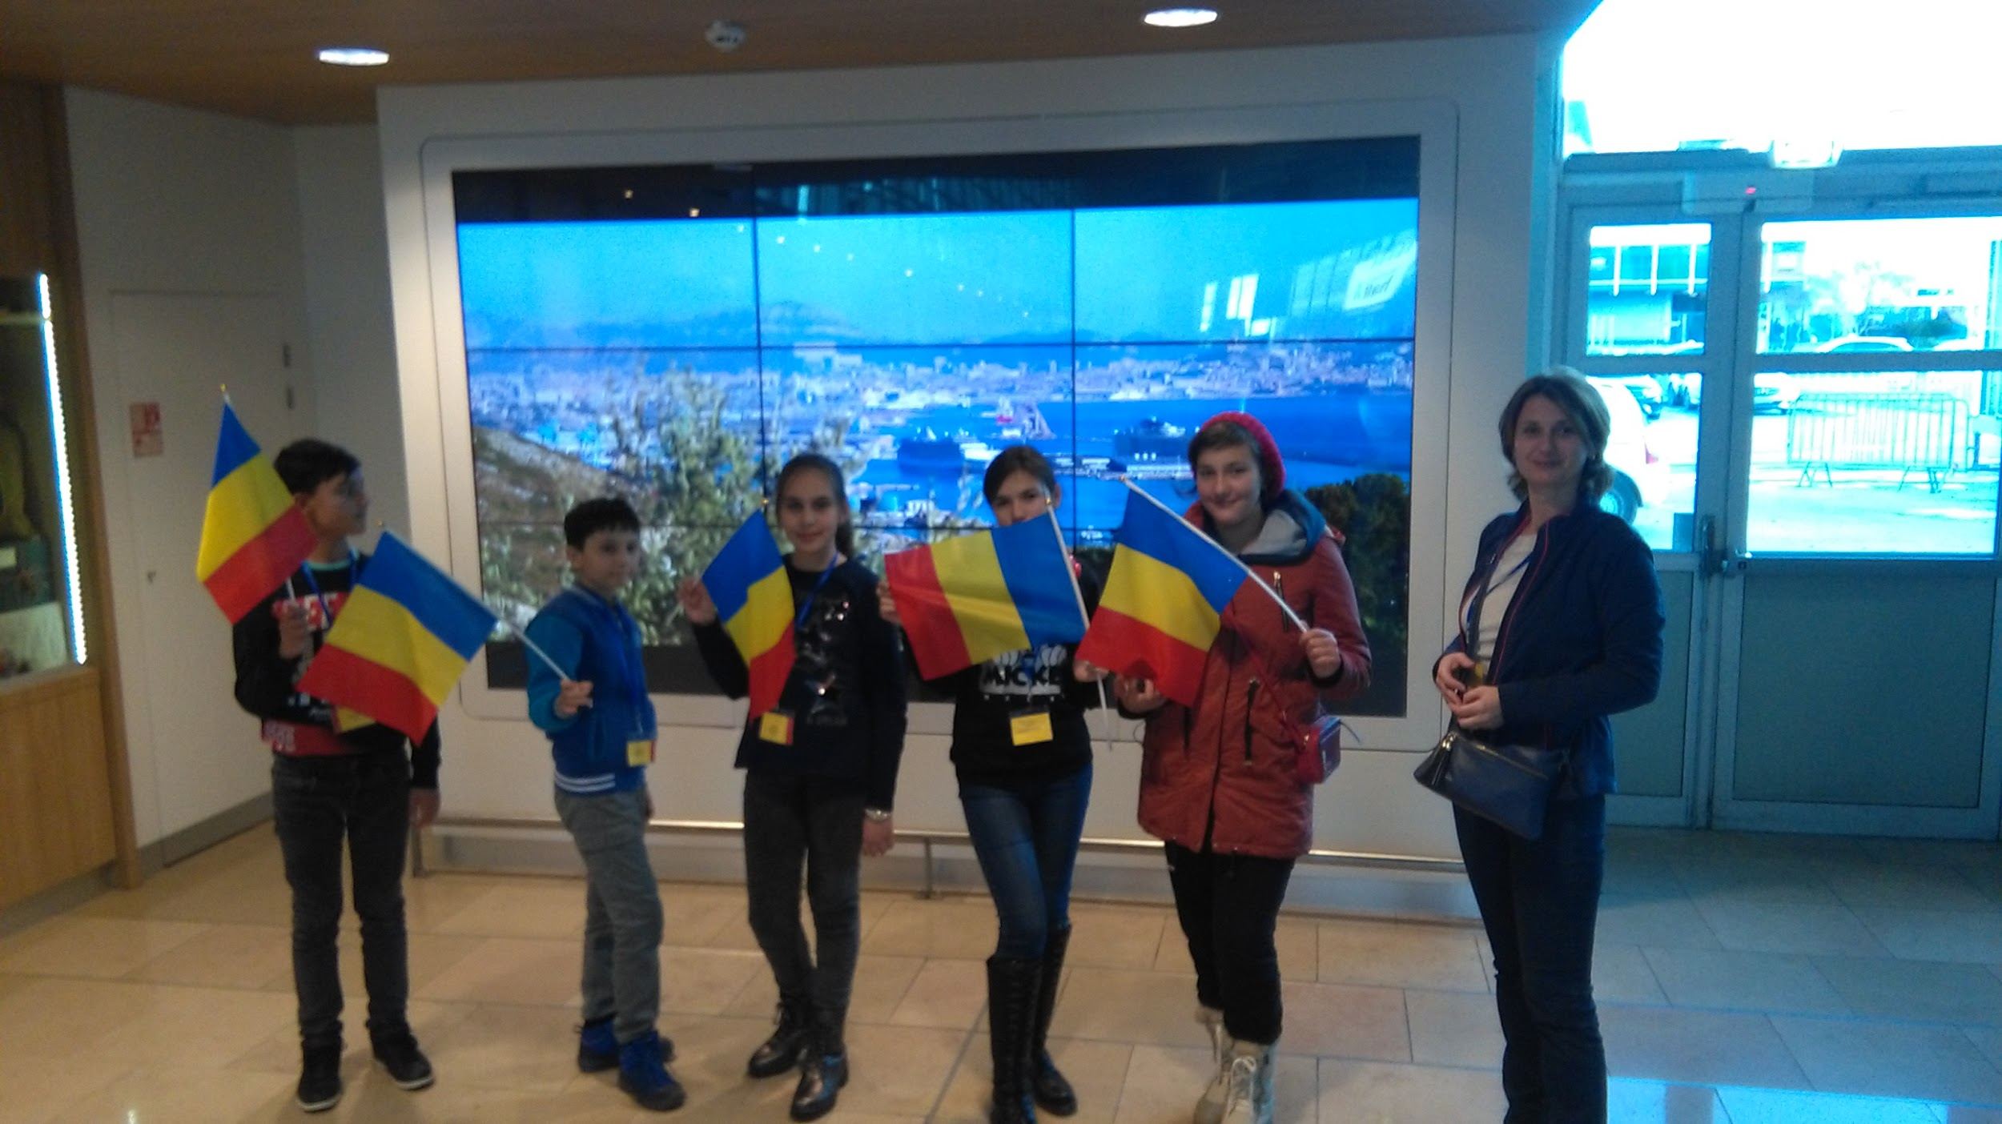
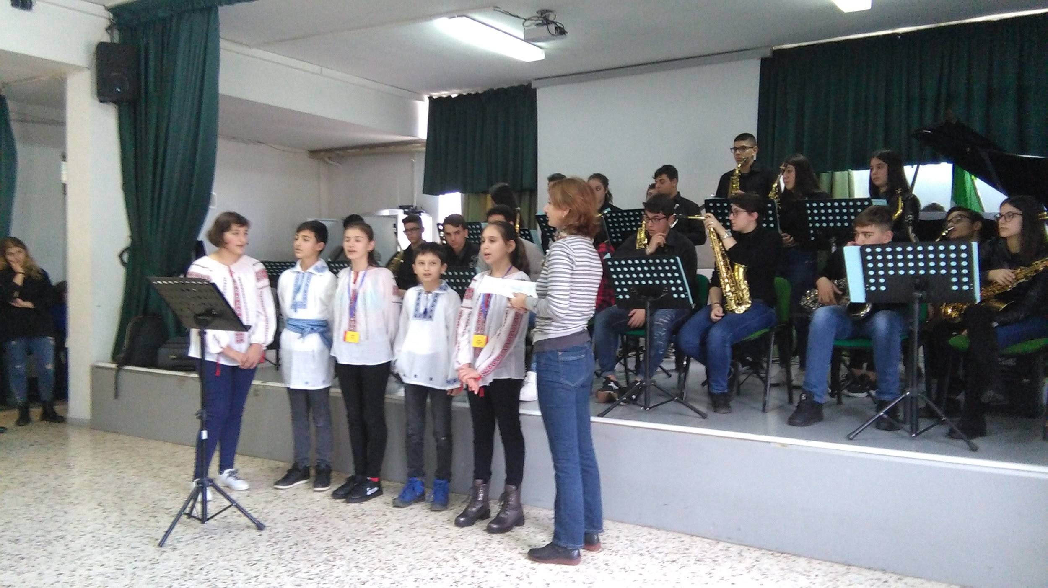
https://slide.ly/view/44ed039aad40a7214907930f880595d5

Slide 9
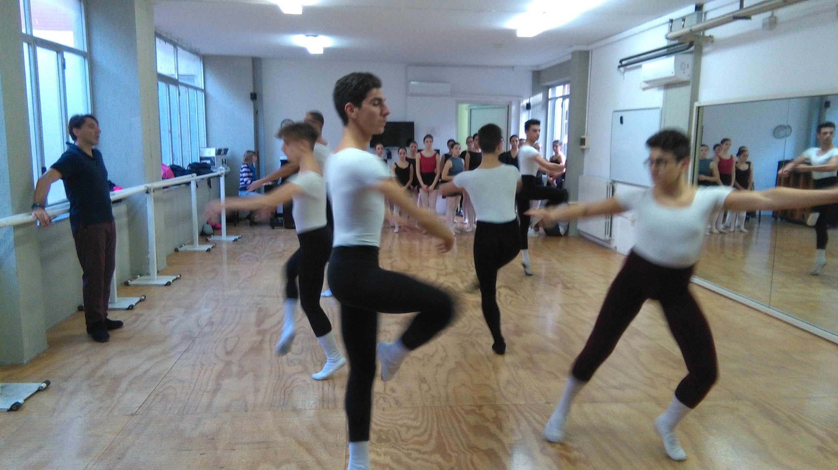
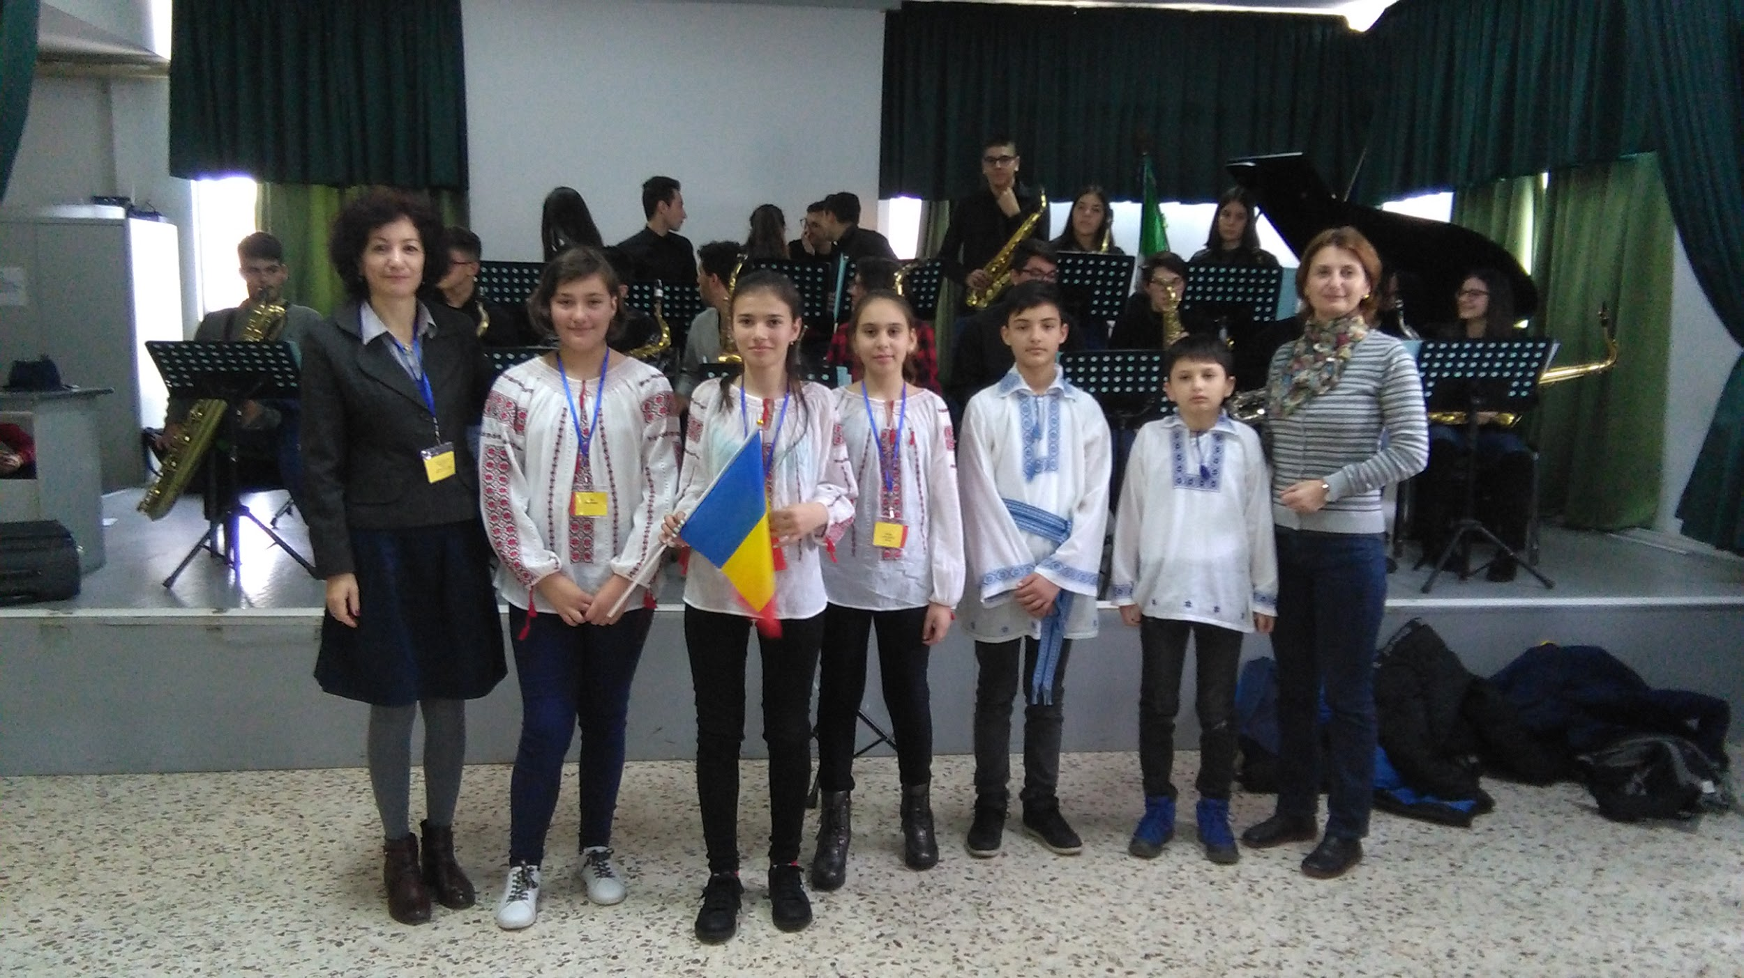

Slide 10
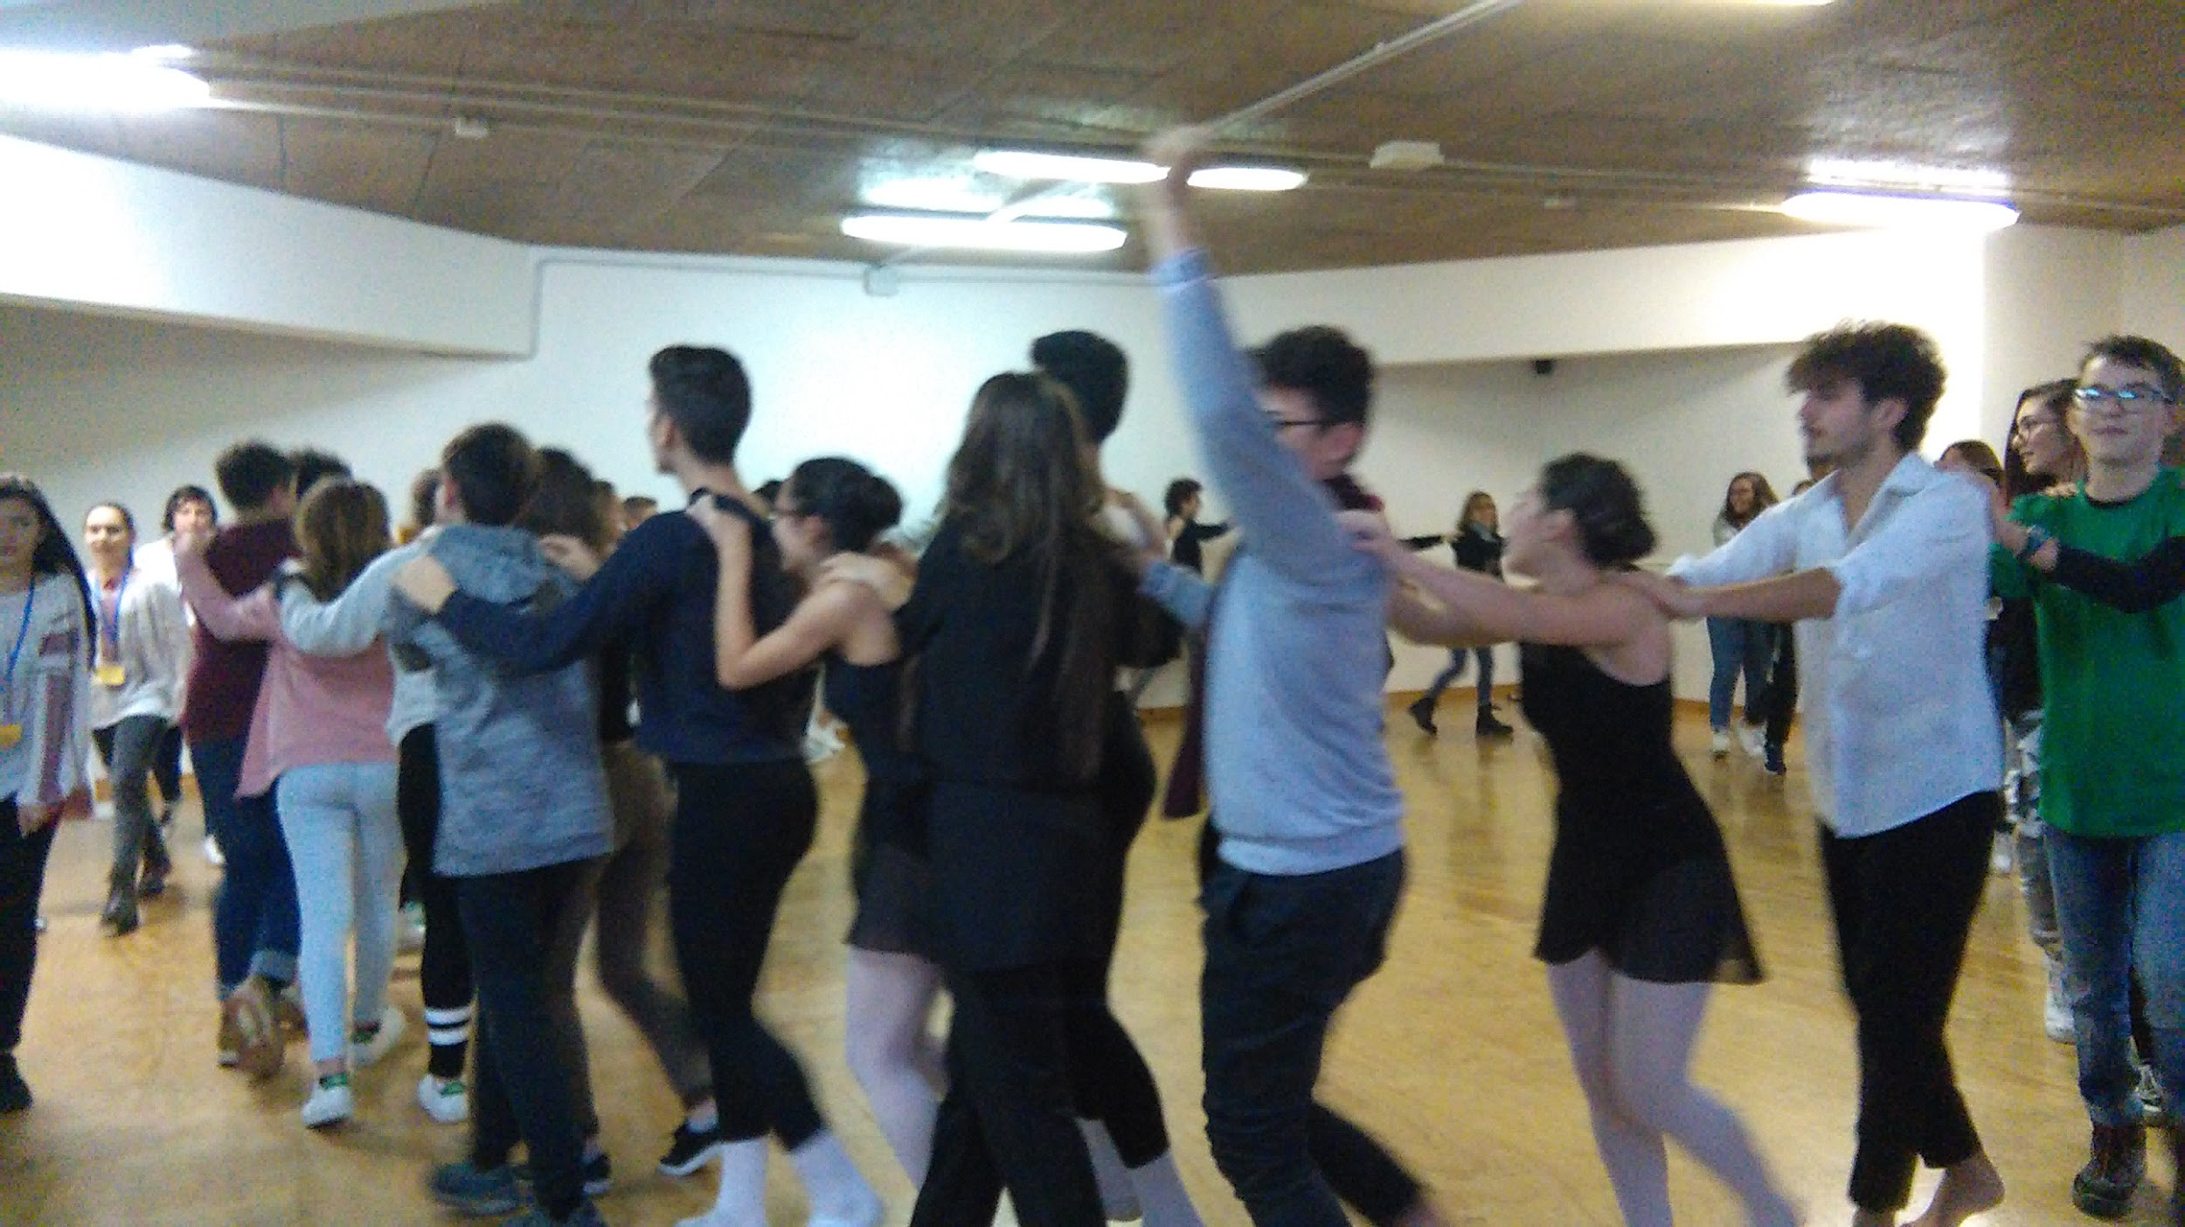
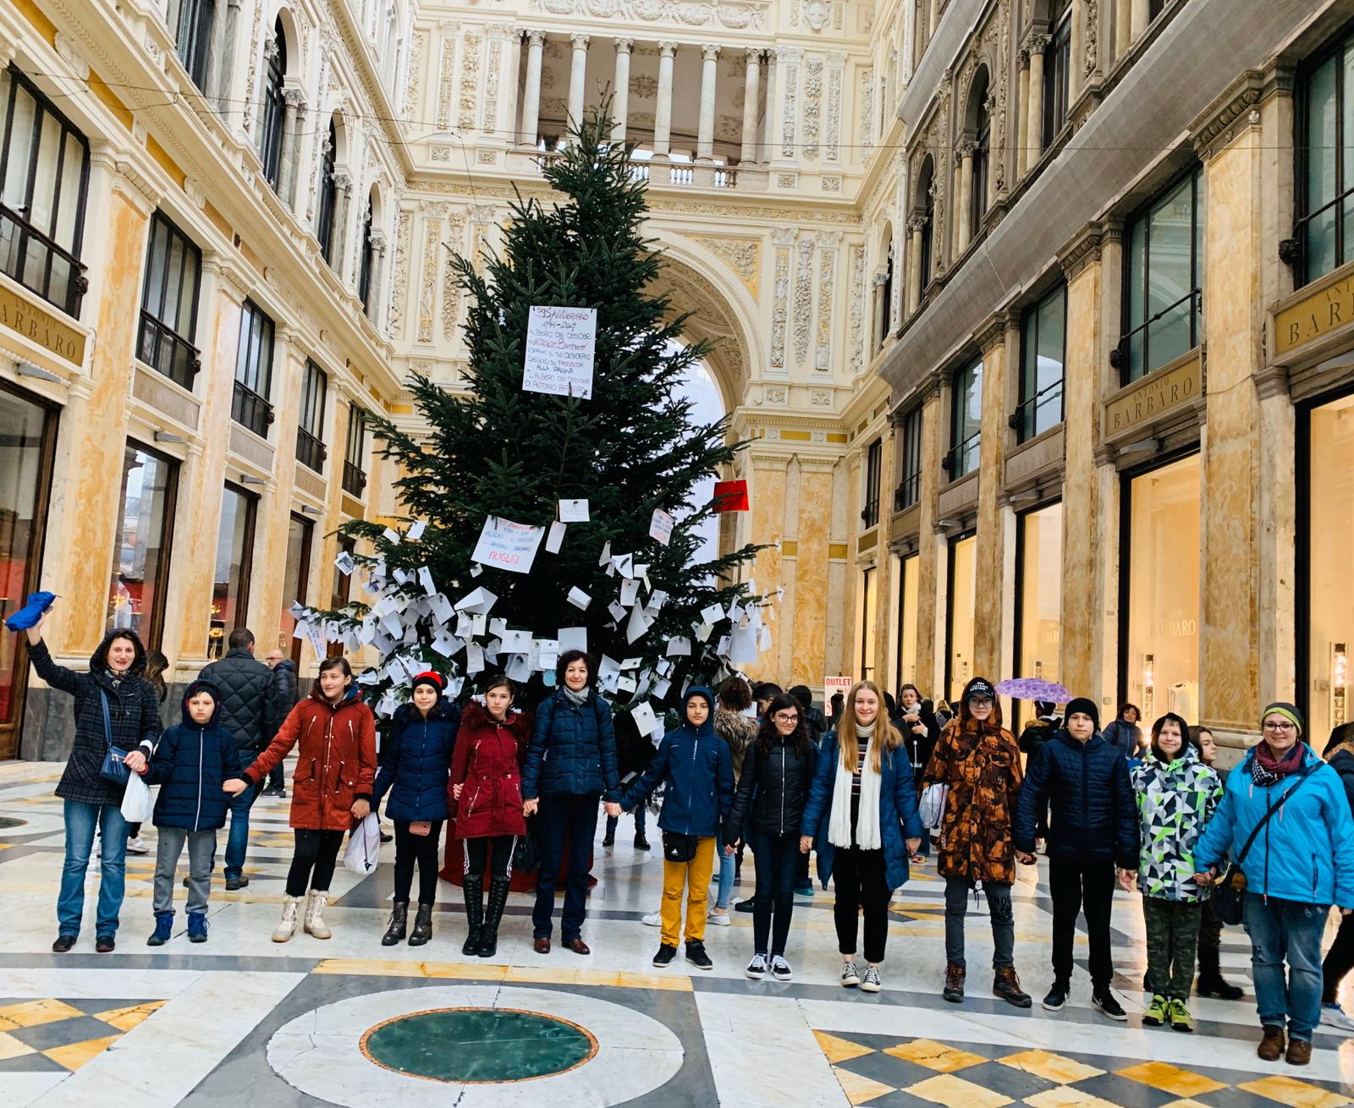

Slide 11
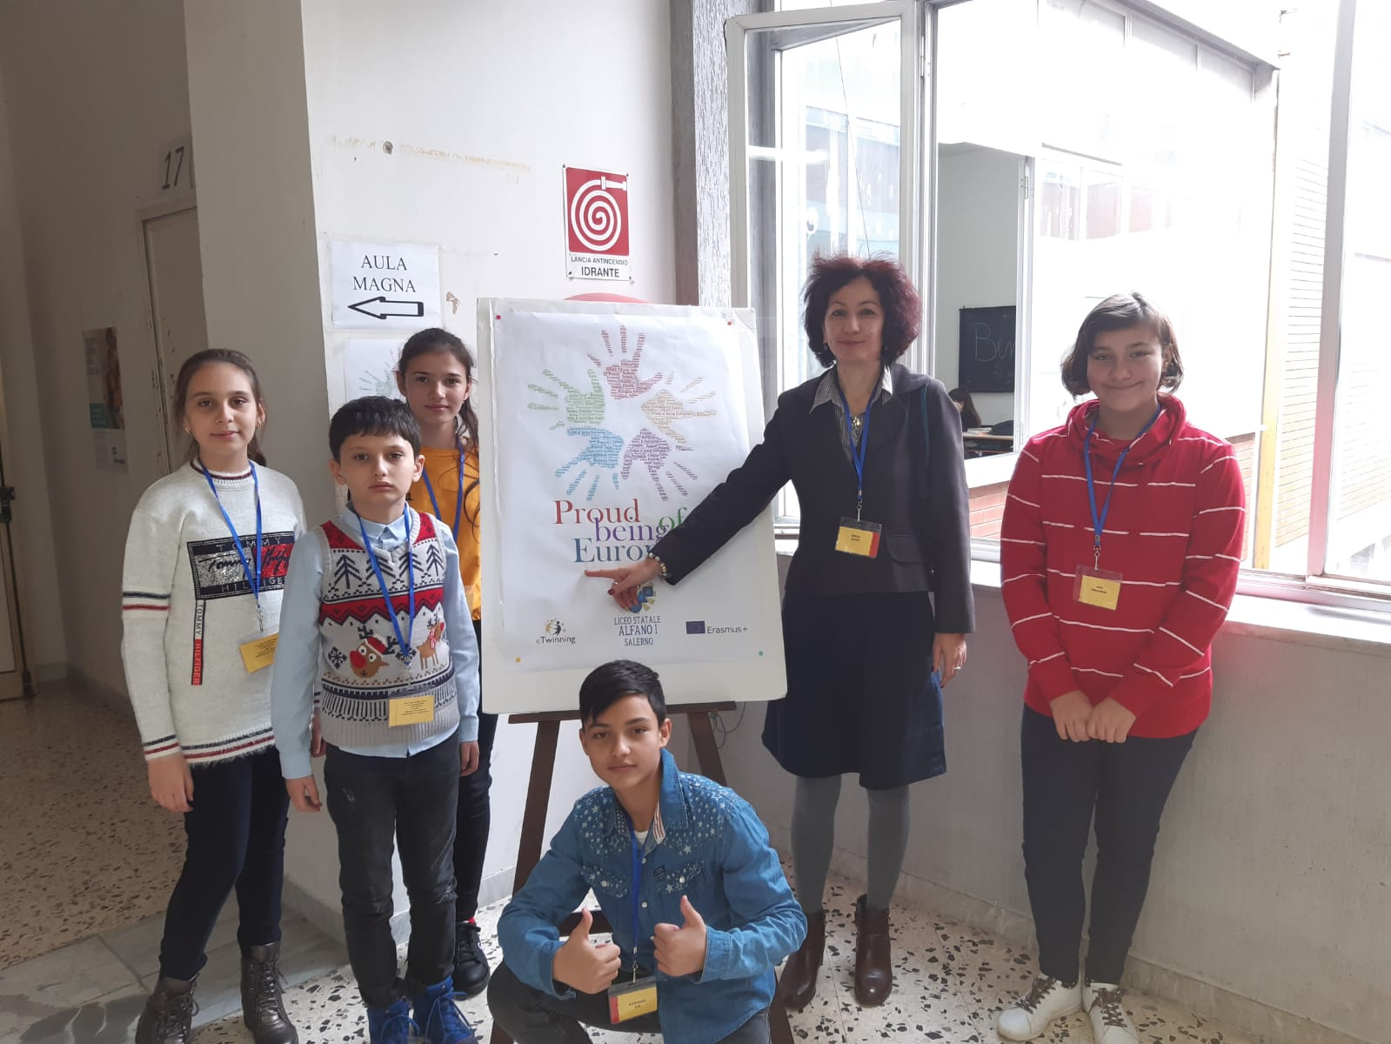
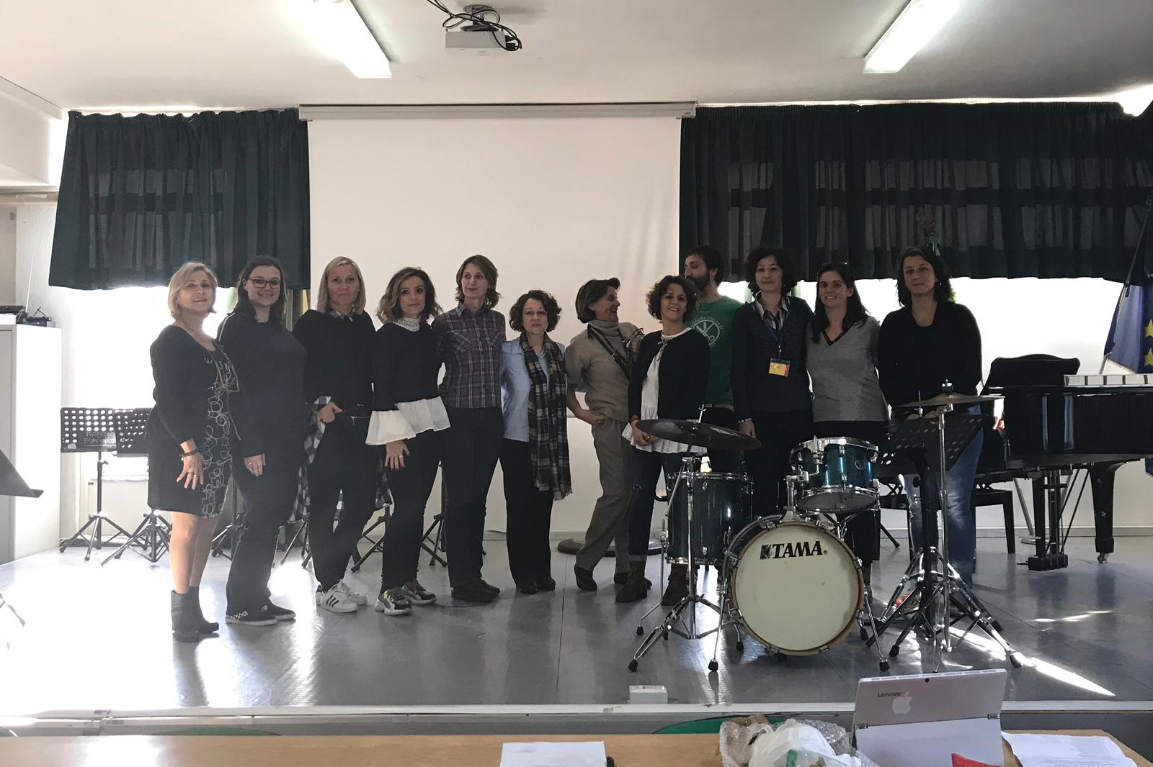

Slide 12
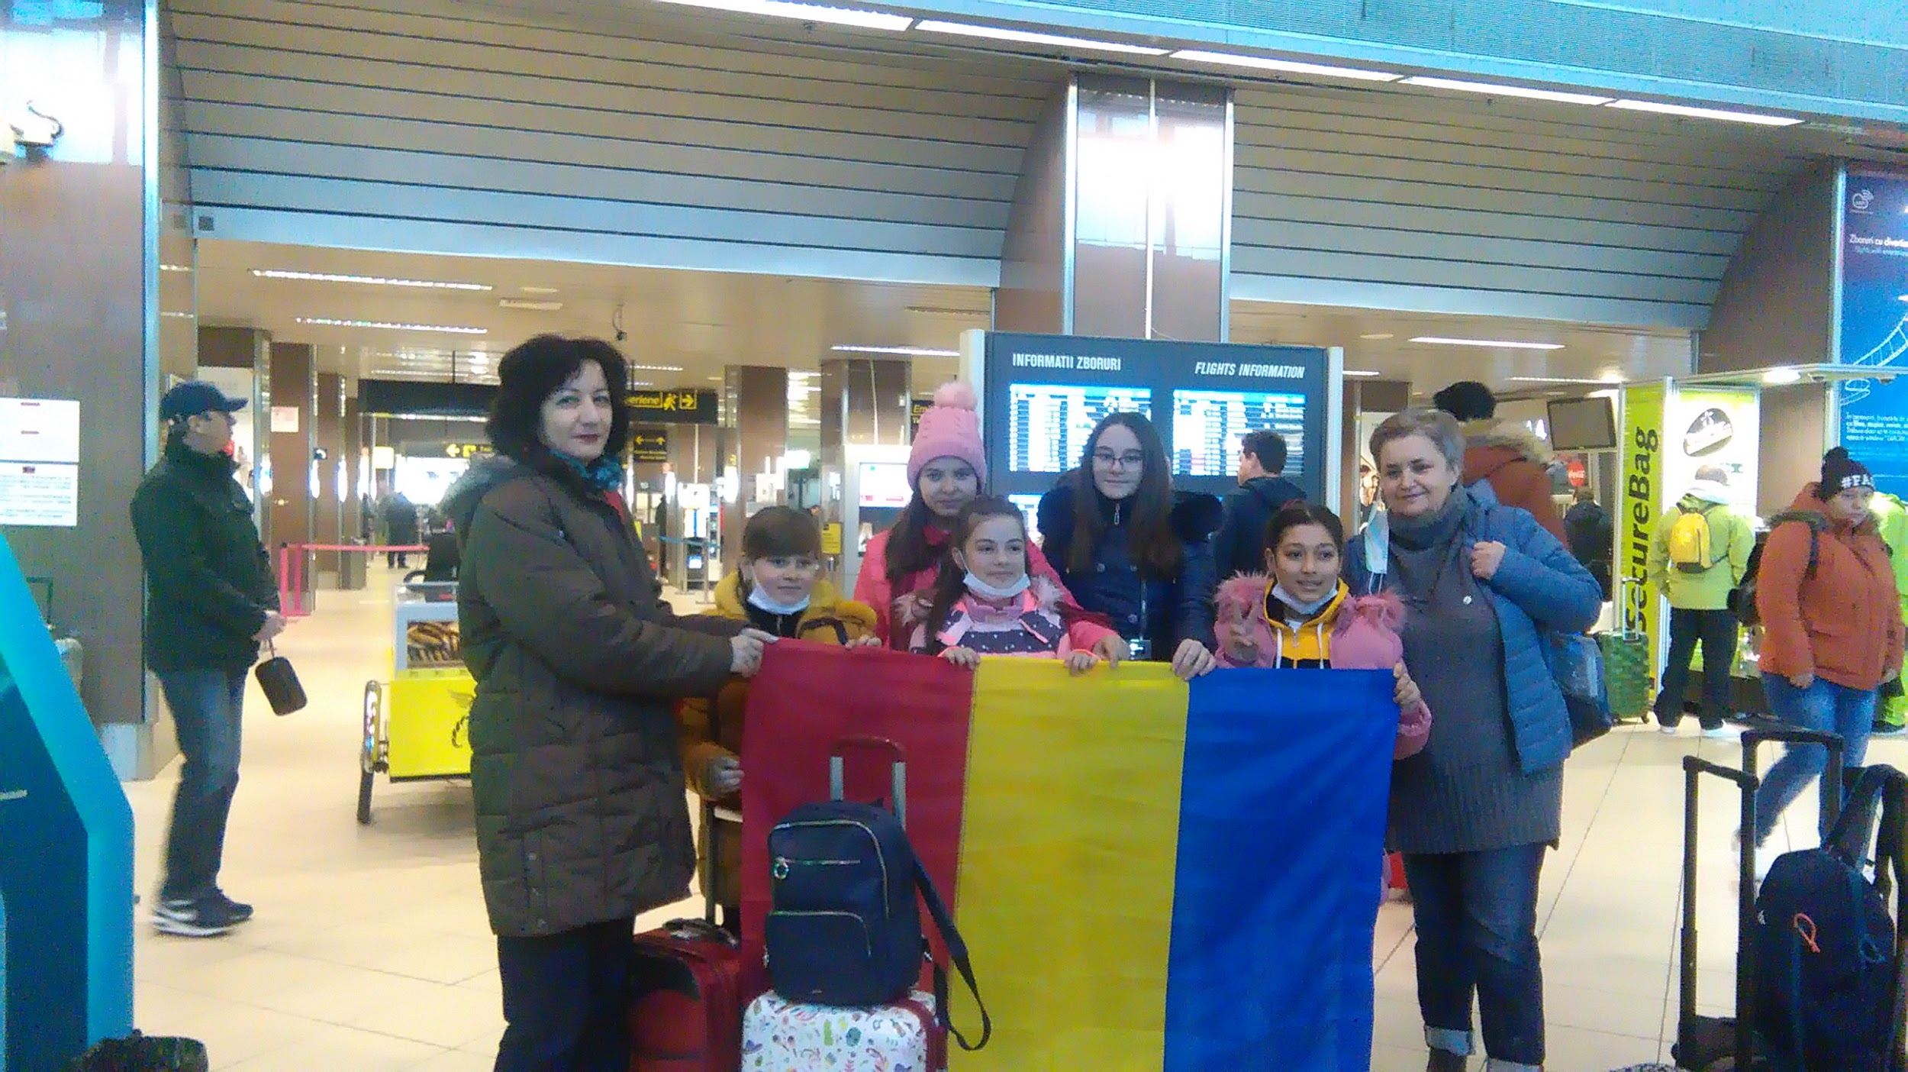
Mobilitatea a 2 a
9-15 Februarie 2020
Colegio Publico Integrado, Zaragoza, Spania
Participanti:
-4 elevi cls. a IV a , 1 elev cls. a VI a
- 2 cadre didactice

Slide 13
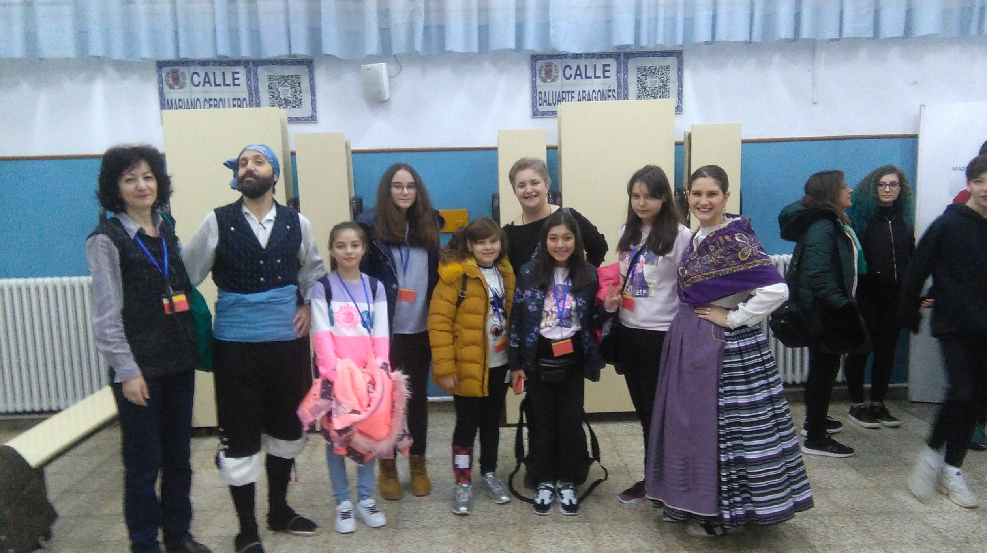
Body Percussion Workshop.
A Different Class – Enjoy how teachers teach in Spain.
Guided tour in Zaragoza
Pottery workshop
Guernica art workshop
Corner museum
Asalto
International Traditional Games
Live Science
Bike ride
Field trip
Activitati :

Slide 14
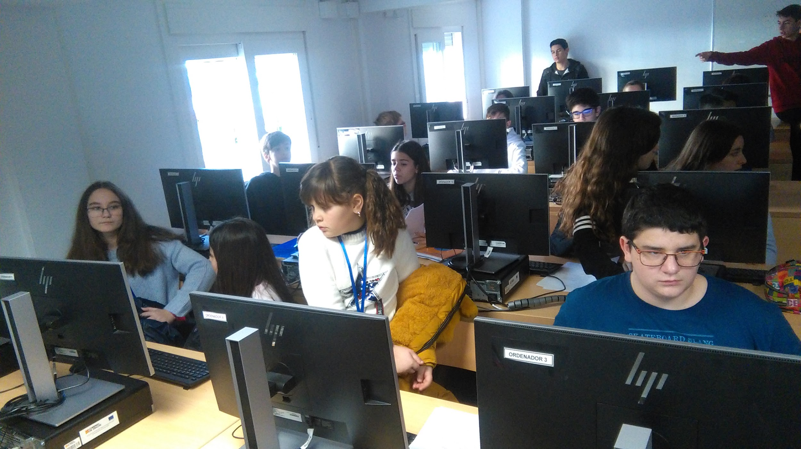
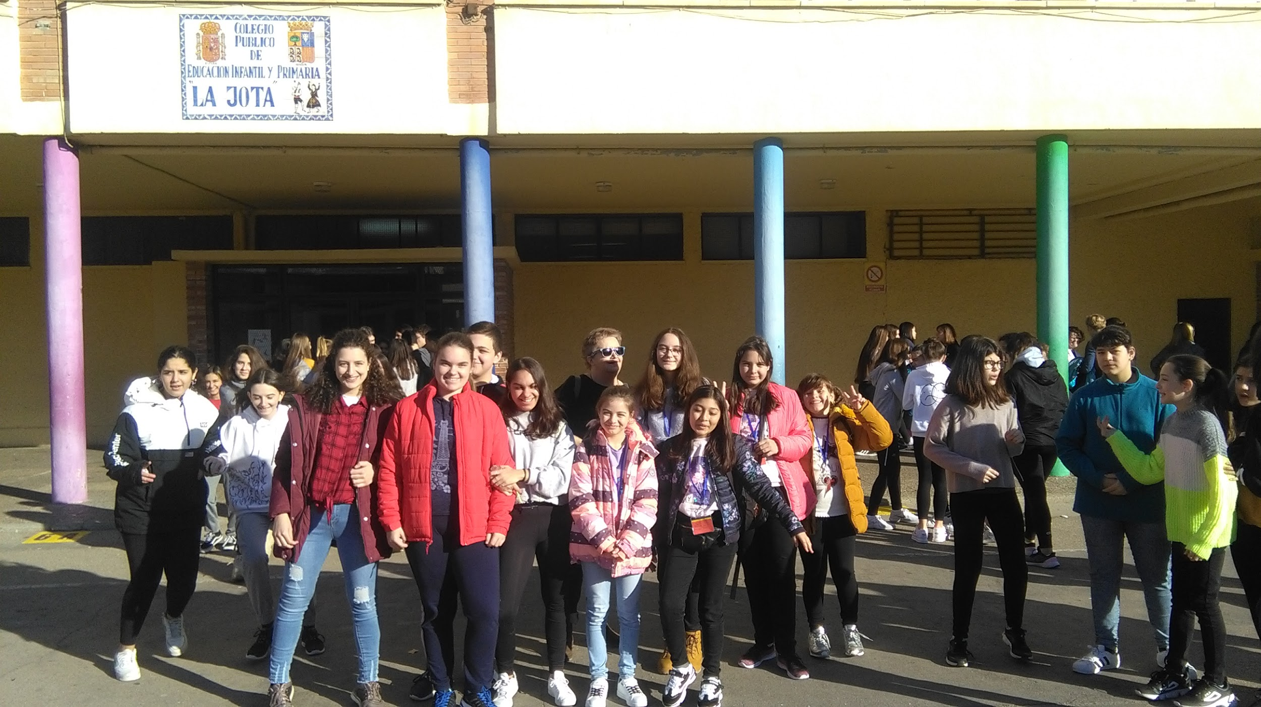

Slide 15
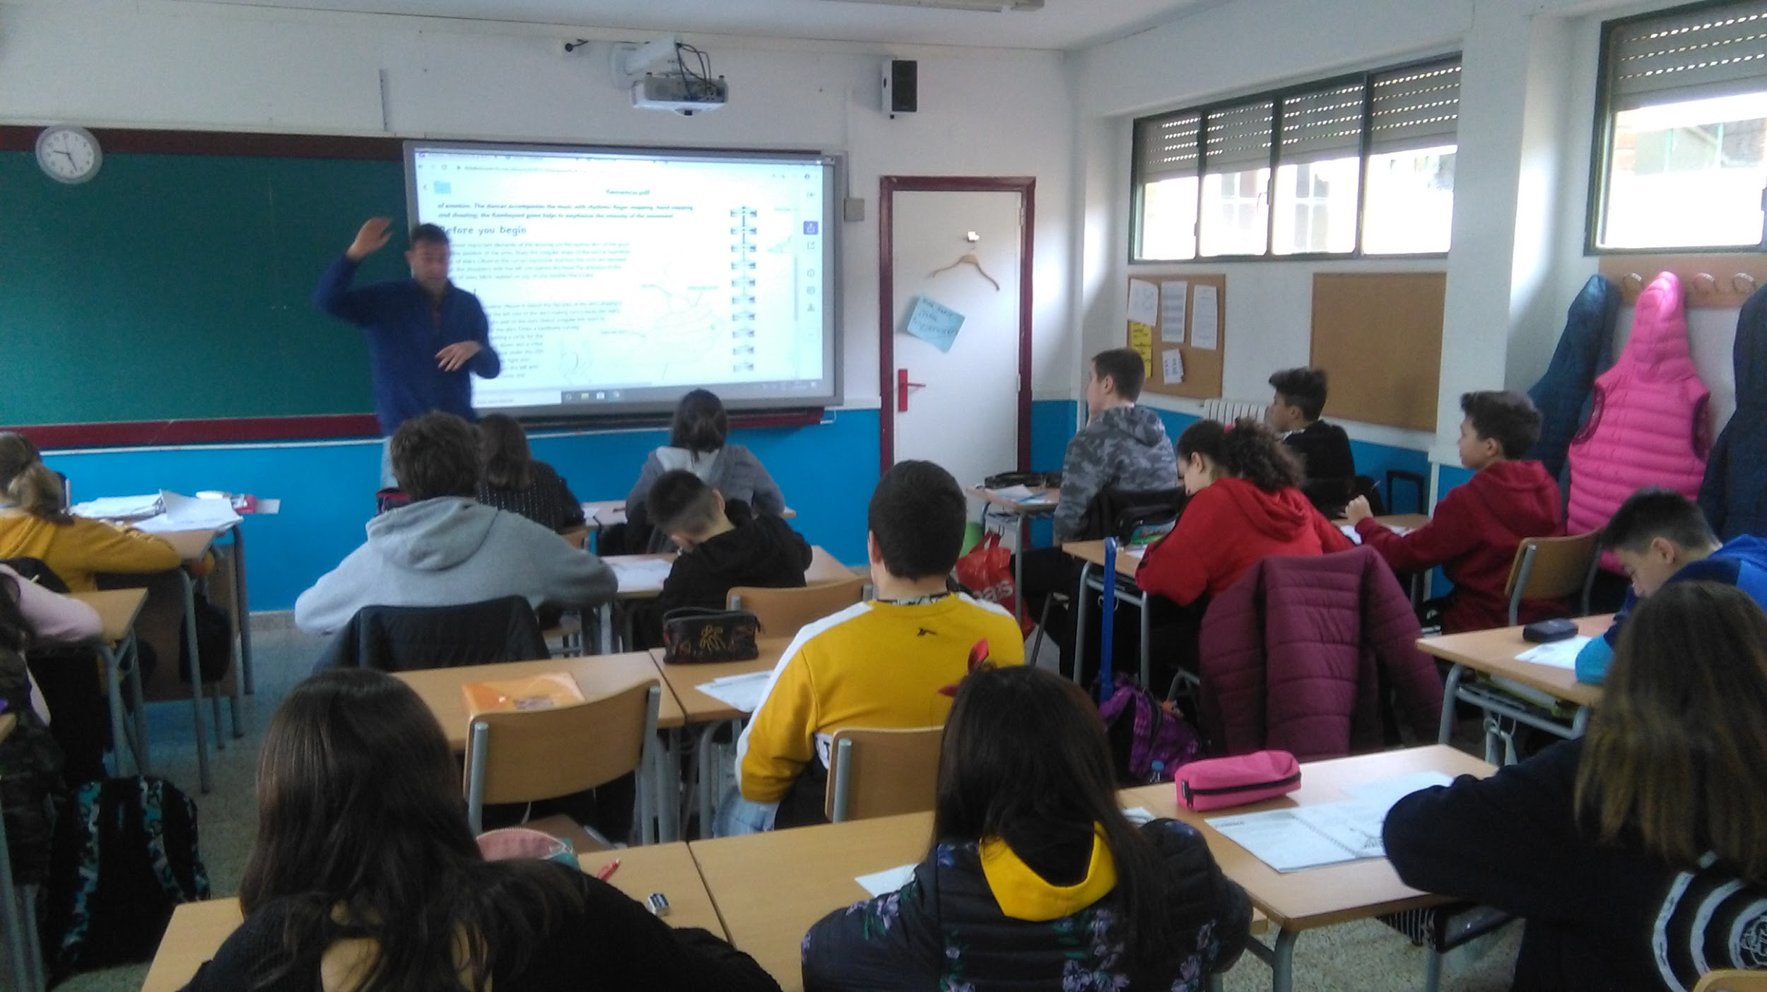
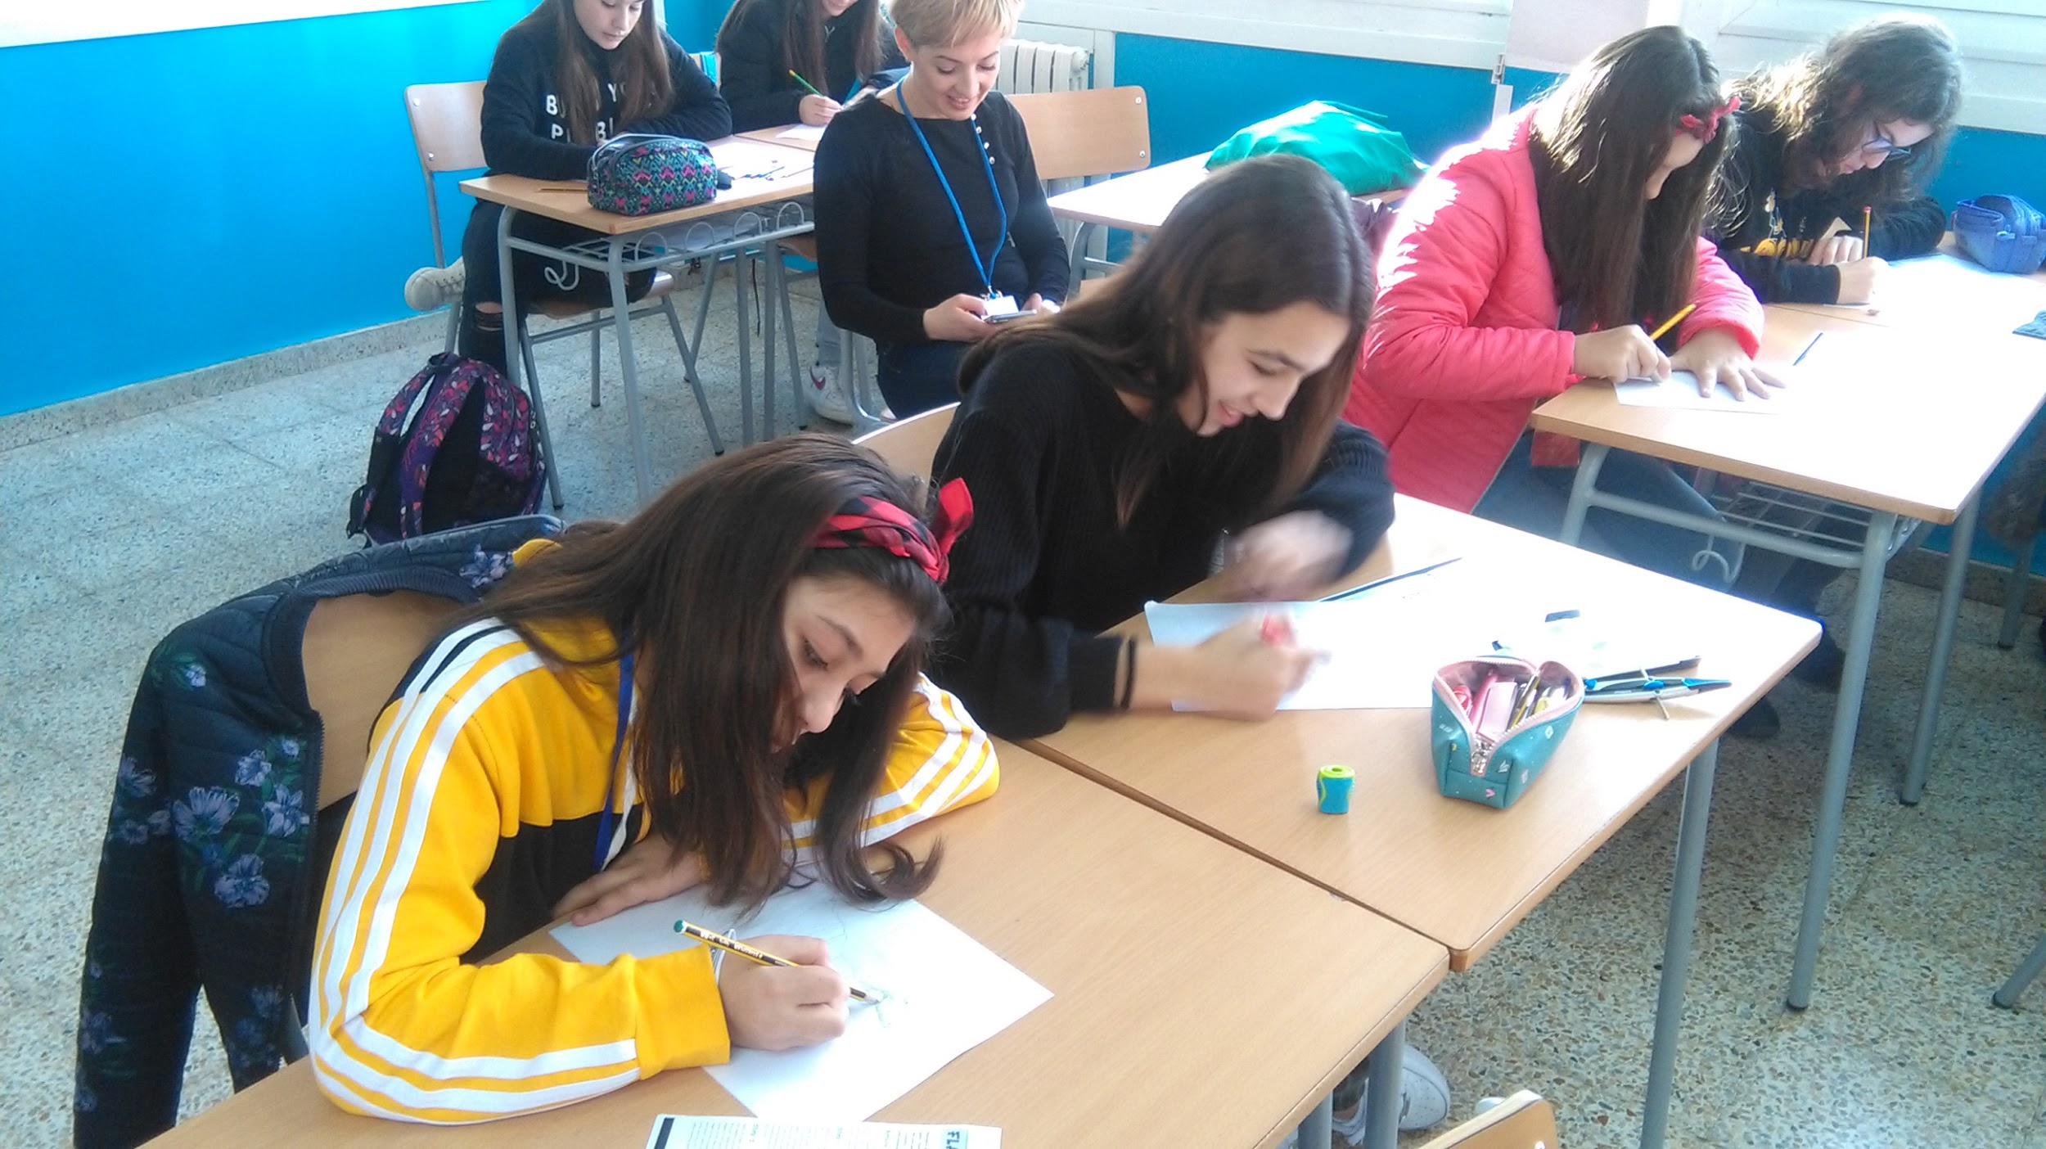

Slide 16
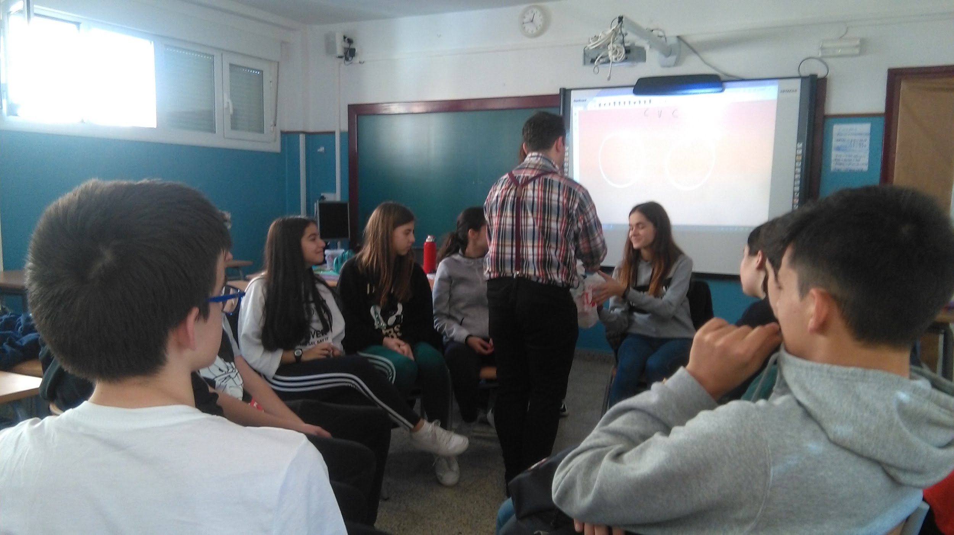
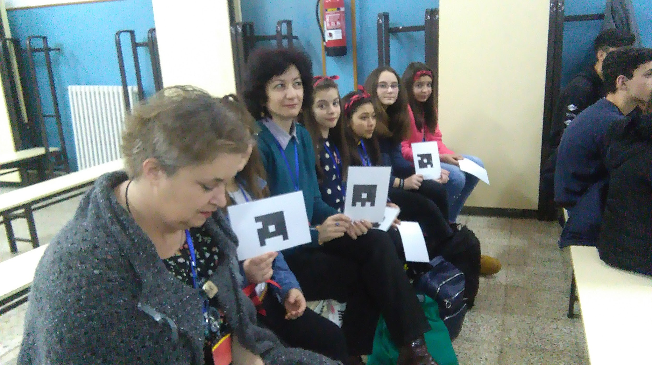
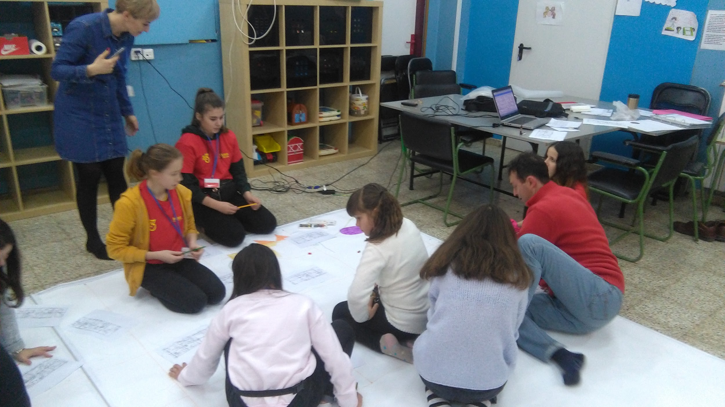

Slide 17
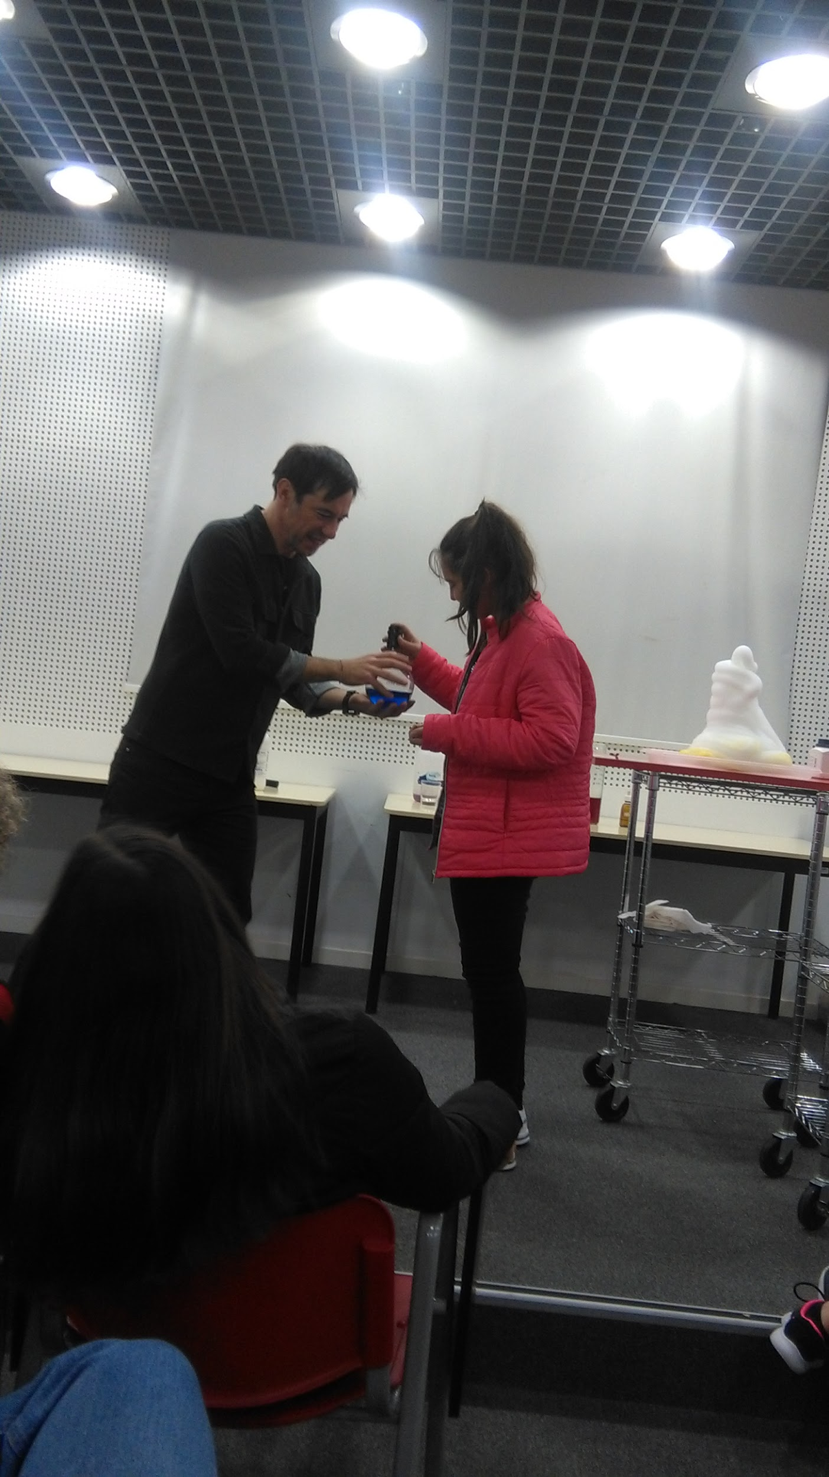
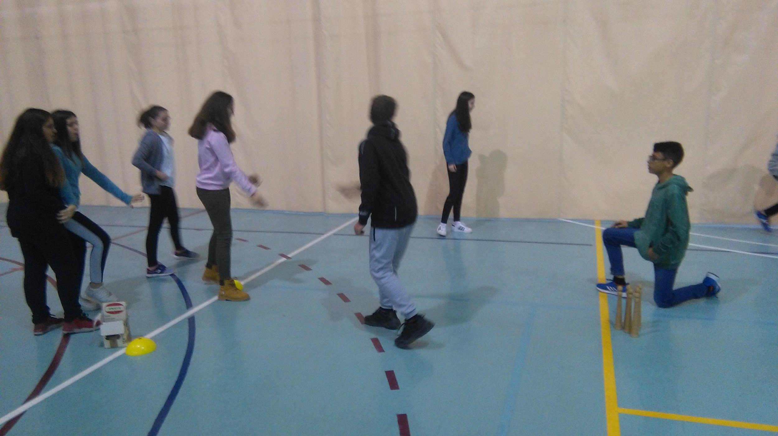
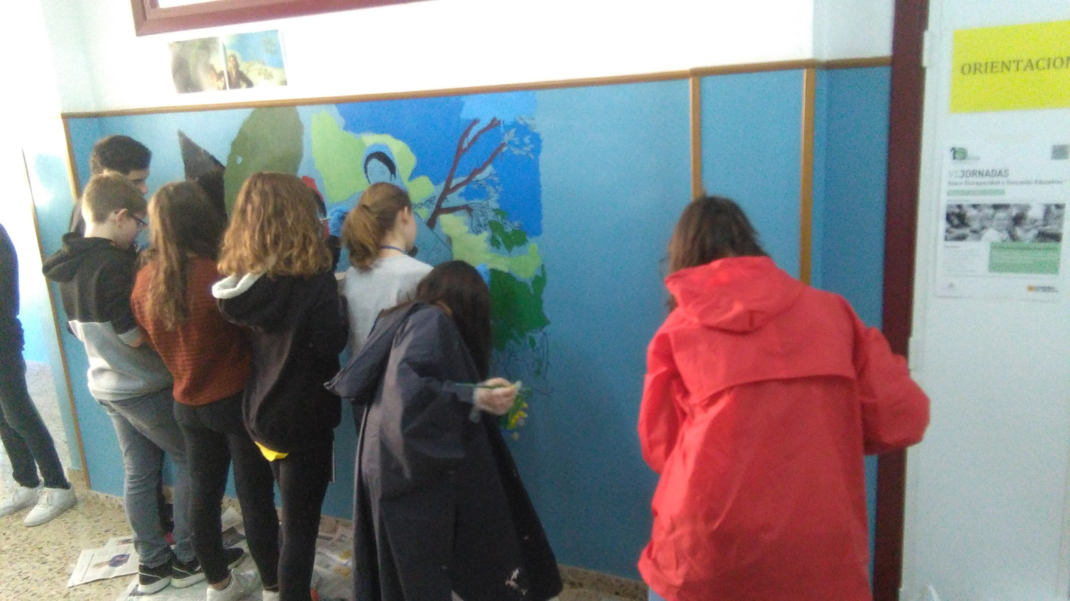

Slide 18
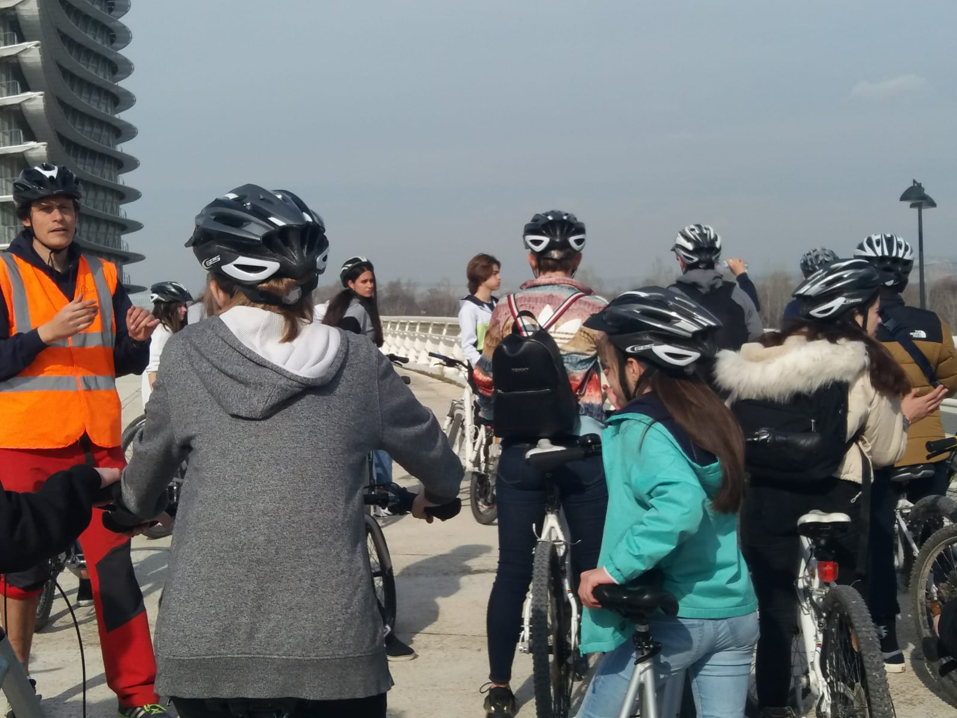
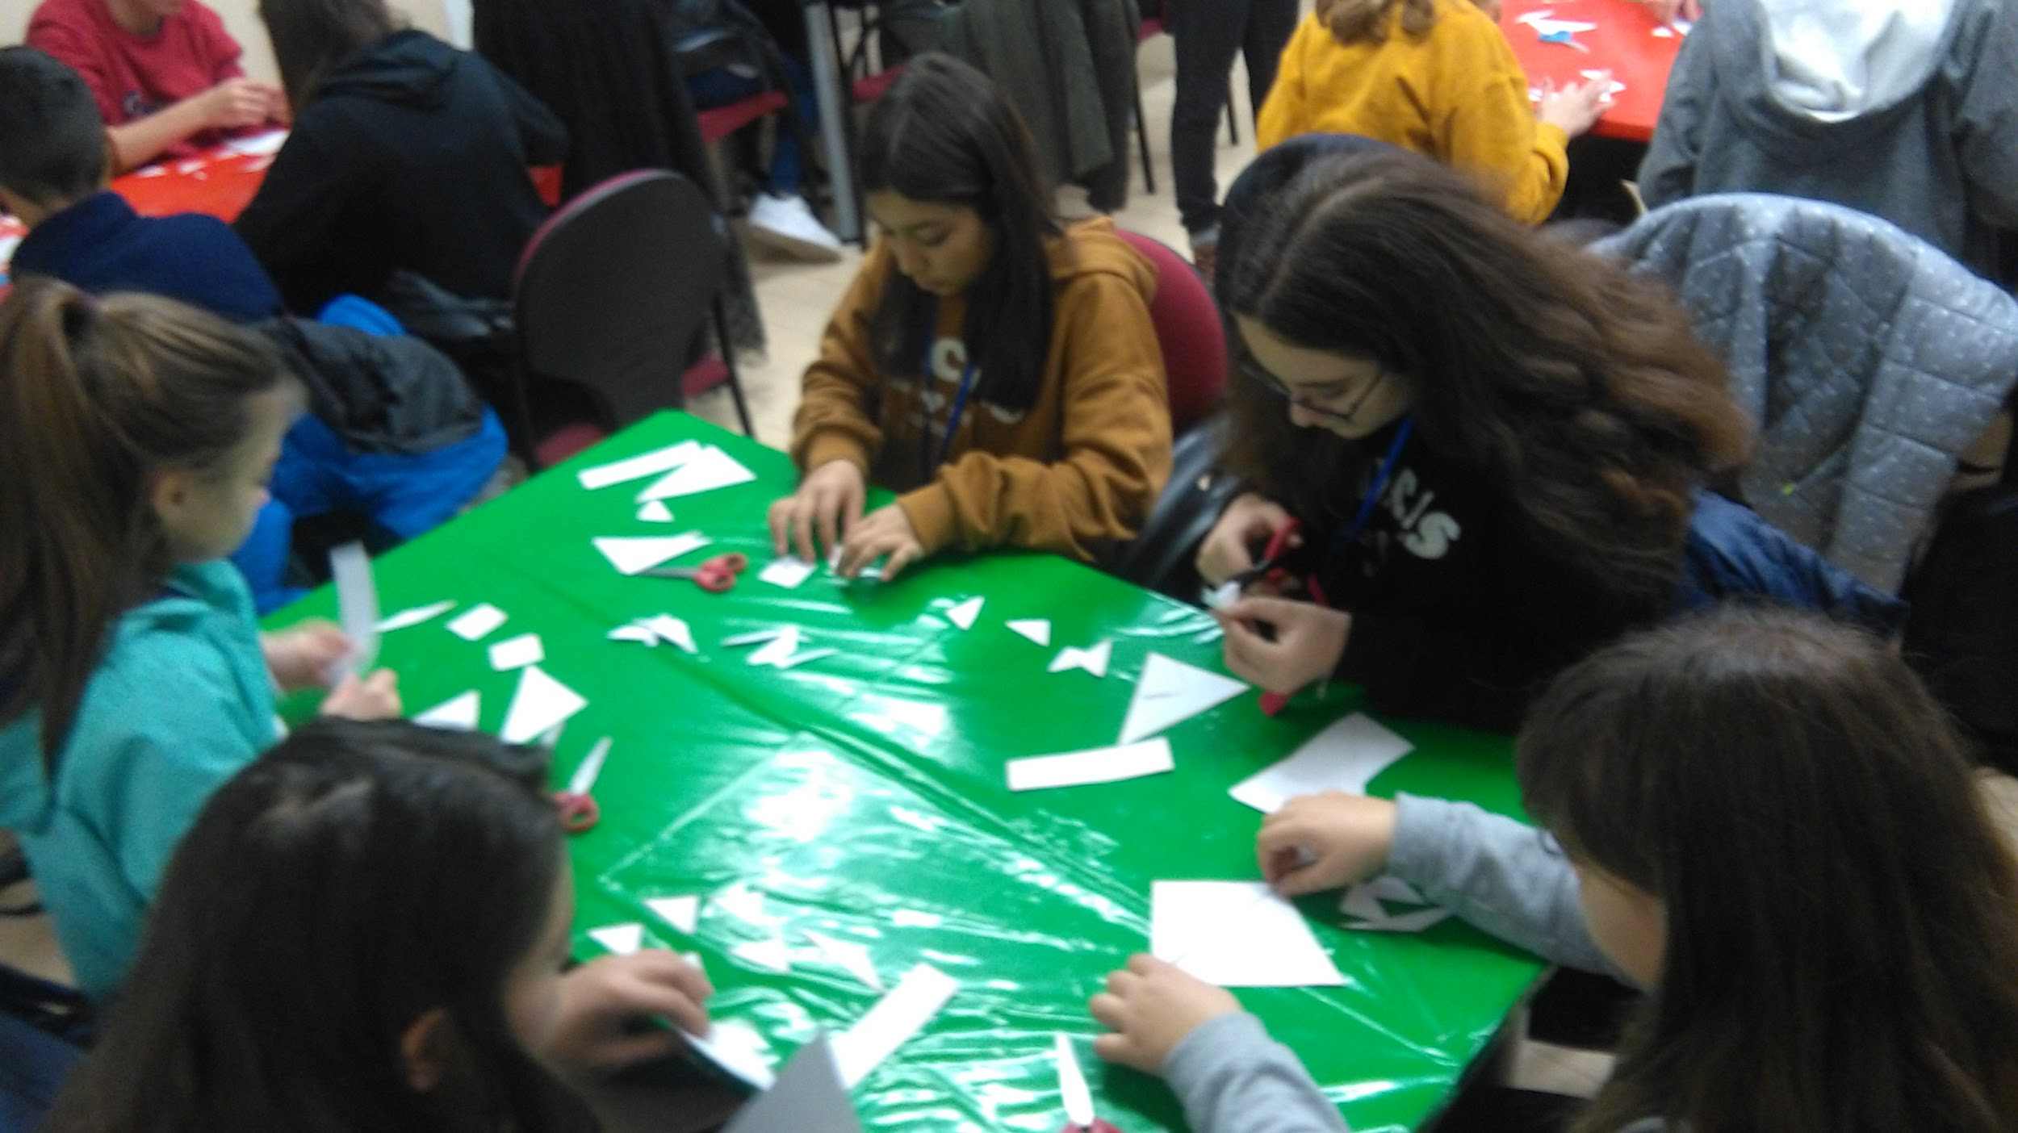
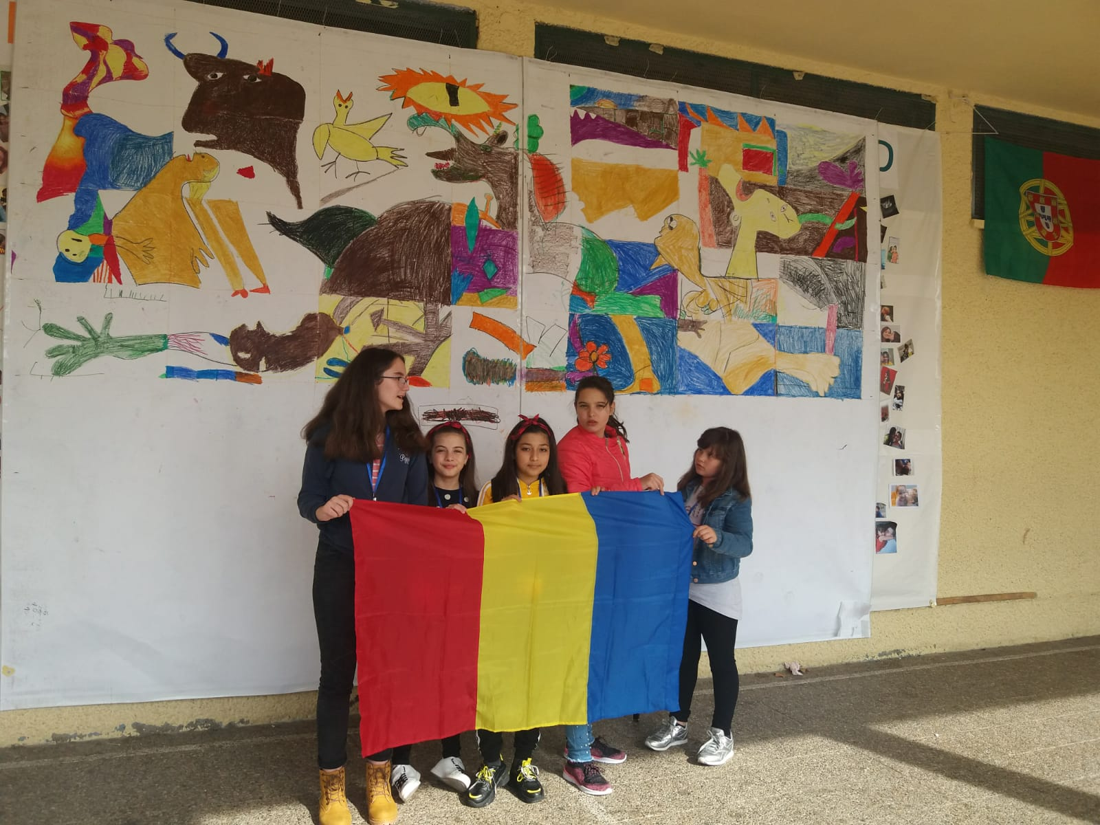

Slide 19
