Slide 1
Top 10 Internet Safety Rules

Slide 2
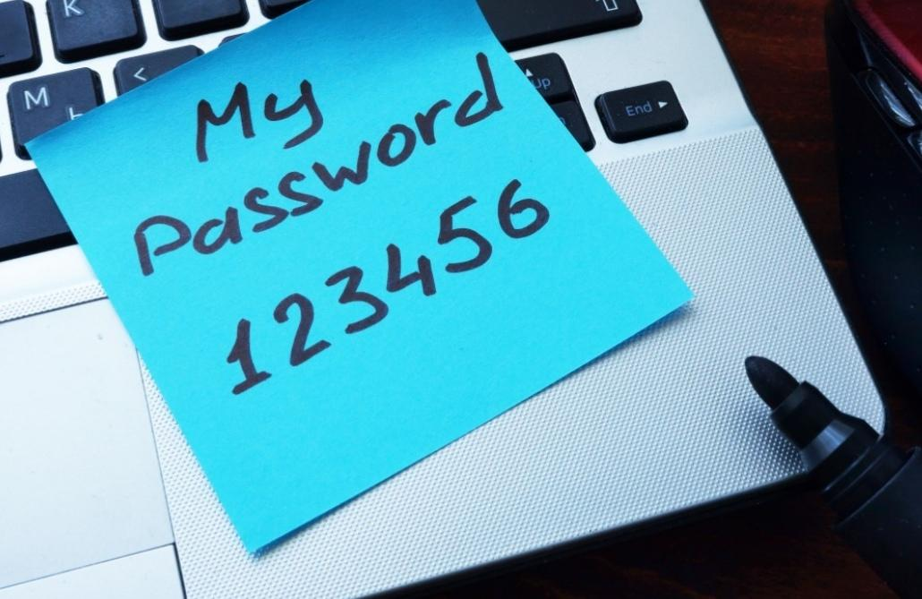
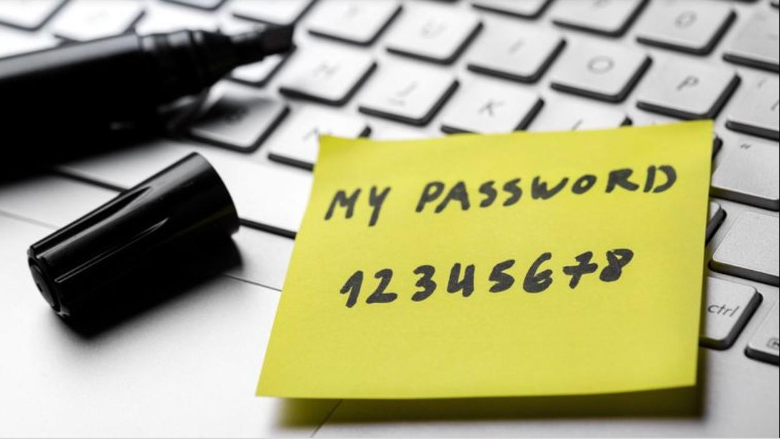
✖
✖
Use a secure password✖️🚫
✖
✖
.to protect your accounts against cybercriminals.

Slide 3
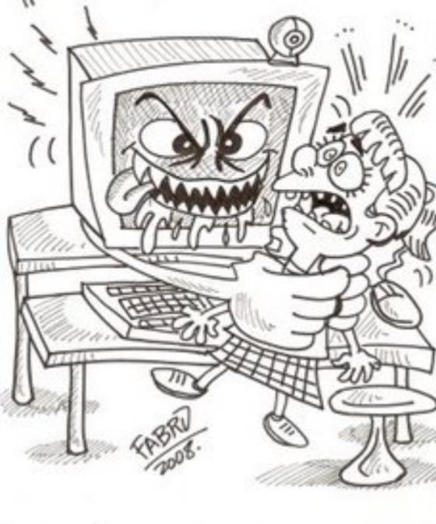
-Don't be hurtful to other people (👥🚫)
-Do not make harmful comments to other people, they can hurt them.

Slide 4
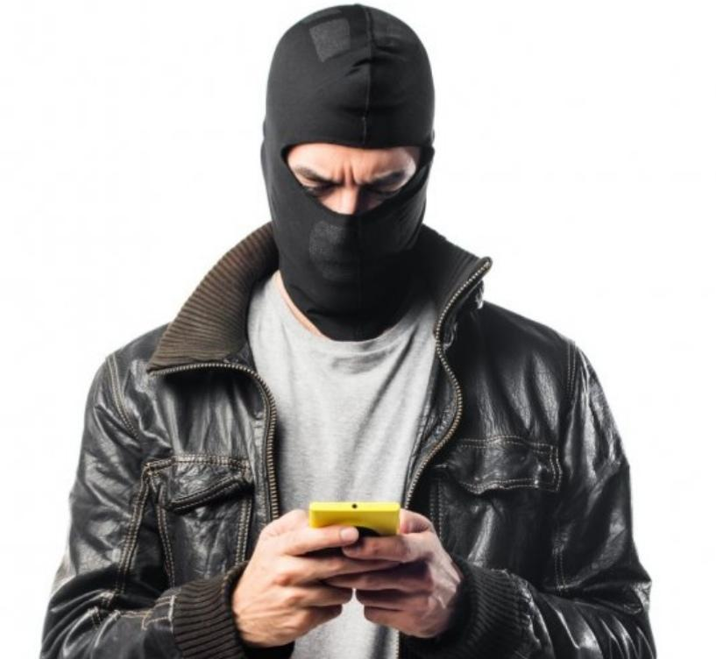
Connect only with your friends
Do not talk to strangers if you do not know who they are and do not know what they will do or say. Talking with friends is safer.

Slide 5
Don’t share personal informatiom 💻🔒
-Do not enter in strange links that are sent to your mail.
-Do not talk to strangers in a web.

Slide 6
Make online purchases from secure sites
You have to buy on secure pages because they can steal all money
Read other opinions about the product and web page.

Slide 7
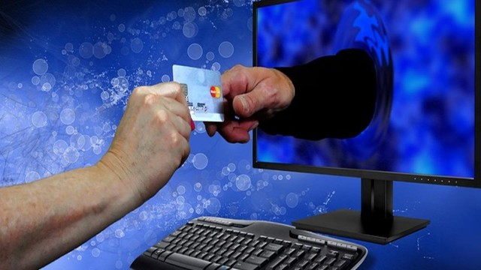
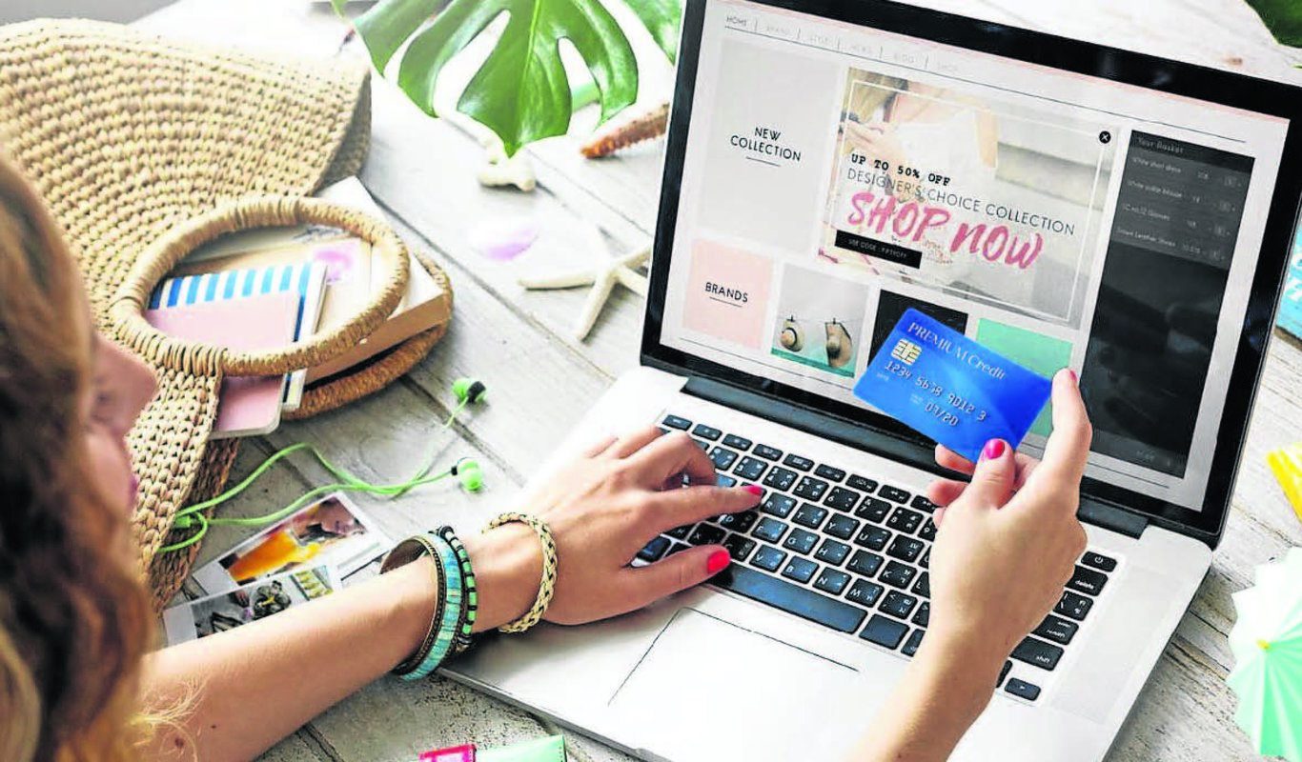
Don’ t buy things when connected to open Wi-Fi networks
Avoid online purchases if you are connected to an open Wi-Fi network as your passwords can be compromised.

Slide 8
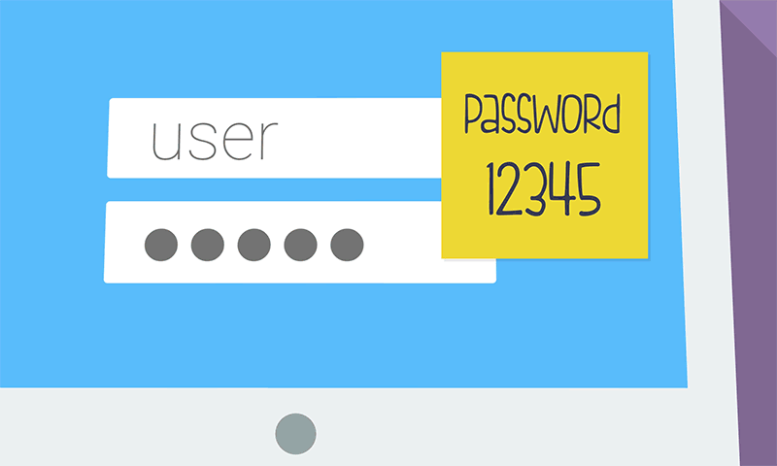
Don't share your password with strangers and don't include your name or personal details on your password

Slide 9
Don’t connect your phone, tablet, computer... to open wifies.

Slide 10
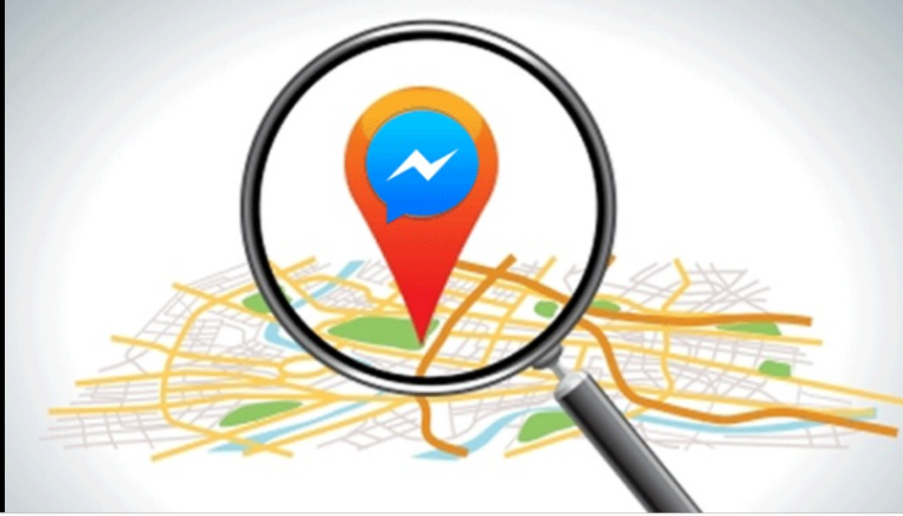
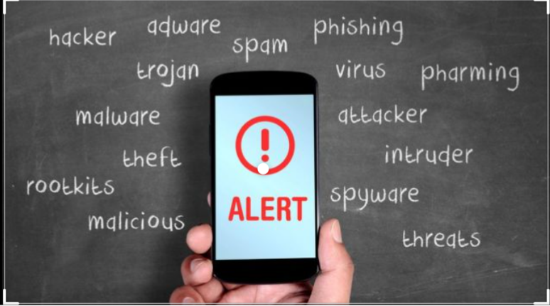
Don’t say where you live and don’t say your telephone number

Slide 11
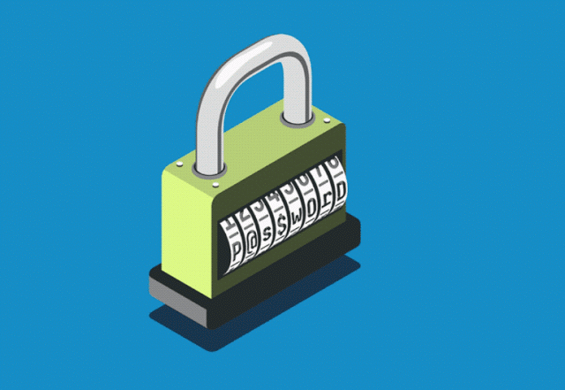
Keep Your Privacy Settings On.

Slide 12
These are our tips! 1st and 2nd year of Compulsory Secondary Education. 24th February Cifuentes.

