Slide 1
Economy secondary high school Weiz, Austria
© 2013 HAK Weiz Young Business School

Slide 2
HAK-Weiz
Located at „School Centre Weiz“
together with HTL-Weiz
~ 400 students (secondary level)
~ 50 teachers

Slide 3
HAK-Weiz
HAK-classical
commercial education +
English, French, Italian, Spanish, Russian
Focus on IT
Logistic management
Business and taxes-law
Controlling
Individual courses (arbitrary, module system)
Psychology
Philosophy
Chemical Experiments
Biology
…

Slide 4
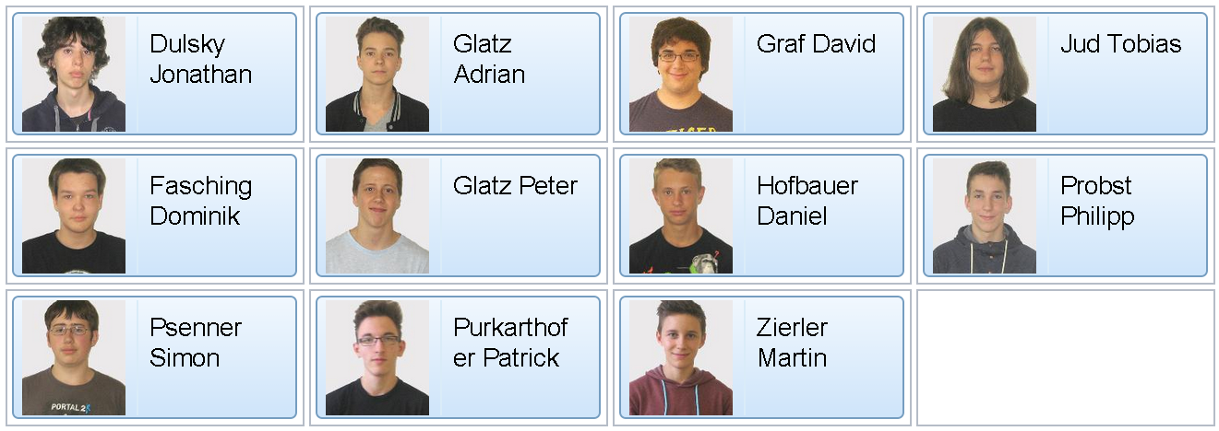
HAK-Weiz
HAK-Digital Business (DigBiz)
commercial education +
Business informatics
Software development
Project management
Operating systems
Computer networks
…
3DK

Slide 5
HAK-Weiz
Final year project
Practically oriented content
Treat commercial- and subject oriented tasks (independently)
Develop and defend solutions
Apply approved management methods
Work in teams
Documentations & presentations

Slide 6
HAK-Weiz
Our contributions …
… to setup an Internet-Platform (with mobile access) for scheduling and accounting the shared cars (HTML5)
… to organize, schedule and account the use of the cars, charging stations, etc. …
We want to implement an open source software to support these needs.
… based on state of the art mobile devices and/or web services.
… to setup business plans to compare different car sharing models and to run virtual firms.

