Slide 1
Learning through
service project
“SHARING HERITAGE: Fostering sensitivity for the past, the present and the future”
By Ángela Cayarga, Carlos Díaz, Coral Fernández, Irene Fernández, Raquel Gutiérrez and Ana Shuye Rodríguez

Slide 2
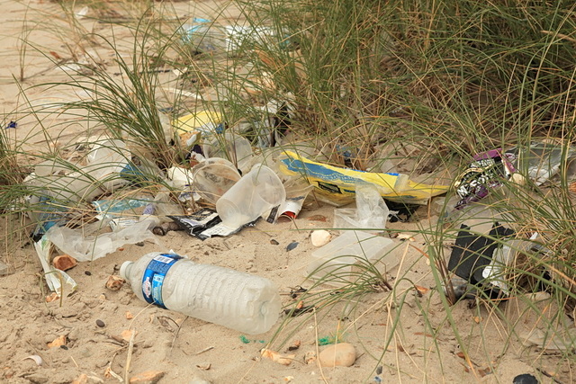
A REAL SOCIAL NEED WORLDWIDE

Slide 3
LEARNING GOALS:
Learn about plastic trash in the oceans, impacts and possible prevention
Where plastic trash comes from
Types of pollution which get into the ocean
How this trash impacts the world
Effects of plastic on sea life
Learn how to preserve the environment

Slide 4
SERVICE:
CLEANUP DAY ON THE BEACH
AWARENESS CAMPAIGN

Slide 5
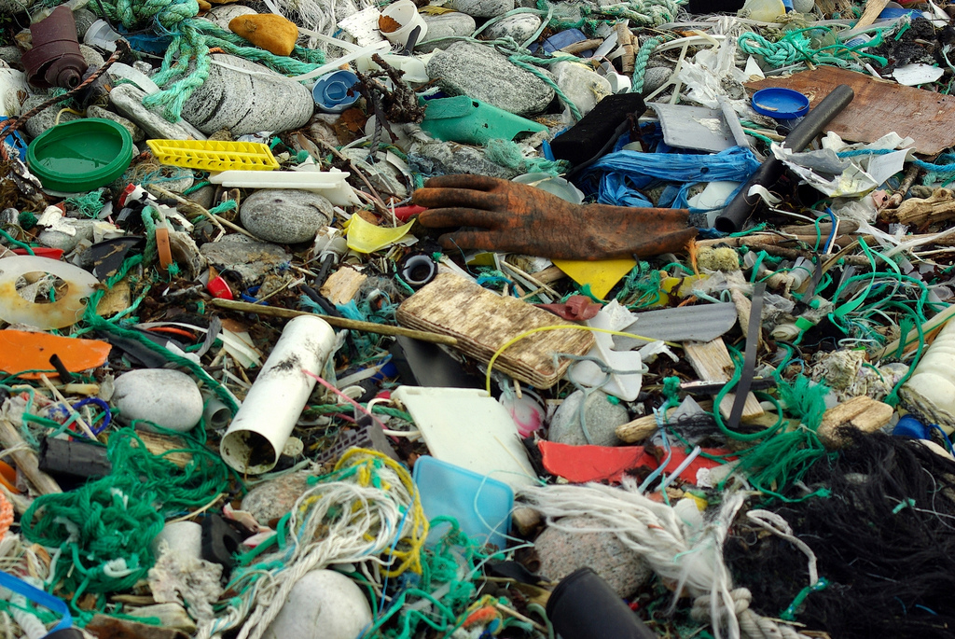

Slide 6
SCHOOL SUBJECTS INVOLVED:
Biology and Geology
Scientific Culture
English
Arts and Drawing

Slide 7
ACTION PLAN:
FIND A NAME
DESIGN A LOGO
PICK UP A LOCATION AND A DATE
DETERMINE SUPPLIES AND TRASH DISPOSAL
MAKE A CLEANING TEAM
FIND EXTERNAL SUPPORT
DOCUMENT THE ACTIVITY
MAKE AN AWARENESS CAMPAIGN (FLYERS, POSTERS, PRESENTATIONS…)

Slide 8
OUR SLOGAN
Break up with plastic

Slide 9
OUR LOGO

Slide 10
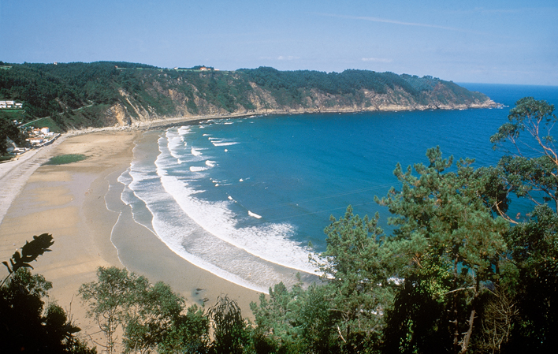
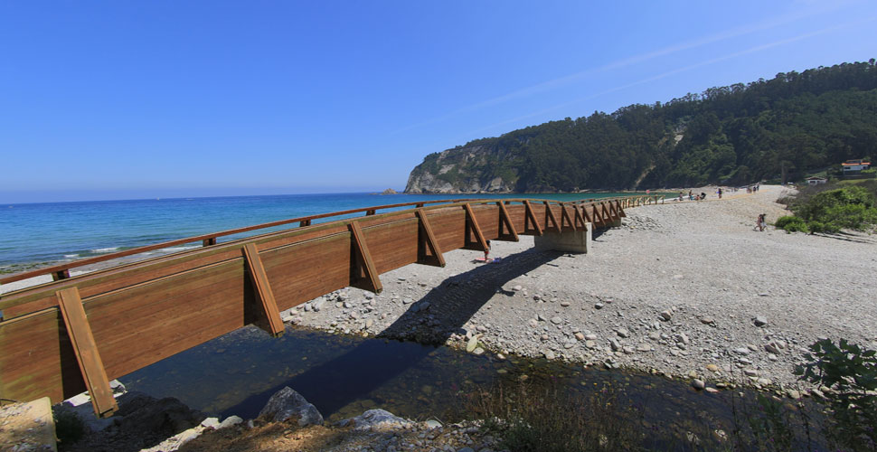
OUR BEACH

Slide 11
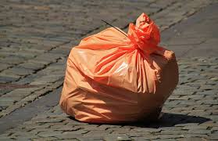
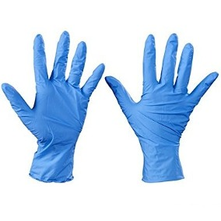
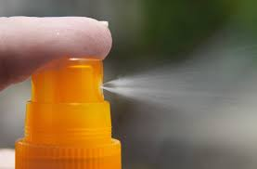
SUPPLIES

Slide 12
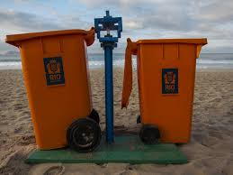
TRASH DISPOSAL

Slide 13
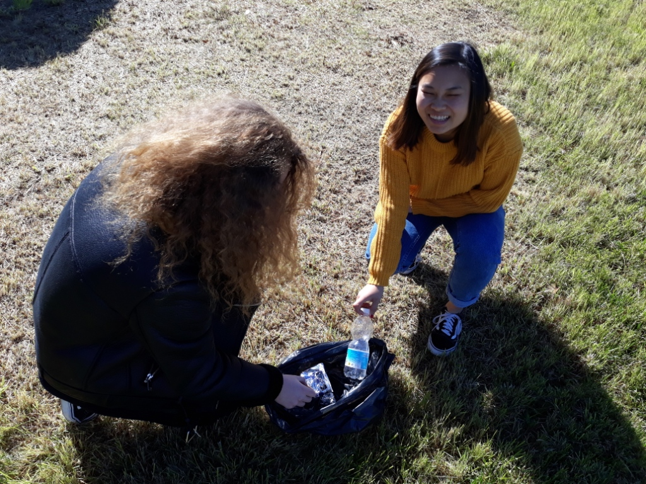
THE CLEANING TEAM

Slide 14
EXTERNAL SUPPORT

Slide 15
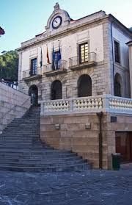
CUDILLERO TOWN HALL

Slide 16
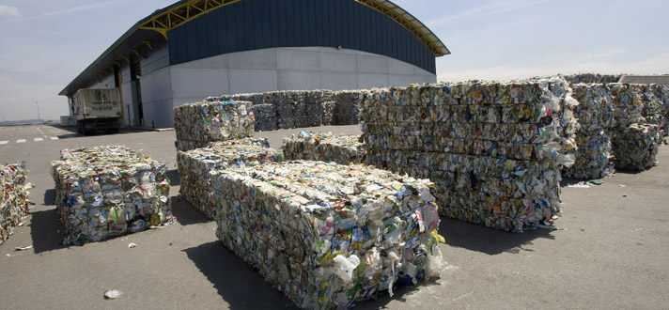
COGERSA

Slide 17
PRIMARY SCHOOLS

Slide 19
AWARENESS CAMPAIGN
PRESENTATIONS
POSTERS
FLYERS
SOCIAL NETWORKING SITES

Slide 20
DOCUMENT THE ACTIVITY!!!

Slide 21
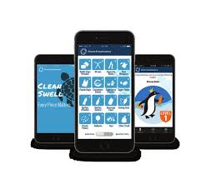
CLEAN SWELL

Slide 22
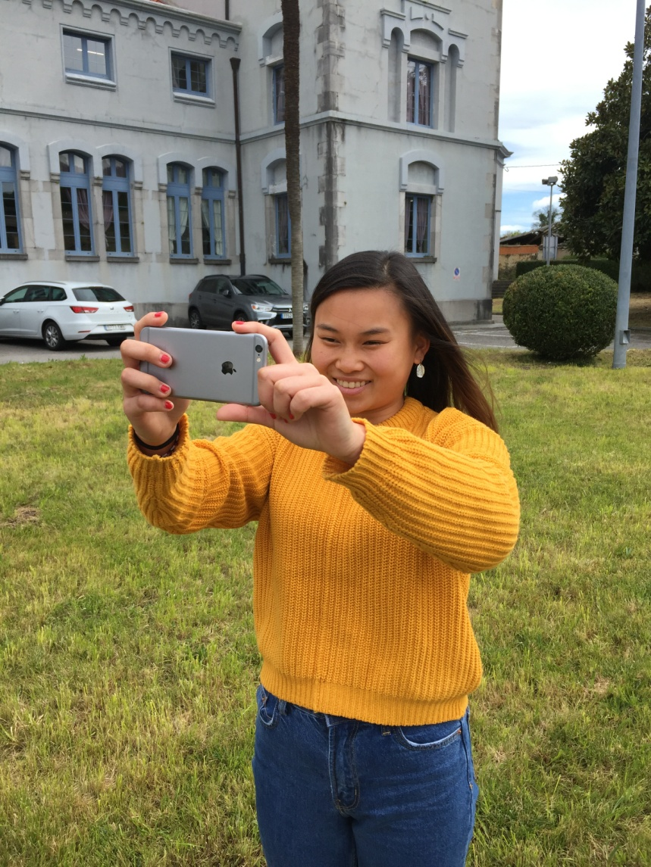
PHOTOS AND VIDEOS

Slide 23
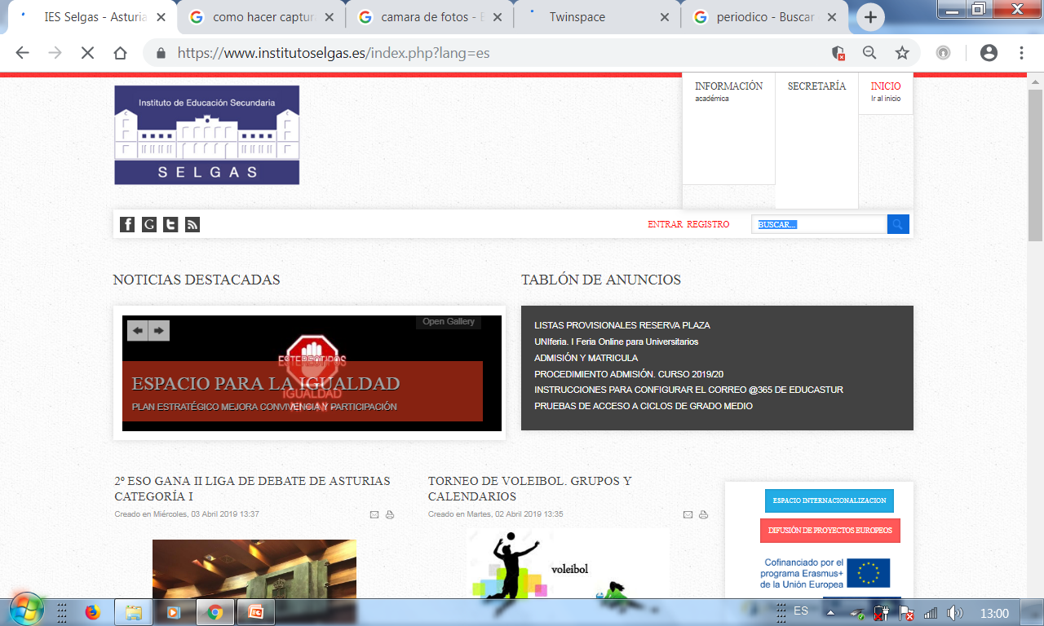
IES SELGAS WEBPAGE

Slide 24
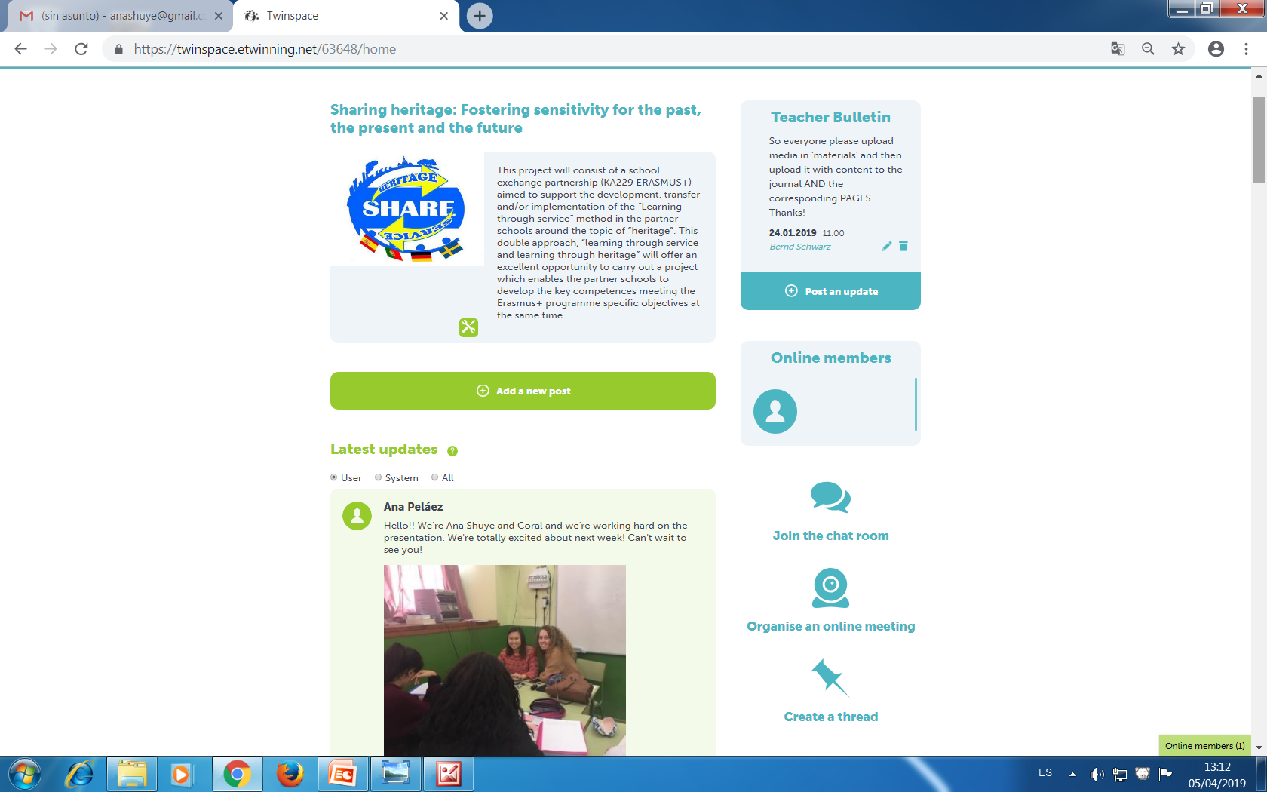
TWINSPACE

Slide 25
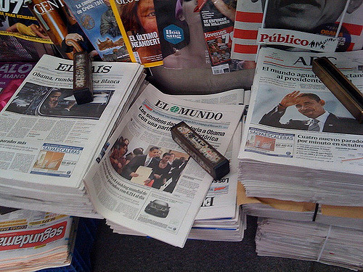
THE MEDIA

