Slide 1
“SWOT ANALYSIS”
By Ana Peláez
English teacher, IES Selgas

Slide 2
The Agenda:
Introduction
Swot analysis
Group work
Presentations

Slide 3
Our project will be a type of service aimed at improving our heritage
(Some examples: fund-raising events, recovering natural paths/spaces projects, beach cleaning days, guided visits, local heritage promotion initiatives, etc.)

Slide 4
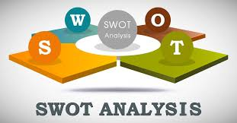

Slide 5
SWOT analysis is a framework for identifying and analyzing the internal and external factors that can have an impact on the viability of a project.

Slide 6
S stands for STRENGTHS
W stands for WEAKNESSES
O stands for OPPORTUNITIES
T stands for THREATS

Slide 7
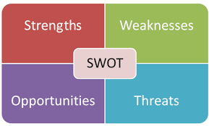
We are going to use this framework to analyse:
heritage situation around our area
our capacity to improve it by offering a service to the community

Slide 8
Strengths:
Resources and internal factors which can support a successful project

Slide 9
Rich heritage
Clear needs
Relations with relevant institutions
High motivation in the group
Creative thinking
ICT skills…

Slide 10
Weaknesses:
Resources and internal factors which can work against a successful project

Slide 11
Poor heritage
No clear needs
Lack of information
Low motivation in the group
Lack of ideas
Low ICT skills…

Slide 12
Opportunities:
External factors that can foster our project

Slide 13
Community interest
Local government plans
ONG’s projects
Other initiatives in the same field…

Slide 14
Threats:
External factors that could put our project at risk

Slide 15
Uncertain number of users
Similar services nearby
Who knows if the service will stay in favour with users
Population age…

Slide 16
READY?

Slide 17
Group work
.

Slide 18
Using the swot framework:
Analyse heritage situation around your area
Analyse your capacity to improve it by offering a service to the community
Upload your results to the Twinspace
Name a spokesperson
Explain your results

Slide 19
There are not right or wrong answers.
The important thing is the reflection!!!

Slide 20
OBRIGADA
TACK
DANKE
GRACIAS

