Slide 1
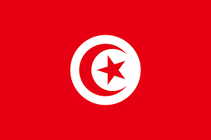
Tunisia

Slide 2
Geography

Slide 3
Tunisia is a country in Northern Africa bordering the Mediterranean Sea, having a western border with Algeria and south-eastern border with Libya
Tunisia occupies an area of 163,610 square kilometres,
of which 8,250 are water.

Slide 4
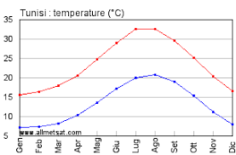
climate
Tunisia's climate is hot in summer and mediterranean climate in the north, where winters
are mild with moderate rainfall and summers are hot and dry. Temperatures in July and August can exceed 40 °C.
Winters are mild with temperatures exceeding 20 °C

Slide 5
city
Tunisis is the capital of tunisia and its population is
993000 people
The biggest cities in the tunisia are:
-Tunisis
-Sfax
-Cartagine
-Susa

Slide 6
River and mountain
The Medjerda River is the longest river
Of Tunisia (460km)
The longest Rivers in Tunisia are:
-Medjerda
-Oued Tessa
-Oued Siliana
Diejeb Chambi is the tallest mountain in the Tunisia

Slide 7
Government

Slide 8
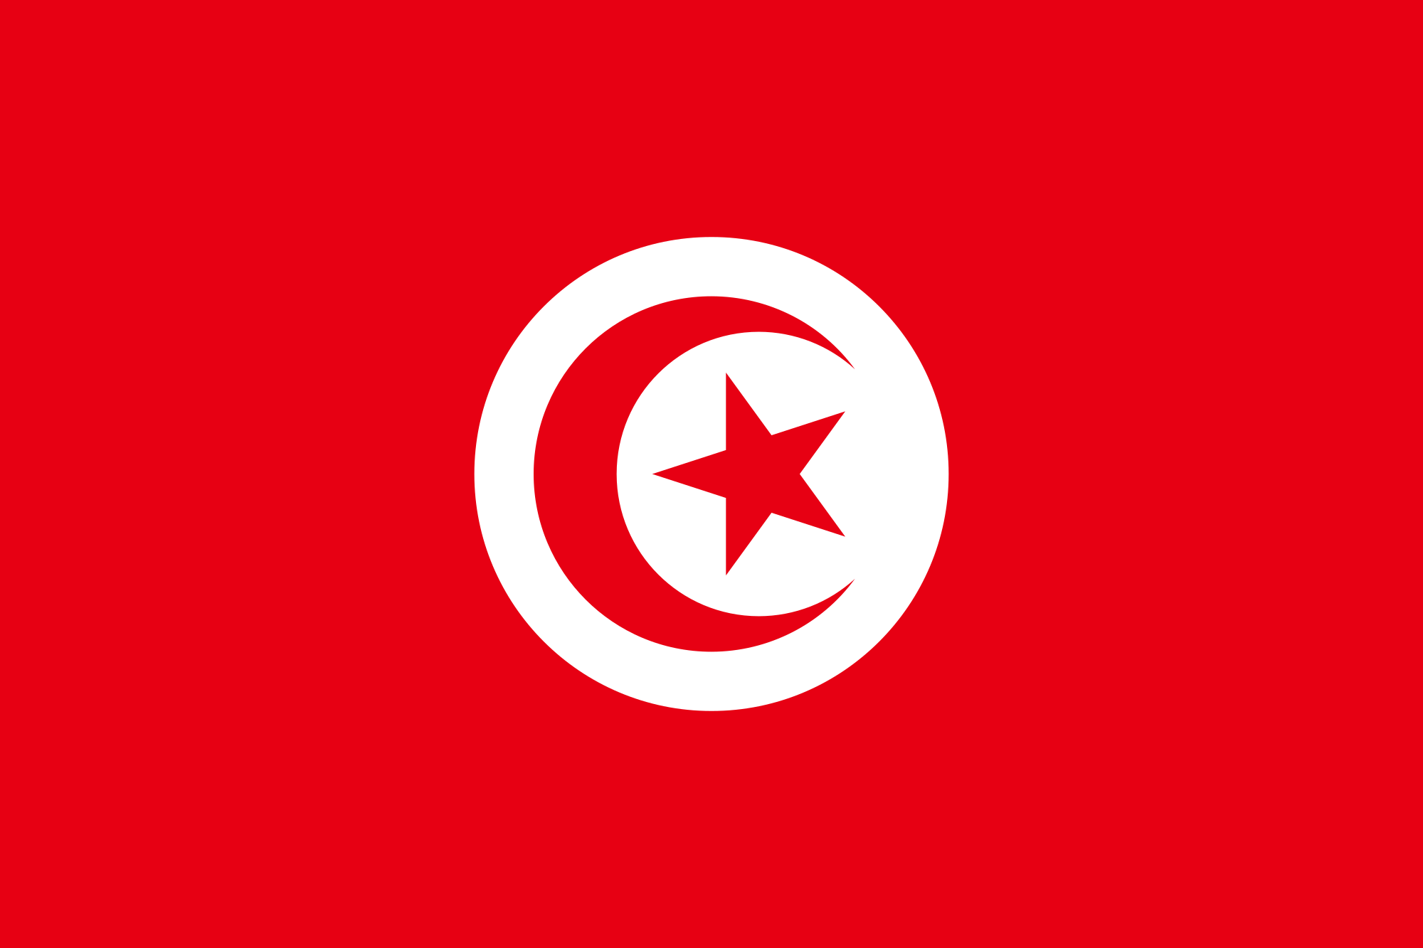
flag
The flag of the Republic of Tunisia is red, in the middle, a white disk containing a five-pointed star surrounded by a red crescent
the color red represents the blood of martyrs killed during the Turkish conquest of Tunisia .The white symbolizes peace, the disk symbolizes the radiance of the nation as the sun, while the crescent and five-pointed star represent unity of all Muslims.

Slide 9
National Anthem and Money
Ḥumāt al-Ḥimá is the national Anthem of Tunisia
The dinar is the currency of Tunisia.

Slide 10
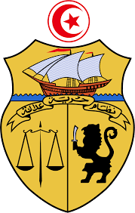
Type of government
The politics of tunisia is a unitary semi-presidential representative democratic republic

Slide 11
The economy
Tunisia grows olives, tomatoes, citrus fruits, sugar beet, dates, almonds and grains;
Its industry consists of petroleum, tourism, mining, textiles and footwear.

Slide 12
languages
There are two languages spoken in Tunisia:
Arabic and French.

Slide 13
Population & People
In tunisia there are 11 category; the main ones are
-Arabs in Tunisia‎
-Romani in Tunisia‎
-European Tunisians
The principal tunisia’s religions is islam. The Judaism , the Christianity , the Baha'i ,
the agnosticism and atheism so there are minority.

Slide 14
Culture
In tunisia there are the festival of cinema and music, in this festival there are a lot of people and is it done every two years.
In tunisia there is a particular dress, shashia, this is a men’s dress that who begin to wear at 20 years.

Slide 15
Famous people
Salvatrice Elena Greco:
She is an actor, she was born on 11 march 1933.
She did the scapolo film’s. her name for her career is sandra milo,
she is a beoutifull woman

Slide 16
Plants and wildlife
Tunisia is well documented for its addax and Dama Gazelle population.
Barbary fig trees are present all over the country.
In the north, Tunisia's natural flora is mostly composed of cork oak, eucalyptus
and thujas.
Around the Sahel region, orange and olive trees are predominant whereas in the
south, oases are filled with date palms, though you will also find cacti and thistle.

Slide 17
WORK DONE BY:
-Bongiovanni Annamaria
-Grossi Rebecca
-Giroletti Gabriele

