Slide 1
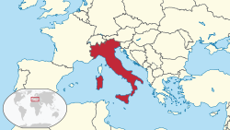
ITALY

Slide 2
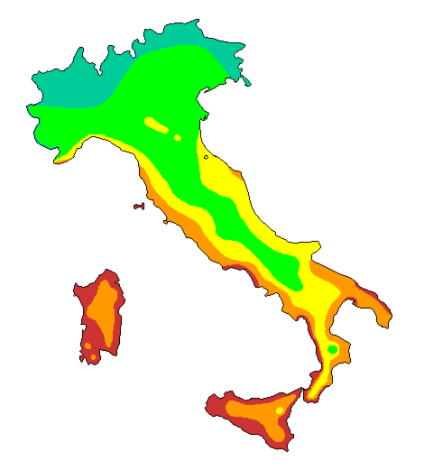
Geography
Italy’s extended is 301.338 km².
Italy has a variety of climate systems. The northern areas of Italy have a relatively cool, mid-latitude version of the Humid subtropical climate, while the coastal areas of Liguria and the peninsula south of Florence generally fit the Mediterranean climate profile.

Slide 3
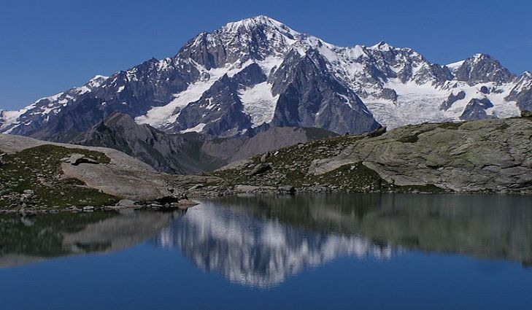
- The longest river in Italy is Po (652 km).
- The highest mountain is Mont Blanc (4.808 m).
- The principal natural resources of Italy are: metals, industrial minerals and gemstoms, fossil fuels, investment.

Slide 4
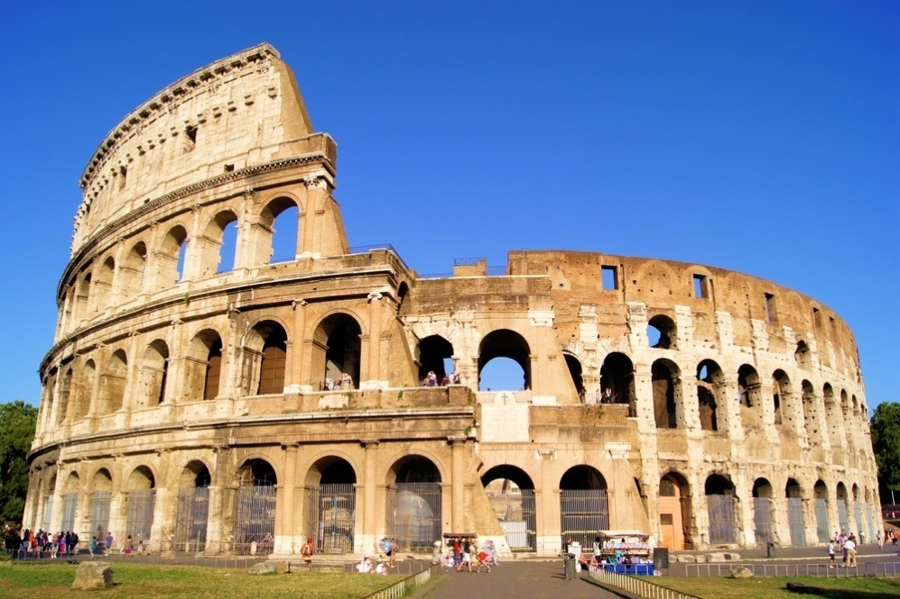
THE CAPITAL
The capital of Italy is Rome and is the largest
city in Italy.
The most famous monument is the Colosseum.

Slide 5
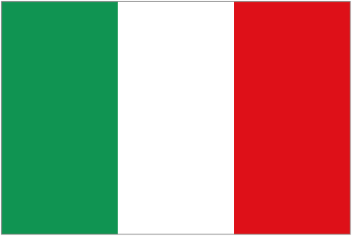
Government
The flag of Italy is a tricolour featuring three equally-sized vertical stripes of green,white and red, with the green at the hoist side. Its current form has been in use since 18 June 1946 and was formally adopted on 1 January 1948.

Slide 6
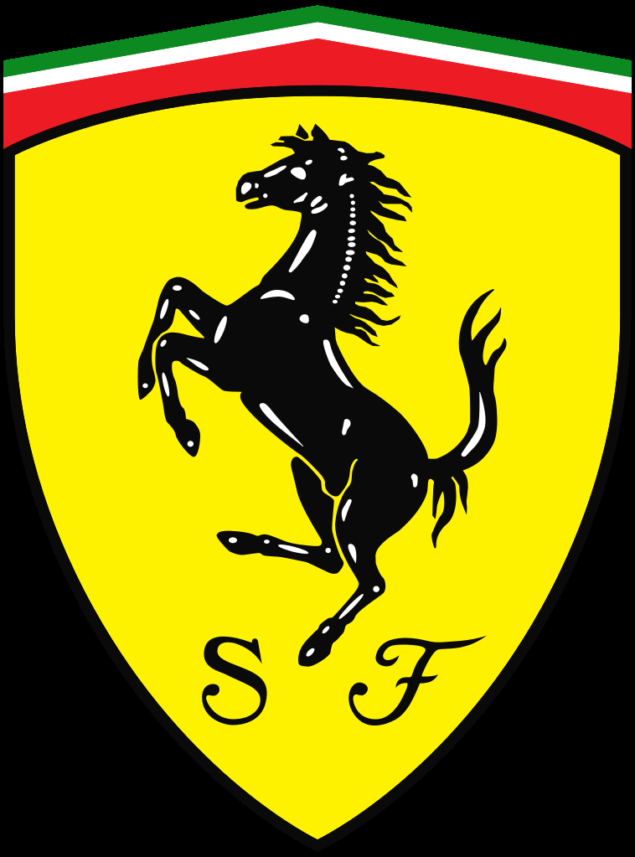
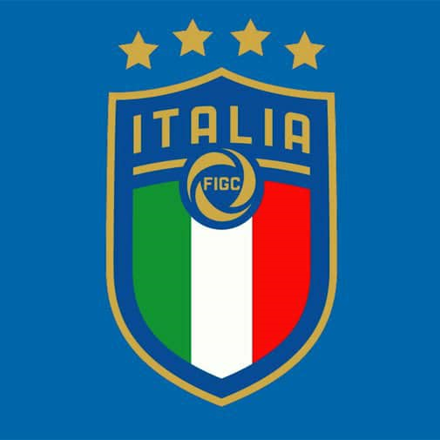
Principal national symbles

Slide 7
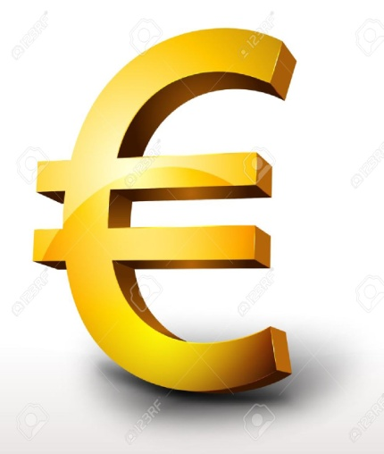
The anthem of is “ Fratelli d’Italia”
In Italy it’s used the euros like kind of money.
Politics of Italy is conducted through a Parliamentary Republic with a multi-party system. .... The Constitution establishes the Government of Italy as composed of the President of the Council and Ministers.
The name of the courent government is Paolo Gentiloni.

Slide 8
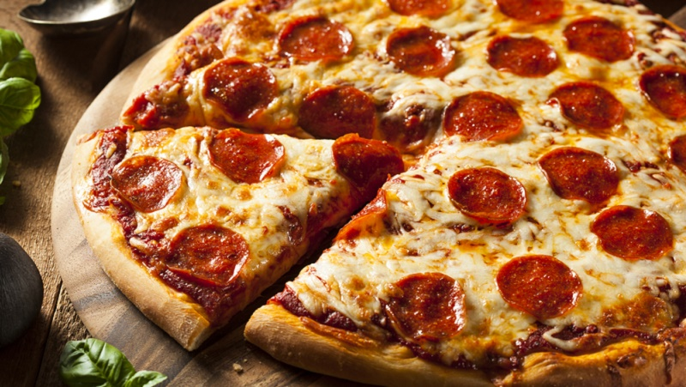
THE ECONOMY
Made in Italy is a merchandise mark indicating that a product is all planned, manufactured and packed in Italy. Made in Italy is globally regarded as synonymous with luxury, excellence, creativity, and top quality, especially concerning the design, fashion, food, manufacturing, craftsmanship, and engineering industries.

Slide 9
LANGUages
The principal language is italian but there are some miniorites languages for example german in Trentino, fench in the Valle d’Aosta.
In Italian “hello” it translates “ciao”.
POPULATION AND PEOPLE
The principal ethnic groups in Italy are arabs and rumenian. The pricipal religions are Catholic religion and Orthodox.

Slide 10
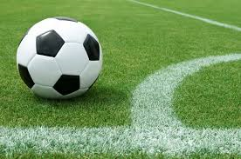
CULTure
Food: pizza, carbonara and lasagna.
Architecture: Colosseum, Tower of Pisa and Duomo of Milan.
Sports: football, basketball and tennis.
Music: classic, pop and rock.

Slide 11
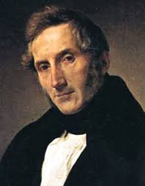
THE PRINCIPAL FAMOUS PEOPLE
The famous people in Italy are Gianluigi Buffon, Silvio Berlusconi, Gianni Versace, Enzo Ferrari and Ferruccio Lamborghini.
In the history of Italy, the famous people are Giuseppe Garibaldi, Camillo Benso Conte of Cavour, Vittorio Emanuele II, Cristoforo Colombo, Danti Alighieri, Alessandro Manzoni and Palladio.

Slide 12
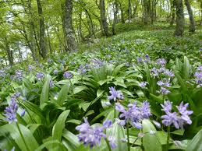
Flora unique in italy
Due to the long phase of settlement of the Italian peninsula and the strong Roman high culture, the natural vegetation and forests in Italy had been destroyed very early. Crops, pastures and vineyards replaced the natural vegetation. One of the hallmarks of contemporary Italy was established by man.

Slide 13
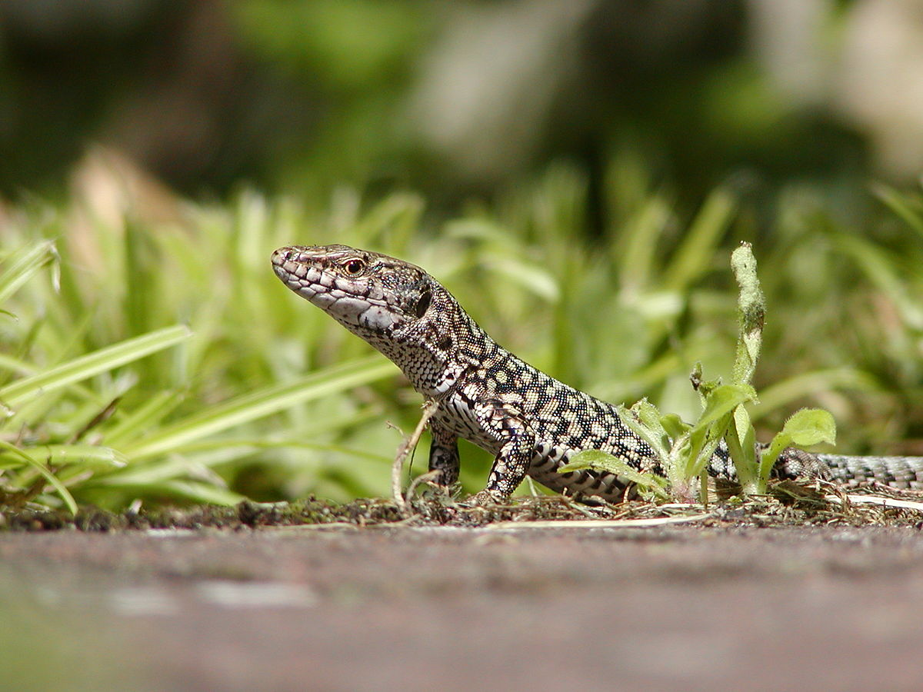
fauna unique in italy
Endemic reptiles include the Aeolian Wall Lizard the Sicilian Wall Lizard , the Italian Aesculapian Snake , the Sicilian Pond Turtle, and the recently described viper walser (Species new to science).

Slide 14
PRODUCED BY :
FRANCESCO PEREGO
ALESSANDRO FUGAZZA
BERSELLI BRIAN ALDO

