Slide 1
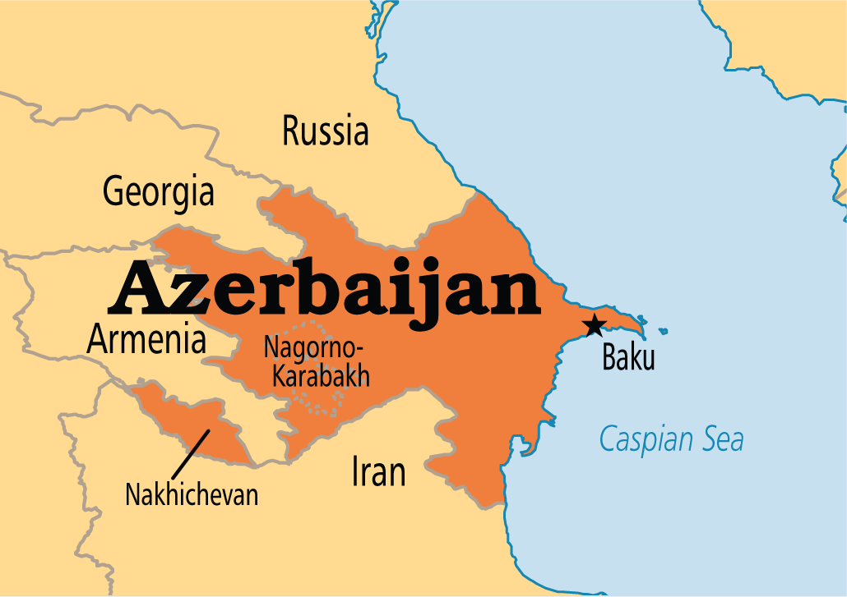
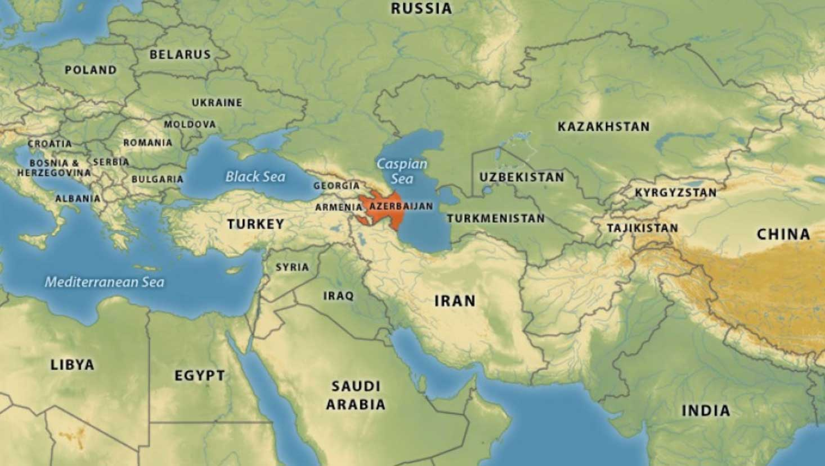
AZERBAIJAN

Slide 2
FEATURES OF THE COUNTRY
Size: 86600 km^2;
Capital city: Baku;
The longest river: Kur 1515 km;
The highest mountain: Bazardüzü 4466m;
Climate: the winters are cold and the summers are very hot;
Flag description: The flag of Azerbaijan is a horizontal tricolour featuring three equally sized fesses of blue, red, and green, with a white crescent and an eight-pointed star in the center;

Slide 3
NATIONALS SYMBOLS
the tricolour flag;
emblem of Azerbaijan: tongues of flame symbolizing the “land of fire” are depicted in the centre of the emblem. Colours used in the emblem are colours of the flag;
march of Azerbaijan: the nation anthem is one of the Azerbaijan symbols. The anthem was composed by Uzeryir Hajibeyov;
may 28: in this day whole Azerbaijan celebrates historical event: the day of declaration of indipendence of the republic;
qizil ulduz medal: is a medal of the national hero of Azerbaijan;
heydar aliyev order: is the highest decoration of the republic;

Slide 4
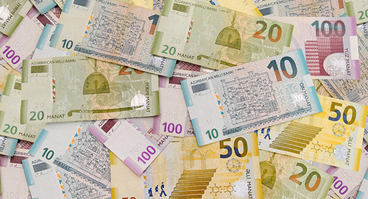
MONEY AND INDIPENDENCE:
Money: money used in Azerbaijan are Manats;
Indipendence: the Azerbaijan's republic proclamed its indipendence in 18 october 1991;

Slide 5
GOVERNEMENT
The governement of Azerbaijan is based on the separation of powers and judical branges. The legislative power is held by the unicameral national assembly and supreme national assembly; the executive power is held by the president and the prime minister; the judical power is vester in costitutional court, economic court and supreme court. The president of Azerbaijan is Ilham Aliyev.

Slide 6
ECONOMY
After gaining indipendence in 1991, Azerbaijan became a member of the international monetary found, the wordl bank, the european bank and the asian and islamic developement bank. Azerbaijan is rich in oil, natural gas, gold, silver, iron, titanium, manganese, and cobalt. About 54,9% of country is an agricoltural land. Azerbaijan's agricolture is based on horticolture and sub-tropical corps, green vegetables, viticolture and wine making cotton growing and medicinal plants, potatoes, sugar beets, cotton and tobacco. The fishing is very common in caspian sea;

Slide 7
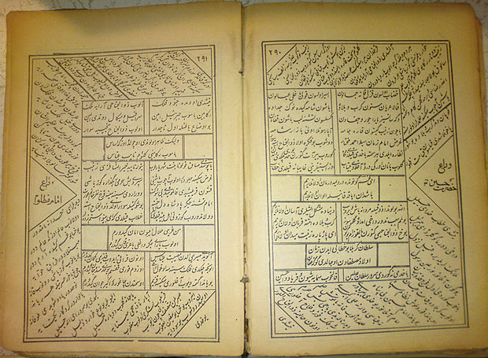
LANGUAGES
Azerbaijani or Azeri, also referred to as Azeri Turkic or Azeri Turkish, is a turkic language spoken in Azerbaijan.
“HELLO” in Azeri is “SALAM”

Slide 8
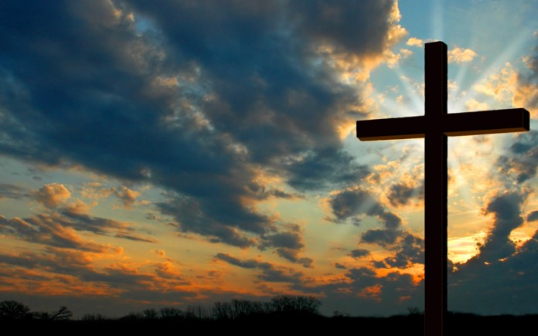
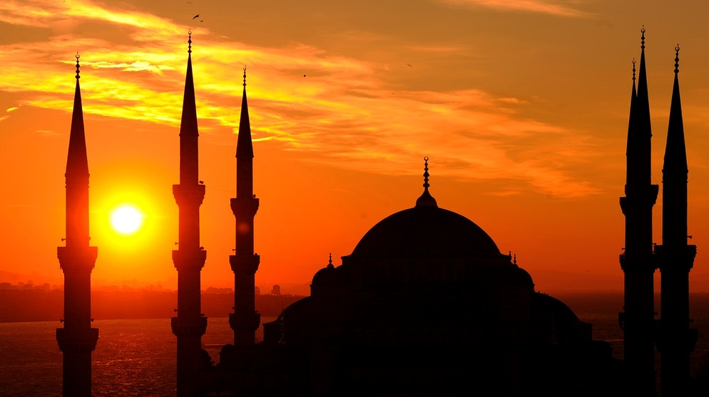
RELIGION
In Azerbaijan the most widespread religions are Islam and Christianity. The rest of population adheres to other faith or are non religious.

Slide 9
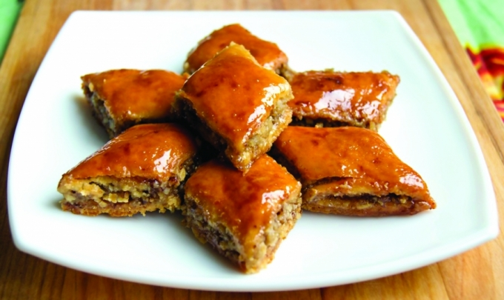
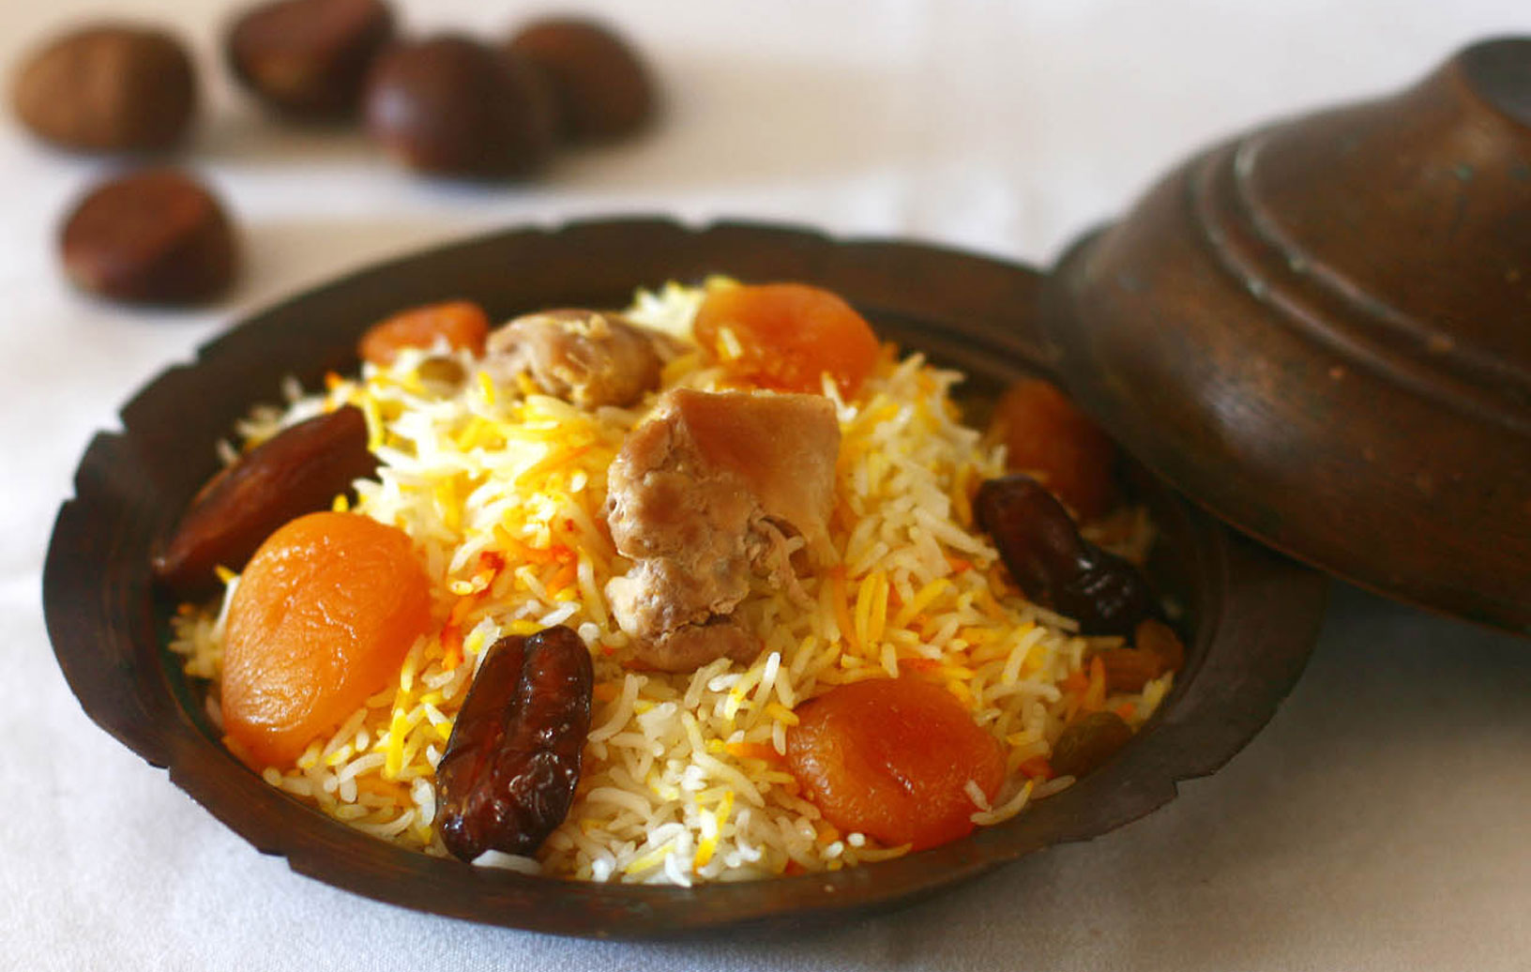
COLTURE
Music: music of Azerbaijan builds on folk traditions;
Cuisine: Azerbaijan's cuisine has a lot in common with iranian and turkish cuisine. Some of famous foods are: Dushbada, Pakhlava and Badambuna;

Slide 10
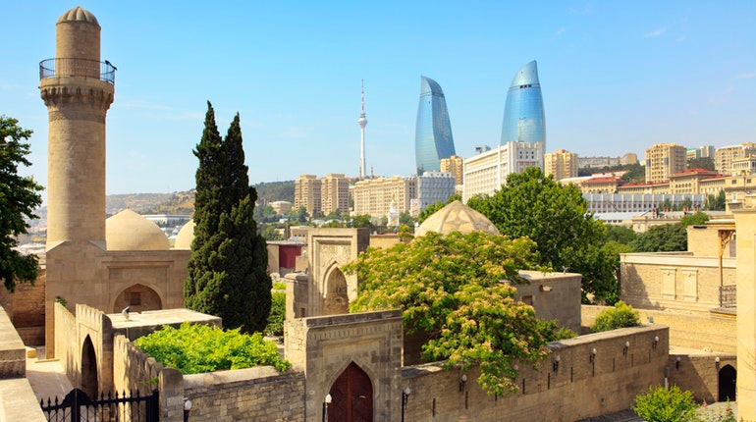
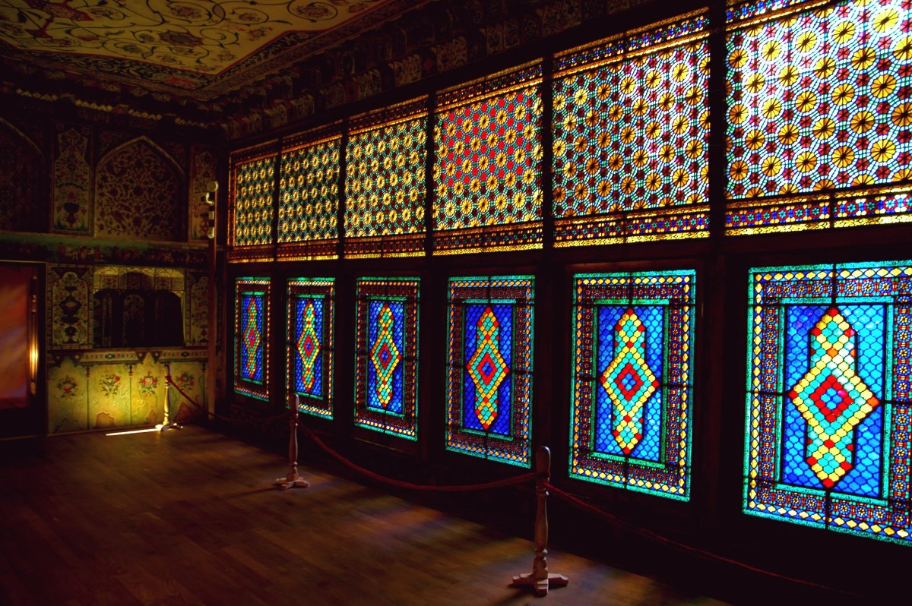
Architecture: Azerbaijan's architecture combine elements of west and east. It has influences from persian architecture. Some important monuments are: palace of Shirvanshahs, tomb of Shirvanshahs and Divan Khama;

Slide 11
Sports:
Volleyball;
Football: the most succesful Azerbaijan football clubs are: Neftchi Baku, Quarabaĝ and Baku. In 2012 Neftchi Baku became the first Azerbaijan's taem to get the qualification of UCL;
Futsal: the Azerbaijan national futsal team reached fourth place in UFC, in 2010;
Rugby;
Martial arts;
Freestyle wrasling;

Slide 12
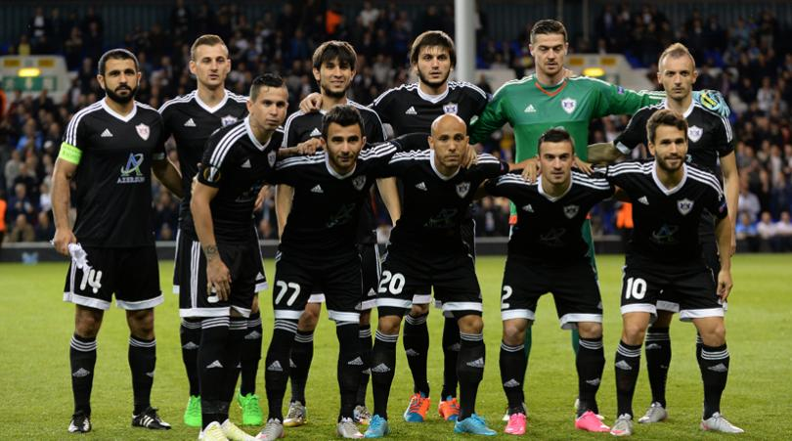
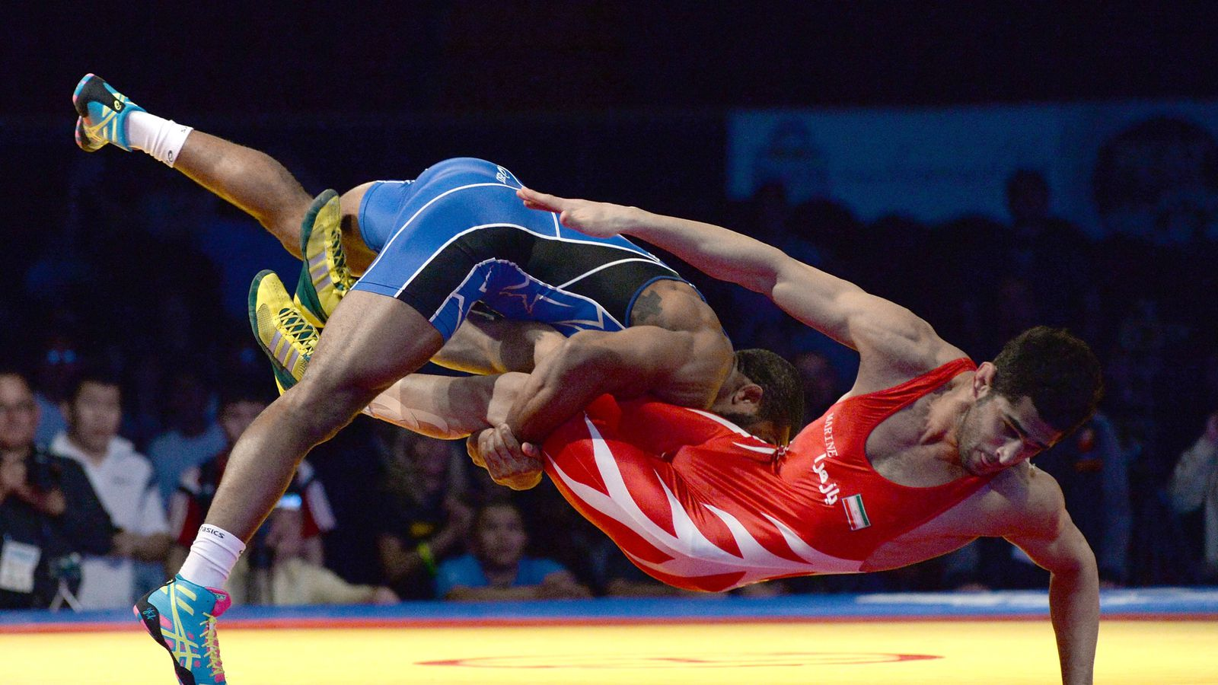
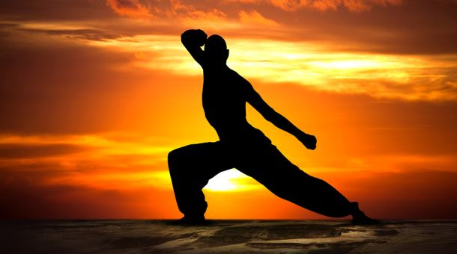

Slide 13
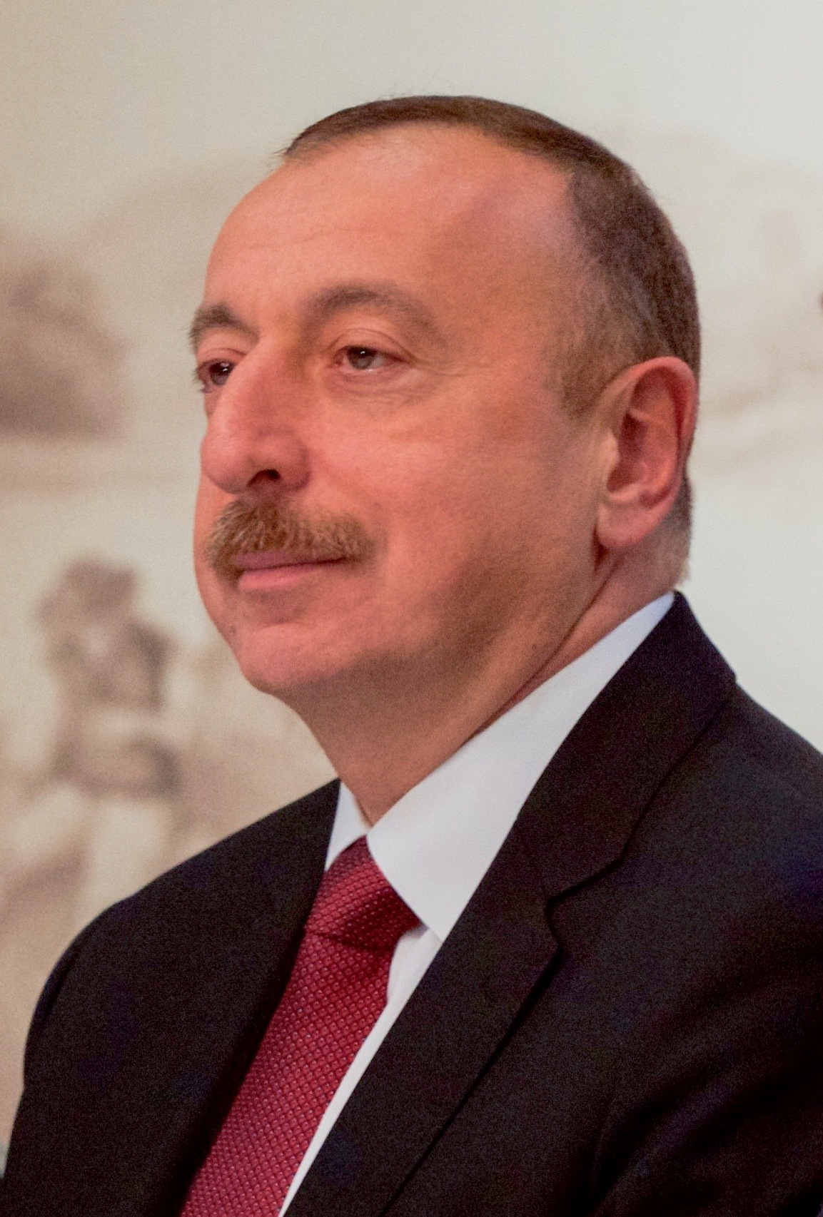
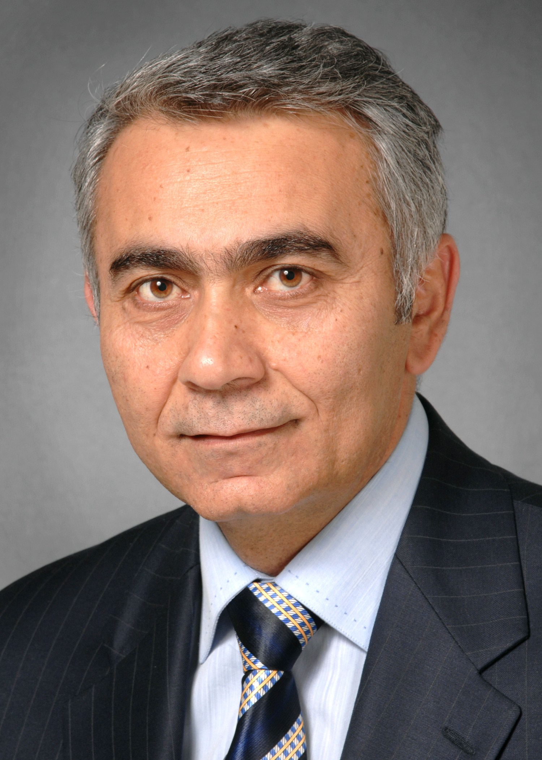
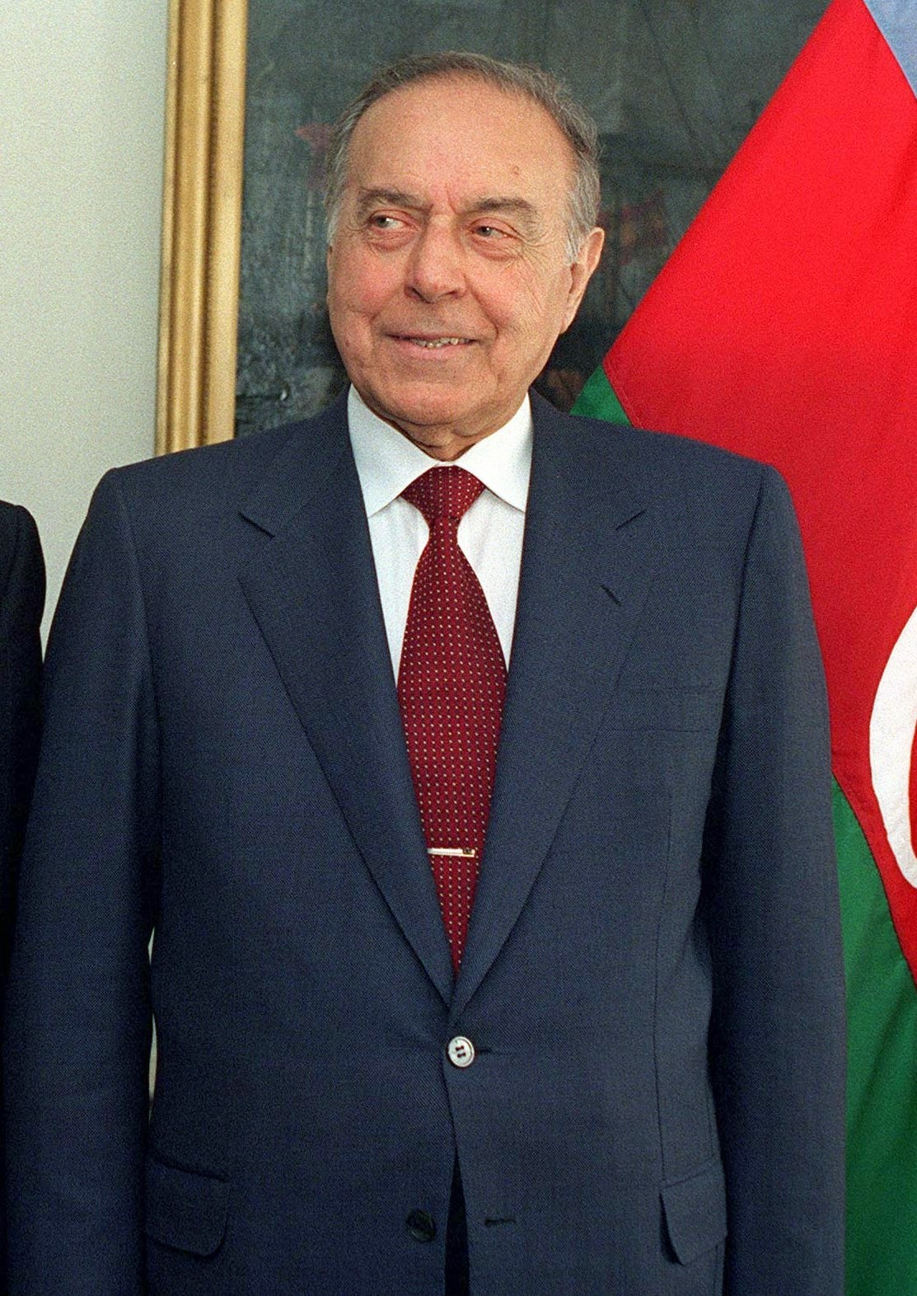
FAMOUS PEOPLE
The most famous people are:
Ilham Aliyev: the president;
Heyoar Aliyev: former president;
Natavan: poet;
Mirza Akhundov: writer and philosopher;

Slide 14
INTERESTING FACTS
Baku hosted ist first GP in 2017;
In Azerbaijan, no social occasion is complete without the tea;
The Karabakh horse renowed for its effortless speed, intelligence and endurance;
Azerbaijan has more mud volcanoes that anyother country on earth;
Babies are bathed in salt water;

Slide 15
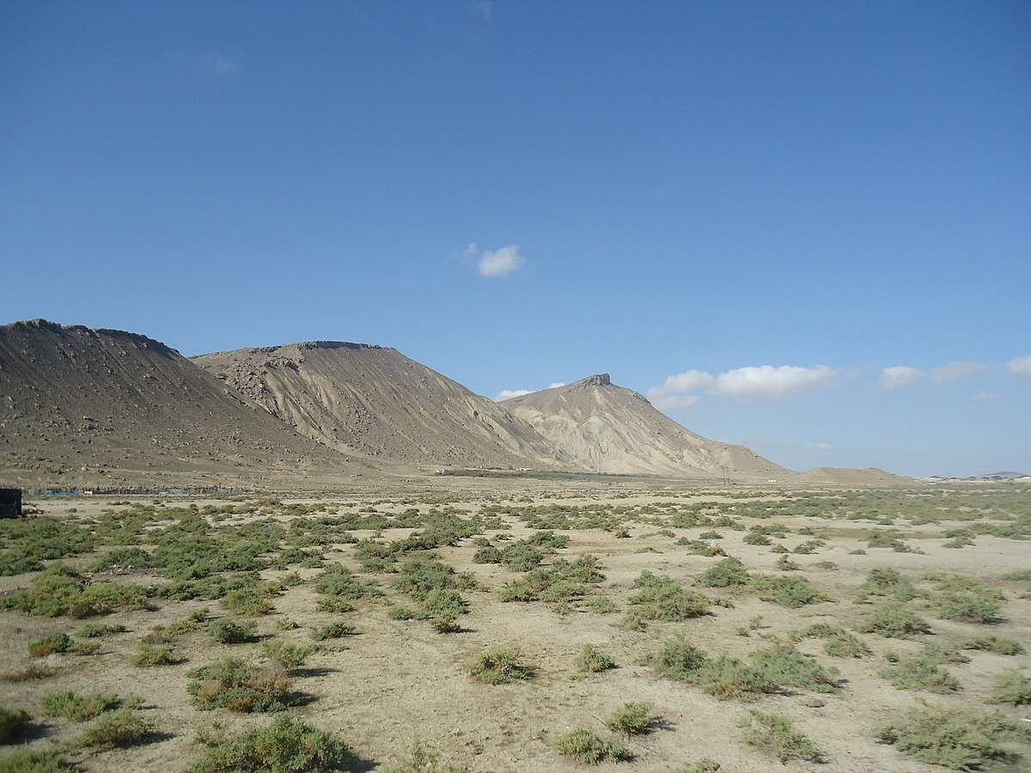
FLORA AND FAUNA
In Azerbaijan grow over 4500 kinds of flowering plants. The Azerbaijan's forest are broad-leaved,mixed and riparian. The fauna is rather aried. The forests are inhabitated by bears, wolves, deer, lynxes, wild boars. The shallow gulfs of the Caspian Sea are populated by a variety of bird. Most birds come there to winter: ducks, geese, swants...

