Slide 1
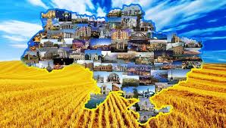
UKRAINE
Classe 2°CD
Azzini Annamary
Belli Sara
Pisati Claudia

Slide 2
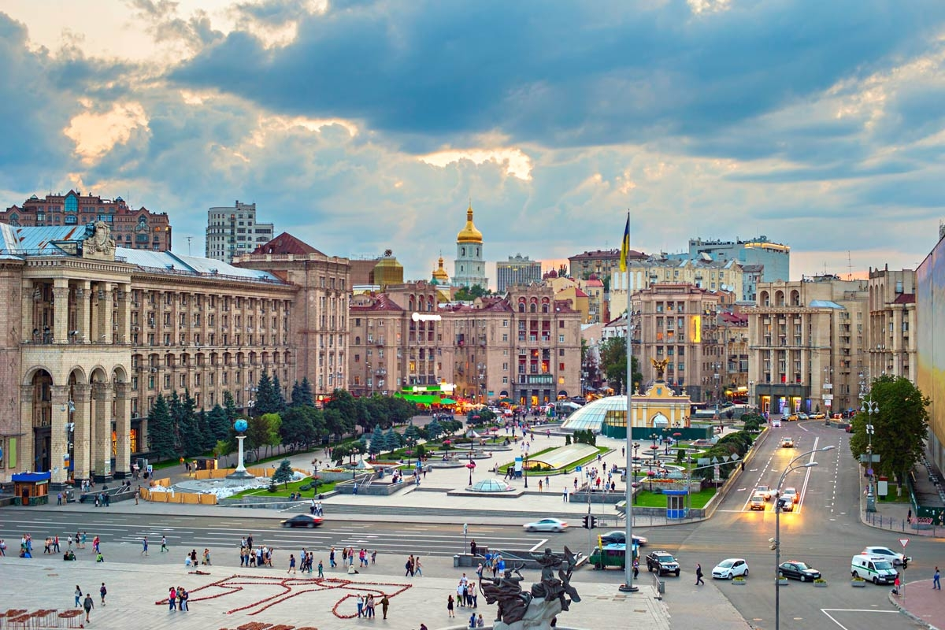
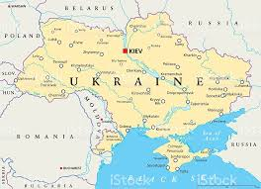
The capital and the largest city of Ukraine is Kiev.
The longest river of Ukraine is the Dnipro River and is the fourth-longest river in Europe.
Mount Hoverla is the highest mountain in Ukraine and the
part of the Carpathian Mountains, is located in the Chromophore region.
The country extends him for 603.700 square km.
Ukraine has a continental climate, with warm, dry summers and fairly severe winters. Ukraine in rich in natural resources: coal, iron re, manganese, nickel, uranium and others. The reserves of sulfur are the largest in the world, the reserves of mercury ore are the second largest. Ukraine has more than 5% of the world reserves of iron ore. Also, there are oil and natural gas deposits but their reserves are not large.

Slide 3
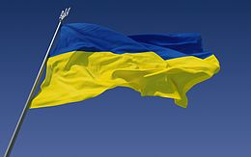
The flag of Ukraine is a banner of two banner of two equally sized horizontal bands of blue and yellow.
Combination of blue and yellow as a simple of Ukrainian lands comes from the flag of the Kingdom of Galicia-Volhynia used in 12th century.
As a national flag, the blue and yellow bicolor has been officially used since the 1848 Spring of Nations when it was hoisted over the Lviv Rathaus.
Creation of the Ukrainian national anthem started in the autumn of 1862 during one of Pavlo Chubynsky's parties.

Slide 4
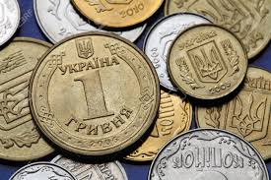
CURRENCY
The hryvnia has been the national currency of Ukraine since 2 september 1996. the hryvnia is subdivided into 100 kopiyka.
The currency of Kieran Rus' in the eleventh century was called grivna. The word is thought to derive from Slavic griva; it might have indicated something valuable worn around the neck, usually made of silver or gold;
later, the word was used to describe silver or gold ingots of certain weight.

Slide 5
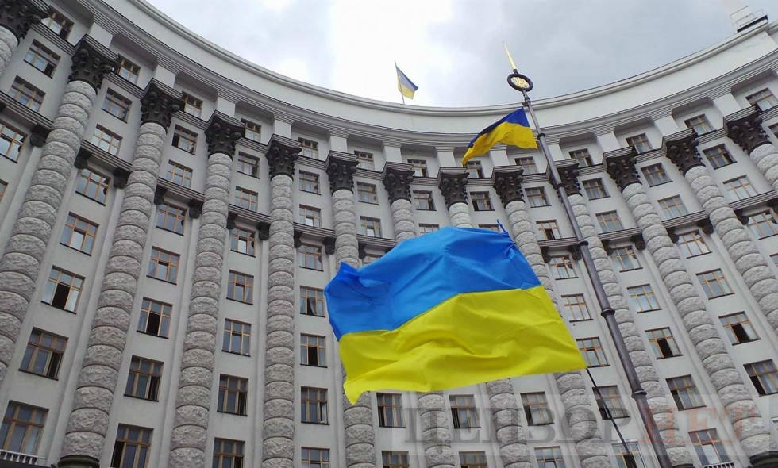
GOVERNMENT
Ukraine is a sovereign country in eastern Europe with a popular of about 43 million people. The country is a unitary republic under a semi - presidential system.
The country exercises separation of power with three levels of government: legislative executive and juridical.
Ukraine operates under a multi-party system, the president and the government hold the executive power while the legislature is vested in the parliament. The politics of the country has been categorized as over-centralized and associated to the legacy of the Soviet Union and caused by the fear of separatism.

Slide 6
UKRAINE IS THE 50TH LARGEST EXPORT ECONOMY IN THE WORLD.
The top exports of Ukraine are Iron, Seed oils corn, Wheat and iron ore. Its top imports are Petroleum Gas. Petroleum, Coal Briquettes, Packaged Medicaments and Cars.
On 16 July 1990 the new parliament adopted the Declaration of State Sovereignty of Ukraine.
This established the principles of the self-determination, democracy, independence and the priority of Ukrainian law over Soviet law.
A referendum (1991) more than 90%of the electorate expressed their support for the act of independence. According to the Constitution, Ukraine's state language is Ukrainian. Russian is widely spoken, 67.5% of the population declared the Ukrainian native language and 29.6% declared the Russian.
The Ukrainian is mainly spoken in central and western Ukraine in western Ukraine the Ukrainian is also the dominant language in cities.

Slide 7
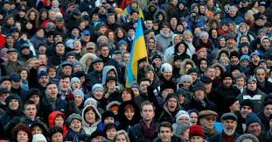
POPULATION
The level of religiosity in Ukraine is greatest in Western Ukraine (91%) and lowest in Eastern Ukraine (56%) and the Donbass (57%). A 2006 survey of the same Razumkov centre, found that: 62,5% of all respondents were not religious, not believers or not affiliated to any religious body 33.6% were Christians (26.8% orthodox,5.9% Catholics and 0.9%protestants),01% were Jewish and 3.8% were members of other religions.
Among those Ukrainians who declared to believe in Orthodoxy,38.1%. While 23.0%declared to be members of the Ukrainian Orthodox church of the Moscovian Patriarchate.
Protestants in Ukraine make up 1.9% of the population as of 2016. a further 7.1%

Slide 8
CULTURE
The culture of Ukraine has been influenced by its eastern and western neighbors. Crafted textile arts play an important role in Ukrainian culture.
The history of Ukrainian literature dates back to the 11th century.
Ukrainian literature began to develop again in the 14th century, and was significantly advanced in the sixteenth century with the introduction of the press however at the end of the eighteenth century emerged modern Ukrainian literature.
Ukrainian architecture includes the motifs and styles that are fund in structures built in modern Ukraine.
Musica is major part of Ukrainian culture, from traditional folk music, to classic and modern rock.
Ukraine greatly benefited from the Soviet emphasis on physical education.
Basketball is becoming popular in Ukraine in 2011.
The traditional Ukrainian diet included chicken, pork, beef, fish and mushroom. Ukrainians also tend to eat a lot of potatoes, grains, fresh, boiled or piclek vegetables.
The wildlife of Ukraine is distinguished by large variety of species with almost 45 thousand kinds of animals.

Slide 9
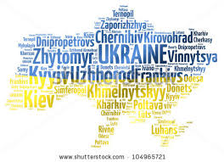
INTERESTING FACT
Five interesting facts of Ukraine are:
1) the national holiday in Ukraine is August 24th
2) the head of state in Ukraine is Leonid Kuchma
3) Ukraine has extremely fertile black earth soils.
4) Ukrainians wear their wedding ring on the ring finger of their right hand instead of the left hand.
5) the third most visited McDonald's in the world is located in Kiev near the train station and considered to be in the top five most crowed McDonald's in the world.
Words in Ukrainian:
Pizza: піца Musica: музика
Fotografia: фотографія Pallavolo: волейбол
Ciao: привіт Vita: життя

Slide 10
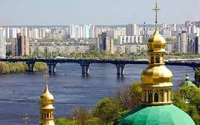
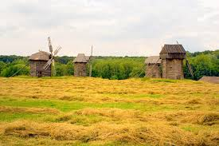
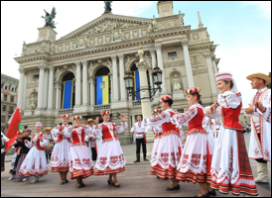
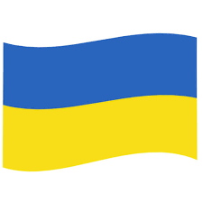
THE END!!

