Slide 1
FROM SNOW DUNES TO SAND DUNES Cultural diversity across Europe from NE to SW School Exchange Meeting - Redu 29-03-2022

Slide 2
Schools involved in the Project
Vídeo - Apresentação do Colégio
https://www.colegionsgraca.com.pt/new/
https://redu.fi/fi

Slide 3
The project
Name of the project: FROM SNOW DUNES TO SAND DUNES - Cultural diversity across Europe from NE to SW
Project priorities
enable the acquisition and development of key competences
understand the social and educational value of cultural heritage and its contribution to job creation, economic growth and social cohesion.
Topics of the project:
Digital skills – Information and Communications Technology
Creativity and culture
Foreign languages

Slide 4
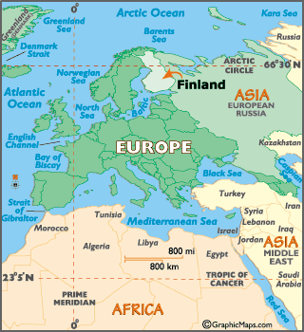
The location
Country: Portugal
(- 2 hours than Finland)
Region: Alentejo
Location: Vila Nova de Milfontes
Airport: Lisbon
Spoken language: Portuguese
Tourism: nature tourism with diversified activities such as trekking, surfing, paddle, canoeing, fishing …

Slide 5
The project
Expected outcomes of the project:
To learn about cultural heritage
Participants increase their knowledge about the culture of their own country and the country they will visit. They become more aware of the importance of cultural heritage and its diversity.
To improve knowledge (hard skills)
about a foreign country: cultural buildings, monuments, language and food of the partner country;
of communication in English;
of communication in the language of the partner country, Finnish and Portuguese;
organisational skills through planning activities, booking travel and accommodation, running workshops, etc.

Slide 6
The project
Expected results of the project: (continued)
To improve skills (soft skills)
teamwork;
communication;
punctuality;
tolerance;
flexibility;
ability to adapt
…

Slide 7
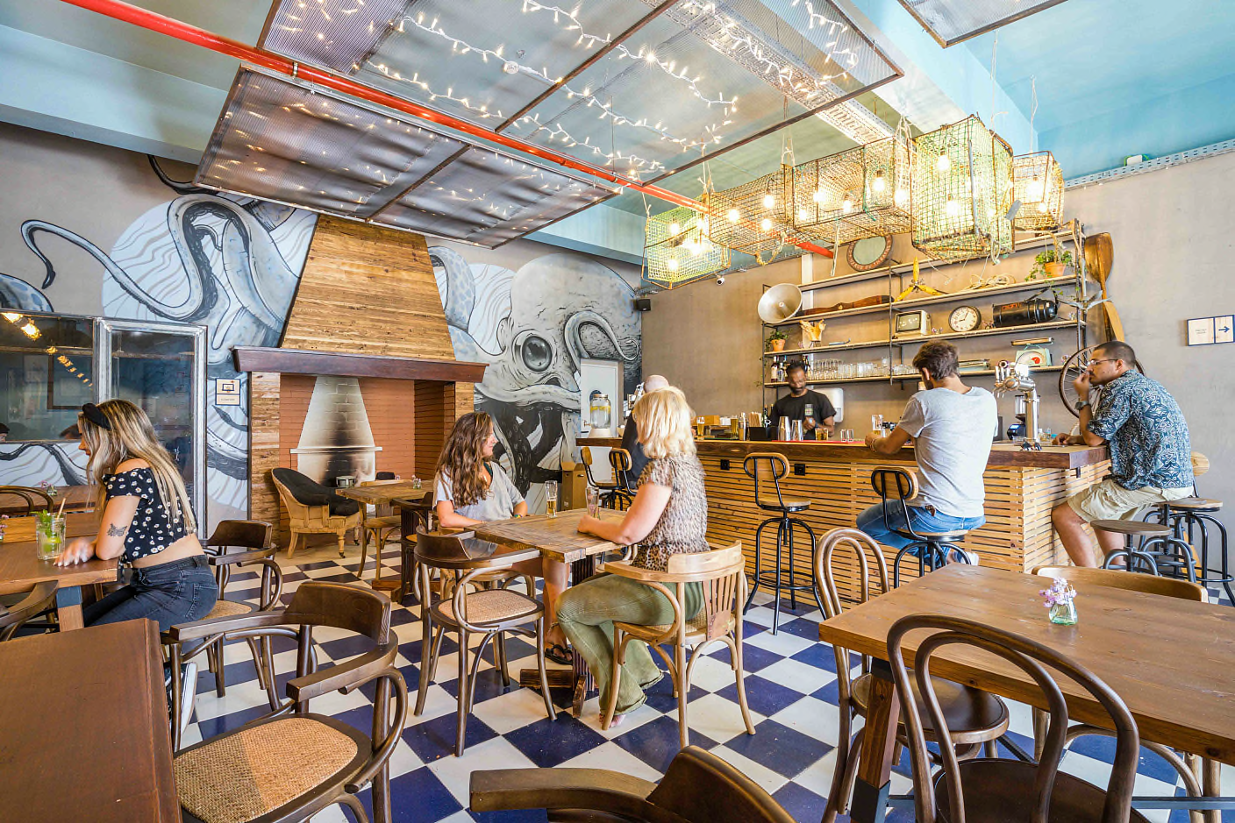
Day 1
Arrival (Lisbon): 21:10
Travelling to Vila Nova de Milfontes by bus
Stop for dinner (service station)
Arrival (Vila Nova de Milfontes): 24:00/00:00
Accommodation: https://www.selina.com/pt/portugal/milfontes/
Notes:
Ti 19.04.2022 Finnair AY637 Kittila, KTT — Helsinki, HEL 14:15-15:35
Ti 19.04.2022 Finnair AY1739 Helsinki, HEL — Lisbon, LIS 18:20-21:10
Ke 27.04.2022 Finnair AY1740 Lisbon, LIS — Helsinki, HEL 06:50-13:30
Ke 27.04.2022 Finnair AY639 Helsinki, HEL — Kittila, KTT 16:25-19:00

Slide 8
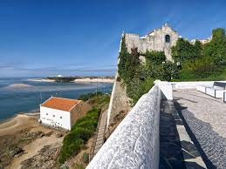
Day 2
9:30 Activity: Get to know each other
Where are we now in the project?
10:30 Workshop
Vila Nova de Milfontes history and local tangible heritage
Lunch (CNSG)
14:00 Workshop Communication
Basics of Portuguese language
15:00 Visiting school camp
15:30 Sightseeing in Vila Nova de Milfontes

Slide 9
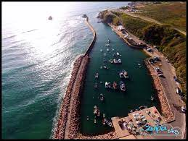
Day 3
9:30 Workshop SW Portugal (geographic and geological characterization)
10:00 Trekking in Natural Park Sudoeste Alentejano e Costa Vicentina (Flora and Fauna)
11:00 Visiting the local fishing harbour and fish market (Porto das Barcas)
12:30 Lunch (Porto das Barcas - https://www.instagram.com/restaurante_porto_das_barcas/ )
14:00 Visiting the shore in the low tide and discover the sea life (depends on the tide)

Slide 10
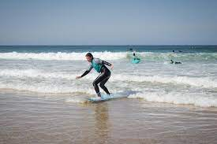
Day 4
9:30 Workshop Way of living in Portugal
10:00 Workshop Cooking a traditional Mediterranean meal
12:30 Lunch (School)
(invite people who have been involved in the project, stakeholders)
14:00 Optional activities
Fishing, beach surfing, shopping
Workshop Collecting material from excursions and activities
Notes:
Selina – check

Slide 11
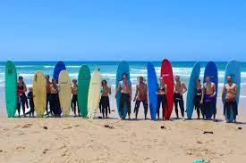
Day 5
9:30 Workshop Life charcos Project / Rota Vicentina project
10:00 Visiting to project Life Charcos
Praia do Malhão
12:30 Lunch
15:00 Outdoor activities , Paddle, canoeing, other beach sports (volleyball, football); sand sculptures…
Notes:
Selina – check

Slide 12
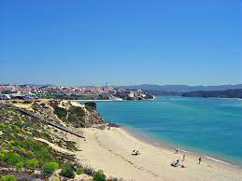
Day 6
9:30 Outdoor activity Trekking the Fishermen’s trail
12:30 Lunch
14:00 Boat trip (Furnas beach, Moinho da Asneira, Milfontes)
https://www.youtube.com/watch?time_continue=19&v=fy49qbUYm0s&feature=emb_logo
Notes:
https://rotavicentina.com/en/videos/
https://www.youtube.com/c/RotaVicentinaSWPortugal/videos
https://www.youtube.com/watch?v=378VE1BxOrs

Slide 13
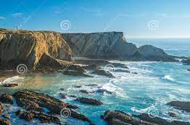
Day 7
9:30 Excursion to São Luis and Odemira (local windmill and other tangible heritage)
13:00 – Lunch (Craveiral)
15:00 Visiting to Cabo Sardão lighthouse and stork nests in the cliffs
Notes:
Selina – check

Slide 14
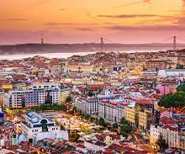
Day 8
8:00 DAY IN LISBON
Sightseeing in Lisbon
Visiting most popular cultural places in Lisbon
(Castelo de São Jorge, Mosteiro dos Jerónimos, Torre de Belém, Pastéis de Belém)
Notes:
Selina – check

Slide 15
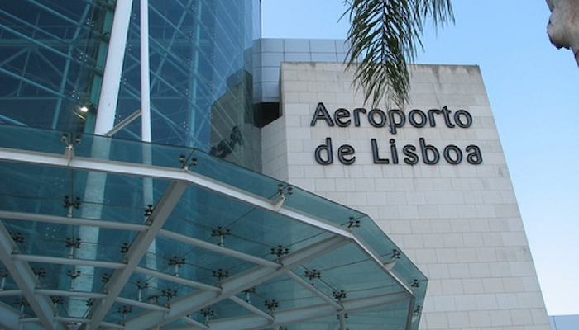
Day 9
Airport
Ke 27.04.2022 Finnair AY1740 Lisbon, LIS — Helsinki, HEL 06:50-13:30
Ke 27.04.2022 Finnair AY639 Helsinki, HEL — Kittila, KTT 16:25-19:00
Notes:
Selina – check

Slide 16
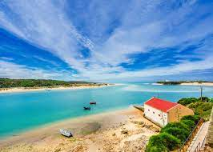
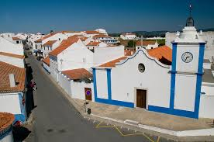
Weather
During the mobility
The temperature can vary between 9º and 20.º Celcius.
Previsão Metereológica (link to weather forecast)

Slide 17
Weather
Fonte: https://weather-and-climate.com/

Slide 18
Obrigad0 Kiitos Thanks

