Slide 1
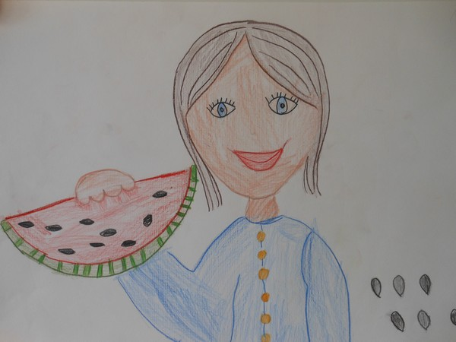
HEALING WATERMELON
Written by pupils of primary school Rovtarske Žibrše
SLOVENIA
Translated by Bojana Levinger

Slide 2
In some hilly village there lived a poor widow withh her only child, son Janezek. His father was resting in the cold soil for a long time, the widow hardly earned enough for living.

Slide 3
The only property, they had was their poor house; two little goats gave them milk. Janezek was very nice and hardworking boy, he helped his mother a lot, he shephered the goats.

Slide 4
Once a severe winter forged the world with ice and there was a great shortage of food. Mother got very ill. She became blind and her heart was beating slower one day after another. Janezek was taking care for her carefully and asked God to cure her.

Slide 5
But mother got weaker and weaker day by day and one day she said to her son: » I will die. But I know, I would be better if I ate only a small slice of watermelon.« Janezek was sad. He knew about the thck snow everywhere around, but he answered: »I'm going around the world and I'm going to bring you the watermelon.« Mother was happy and Janezek left their home.

Slide 6
While he was walking through the strong wind, he was thinking how little hope was there for him and his mother. He was afraid that his mother might die before he found the watermelon.

Slide 7
But he didn't give up. His love for his mother gave him power. He was walking and walking and he came to a field. He fell down on icy ground tired and exhausted.

Slide 8
Suddenly he felt the heat growing through his body. He exposed his breasts and melted the ice with his naked body. The ice was melting under him and suddenly some small hairy plants started to grow. They were growing and growing.

Slide 9
Janezek expanded his arms and he was watching yellow flowers . He was very surprised. And from this flowers grew big round watermelons, which were really beautiful.

Slide 10
Janezek picked up the biggest and the most beautiful one.

Slide 11
When he returned home, he gave the piece of watermelon to his mother and as soon she ate the sweet fruit, she opened her eyes and she felt well and healthy again. The watermelon worked as a magical medicine.

Slide 12
Janezek planted the black seeds of the watermelon and every time when somebody got ill, he knew how to help him. he took the watermelon and helped people and animals, too.

