Slide 1
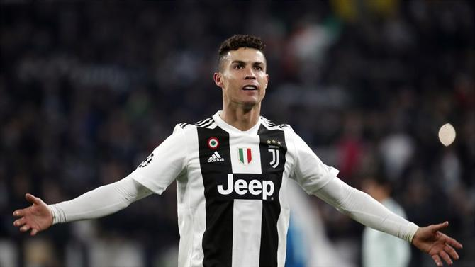
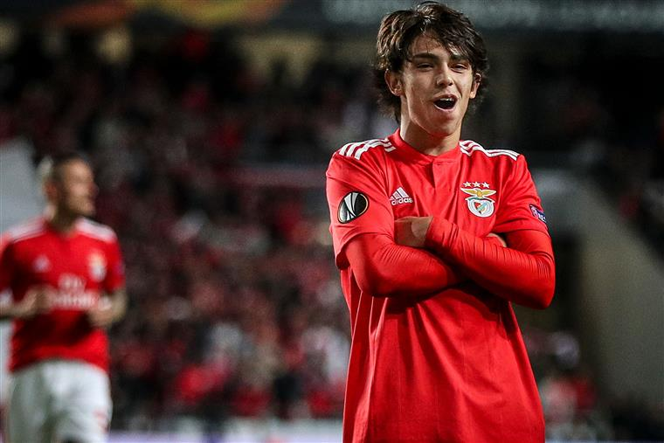
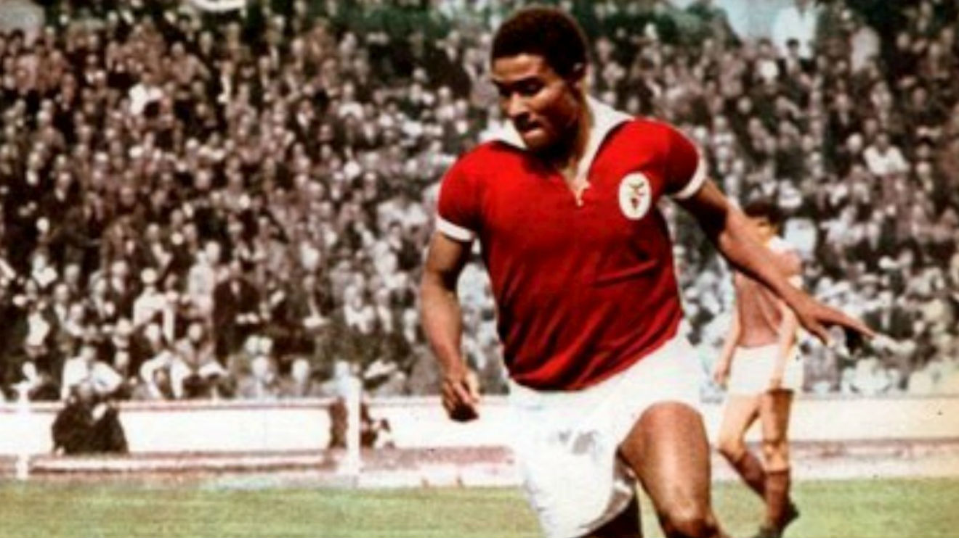
Football/Soccer
Hallå, today I´m going to talk about football, a very important sport in Portugal and Sweden, of course, both having many known players. I´m not going to talk about the rules, because I´d rather share how it came to Portugal, how it was back then, how it is now and some famous players from past and present of Portugal.

Slide 2
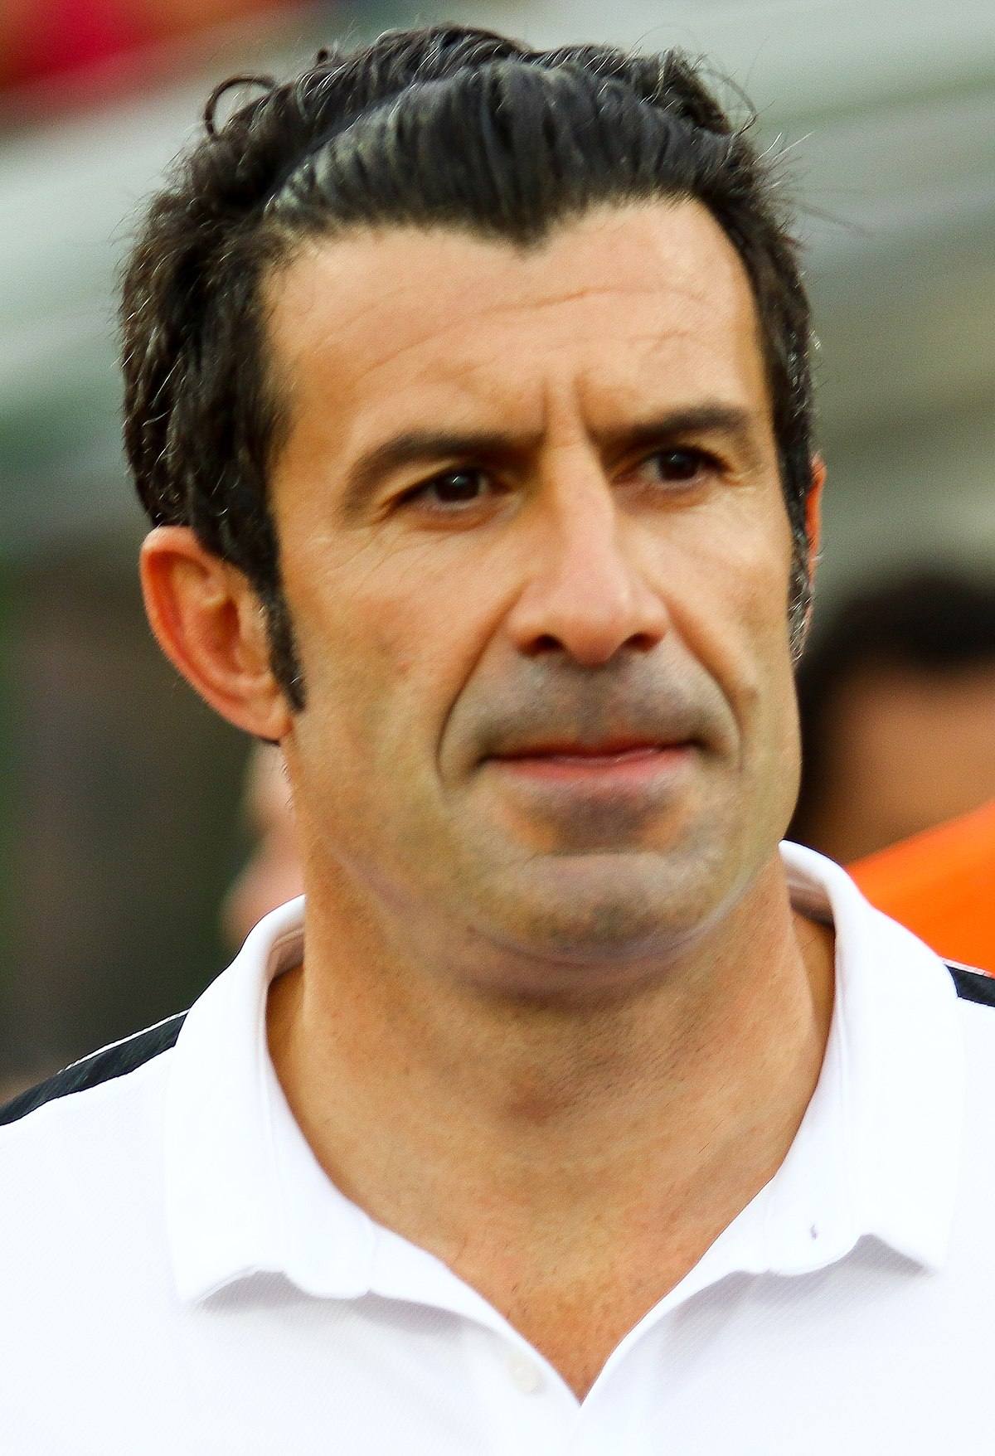
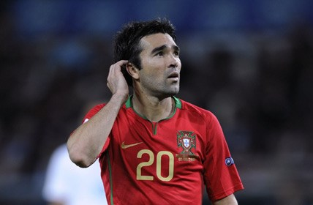
How did it get here?
In the 19th century, football was starting to be noticed in England, and eventually English people that lived in Portugal and Portuguese students that studied in England brought the game to Portugal, and the first game was played in an archipelago of Portugal, called Madeira, more exactly in a place named Largo de Achada, in Camacha, in 1875, introduced by a student in England called Henry Hinton.

Slide 3
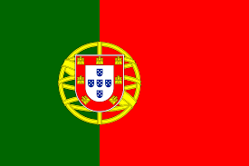
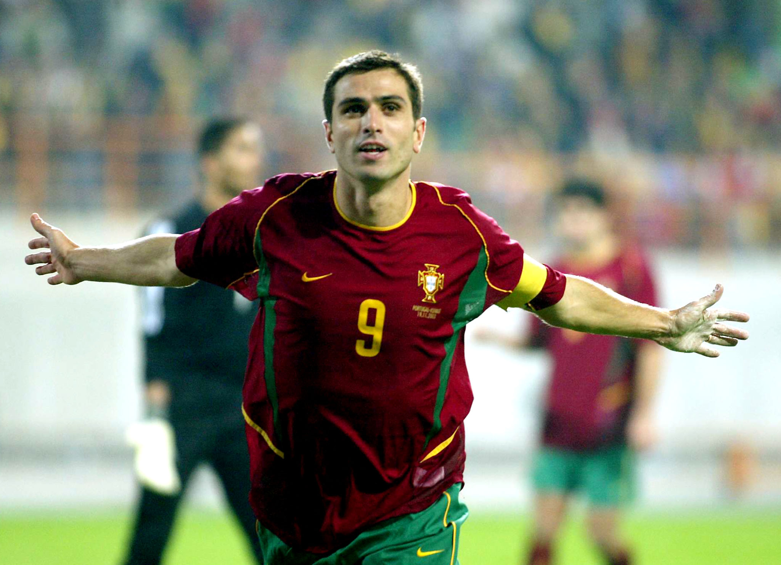
In the past
In the begining of the 20th century/end of the 19th century, clubs eventually started to be created, like Benfica in 1904( my club ), Porto in 1893 and Sporting in 1906. With time, these teams have grown to be the three “Giants” of Portugal. The actual championship was created in 1934, called “liga portuguesa”. With time, great Portuguese players were born, like Pauleta, Eusebio, Figo, among others…

Slide 4
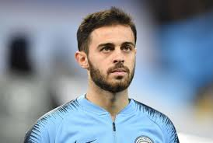
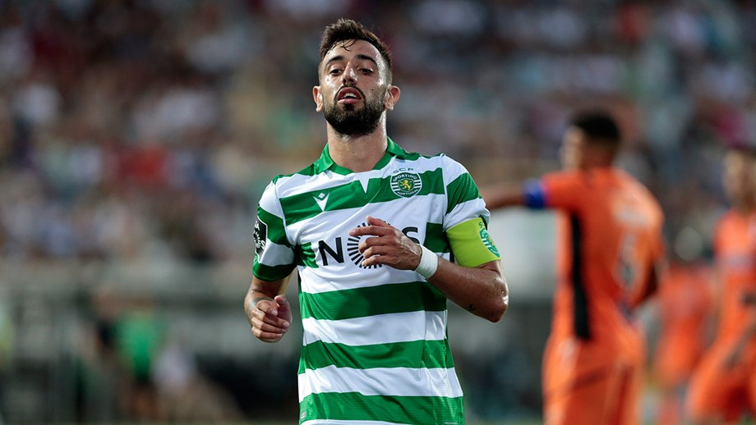
What about now?
Well, these days, we are ranked in 7th in all the leagues, behind Russian league, but don’t let that fool you, we don’t usually do well in Champions and Europa league, but so many great stars have been in Portuguese clubs, like CR7, David Luis, Ederson, Bernardo Silva, Joao Felix, Jan Oblak… so many more… our league is very competitive as well, you never know who will win or lose. Sporting have been in tough times but I believe they will make their way up again and stand up to Benfica and Porto. In the Portugal national team, we have CR7, Bernardo Silva, Joao Felix, Bruno Fernandes and some players with great potential as well.

Slide 5
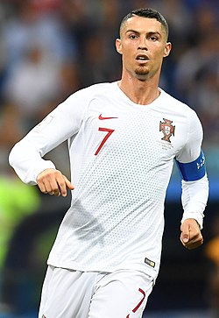
Cristiano Ronaldo(CR7)
Ah… Ronaldo… he isn´t considered the goat by so many people for no reason, is he? 5 Ballon Dor, UEFA´s golden boot 4 times, 5 Champions leagues, the European trophies in 2016, the nations league in 2019… and so so much more! The man, born on 5th February 1985, is a machine, but that machine went through a lot. He was born in Madeira, in a very poor neighborhood, and was mocked in school by everyone, but his talent in football was soon noticed, and also his will to become the best! He started playing for Andorinhas Fc in Madeira, then went to Nacional in Madeira as well, and his performance led him to Sporting academy, and at the age of 18 he went to Manchester United and then Real Madrid and now he is in Juventus, and in that process, won so many trophies… what a guy, right?

Slide 6
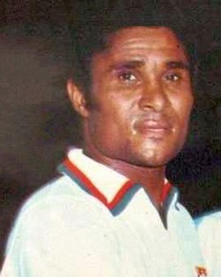
Eusebio(pantera negra)
My idol… he has passed away in 2014 unfortunately, but that doesn´t take all the glory that he gained and the icon he became. Eusebio was born in a very poor area of Mozambique, on 25th January 1942. Black panter played 15 years in Benfica and for Portugal. At the time, Benfica was at its prime, and with the arrival of Eusebio to the team, Benfica won one European Champions Cup(now called Champions league), and another before his arrival, and he also won the Ballon Dor in 1965 and gave Portugal 3rd place in the 1966 world cup, and won 2 golden boots, making of him a legend.

Slide 7
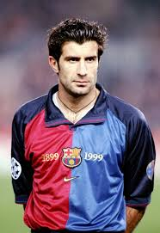
Luis Figo
No nickname, I know, I know, but that doesn´t mean he isn´t a legend, he did win the Ballon Dor in 2000 and the best EUFA player in 2001, but I think most people know him for a big big betrayal… the man that changed Barcelona for Real Madrid… yikes… He was born in Lisbon, on 4th November 1972, and played for Sporting, Barcelona, Real Madrid and Inter Milan and retired on 21st May 2009.

Slide 8
Curiosities
Let’s talk about that deal that made Figo go to Real. His contract was expiring at Barcelona, and he wanted way more money in that contract that was given to him, so he treatened Barcelona that if Florentino Peres was chosen to be Real Madrid president he would change clubs. Well, surprise surprise, he became the president, so he was obliged to go there, and he went.
Did you know CR7 was skinny when he was young? But he started training his body since he was 10 years old, racing against cars and training more than others, be became the machine he is today.

Slide 9
So, that was all, I hope all of you enjoyed, I chose this as a subject for you all to understand better Portuguese football, and don’t think I don’t know anything about your football. I may not be an expert, but I know Zlatan Ibrahimovic, the lion, Lindelof (he was in Benfica) and Forsberg, and of course, Larsson. Well, that´s it, adjö.

